Slide 1
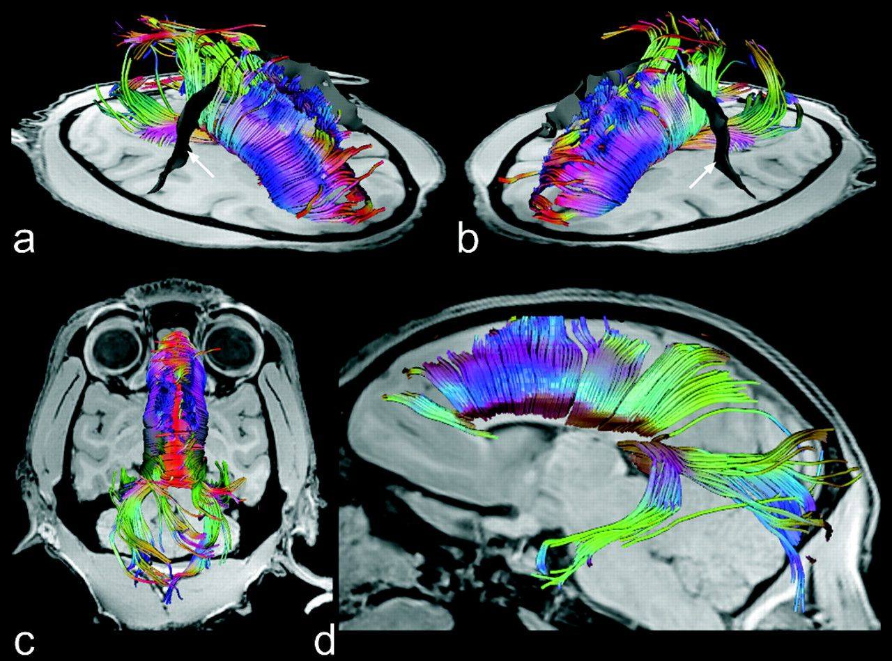
Figure 1. Transcallosal fiber tracts from a single rhesus monkey overlaid onto individual anatomic images. (a, b) ...
Notes:
Figure 1. Transcallosal fiber tracts from a single rhesus monkey overlaid onto individual anatomic images. (a, b) Oblique, (c) top, and (d) sagittal views of a 3D reconstruction of all callosal fibers comprising bundles projecting into different cortical regions. The colors correspond to the local mean diffusion direction: red = left–right, green = anterior–posterior, blue = superior–inferior. Arrows (white) indicate surface reconstructions of the central sulcus (black).
Unless provided in the caption above, the following copyright applies to the content of this slide: © The Author 2007. Published by Oxford University Press. All rights reserved. For permissions, please e-mail: journals.permissions@oxfordjournals.org

Slide 2
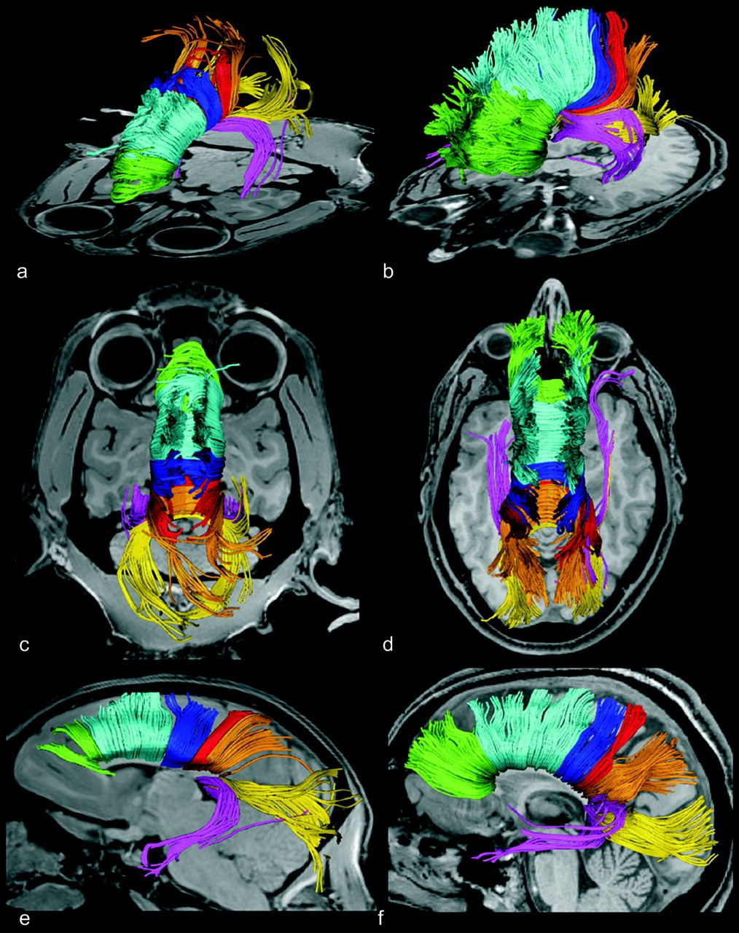
Figure 2. Segregated transcallosal fiber tracts of a rhesus monkey (a, c, e) and a human subject (b, d, f) overlaid ...
Notes:
Figure 2. Segregated transcallosal fiber tracts of a rhesus monkey (a, c, e) and a human subject (b, d, f) overlaid onto individual anatomic images. (a, b) Oblique, (c, d) top, and (e, f) sagittal views of 3D reconstructions of all callosal fibers. In contrast to Figure 1, color distinguishes fibers projecting into specific cortical regions: green = prefrontal lobe, light blue = premotor and supplementary motor areas, dark blue = primary motor cortex, red = primary sensory cortex, orange = parietal lobe, yellow = occipital lobe, violet = temporal lobe.
Unless provided in the caption above, the following copyright applies to the content of this slide: © The Author 2007. Published by Oxford University Press. All rights reserved. For permissions, please e-mail: journals.permissions@oxfordjournals.org

Slide 3
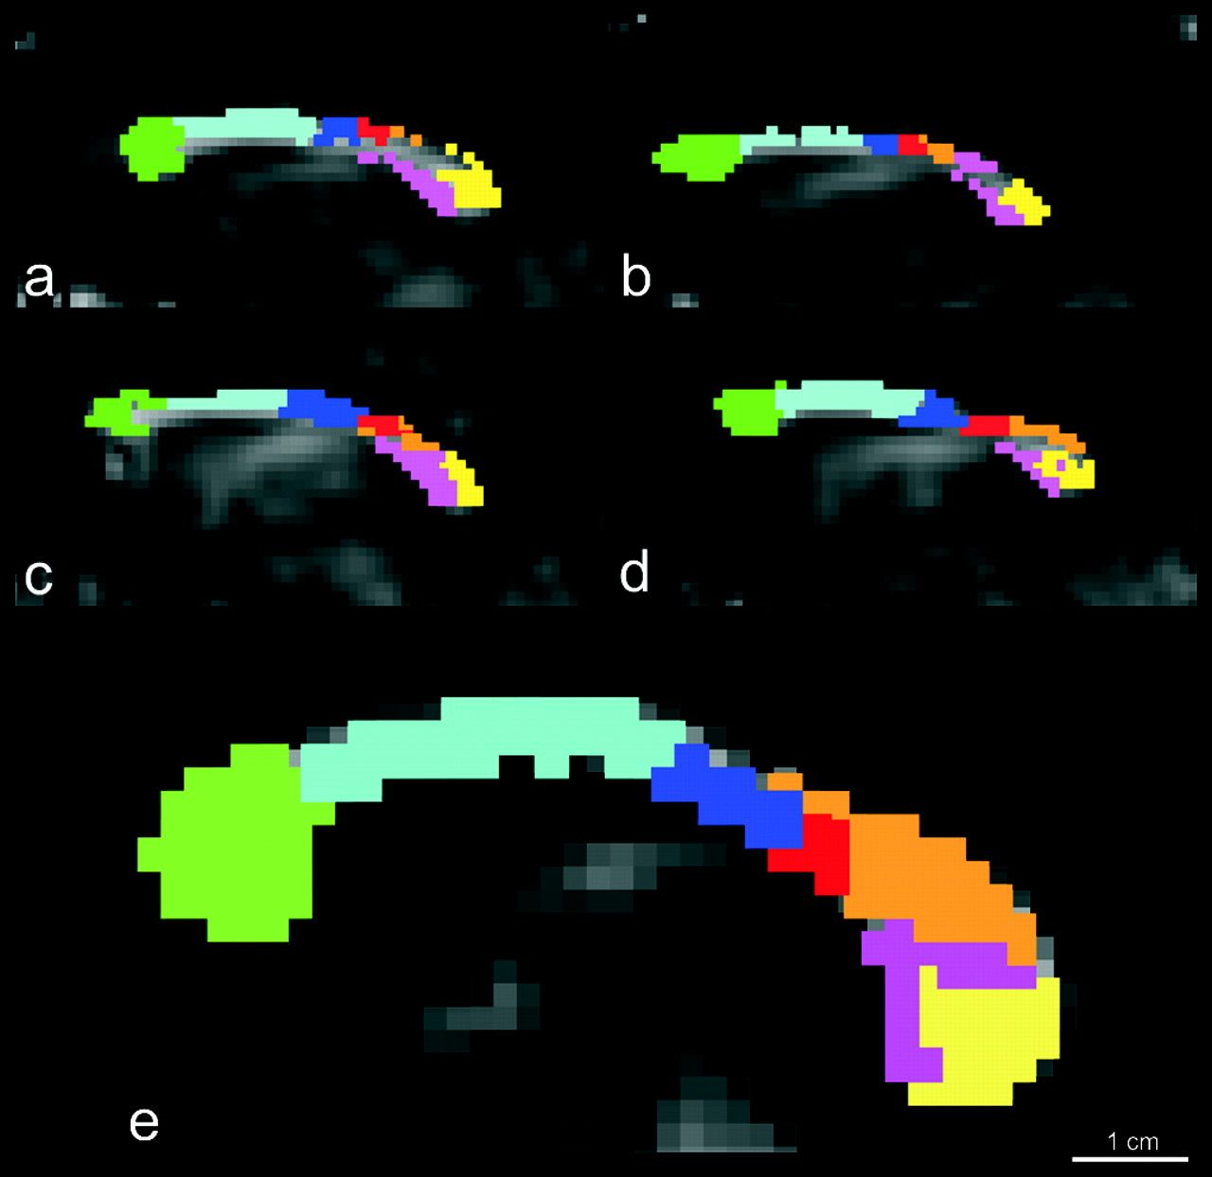
Figure 3. The midsagittal CC of 4 rhesus monkeys (a–d) and 1 human subject (e, see also, Hofer and Frahm 2006) with ...
Notes:
Figure 3. The midsagittal CC of 4 rhesus monkeys (a–d) and 1 human subject (e, see also, Hofer and Frahm 2006) with overlay of all discernable fibers projecting into specific cortical areas. The color scheme is identical to that of Figure 2.
Unless provided in the caption above, the following copyright applies to the content of this slide: © The Author 2007. Published by Oxford University Press. All rights reserved. For permissions, please e-mail: journals.permissions@oxfordjournals.org

Slide 4
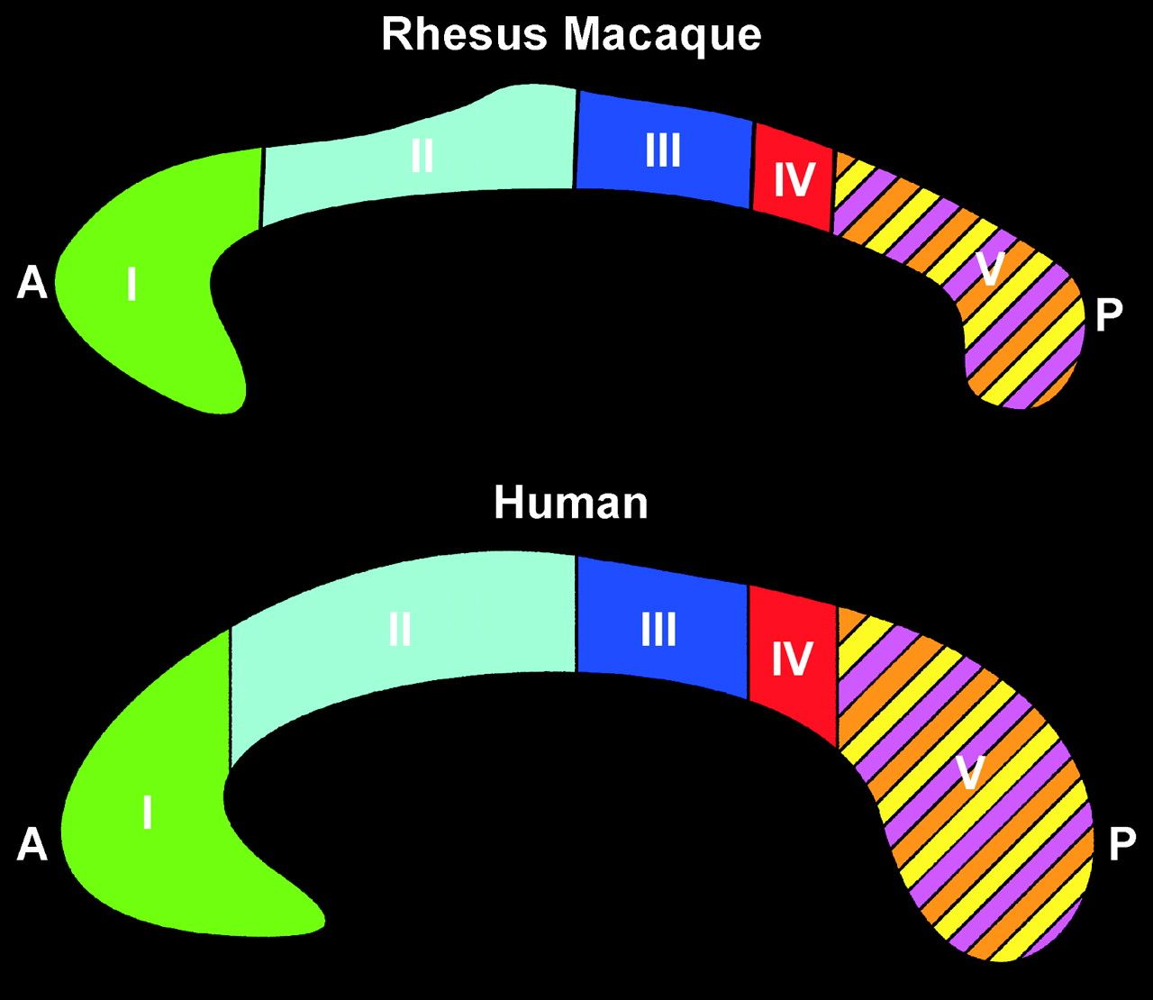
Figure 4. Comparative fiber topography of a monkey (top) and the human CC (bottom) in a midsagittal section. Regions ...
Notes:
Figure 4. Comparative fiber topography of a monkey (top) and the human CC (bottom) in a midsagittal section. Regions refer to fibers projecting into specific cortical areas: I = prefrontal lobe, II = premotor and supplementary motor cortices, III = motor cortex, IV = sensory cortex, V = parietal, temporal, and occipital lobes. Colors are identical to Figures 2 and 3. A, anterior; P, posterior.
Unless provided in the caption above, the following copyright applies to the content of this slide: © The Author 2007. Published by Oxford University Press. All rights reserved. For permissions, please e-mail: journals.permissions@oxfordjournals.org

Slide 5
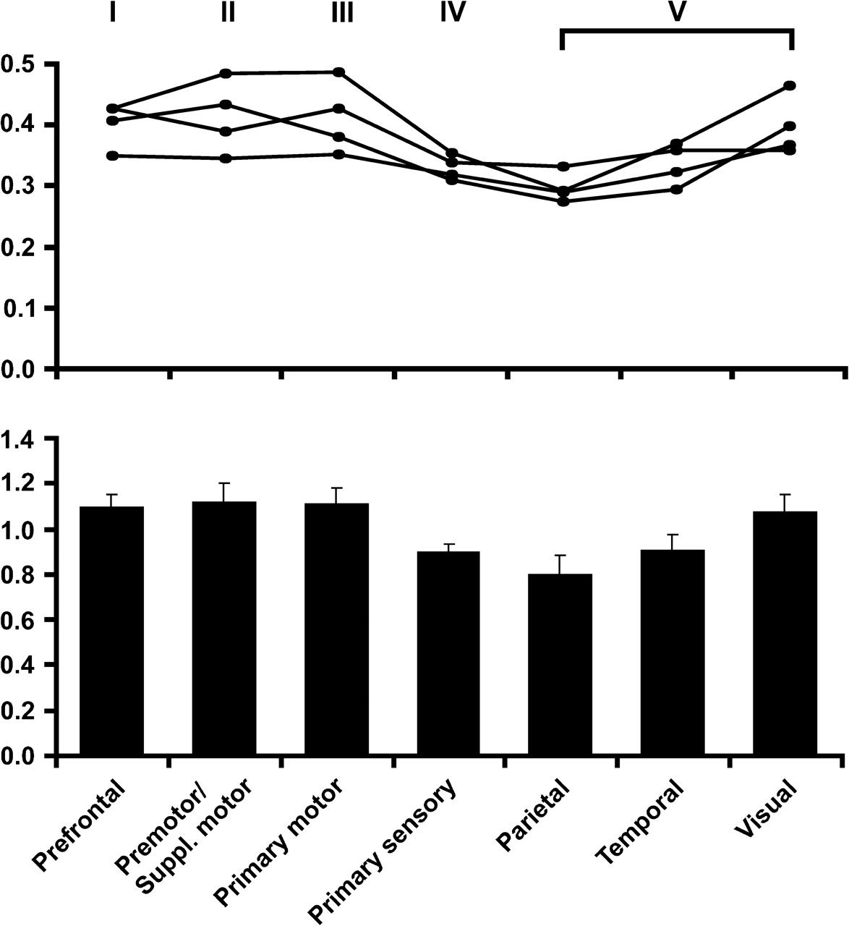
Figure 5. (Top) Mean FA of water diffusion in the macaque CC (n = 4) for different regions as indicated in Figures 3 ...
Notes:
Figure 5. (Top) Mean FA of water diffusion in the macaque CC (n = 4) for different regions as indicated in Figures 3 and 4. (Bottom) Relative values individually normalized to the mean value averaged across the entire CC and animals.
Unless provided in the caption above, the following copyright applies to the content of this slide: © The Author 2007. Published by Oxford University Press. All rights reserved. For permissions, please e-mail: journals.permissions@oxfordjournals.org

