Slide 1
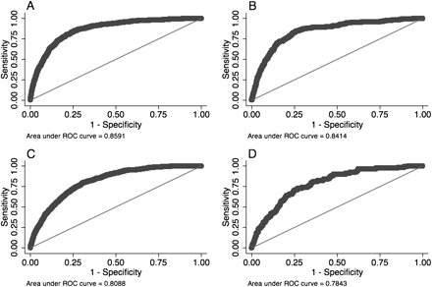
Figure 1 Receiver operator characteristic (ROC) plots for models 1 and 2. A) Model 1, developed in and applied to all ...
Notes:
Figure 1 Receiver operator characteristic (ROC) plots for models 1 and 2. A) Model 1, developed in and applied to all PLCO control subjects; B) model 1 applied to external validation dataset (PLCO intervention arm); C) model 2 developed in and applied to smokers in the PLCO control arm; D) model 2 applied to smokers in external validation set (PLCO intervention arm). PLCO = Prostate, Lung, Colorectal, Ovarian cancer screening trial.
Unless provided in the caption above, the following copyright applies to the content of this slide: © The Author 2011. Published by Oxford University Press.

Slide 2
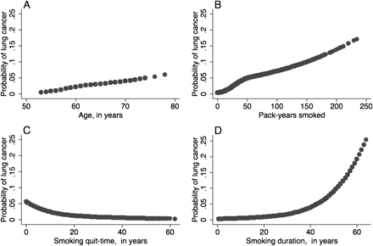
Figure 2 Estimated probabilities of developing lung cancer in smokers for four predictors in unadjusted logistic ...
Notes:
Figure 2 Estimated probabilities of developing lung cancer in smokers for four predictors in unadjusted logistic regression models. A) Age. B) Pack-years smoked. C) Smoking quit-time. D) Smoking duration. The nonlinear relationships between these predictor variables and lung cancer risk were estimated using restricted cubic splines. Splines for age, pack-years smoked, quit-time and smoking duration were prepared with knot placement based on the percentile distributions of these variables in smokers only. Knots for age were at 55, 60, 64, and 72 years. Knots for pack-years were at 3.25, 23.25 and 63 pack-years. Knots for quit-time were at 0, 15, and 35 years. Knots for duration were at 8, 28, and 45 years. The y-axis in each of the four figures is the same scale to allow comparison of the relative impacts of each predictor on lung cancer risk.
Unless provided in the caption above, the following copyright applies to the content of this slide: © The Author 2011. Published by Oxford University Press.

