Slide 1
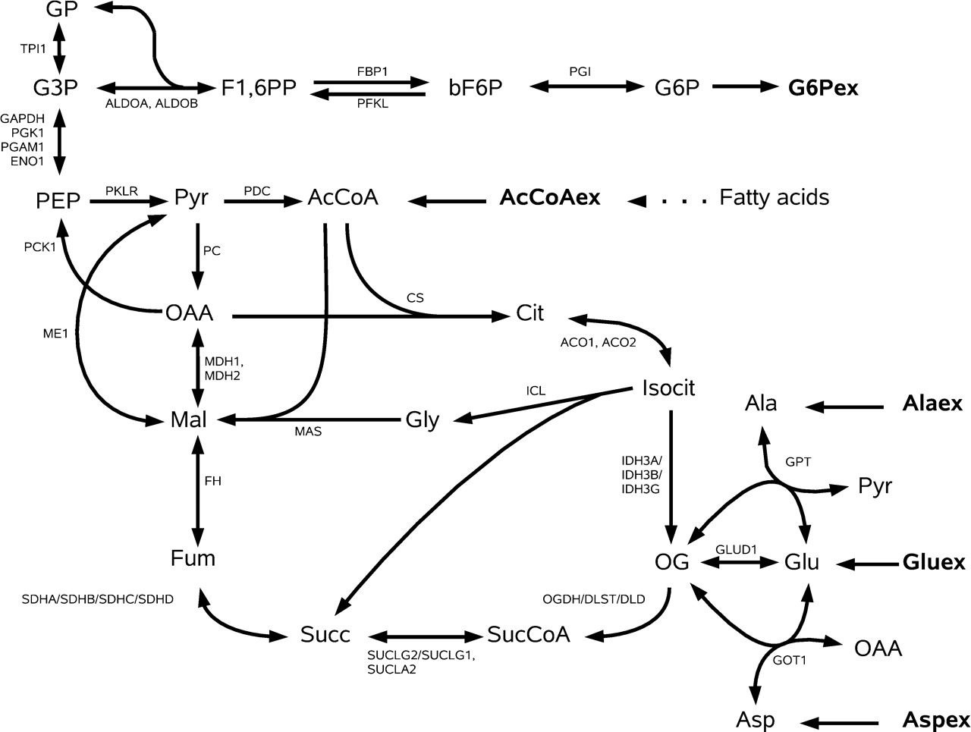
Fig. 1. Complete model of human glycolysis/gluconeogenesis and Krebs cycle, containing reactions of the glyoxylate ...
Notes:
Fig. 1. Complete model of human glycolysis/gluconeogenesis and Krebs cycle, containing reactions of the glyoxylate cycle. For abbreviations of metabolites, see Supplementary Material. Enzyme abbreviations are according to the database ExPASy. When separated by commas or slashes, they correspond to isoenzymes or multi-enzyme complexes, respectively. The external metabolites, that is, the source and sink metabolites are represented in bold-face or are omitted (e.g. the cofactors such as ATP, ADP and NAD). Reactions between PEP and G3P are lumped into one reaction.
Unless provided in the caption above, the following copyright applies to the content of this slide: © The Author 2008. Published by Oxford University Press. All rights reserved. For Permissions, please email: journals.permissions@oxfordjournals.org

Slide 2
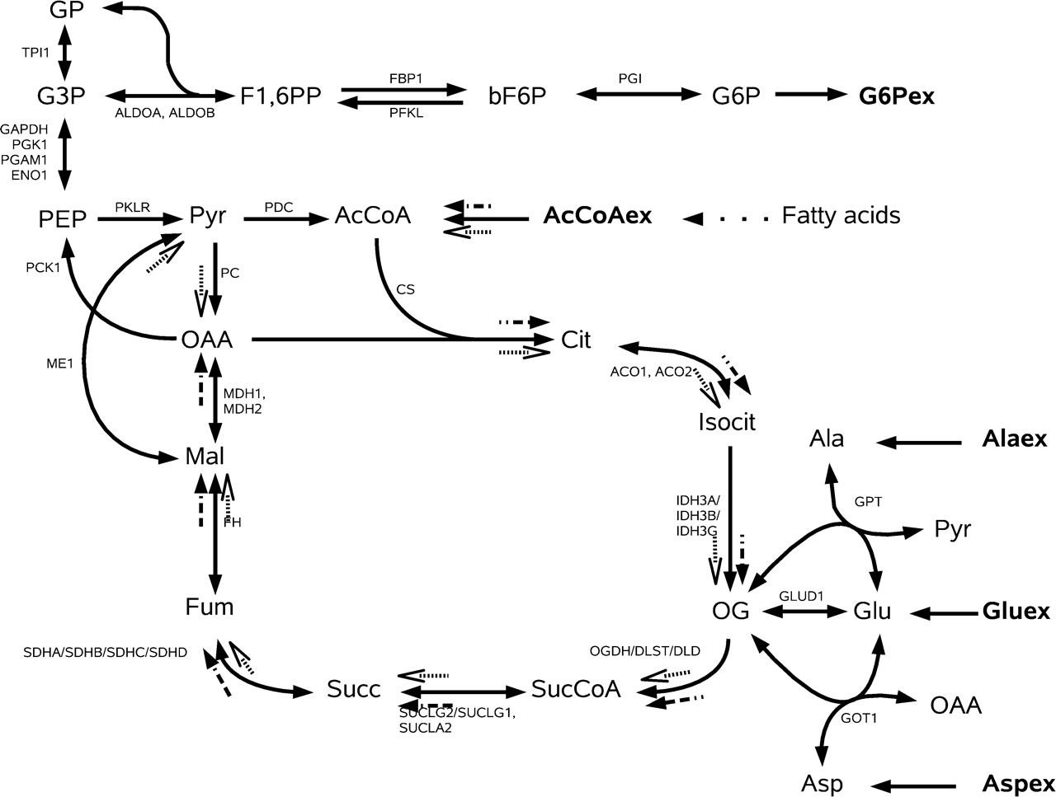
Fig. 2. Two EMs of the model without glyoxylate cycle and no entry of external amino acids, where AcCoA is consumed ...
Notes:
Fig. 2. Two EMs of the model without glyoxylate cycle and no entry of external amino acids, where AcCoA is consumed (empty and full dashed arrows). The mode shown in full dashed arrows is the usual Krebs cycle.
Unless provided in the caption above, the following copyright applies to the content of this slide: © The Author 2008. Published by Oxford University Press. All rights reserved. For Permissions, please email: journals.permissions@oxfordjournals.org

Slide 3
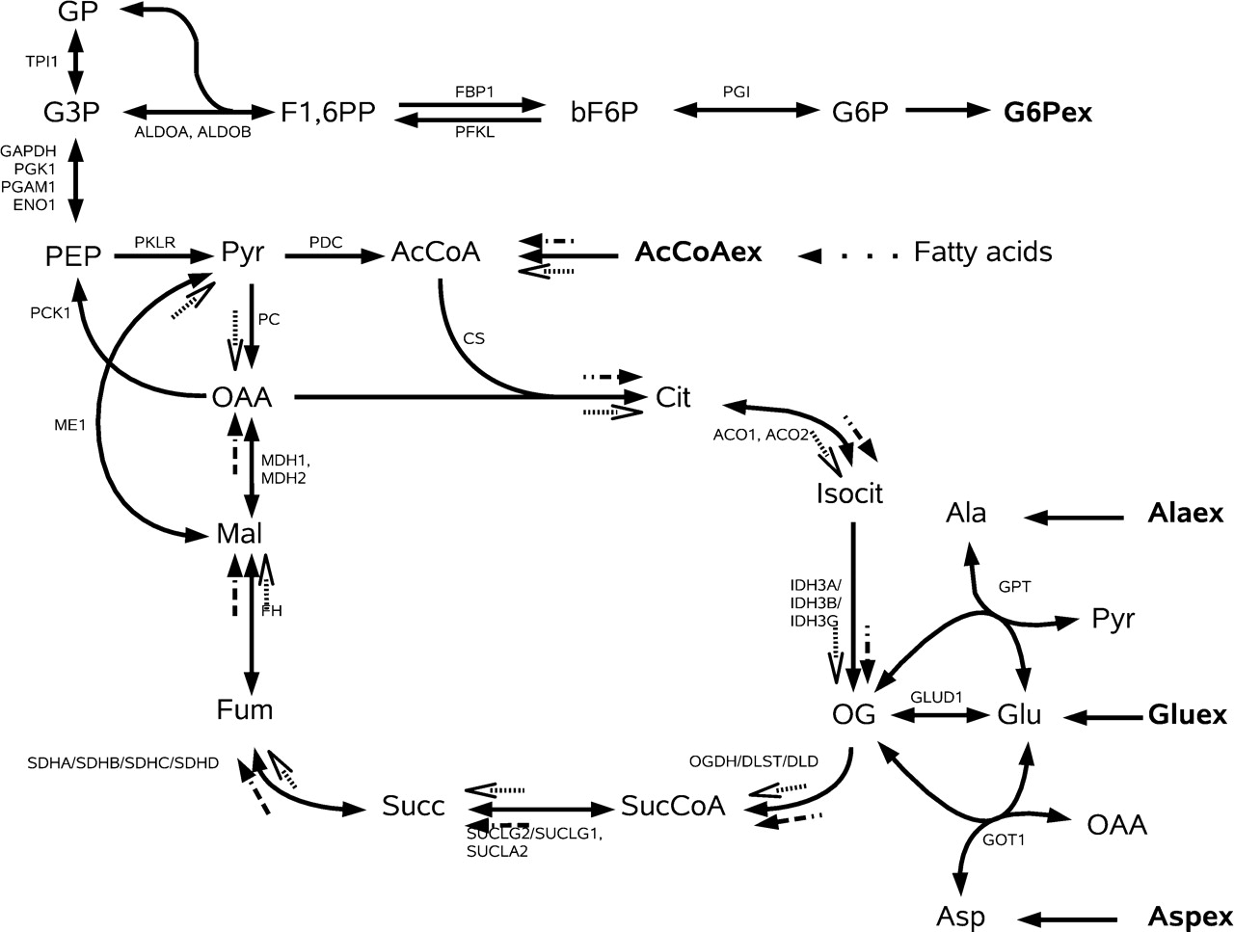
Fig. 3. Two EMs of the model with glyoxylate cycle and no external reaction of amino acids, where AcCoA is consumed ...
Notes:
Fig. 3. Two EMs of the model with glyoxylate cycle and no external reaction of amino acids, where AcCoA is consumed (empty and full dashed arrows) and G6P produced. The mode shown in full dashed arrows is the usual glyoxylate cycle.
Unless provided in the caption above, the following copyright applies to the content of this slide: © The Author 2008. Published by Oxford University Press. All rights reserved. For Permissions, please email: journals.permissions@oxfordjournals.org

Slide 4
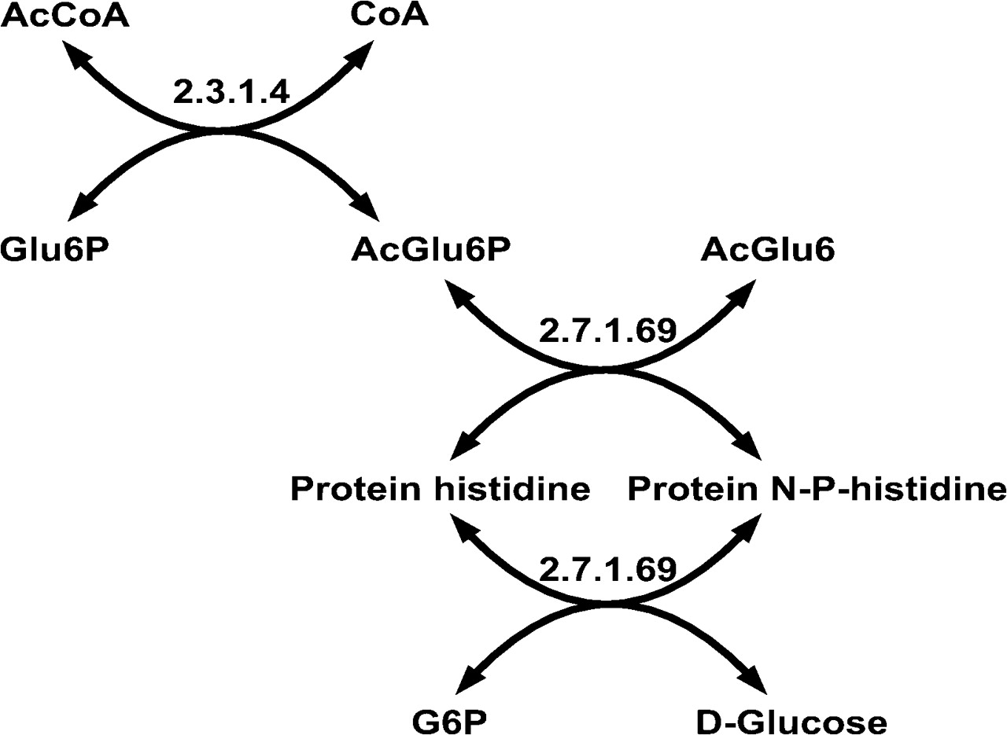
Fig. 4. Best scored path obtained from PathFinding with query 1. It involves part of the phosphotransferase system ...
Notes:
Fig. 4. Best scored path obtained from PathFinding with query 1. It involves part of the phosphotransferase system (PTS) present in bacteria only and is, thus, not relevant for humans. Moreover, no atom is transferred from AcCoA to G6P on that route. Weight = 178.0.
Unless provided in the caption above, the following copyright applies to the content of this slide: © The Author 2008. Published by Oxford University Press. All rights reserved. For Permissions, please email: journals.permissions@oxfordjournals.org

Slide 5
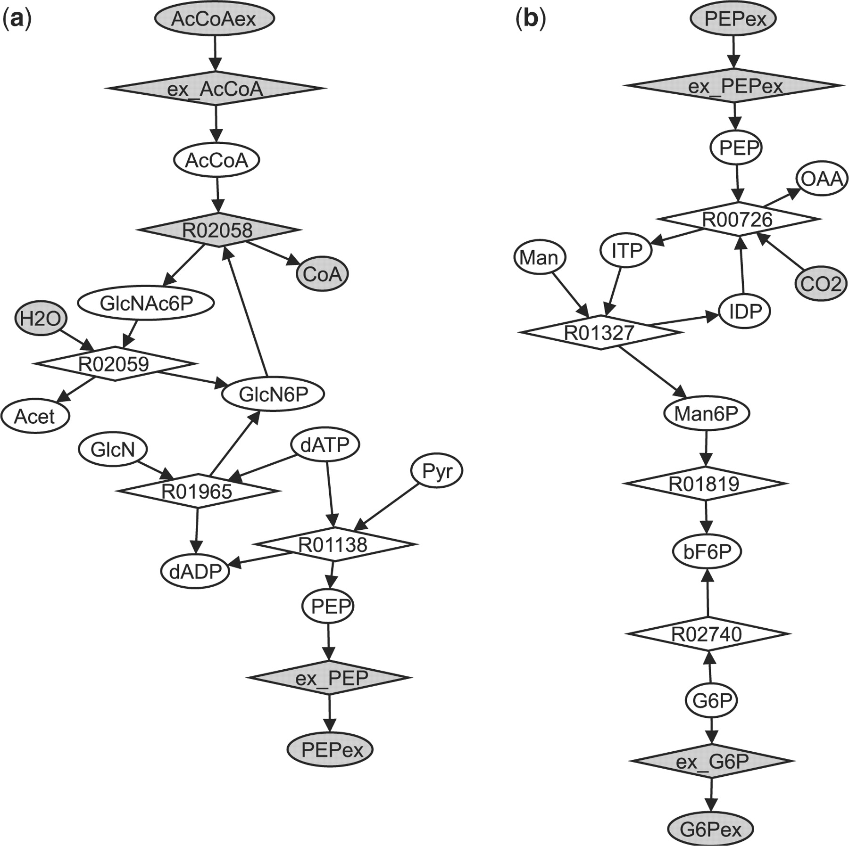
Fig. 5. (a) Path 2 from the results of PathFinding query 4; (b) Path 16 from the results of PathFinding query 5. Grey ...
Notes:
Fig. 5. (a) Path 2 from the results of PathFinding query 4; (b) Path 16 from the results of PathFinding query 5. Grey ellipses, external metabolites; white ellipses, internal metabolites; grey diamonds, irreversible reactions; white diamonds, reversible reactions. External reactions ex_AcCoA, ex_PEP, ex_G6P added a posteriori for EMA.
Unless provided in the caption above, the following copyright applies to the content of this slide: © The Author 2008. Published by Oxford University Press. All rights reserved. For Permissions, please email: journals.permissions@oxfordjournals.org

Slide 6
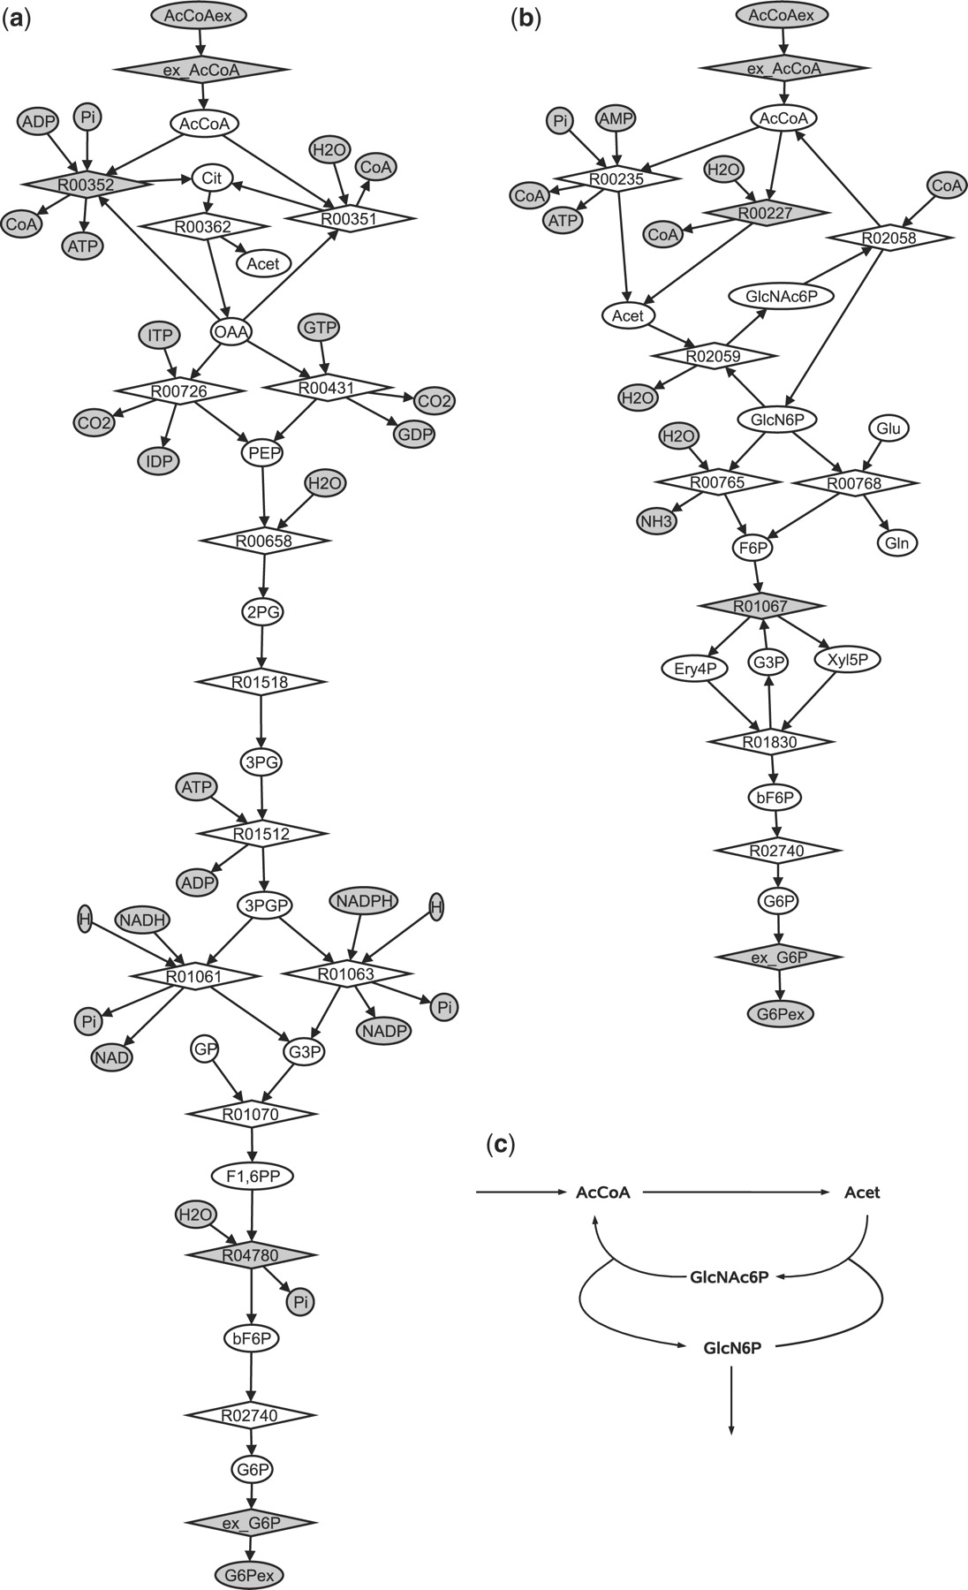
Fig. 6. (a) First result obtained by PHT for the conversion of AcCoA to G6P, with the features ‘Atom Mapper’ and ...
Notes:
Fig. 6. (a) First result obtained by PHT for the conversion of AcCoA to G6P, with the features ‘Atom Mapper’ and ‘Atom Tracer’ switched off. (b) Result for the same query with the features ‘Atom Mapper’ and ‘Atom Tracer’ switched on and off, respectively. Grey ellipses, external metabolites; white ellipses, internal metabolites; grey diamonds, irreversible reactions, white diamonds, reversible reactions. External reactions ex_AcCoA and ex_G6P added a posteriori for EMA. (c) Scheme of part of the path shown in (b). There is no steady-state conversion of AcCoA to GlcN6P. For simplicity, the external metabolites were removed and reactions R00227 and R00235 were combined into one.
Unless provided in the caption above, the following copyright applies to the content of this slide: © The Author 2008. Published by Oxford University Press. All rights reserved. For Permissions, please email: journals.permissions@oxfordjournals.org

