Slide 1
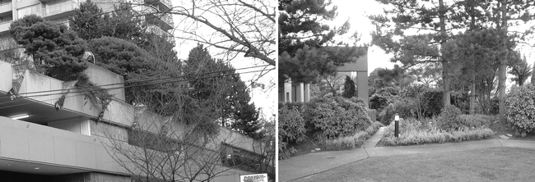
Figure 1. Examples of (a, b) intensive green roofs (with deeper substrate, more elaborate vegetation, and higher ...
Notes:
Figure 1. Examples of (a, b) intensive green roofs (with deeper substrate, more elaborate vegetation, and higher maintenance requirements) and (c, d) extensive green roofs (with shallow substrate; hardy, drought-tolerant vegetation; and low maintenance requirements). Photographs: Brad Rowe.
Unless provided in the caption above, the following copyright applies to the content of this slide: © 2007 American Institute of Biological Sciences

Slide 2
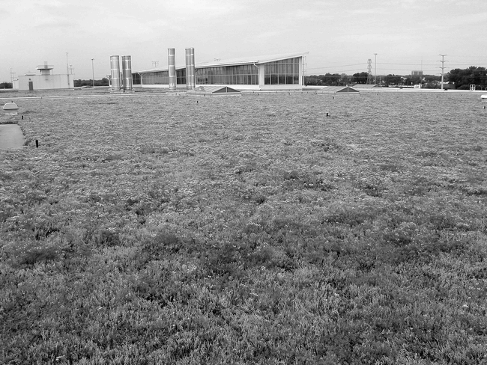
Notes:
Unless provided in the caption above, the following copyright applies to the content of this slide: © 2007 American Institute of Biological Sciences

Slide 3
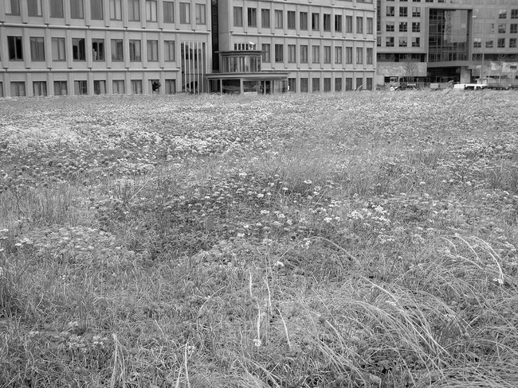
Notes:
Unless provided in the caption above, the following copyright applies to the content of this slide: © 2007 American Institute of Biological Sciences

Slide 4
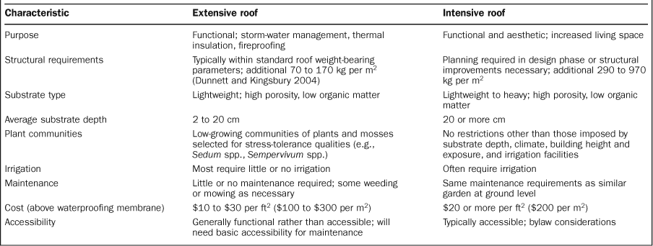
Table 1. A comparison of extensive and intensive green roofs.
Notes:
Table 1. A comparison of extensive and intensive green roofs.
Unless provided in the caption above, the following copyright applies to the content of this slide: © 2007 American Institute of Biological Sciences

Slide 5
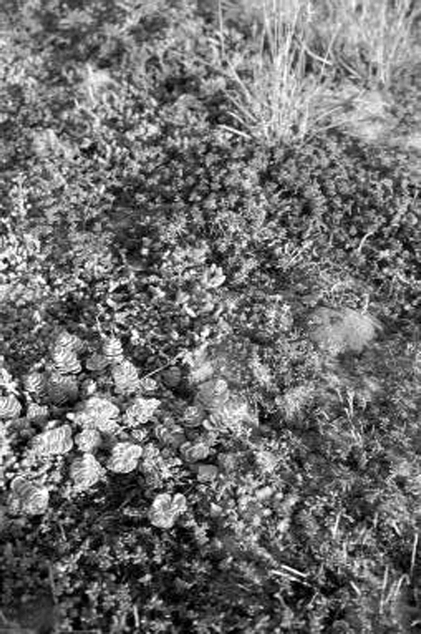
Figure 2. Typical extensive green-roof vegetation. (a) Sedum species and mosses; (b) Rhodiola rosea, a succulent alpine ...
Notes:
Figure 2. Typical extensive green-roof vegetation. (a) Sedum species and mosses; (b) Rhodiola rosea, a succulent alpine and rock outcrop species of northeastern North America and northern Europe, in one of its native habitats (limestone barrens in Newfoundland); (c) Sedum species on a typical extensive green roof. Photographs: (a) Erica Oberndorfer; (b) Jeremy Lundholm; (c) Karen Liu.
Unless provided in the caption above, the following copyright applies to the content of this slide: © 2007 American Institute of Biological Sciences

Slide 6
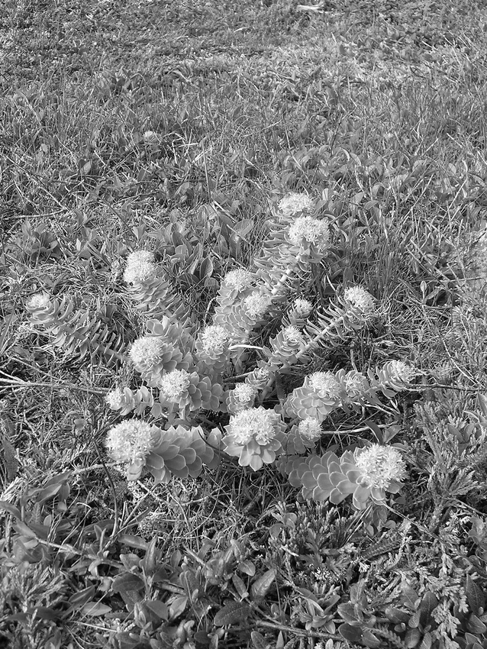
Notes:
Unless provided in the caption above, the following copyright applies to the content of this slide: © 2007 American Institute of Biological Sciences

Slide 7
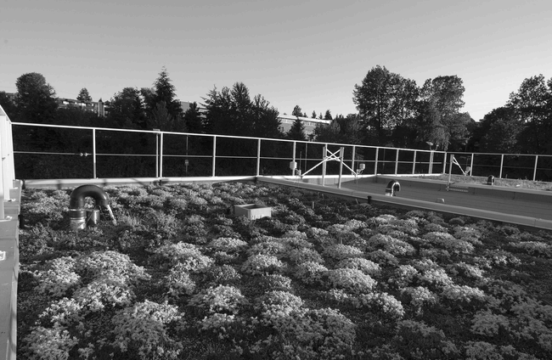
Notes:
Unless provided in the caption above, the following copyright applies to the content of this slide: © 2007 American Institute of Biological Sciences

Slide 8
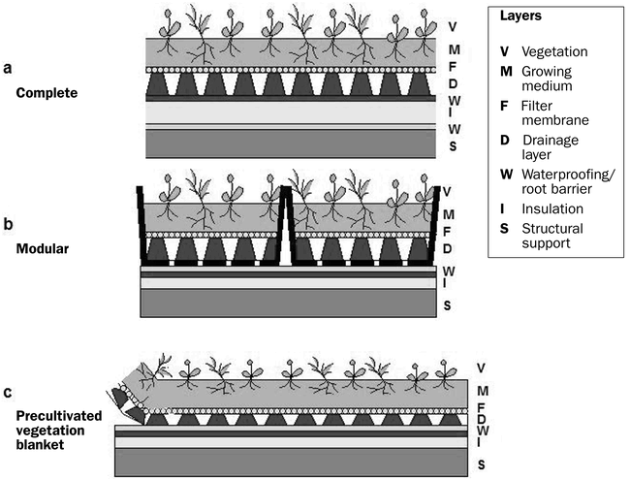
Figure 3. Types of conventional extensive green-roofing technology. (a) Complete systems: each component, including the ...
Notes:
Figure 3. Types of conventional extensive green-roofing technology. (a) Complete systems: each component, including the roof membrane, is installed as an integral part of the roof. (b) Modular systems: vegetation trays cultivated ex situ are installed above the existing roofing system. (c) Precultivated vegetation blankets: growing medium, plants, drainage mats, and root barriers are rolled onto the existing roofing. Inverted systems (not shown), which are increasingly popular, feature waterproofing membranes below the insulation layer. Many proprietary systems with variations on these strategies are available throughout North America and Europe. Graphics: Jeremy Lundholm.
Unless provided in the caption above, the following copyright applies to the content of this slide: © 2007 American Institute of Biological Sciences

Slide 9
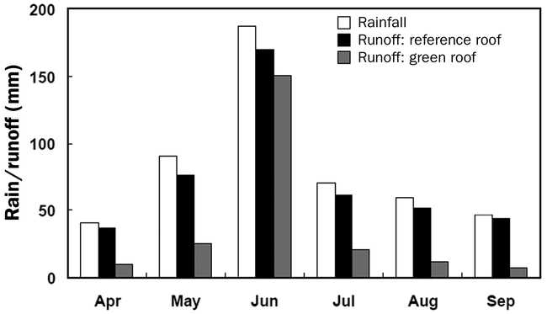
Figure 4. Storm-water runoff retention in a green-roof test plot in Ottawa, Ontario, Canada, in 2002. Values are sums ...
Notes:
Figure 4. Storm-water runoff retention in a green-roof test plot in Ottawa, Ontario, Canada, in 2002. Values are sums of total runoff retained. The green roof had 15 centimeters of growing medium and was planted with lawn grasses (Liu and Baskaran 2003); it was compared with an adjacent conventional roof of the same size.
Unless provided in the caption above, the following copyright applies to the content of this slide: © 2007 American Institute of Biological Sciences

Slide 10
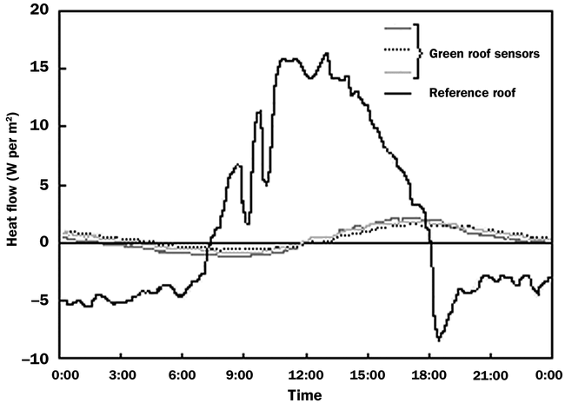
Figure 5. Heat flux across roof membranes for different roofing systems in Toronto, Ontario, Canada, on (a) a summer ...
Notes:
Figure 5. Heat flux across roof membranes for different roofing systems in Toronto, Ontario, Canada, on (a) a summer day (26 June 2003) and (b) a typical winter day with light snow coverage (23 January 2003), indicating that the green roof reduces the temperature fluctuations within the roofing system. Positive heat flux values indicate that net heat flux is from the outside into the building; negative values indicate that the net flux is from the inside to the outside. The green roof had 10 centimeters (cm) of light-colored growing medium. (c) Comparison of the average daily heat flow through the green roofs and reference (conventional) roof over two years. Green roofs were installed in late July 2002. Green roof A has 10 cm of light-colored growing medium; green roof B has 7.5 cm of dark-colored growing medium. Both were installed in Toronto. Abbreviations: AI, after installation; BI, before installation; kWh, kilowatt-hour; W, watt. Graphs are redrawn from Liu and Minor (2005).
Unless provided in the caption above, the following copyright applies to the content of this slide: © 2007 American Institute of Biological Sciences

Slide 11
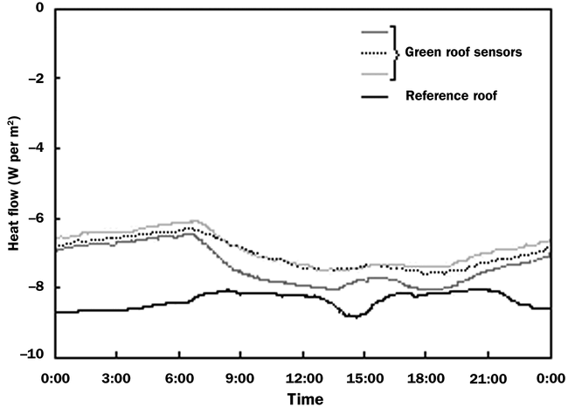
Notes:
Unless provided in the caption above, the following copyright applies to the content of this slide: © 2007 American Institute of Biological Sciences

Slide 12
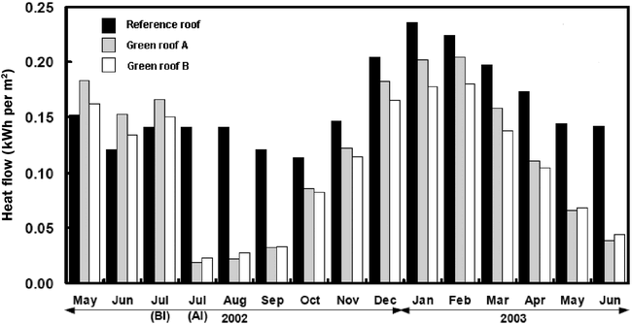
Notes:
Unless provided in the caption above, the following copyright applies to the content of this slide: © 2007 American Institute of Biological Sciences

Slide 13
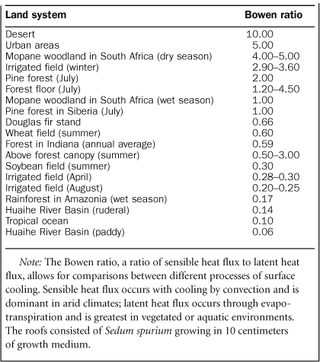
Table 2. Typical Bowen ratios reported for a range of natural and agricultural vegetated land surfaces.
Notes:
Table 2. Typical Bowen ratios reported for a range of natural and agricultural vegetated land surfaces.
Unless provided in the caption above, the following copyright applies to the content of this slide: © 2007 American Institute of Biological Sciences

