Slide 1
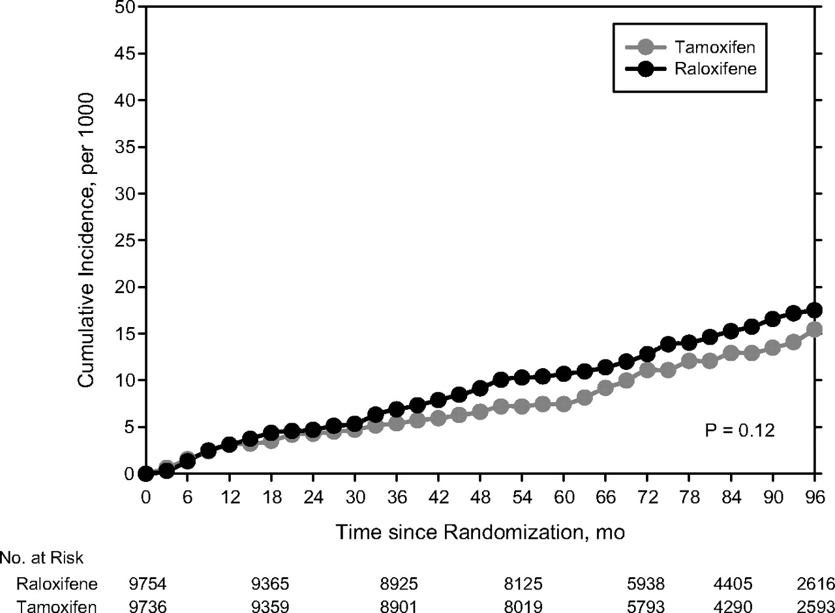
Figure 1 Cumulative incidence of non-invasive breast cancer in the NSABP Study of Tamoxifen and Raloxifene trial ...
Notes:
Figure 1 Cumulative incidence of non-invasive breast cancer in the NSABP Study of Tamoxifen and Raloxifene trial through 81 months of median follow-up, NSABP STAR (P-1).
Unless provided in the caption above, the following copyright applies to the content of this slide: Published by Oxford University Press 2010.

