Slide 1
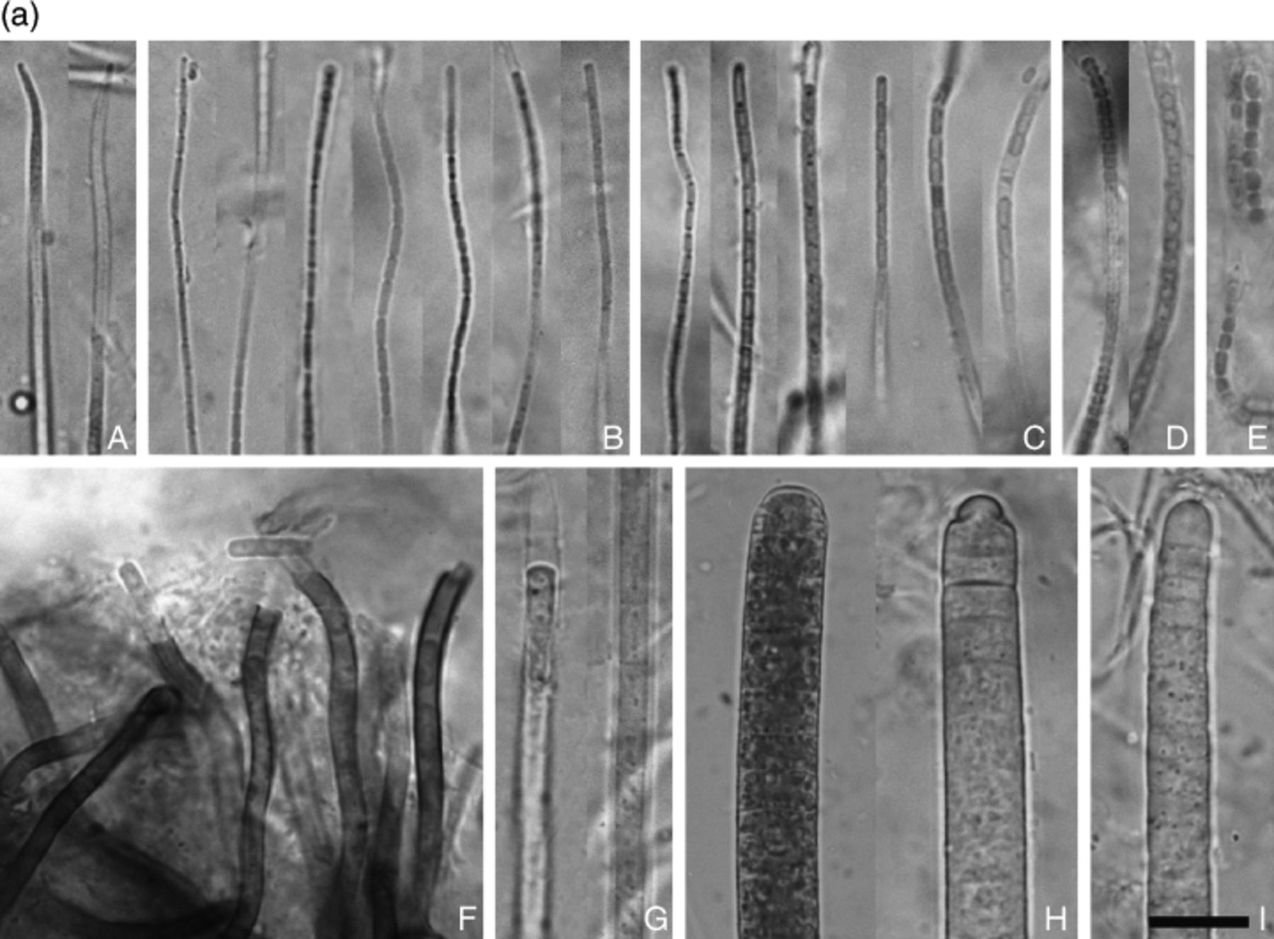
1 Diversity of cyanobacterial morphospecies identified in the studied mat samples. (a) A, Geitlerinema ...
Notes:
1 Diversity of cyanobacterial morphospecies identified in the studied mat samples. (a) A, Geitlerinema deflexum; B, Leptolyngbya antarctica; C, Leptolyngbya frigida; D, Phormidium priestleyi; E, Arthronema sp.; F, Schizothrix sp./Pseudophormidium sp.; G, Phormidium murrayi; H, Oscillatoria subproboscidea; I, Phormidium pseudopriestleyi. Bar, 10 μm. (b) A, Nostoc sp.; B, Nodularia harveyana; C, Calothrix sp.; D, Aphanocapsa cf. holastica; E, Aphanocapsa cf. hyalina; F, Chlorogoea sp.; G, Cyanosarcina sp.; H, Aphanothece sp. Bar, 10 μm.
Unless provided in the caption above, the following copyright applies to the content of this slide: © 2006 Federation of European Microbiological Societies Published by Blackwell Publishing Ltd. All rights reserved

Slide 2
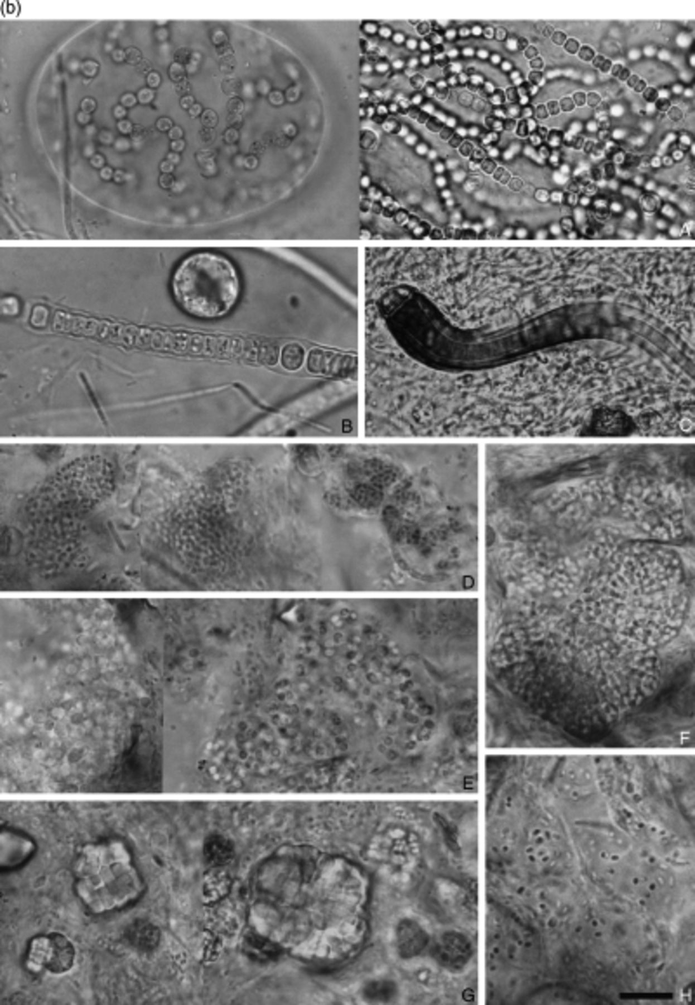
1 Diversity of cyanobacterial morphospecies identified in the studied mat samples. (a) A, Geitlerinema ...
Notes:
1 Diversity of cyanobacterial morphospecies identified in the studied mat samples. (a) A, Geitlerinema deflexum; B, Leptolyngbya antarctica; C, Leptolyngbya frigida; D, Phormidium priestleyi; E, Arthronema sp.; F, Schizothrix sp./Pseudophormidium sp.; G, Phormidium murrayi; H, Oscillatoria subproboscidea; I, Phormidium pseudopriestleyi. Bar, 10 μm. (b) A, Nostoc sp.; B, Nodularia harveyana; C, Calothrix sp.; D, Aphanocapsa cf. holastica; E, Aphanocapsa cf. hyalina; F, Chlorogoea sp.; G, Cyanosarcina sp.; H, Aphanothece sp. Bar, 10 μm.
Unless provided in the caption above, the following copyright applies to the content of this slide: © 2006 Federation of European Microbiological Societies Published by Blackwell Publishing Ltd. All rights reserved

Slide 3
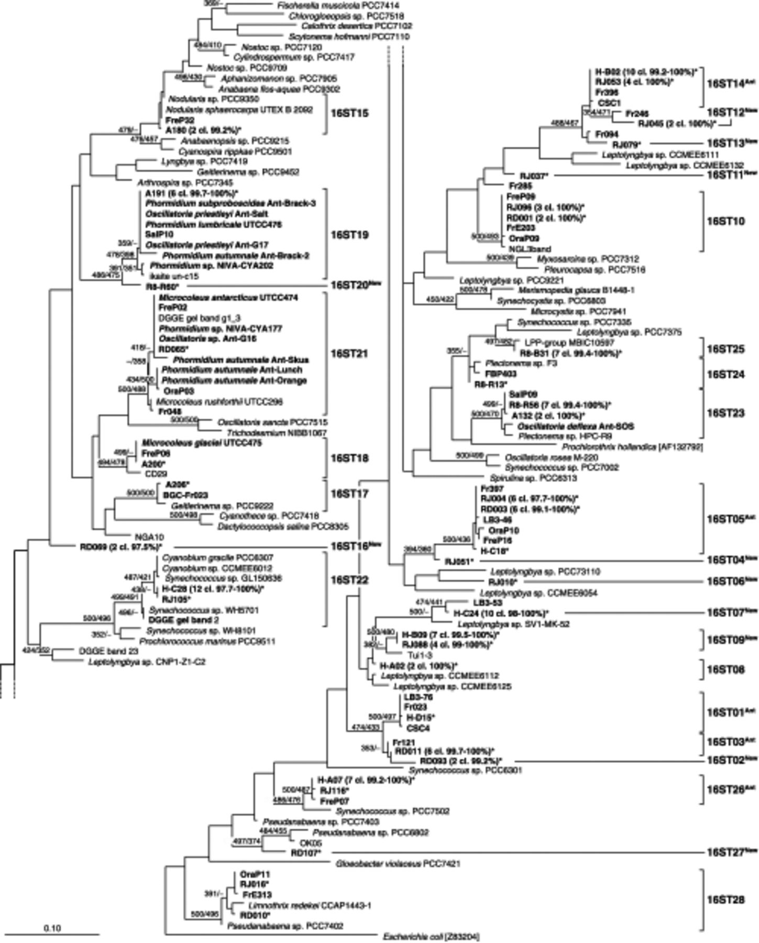
2 Phylogenetic tree inferred from 16S rRNA gene sequences (Escherichia coli positions 405–780) by maximum ...
Notes:
2 Phylogenetic tree inferred from 16S rRNA gene sequences (Escherichia coli positions 405–780) by maximum likelihood (likelihood=−8693.4402). Bootstrap values obtained using the neighbor-joining and the parsimony methods for the tree construction are indicated at the nodes when equal to or greater than 70%. The tree includes the 37 representative clone sequences out of 128 determined in the present study (boldface type, marked with an ‘*’), 111 previously published sequences (Antarctic sequences are in boldface type), and the E. coli sequence used as an out-group. The number of clone sequences belonging to the concerned operational taxonomic unit/lake, as well as the percentage of similarity between them, were indicated close to the representative sequence and between brackets. The evolutionary distance between two sequences is obtained by adding the lengths of the horizontal branches connecting them and using the scale bar (0.1 mutation per position).
Unless provided in the caption above, the following copyright applies to the content of this slide: © 2006 Federation of European Microbiological Societies Published by Blackwell Publishing Ltd. All rights reserved

