Slide 1
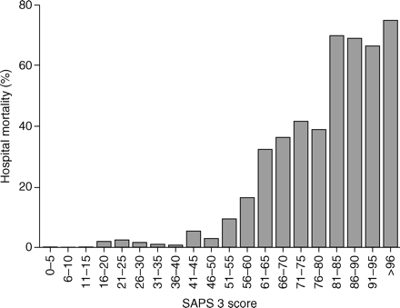
Fig 1 Bar chart representing hospital mortality rates (%) according to SAPS 3 score.
Notes:
Fig 1 Bar chart representing hospital mortality rates (%) according to SAPS 3 score.
Unless provided in the caption above, the following copyright applies to the content of this slide: © The Board of Management and Trustees of the British Journal of Anaesthesia 2008. All rights reserved. For Permissions, please e-mail: journals.permissions@oxfordjournals.org

Slide 2
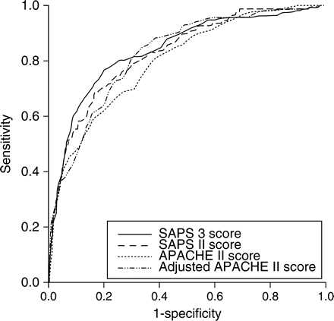
Fig 2 ROC curves for APACHE II, adjusted APACHE II, SAPS II, and SAPS 3 scores on prediction of hospital ...
Notes:
Fig 2 ROC curves for APACHE II, adjusted APACHE II, SAPS II, and SAPS 3 scores on prediction of hospital mortality.
Unless provided in the caption above, the following copyright applies to the content of this slide: © The Board of Management and Trustees of the British Journal of Anaesthesia 2008. All rights reserved. For Permissions, please e-mail: journals.permissions@oxfordjournals.org

