Slide 1
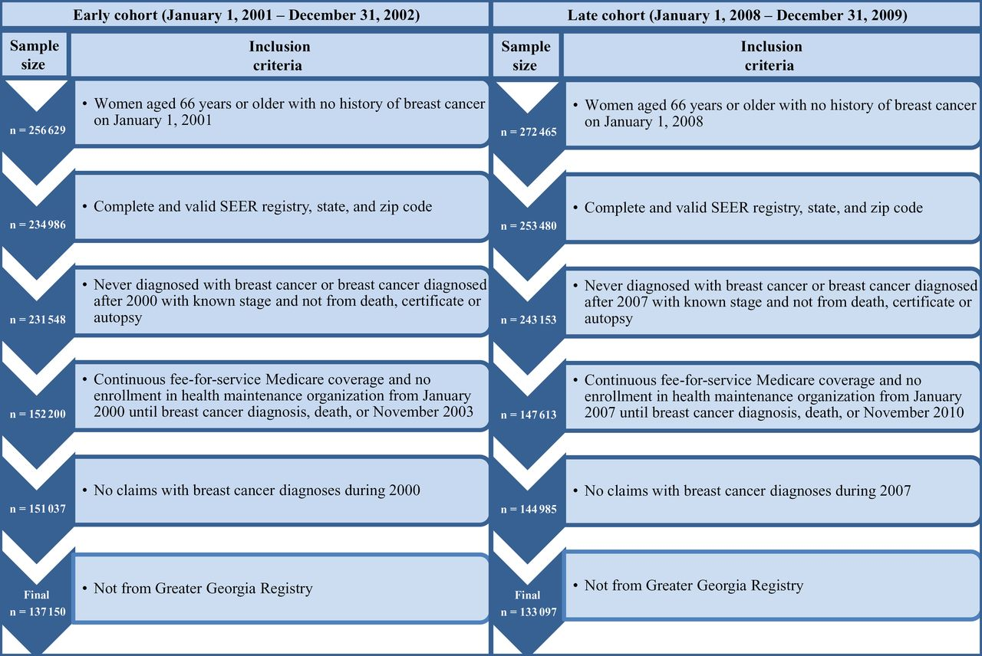
Figure 1. Creation of study sample. We included women who were part of the Surveillance, Epidemiology, and End ...
Notes:
Figure 1. Creation of study sample. We included women who were part of the Surveillance, Epidemiology, and End Results–Medicare 5% sample, who did not have a history of breast cancer at the beginning of each study period. This sample includes some women who would later develop breast cancer, as well as women who did not develop breast cancer. We followed the steps in the figure to create the sample.
Unless provided in the caption above, the following copyright applies to the content of this slide: © The Author 2014. Published by Oxford University Press. All rights reserved. For Permissions, please e-mail: journals.permissions@oup.com.

Slide 2
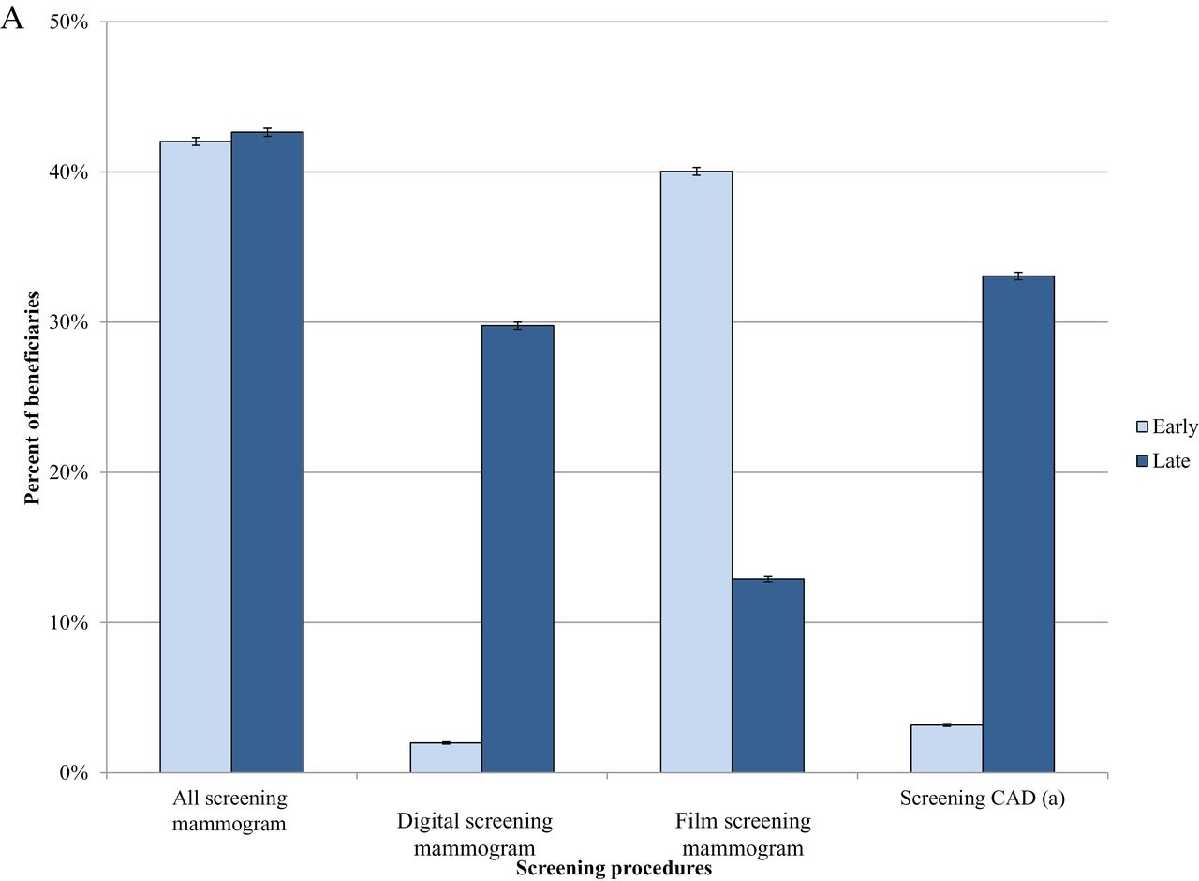
Figure 2. Use of breast cancer procedures according to time period. There were 137150 women in the early cohort ...
Notes:
Figure 2. Use of breast cancer procedures according to time period. There were 137150 women in the early cohort (2001–2002) and 133097 women in the later cohort (2008–2009). The percentages of women in the early and late cohorts who underwent screening (A) and adjunct testing procedures (B) are shown. Other imaging includes positron emitting tomography imaging; computed tomography of head, brain, thorax, abdomen; magnetic resonance imaging (MRI) of brain, brainstem; radiologic examination of surgical specimen; three-dimensional rendering; bone and joint imaging; and radiopharmaceutical localization of tumor. Error bars represent 95% confidence intervals. CAD = computer-aided detection.
Unless provided in the caption above, the following copyright applies to the content of this slide: © The Author 2014. Published by Oxford University Press. All rights reserved. For Permissions, please e-mail: journals.permissions@oup.com.

Slide 3
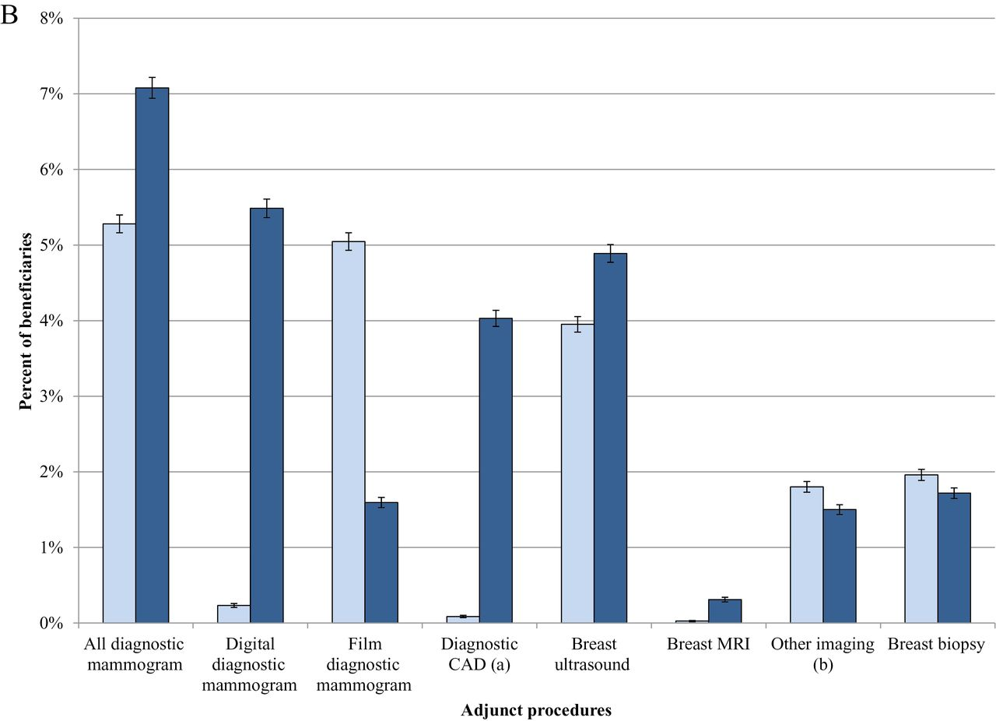
Figure 2. Use of breast cancer procedures according to time period. There were 137150 women in the early cohort ...
Notes:
Figure 2. Use of breast cancer procedures according to time period. There were 137150 women in the early cohort (2001–2002) and 133097 women in the later cohort (2008–2009). The percentages of women in the early and late cohorts who underwent screening (A) and adjunct testing procedures (B) are shown. Other imaging includes positron emitting tomography imaging; computed tomography of head, brain, thorax, abdomen; magnetic resonance imaging (MRI) of brain, brainstem; radiologic examination of surgical specimen; three-dimensional rendering; bone and joint imaging; and radiopharmaceutical localization of tumor. Error bars represent 95% confidence intervals. CAD = computer-aided detection.
Unless provided in the caption above, the following copyright applies to the content of this slide: © The Author 2014. Published by Oxford University Press. All rights reserved. For Permissions, please e-mail: journals.permissions@oup.com.

Slide 4
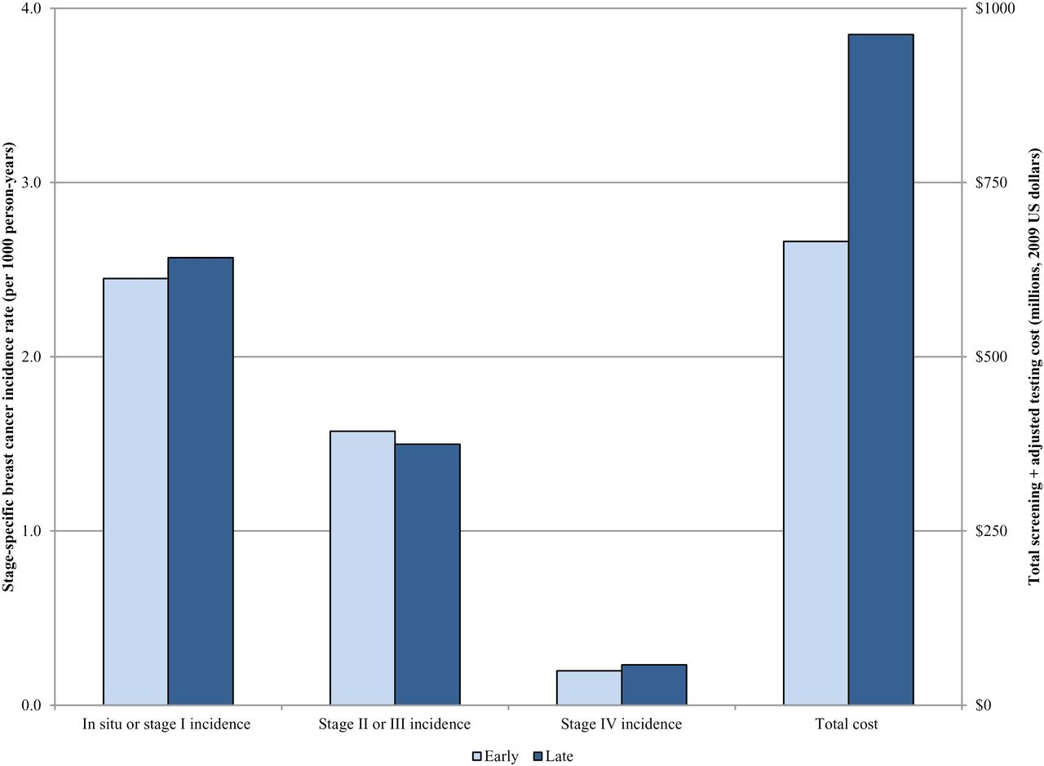
Figure 3. Stage-specific cancer incidence and total Medicare screening-related cost according to time period. There was ...
Notes:
Figure 3. Stage-specific cancer incidence and total Medicare screening-related cost according to time period. There was no statistically significant change in the incidence of early-stage (in situ and stage I) disease (2.45 per 1000 person-years in the early cohort [258118 person-years] to 2.57 per 1000 person-years in the late cohort [251114 person-years]). Similarly, the incidence of late-stage (stage IV) disease did not change statistically significantly over time; it was 0.20 per 1000 person-years in the early cohort and 0.23 per 1000 person-years in the late cohort. During this same time period, there was an absolute increase in Medicare spending for breast screening-related procedures from $666 million in the early period to $962 million in the later period, a 44% increase.
Unless provided in the caption above, the following copyright applies to the content of this slide: © The Author 2014. Published by Oxford University Press. All rights reserved. For Permissions, please e-mail: journals.permissions@oup.com.

