Slide 1
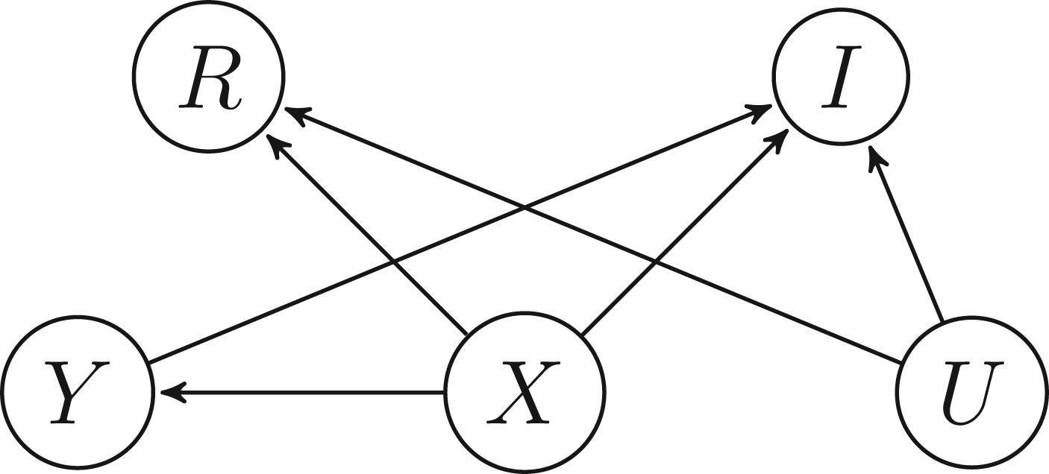
Figure 1. A DAG for a setup where PMAR holds but SMAR does not hold.
Notes:
Figure 1. A DAG for a setup where PMAR holds but SMAR does not hold.
Unless provided in the caption above, the following copyright applies to the content of this slide: © The Author 2016. Published by Oxford University Press on behalf of the American Association for Public Opinion Research. All rights reserved. For Permissions, please email: journals.permissions@oup.com

Slide 2
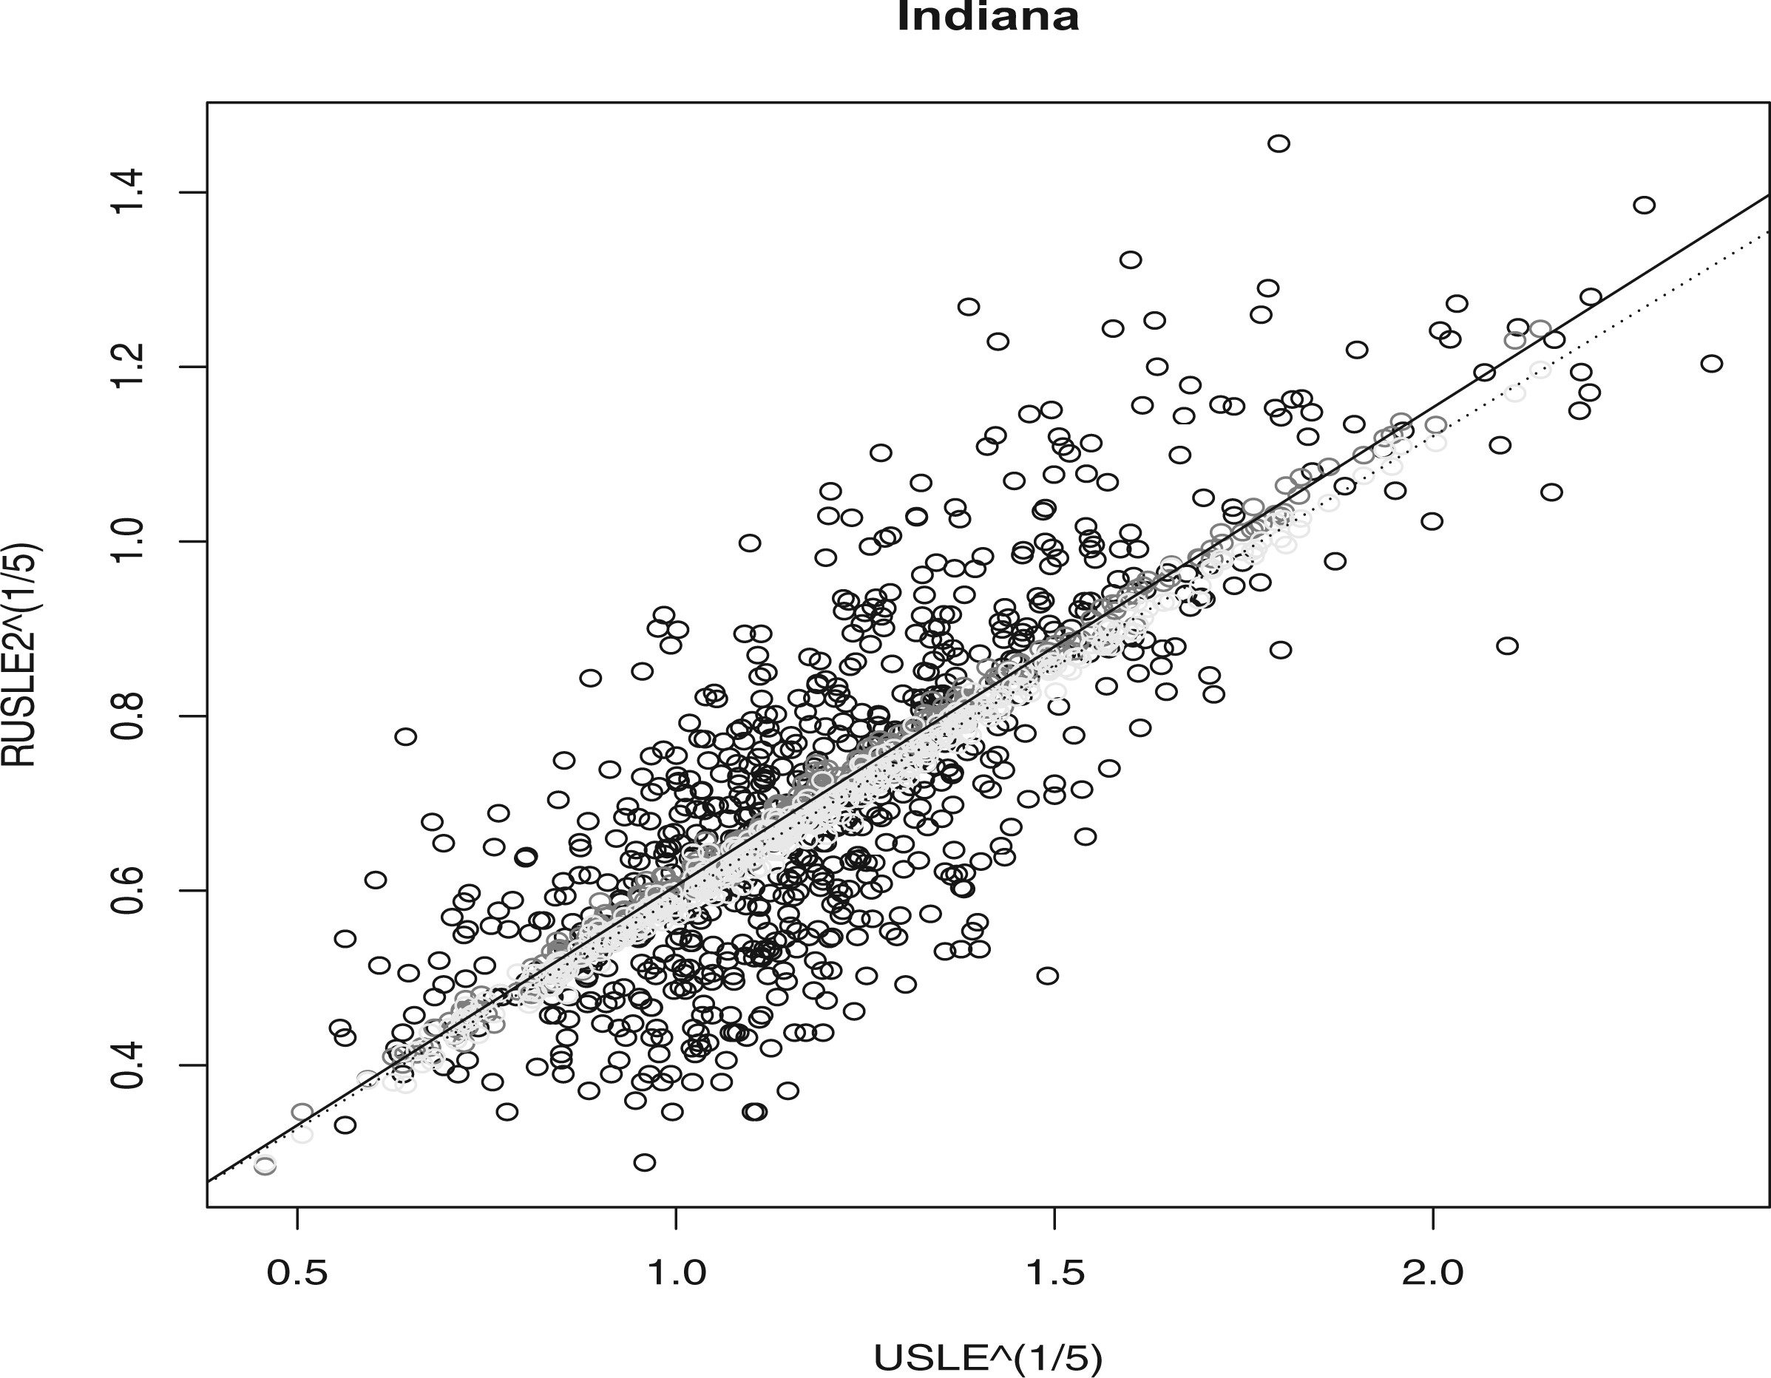
Figure 3. RUSLE2^{0.2} vs. USLE^{0.2} for Corn Belt states. Black = observed. Dark grey = imputed ...
Notes:
Figure 3. RUSLE20.2 vs. USLE0.2 for Corn Belt states. Black = observed. Dark grey = imputed values based on OLS. Light grey = imputed values based on WLS. Solid line = OLS regression line. Dashed line = WLS regression line.
Unless provided in the caption above, the following copyright applies to the content of this slide: © The Author 2016. Published by Oxford University Press on behalf of the American Association for Public Opinion Research. All rights reserved. For Permissions, please email: journals.permissions@oup.com

Slide 3
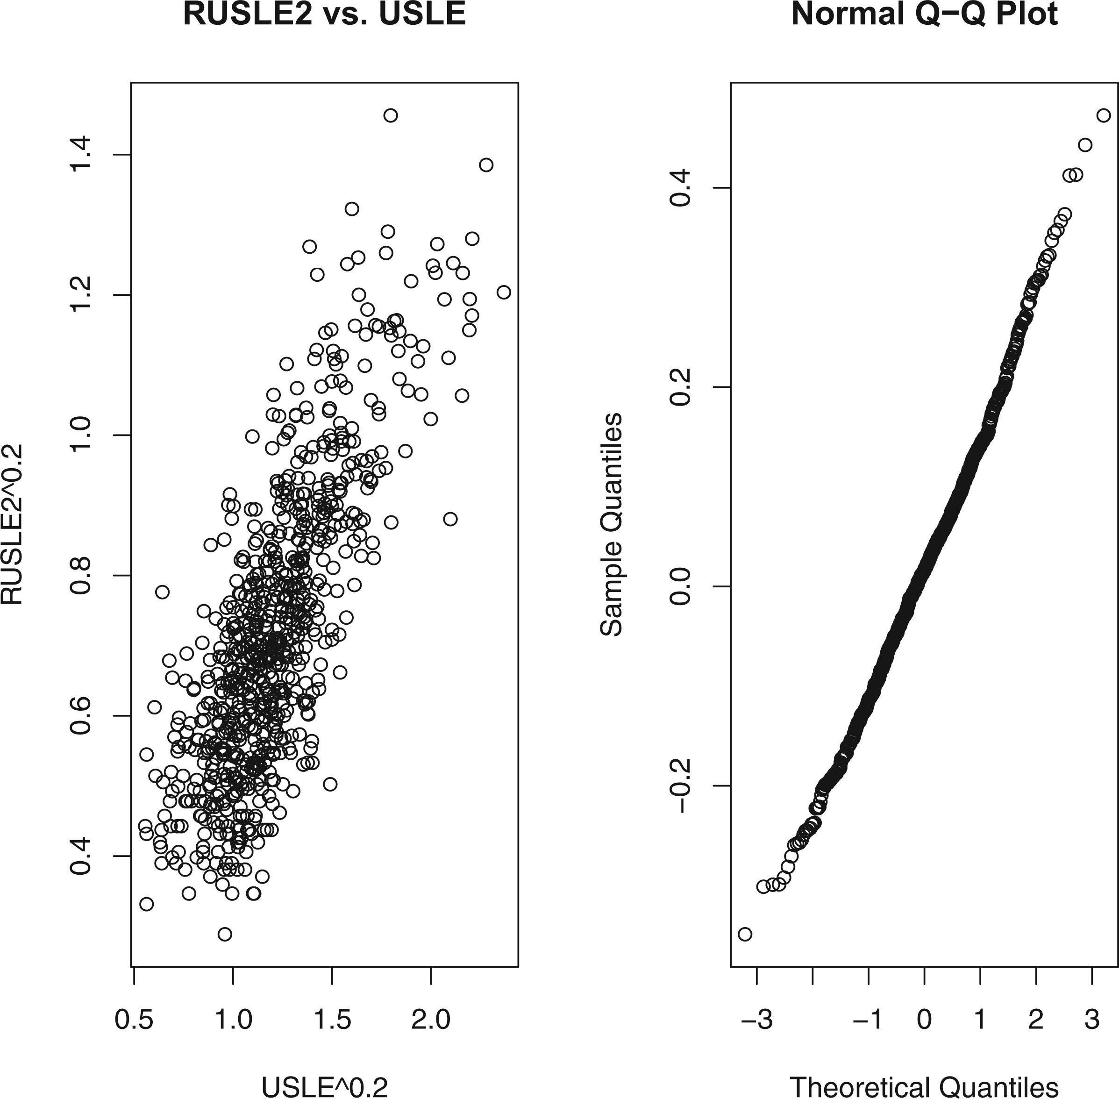
Figure 2 Illustration of relationships between RUSLE2 and USLE for IN. Left: RUSLE2^{0.2} vs. ...
Notes:
Figure 2 Illustration of relationships between RUSLE2 and USLE for IN. Left: RUSLE20.2 vs. USLE0.2. Right: Residuals from the ordinary least squares regression of RUSLE20.2 on USLE0.2 vs. the quantiles of a normal distribution.
Unless provided in the caption above, the following copyright applies to the content of this slide: © The Author 2016. Published by Oxford University Press on behalf of the American Association for Public Opinion Research. All rights reserved. For Permissions, please email: journals.permissions@oup.com

