Slide 1
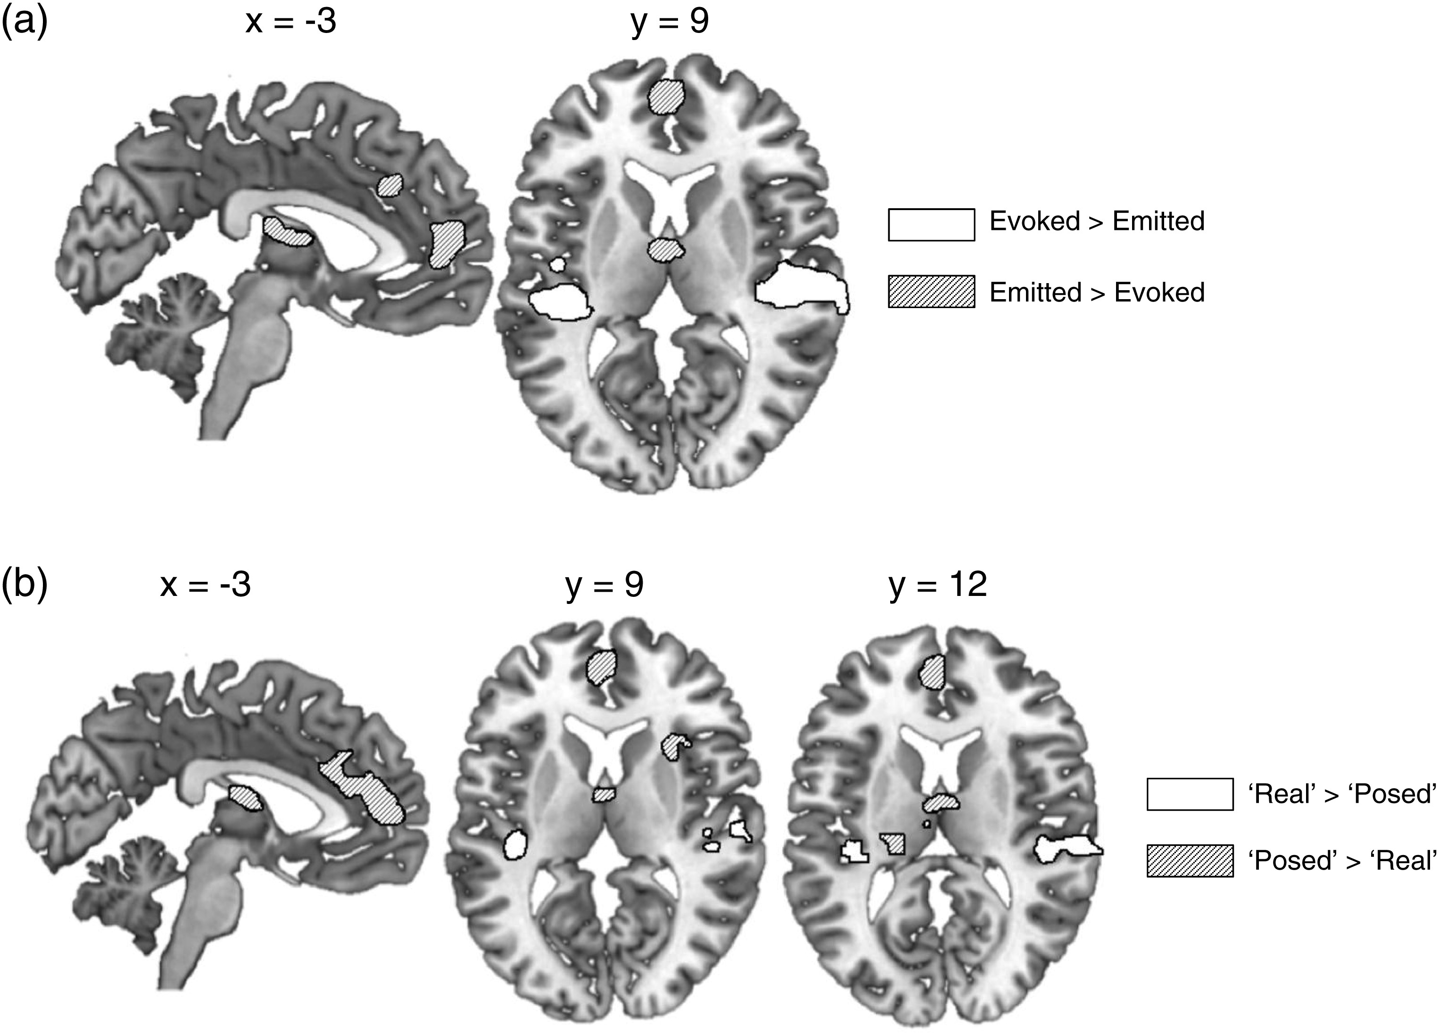
Figure 1. Direct comparison of Evoked and Emitted laughter, where (a) responses were coded according to their ...
Notes:
Figure 1. Direct comparison of Evoked and Emitted laughter, where (a) responses were coded according to their predefined categories or (b) according to each participant's post-test classification of the items as “Real” and “Posed.” Activations are shown at a voxel height threshold of P < 0.001 and a corrected cluster extent threshold of P < 0.001 (Slotnick et al. 2003).
Unless provided in the caption above, the following copyright applies to the content of this slide: © The Author 2013. Published by Oxford University Press.This is an Open Access article distributed under the terms of the Creative Commons Attribution License (http://creativecommons.org/licenses/by/3.0/), which permits unrestricted reuse, distribution, and reproduction in any medium, provided the original work is properly cited.

Slide 2
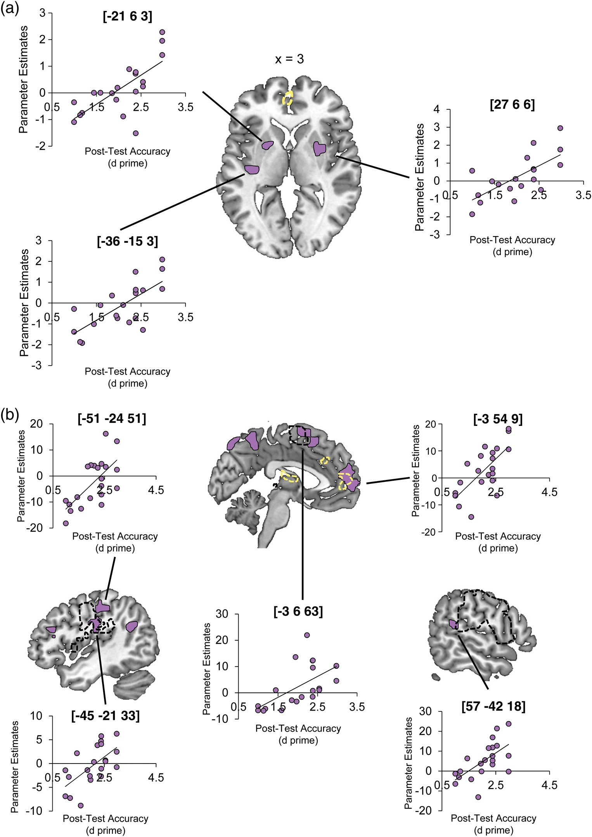
Figure 2. Relationship between neural responses to laughter and post-test classification of stimuli as “real” or ...
Notes:
Figure 2. Relationship between neural responses to laughter and post-test classification of stimuli as “real” or “posed.” Images show significant clusters (purple shading) from regression analyses using individual post-test scores on the classification as a predictor of the BOLD response for the contrasts (a) Emitted > Evoked laughter and (b) All Laughs (Evoked and Emitted) > Rest. The scatter plots show the relationship between the neural and behavioral data taken from local peaks in significantly active clusters within each model. Regression activations are shown at a voxel height threshold of P < 0.005, and a corrected cluster extent threshold of P < 0.001 (Slotnick et al. 2003), alongside (in a) the regions activated during smiling (compared with Rest, in black dashed outline at P Evoked laughs (in yellow dashed outline at a voxel height threshold of P < 0.001, and a corrected cluster extent threshold of P < 0.001).
Unless provided in the caption above, the following copyright applies to the content of this slide: © The Author 2013. Published by Oxford University Press.This is an Open Access article distributed under the terms of the Creative Commons Attribution License (http://creativecommons.org/licenses/by/3.0/), which permits unrestricted reuse, distribution, and reproduction in any medium, provided the original work is properly cited.

Slide 3
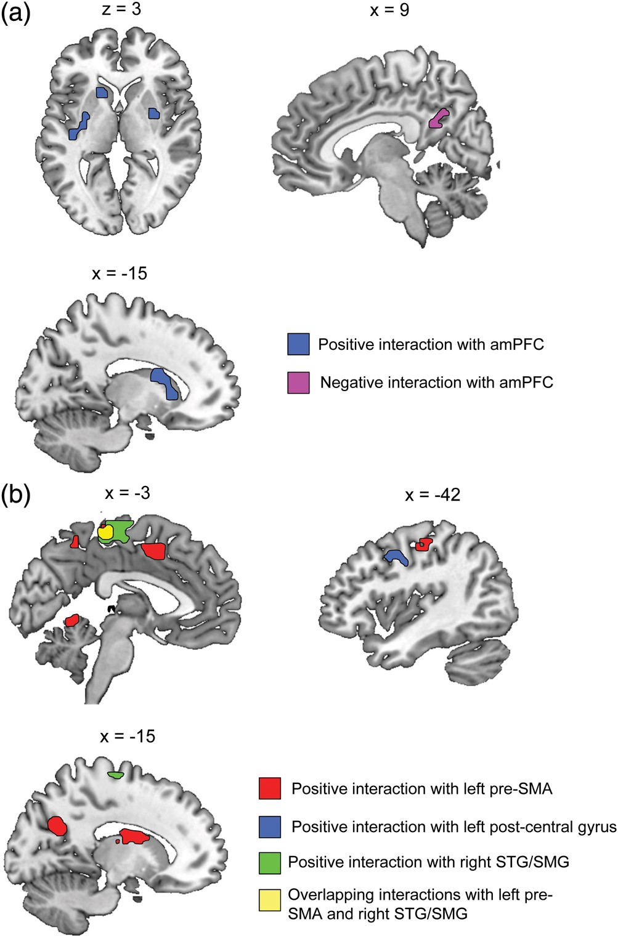
Figure 3. Differing functional connectivity dependent on perceived emotional authenticity of heard laughter. (a) Images ...
Notes:
Figure 3. Differing functional connectivity dependent on perceived emotional authenticity of heard laughter. (a) Images show regions that exhibited positive interactions during the perception of “Real” laughter (compared with “Posed”) with the medial prefrontal activation identified in the individual differences regression on All Laughs > Rest (see Fig. 2b). amPFC = anterior medial prefrontal cortex. (b) Images show regions that exhibited modulations in connectivity during the perception of “Real” laughter (compared with “Posed”) with the sensorimotor regions identified in the individual differences regression analysis on All Laughs > Rest (see Fig. 2b). Activations are shown at a voxel height threshold of P < 0.005 and a corrected cluster extent threshold of P < 0.001 (Slotnick et al. 2003). STG, superior temporal gyrus; SMG, supramarginal gyrus.
Unless provided in the caption above, the following copyright applies to the content of this slide: © The Author 2013. Published by Oxford University Press.This is an Open Access article distributed under the terms of the Creative Commons Attribution License (http://creativecommons.org/licenses/by/3.0/), which permits unrestricted reuse, distribution, and reproduction in any medium, provided the original work is properly cited.

