Slide 1
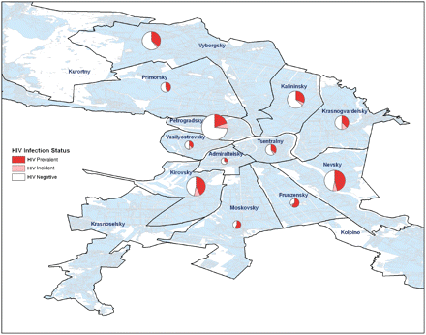
Figure 1 Map of HIV incident, HIV prevalent and HIV negative participants among 670 IDU recruited in St Petersburg ...
Notes:
Figure 1 Map of HIV incident, HIV prevalent and HIV negative participants among 670 IDU recruited in St Petersburg Russia 2005–08, by city district (size of circle proportionate to number of participants recruited from each district)
Unless provided in the caption above, the following copyright applies to the content of this slide: © The Author(s) 2010. Published by Oxford University Press on behalf of the European Public Health Association.This is an Open Access article distributed under the terms of the Creative Commons Attribution Non-Commercial License (http://creativecommons.org/licenses/by-nc/3.0), which permits unrestricted non-commercial use, distribution, and reproduction in any medium, provided the original work is properly cited.

