Slide 1
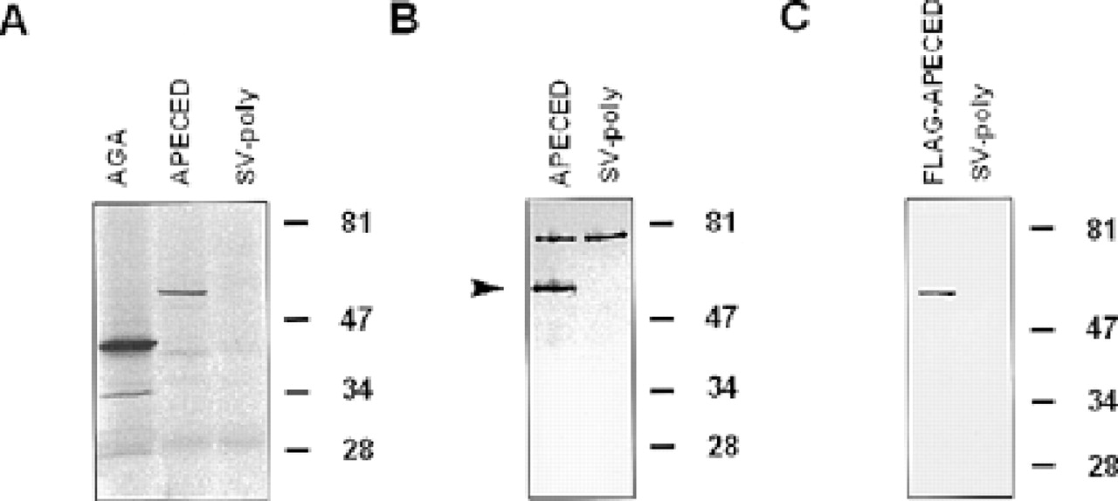
Figure 1 Expression of the APECED protein in vitro and in COS-1 cells. (A) In vitro transcribed and translated AIRE ...
Notes:
Figure 1 Expression of the APECED protein in vitro and in COS-1 cells. (A) In vitro transcribed and translated AIRE cDNA in pGEM3Z(+) vector reveals a 58 kDa protein. (B) Western blot analysis of transiently transfected COS-1 cells. The polyclonal peptide antibody recognizing the APECED protein reveals a specific 58 kDa polypeptide, as indicated by the arrowhead. Cells transfected with the SV-poly vector were used as controls. (C) Western blotting using the M2 monoclonal antibody that recognizes a FLAG fusion protein of 60 kDa. All the polypeptides were resolved by 11% SDS-PAGE. The molecular weights of the low-range marker (Bio-Rad, Hercules, CA) are indicated on the right side of each figure.
Unless provided in the caption above, the following copyright applies to the content of this slide: © 1999 Oxford University Press

Slide 2
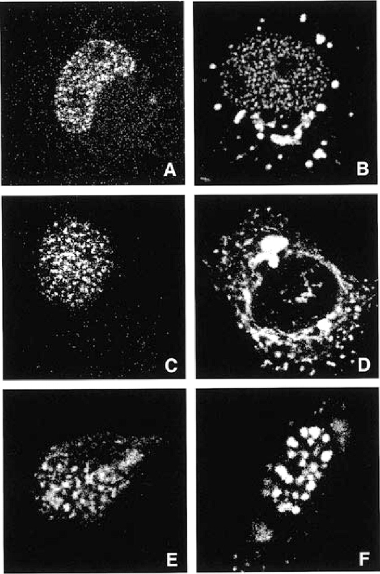
Figure 2 Subcellular localization of the APECED protein visualized by indirect immunofluorescent analysis of COS-1, ...
Notes:
Figure 2 Subcellular localization of the APECED protein visualized by indirect immunofluorescent analysis of COS-1, HeLa and NIH 3T3 cells transfected with AIRE cDNA. The cells were incubated with the polyclonal peptide antibody against the APECED polypeptide. (A) In COS-1 cells the bulk of the protein is localized to NB-like structures. (B) In 20% of the transfected COS-1 cells the antiserum gave both nuclear and cytoplasmic staining. (C) Nuclear dots were also observed in the nuclei of transfected HeLa cells. (D) Up to 60% of the transfected HeLa cells showed an additional cytoplasmic staining. (E) The NB-like labelling was detected in almost all transfected NIH 3T3 cells. (F) A small proportion of transfected NIH 3T3 cells exhibited some cytoplasmic staining.
Unless provided in the caption above, the following copyright applies to the content of this slide: © 1999 Oxford University Press

Slide 3
Figure 3 The specificity of the anti-APECED antiserum was tested by double immunofluorescence labelling with M2 ...
Notes:
Figure 3 The specificity of the anti-APECED antiserum was tested by double immunofluorescence labelling with M2 antibody, which detects the FLAG fusion protein. Staining of COS-1 cells transiently transfected with the FLAG-AIRE cDNA by polyclonal rabbit antibody against the APECED protein (A) and by the monoclonal M2 antibody (B) exactly overlapped, indicated by yellow fluorescence (C). This confirms that the polyclonal antibody detects the exogenous protein.
Unless provided in the caption above, the following copyright applies to the content of this slide: © 1999 Oxford University Press

Slide 4
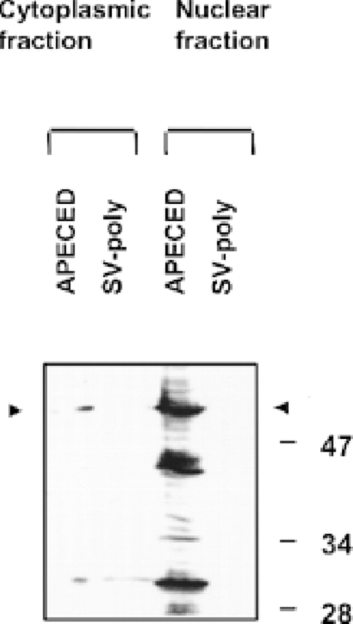
Figure 4 Western blotting of the nuclear and cytoplasmic fractions of transfected COS-1 cells using APECED-specific ...
Notes:
Figure 4 Western blotting of the nuclear and cytoplasmic fractions of transfected COS-1 cells using APECED-specific antiserum. Equivalent volumes of the subcellular fractions were analysed. The polypeptides were resolved by 11 % SDS-PAGE. The molecular weights of the low-range marker (Bio-Rad) are indicated.
Unless provided in the caption above, the following copyright applies to the content of this slide: © 1999 Oxford University Press

Slide 5
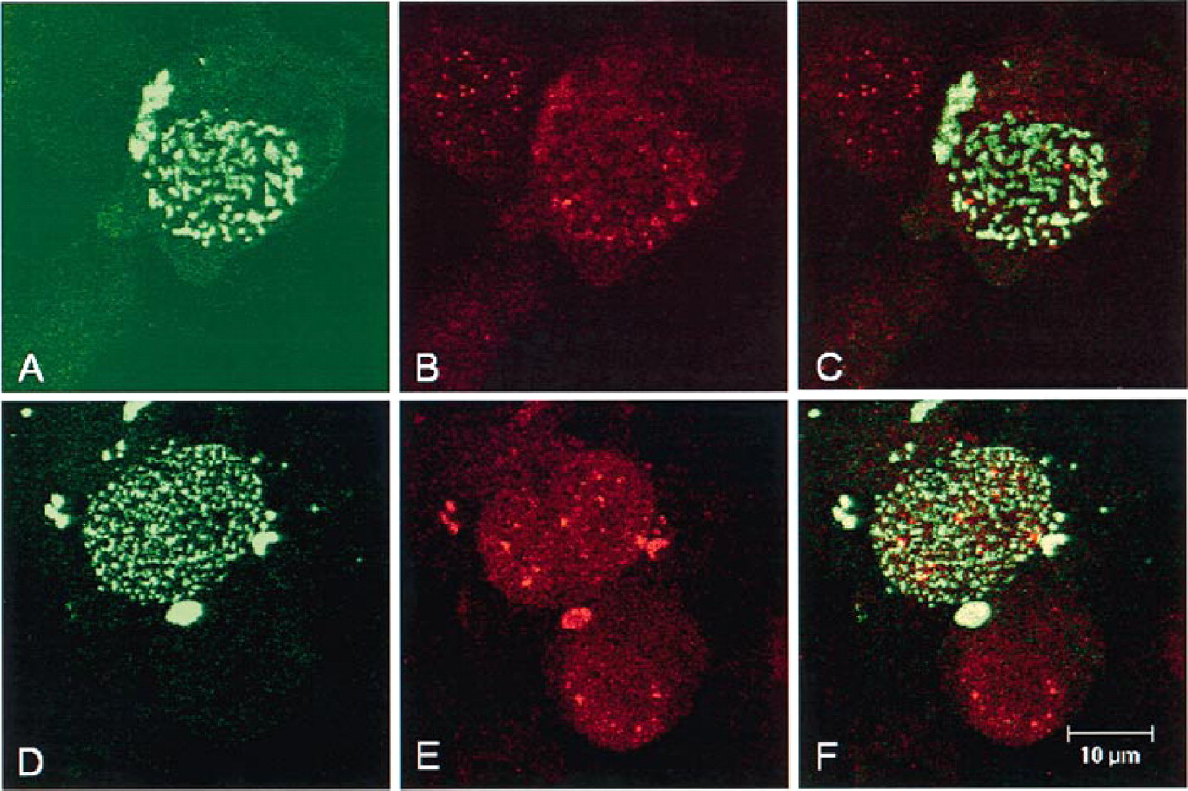
Figure 5 Double labelling of the APECED protein and the components of PML NBs in COS-1 cells transiently transfected ...
Notes:
Figure 5 Double labelling of the APECED protein and the components of PML NBs in COS-1 cells transiently transfected with FLAG-AIRE cDNA. (A-C) Cells stained with M2 antibody recognizing the FLAG epitope (A, green in C) and polyclonal anti-PML rabbit antiserum (B, red in C). (D-F) Cells stained with M2 antibody (D, green in F) and anti-Sp100 rabbit antiserum (E, red in F). The immunofluorescence was visualized by laser scanning confocal microscopy. (C) and (F) represent depictions of overlaid images.
Unless provided in the caption above, the following copyright applies to the content of this slide: © 1999 Oxford University Press

Slide 6
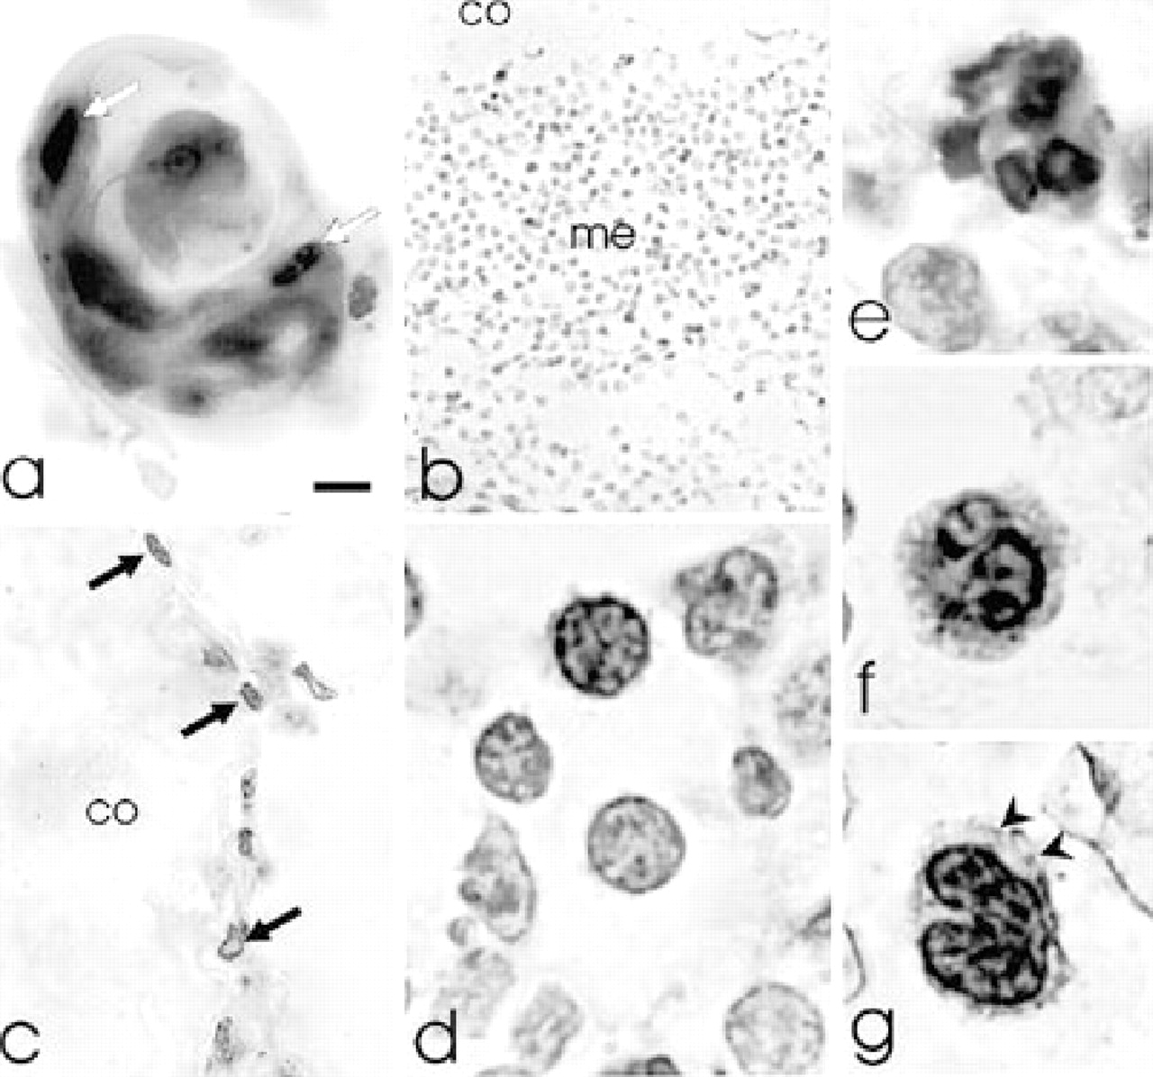
Figure 6 (a) Strong staining can be seen in the nuclei of epithelial cells (arrows) in thymic corpuscle. (b) Faint to ...
Notes:
Figure 6 (a) Strong staining can be seen in the nuclei of epithelial cells (arrows) in thymic corpuscle. (b) Faint to moderate staining is present in many of the lymphocytes in the medulla (me) of the thymus while the cortex (co) is not labelled. (c) Labelled cells (arrows) are seen in the periphery of the thymic cortex (co). (d) In spleen several lymphocytes exhibit immunoreactivity. In strongly labelled lymphocytes staining is localized close to the nuclear membrane and in dots inside the nucleus. Strongly labelled neutrophilic (e) and basophilic granulocytes (f) could be observed in the spleen. (g) In the strongly stained monocytes in a human PBL smear labelling is confined to the nucleus. Labelling is associated with the nuclear membrane and in dots in the nucleus while the cytoplasm (arrowheads) is not stained. Bar: 4 µm for (a); 70 µm for (b); 20 µm for (c); 7 µm for (d); 5 µm for (e-g).
Unless provided in the caption above, the following copyright applies to the content of this slide: © 1999 Oxford University Press

Slide 7
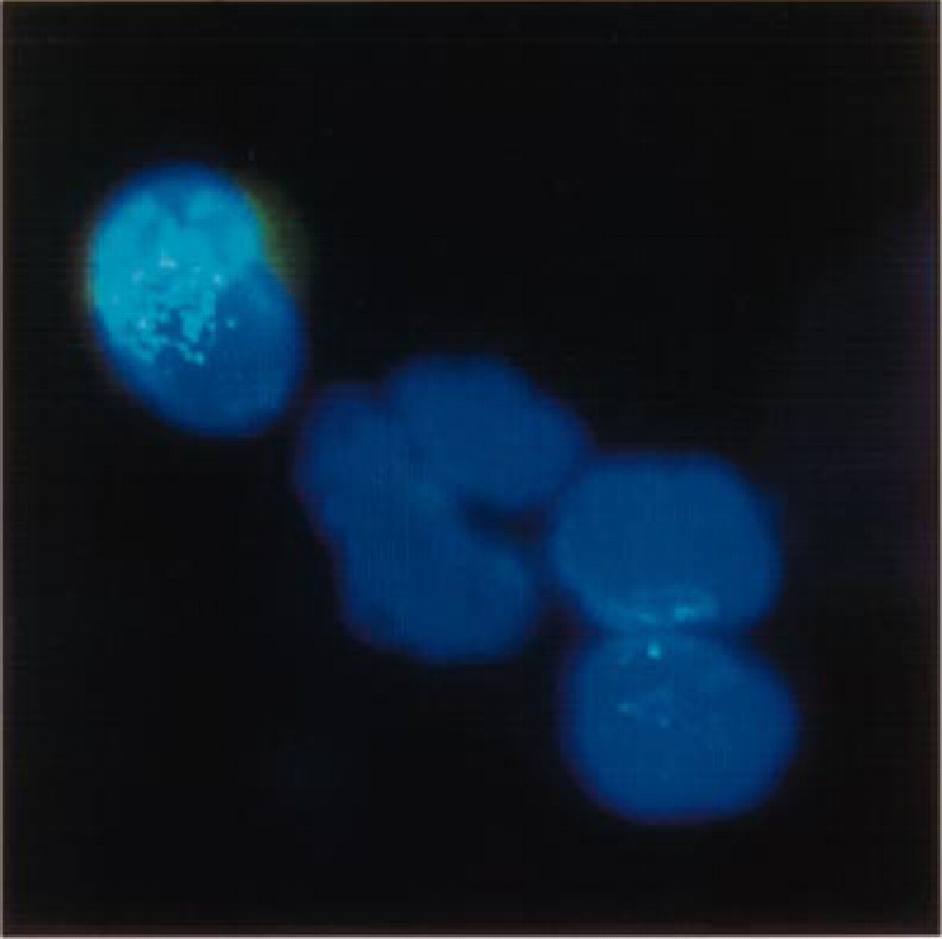
Figure 7 Peripheral blood mononuclear cells after Ficoll gradient centrfugation. APECED protein was detected with ...
Notes:
Figure 7 Peripheral blood mononuclear cells after Ficoll gradient centrfugation. APECED protein was detected with antibody against APECED polypeptide. The fairly weak immunofluorescence was digitally enhanced to visualize the location of the protein.
Unless provided in the caption above, the following copyright applies to the content of this slide: © 1999 Oxford University Press

