Slide 1
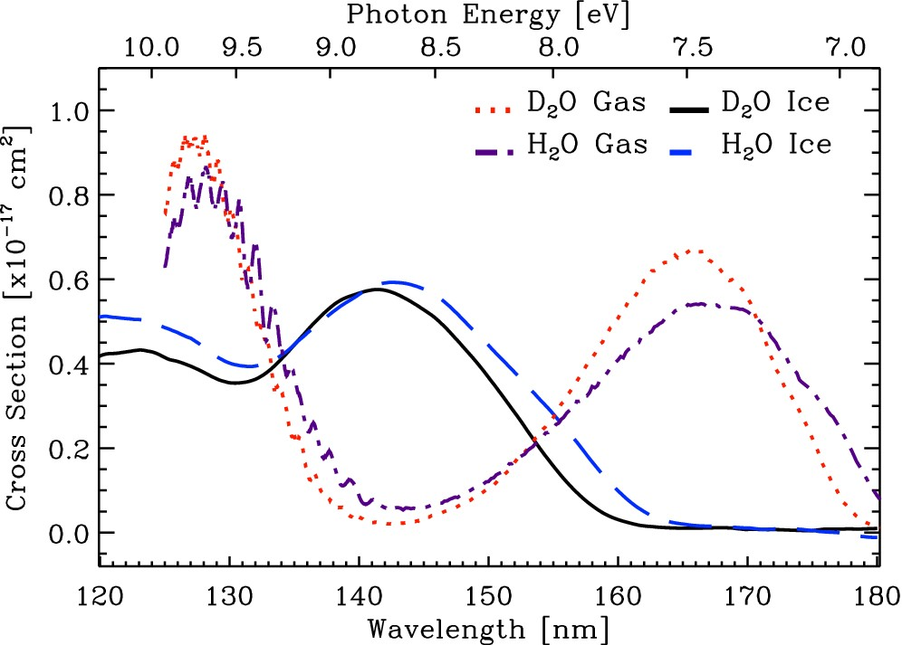
Figure 1. VUV absorption cross-section as a function of photon wavelength (bottom X-axis) and photon energy (top ...
Notes:
Figure 1. VUV absorption cross-section as a function of photon wavelength (bottom X-axis) and photon energy (top X-axis) of D2O ice deposited at 8 K, black trace. Blue trace is the VUV absorption cross-section spectrum of solid phase H2O, adapted from Paper I. Red and violet traces are the VUV absorption cross-section spectra of gas phase D2O and H2O, respectively, adapted from Cheng et al. (2004) and Chung et al. (2001).
Unless provided in the caption above, the following copyright applies to the content of this slide: © 2014 The Authors Published by Oxford University Press on behalf of the Royal Astronomical Society

Slide 2
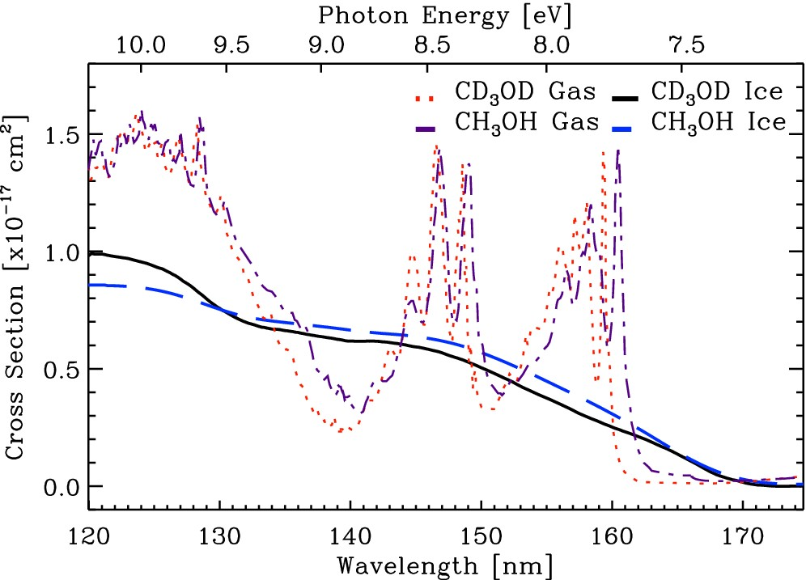
Figure 2. VUV absorption cross-section as a function of photon wavelength (bottom X-axis) and UV-photon energy (top ...
Notes:
Figure 2. VUV absorption cross-section as a function of photon wavelength (bottom X-axis) and UV-photon energy (top X-axis) of CD3OD ice deposited at 8 K, black trace. Blue trace is the VUV absorption cross-section spectrum of solid phase CH3OH adapted from Paper I. Red and violet traces are the VUV absorption cross-section spectra of gas phase CD3OD and CH3OH, respectively, adapted from Cheng et al. (2002).
Unless provided in the caption above, the following copyright applies to the content of this slide: © 2014 The Authors Published by Oxford University Press on behalf of the Royal Astronomical Society

Slide 3
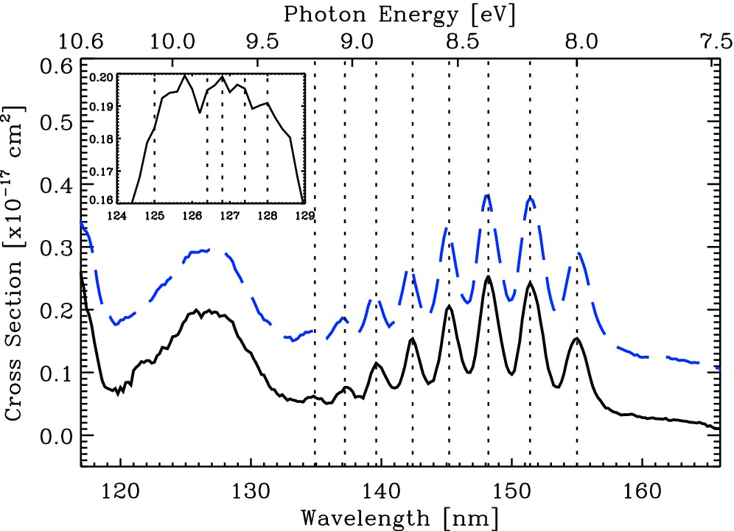
Figure 3. VUV absorption cross-section as a function of photon wavelength (bottom X-axis) and VUV photon energy (top ...
Notes:
Figure 3. VUV absorption cross-section as a function of photon wavelength (bottom X-axis) and VUV photon energy (top X-axis) of 13CO2 ice deposited at 8 K, black trace. Blue trace is the VUV absorption cross-section spectrum of solid CO2 adapted from Paper II. Inset figure is a close-up of the 13CO2 VUV absorption cross-section in the 124–129 nm range. The spectrum of solid CO2 was offset by 1 × 10−18 cm2 for clarity.
Unless provided in the caption above, the following copyright applies to the content of this slide: © 2014 The Authors Published by Oxford University Press on behalf of the Royal Astronomical Society

Slide 4
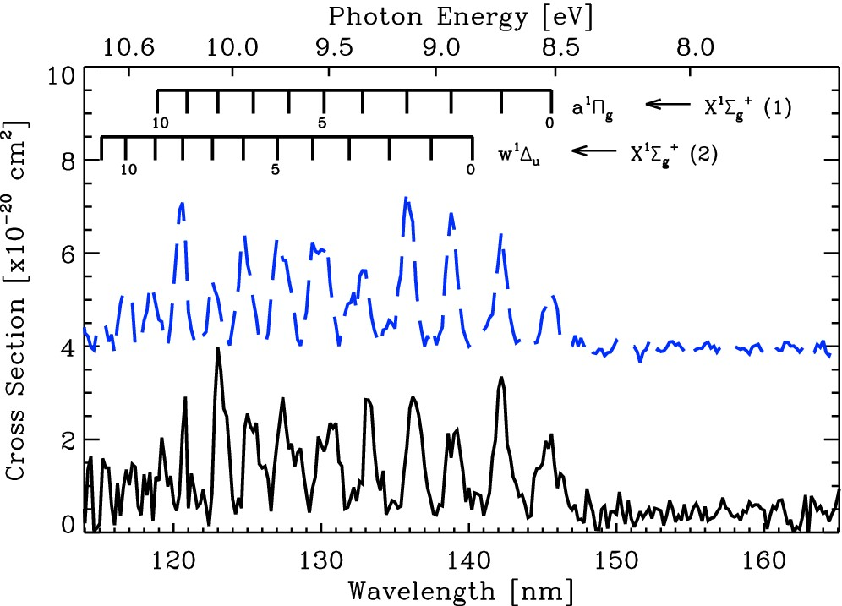
Figure 4. VUV absorption cross-section as a function of photon wavelength (bottom X-axis) and VUV photon energy (top ...
Notes:
Figure 4. VUV absorption cross-section as a function of photon wavelength (bottom X-axis) and VUV photon energy (top X-axis) of 15N2 ice deposited at 8 K, black trace. Blue trace is the VUV absorption cross-section spectrum of solid phase N2 adapted from Paper II. The spectrum of solid N2 was offset by 4 × 10−20 cm2 for clarity.
Unless provided in the caption above, the following copyright applies to the content of this slide: © 2014 The Authors Published by Oxford University Press on behalf of the Royal Astronomical Society

