Slide 1
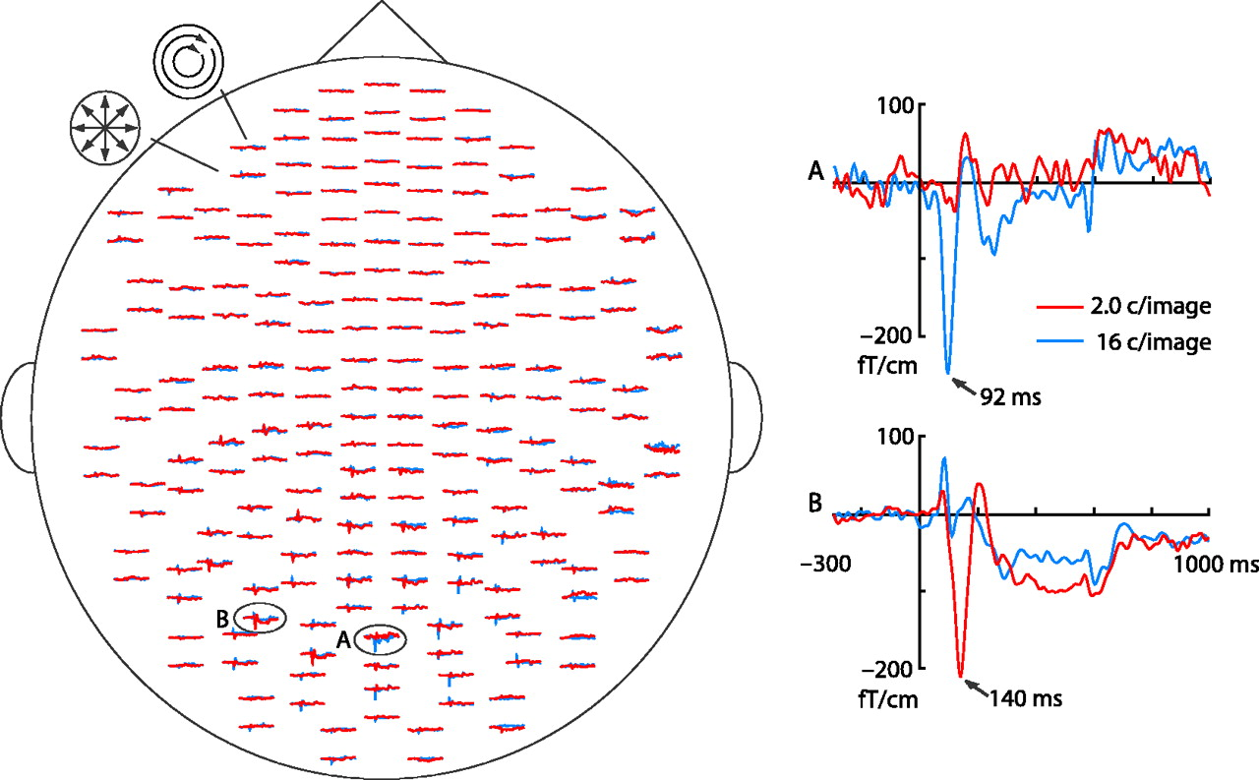
Figure 1. Averaged responses of Subject 1 to facial images with two noise SFs. Each pair of traces represents responses ...
Notes:
Figure 1. Averaged responses of Subject 1 to facial images with two noise SFs. Each pair of traces represents responses from the two orthogonal planar gradiometers in a sensor unit (cf. Hämäläinen et al., 1993). (A) A typical mid-occipital response; (B) a typical temporo-occipital response.
Unless provided in the caption above, the following copyright applies to the content of this slide: Cerebral Cortex V 15 N 5 © Oxford University Press 2004; all rights reserved

Slide 2
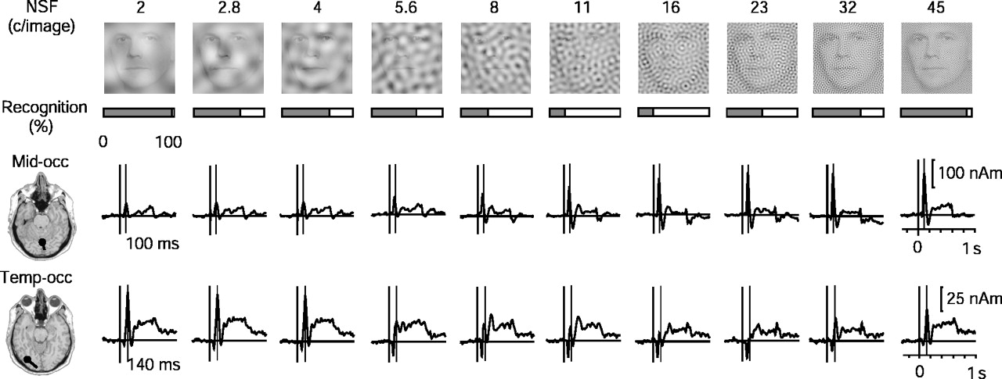
Figure 2. Effects of noise spatial frequency (NSF) on face processing. Top row: examples of faces with narrow band ...
Notes:
Figure 2. Effects of noise spatial frequency (NSF) on face processing. Top row: examples of faces with narrow band spatial noise with different center spatial frequencies from 2 to 45 c/image; note that noise amplitude was equal across all NSFs although the examples here might fail to illustrate that due to strong reduction in scale and limitations in printing technique. For the same reason, the reader may find the most difficult stimuli to be at lower NSFs than the subjects did (for original stimuli, see Supplementary Material). Second row from top: mean recognition performance (% hits marked as grey) for six subjects at each NSF, measured from the target trials during the MEG recording. Bottom rows: source amplitudes as a function of time at different NSFs for the mid-occipital and temporo-occipital activations in subject S1; the sources are superimposed on MRI slices on the left.
Unless provided in the caption above, the following copyright applies to the content of this slide: Cerebral Cortex V 15 N 5 © Oxford University Press 2004; all rights reserved

Slide 3
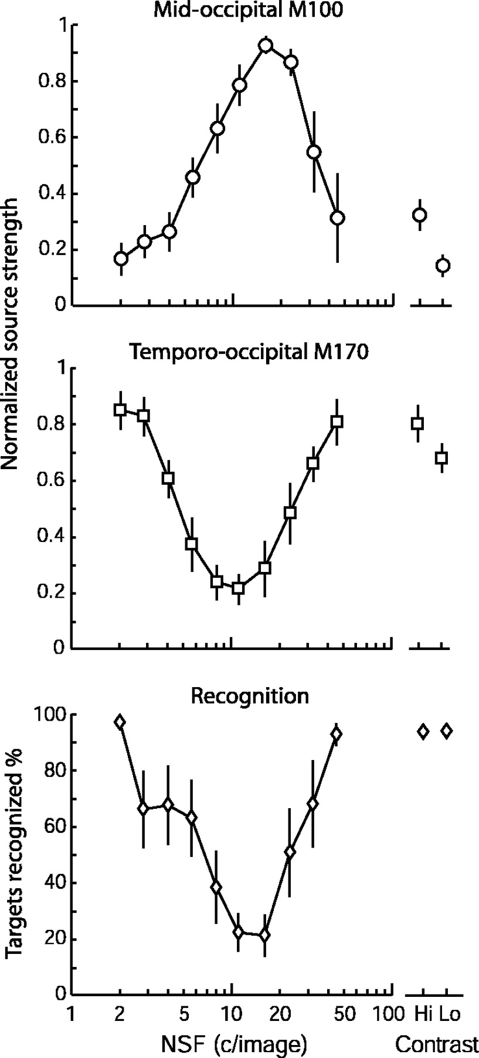
Figure 3. Mean ± SEM source strengths and recognition performance of the six subjects as a function of NSF. Data for ...
Notes:
Figure 3. Mean ± SEM source strengths and recognition performance of the six subjects as a function of NSF. Data for the noiseless high-contrast (Hi) and low-contrast (Lo) faces are shown on the right. The responses of all conditions were quantified in a time window of 60–120 ms for the mid-occipital sources (top) and 120–200 ms for the temporo-occipital source (middle). The responses were first normalized for each subject according to the individual maximum amplitude.
Unless provided in the caption above, the following copyright applies to the content of this slide: Cerebral Cortex V 15 N 5 © Oxford University Press 2004; all rights reserved

Slide 4
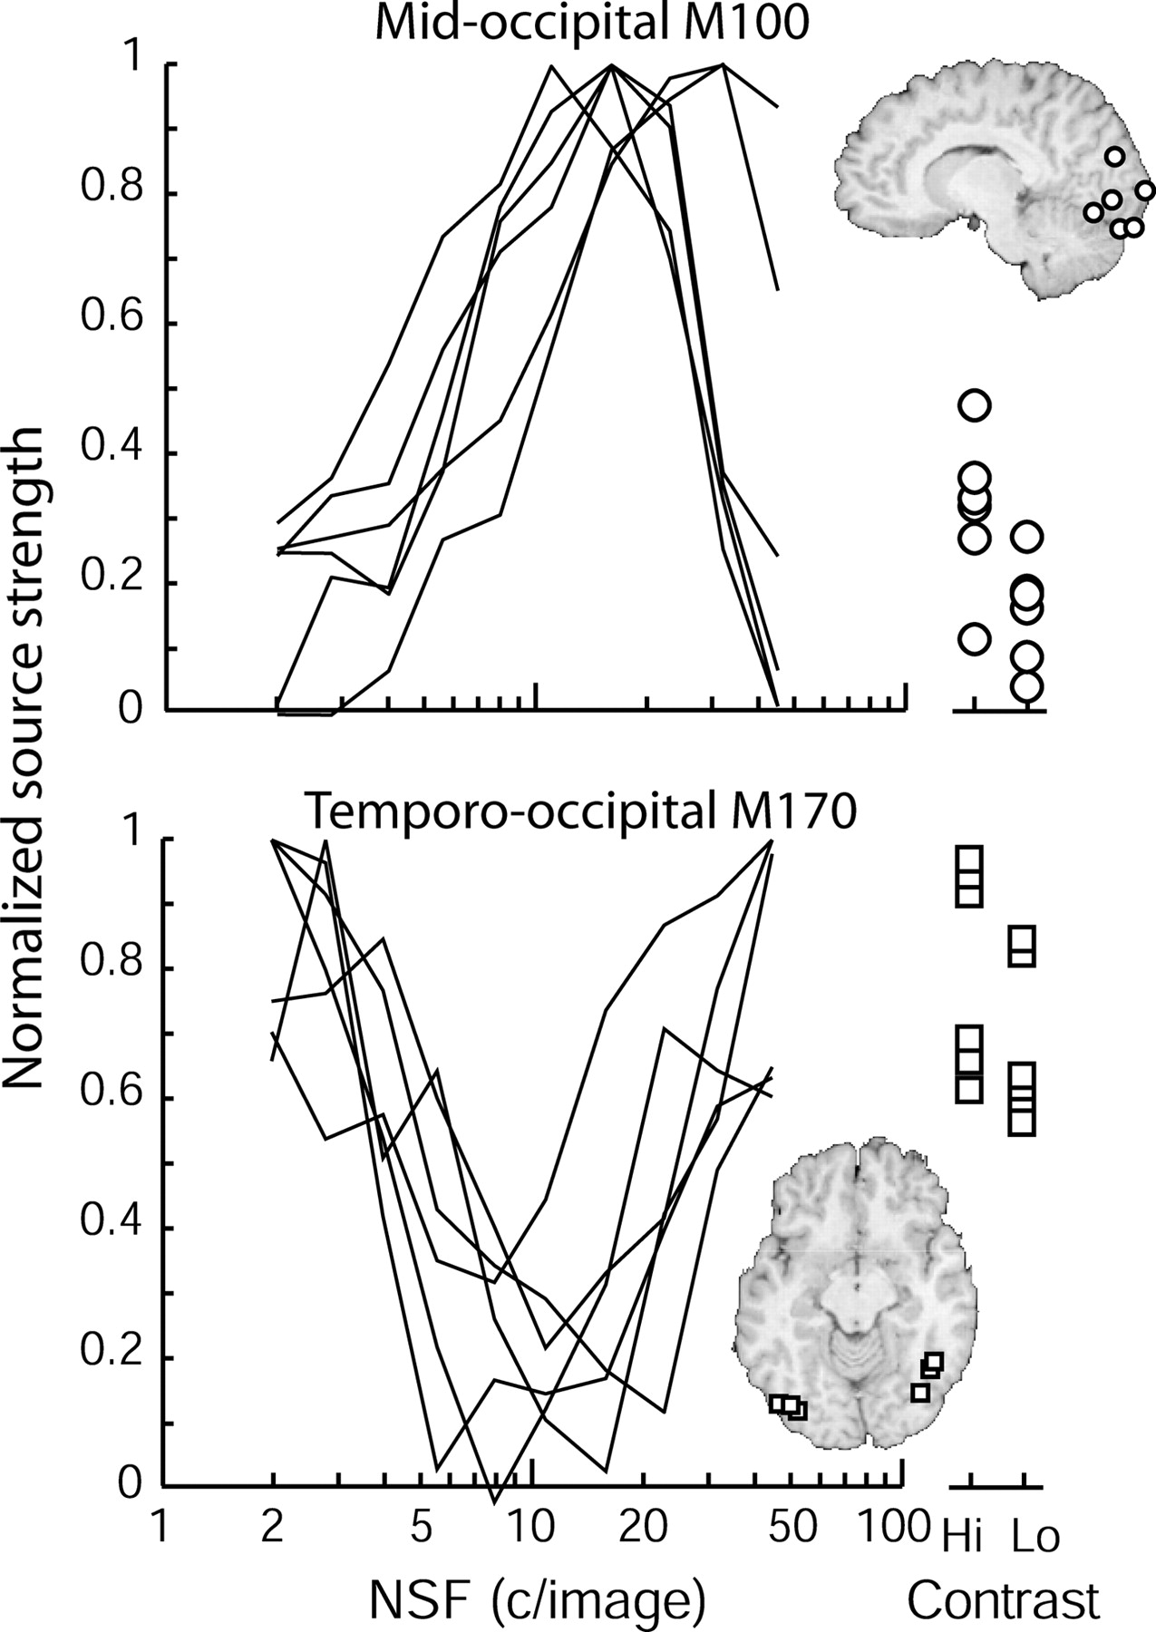
Figure 4. Individual source strengths and source locations. The source locations of all subjects are shown on the ...
Notes:
Figure 4. Individual source strengths and source locations. The source locations of all subjects are shown on the standard brain; the slices were selected so that the sources of all six subjects are visible with an error less than ±1 cm in the direction normal to the slice plane.
Unless provided in the caption above, the following copyright applies to the content of this slide: Cerebral Cortex V 15 N 5 © Oxford University Press 2004; all rights reserved

Slide 5
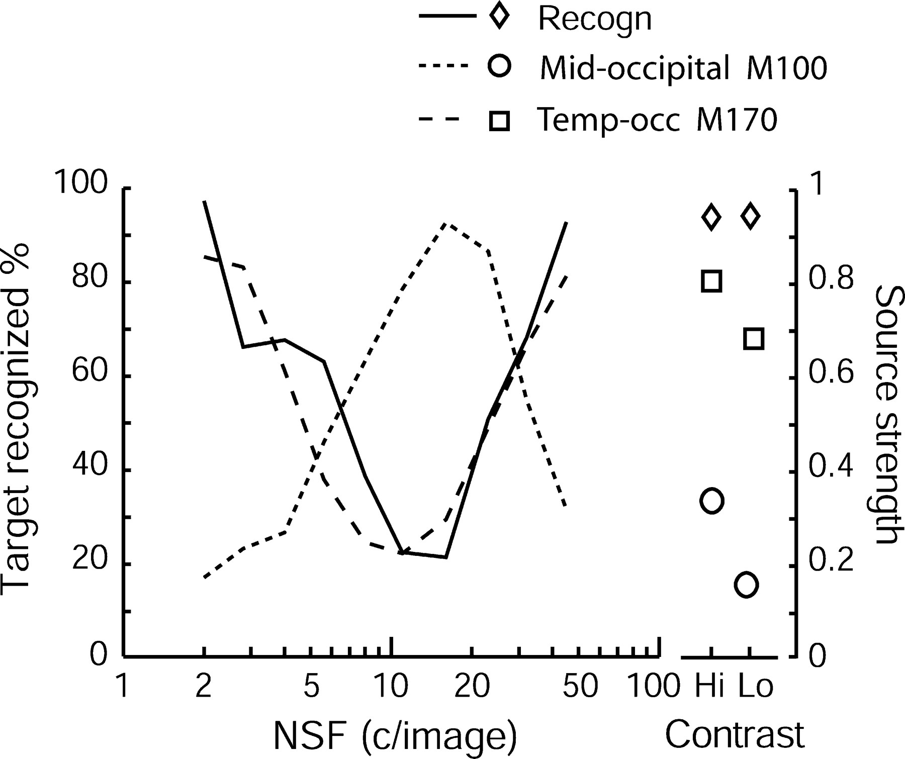
Figure 5. Recognition performance (the mean percentage of detected target faces during the MEG recordings) and the ...
Notes:
Figure 5. Recognition performance (the mean percentage of detected target faces during the MEG recordings) and the source strengths for mid-occipital and temporo-occipital responses.
Unless provided in the caption above, the following copyright applies to the content of this slide: Cerebral Cortex V 15 N 5 © Oxford University Press 2004; all rights reserved

Slide 6
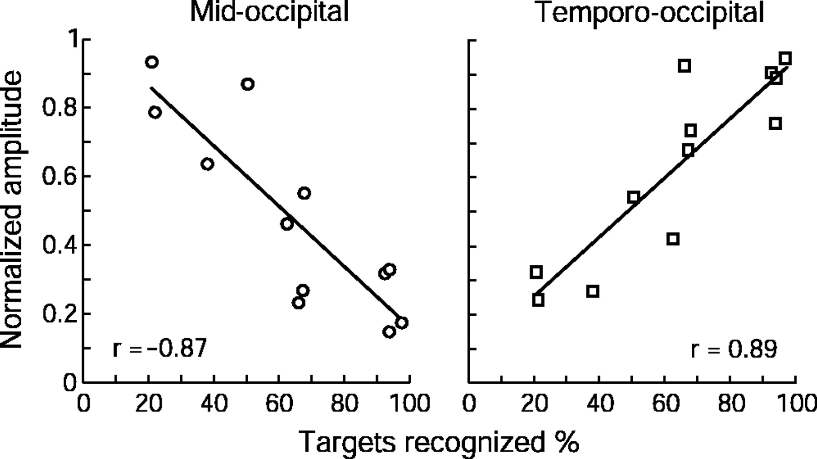
Figure 6. Mean normalized mid-occipital (left) and temporo-occipital (right) source strengths across subjects for all ...
Notes:
Figure 6. Mean normalized mid-occipital (left) and temporo-occipital (right) source strengths across subjects for all 12 stimulus categories as a function of recognition performance.
Unless provided in the caption above, the following copyright applies to the content of this slide: Cerebral Cortex V 15 N 5 © Oxford University Press 2004; all rights reserved

Slide 7
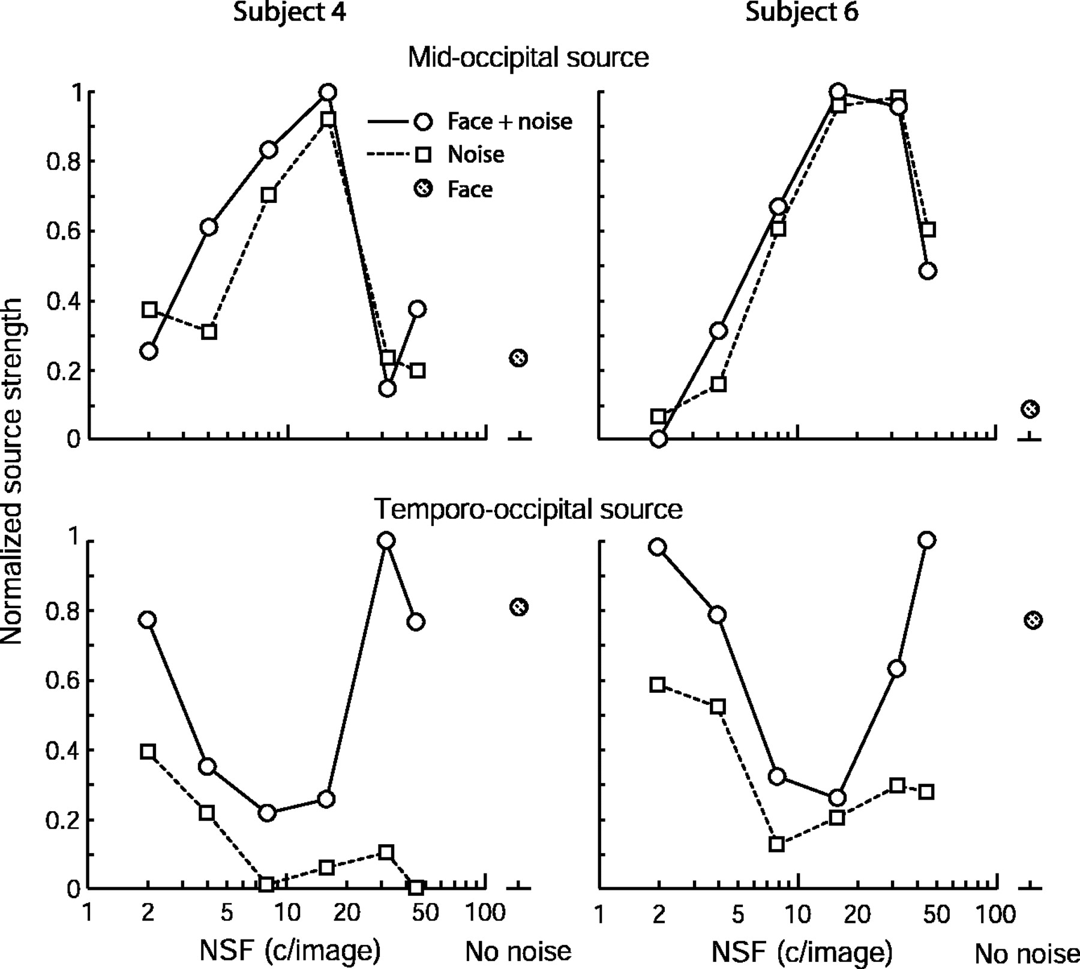
Figure 7. Response strengths of two subjects to faces embedded in noise (continuous lines) and plain noise (dashed ...
Notes:
Figure 7. Response strengths of two subjects to faces embedded in noise (continuous lines) and plain noise (dashed lines) as a function of NSF, and to plain faces (gray circles). Details as in Figure 3.
Unless provided in the caption above, the following copyright applies to the content of this slide: Cerebral Cortex V 15 N 5 © Oxford University Press 2004; all rights reserved

Slide 8
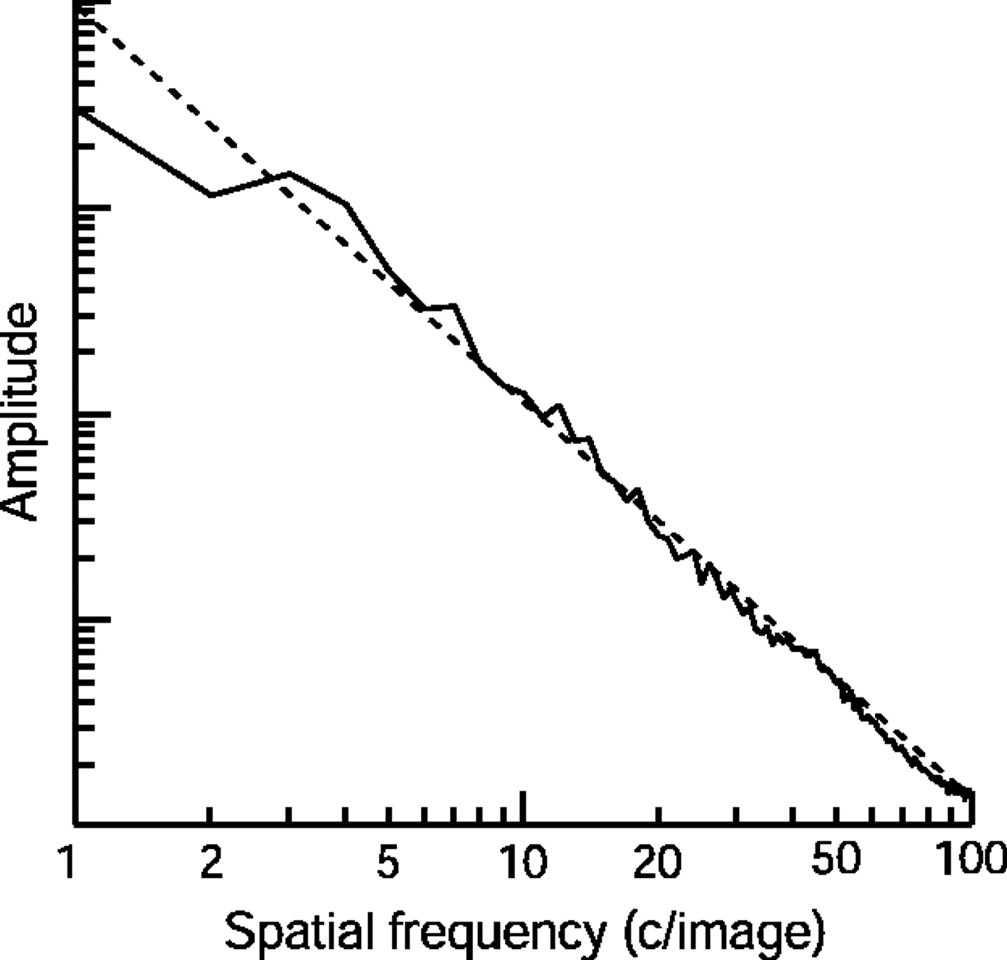
Figure 8. The average amplitude spectrum of the face images used in the stimuli (continuous line). The dashed line ...
Notes:
Figure 8. The average amplitude spectrum of the face images used in the stimuli (continuous line). The dashed line shows the function A = kf−1.9, where A is amplitude, f is spatial frequency and k is a constant.
Unless provided in the caption above, the following copyright applies to the content of this slide: Cerebral Cortex V 15 N 5 © Oxford University Press 2004; all rights reserved

