Slide 1
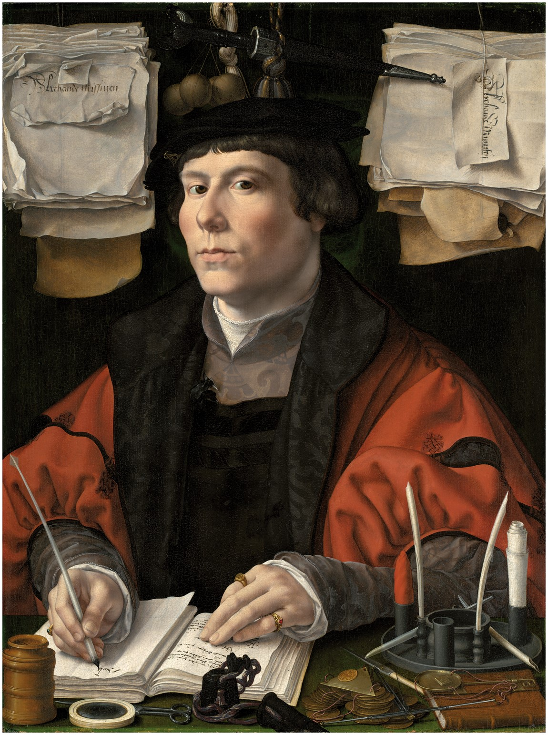
Jan Gossaert, ‘Portrait of a Merchant’, c.1530. Oil on panel. Courtesy of the National Gallery of Art, ...
Notes:
Jan Gossaert, ‘Portrait of a Merchant’, c.1530. Oil on panel. Courtesy of the National Gallery of Art, Washington DC.
Unless provided in the caption above, the following copyright applies to the content of this slide: © The Past and Present Society

