Slide 1
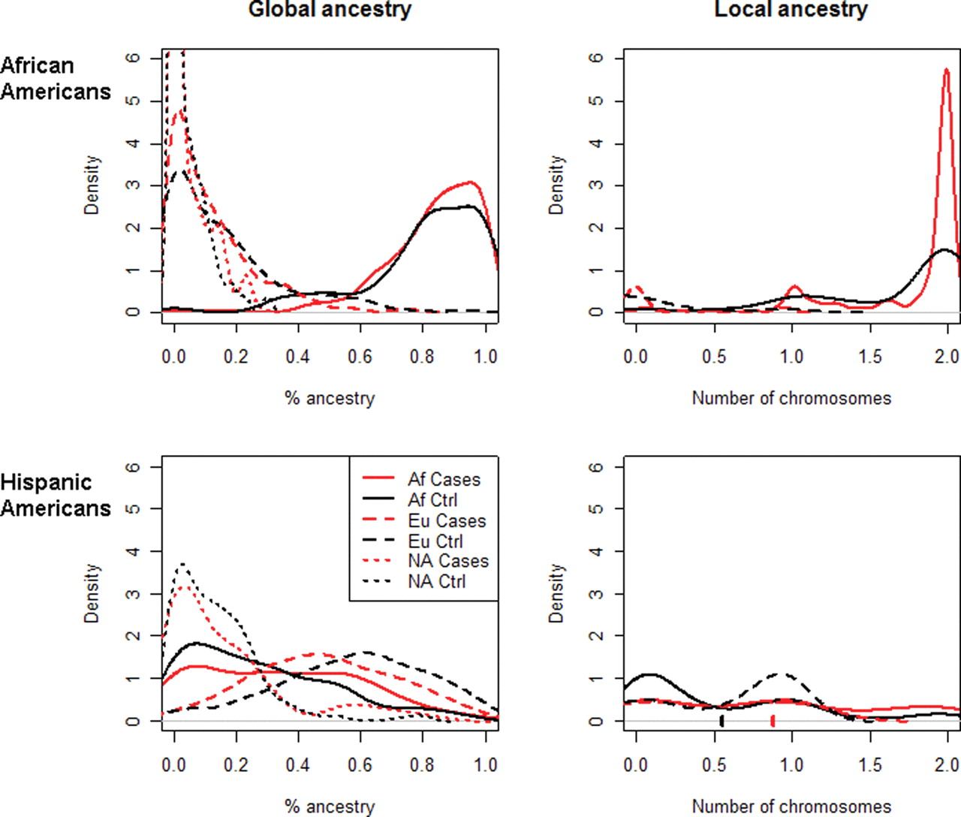
Figure 1. Ancestry distribution Graphs. Density of ancestry proportions among African and Hispanic Americans as ...
Notes:
Figure 1. Ancestry distribution Graphs. Density of ancestry proportions among African and Hispanic Americans as discerned from a panel of 40 AIMs for estimating global ancestry (left column) and 38 chromosome 22 SNPs for estimating local ancestry (right column), separately in the African American cohort (top row) and the Hispanic American cohort (bottom row). In the left graphs the ancestry is shown as a percentage (on the x-axis), although in the right graphs the local MYH9 ancestry is shown as the estimated number of chromosomes (0–2) on the x-axis. The average ancestry reported in the text is the mean of the distribution described by the corresponding curve. For example, the significant difference in average local African ancestry in the Hispanic American cohort mentioned in the text (0.87 for non-diabetic ESKD cases, 0.54 for controls) is the difference between the red and black checkmarks on the x-axis in the bottom right plot. ‘Af’ designates African ancestry, ‘Eu’ designates European ancestry and ‘NA’ designates Native American ancestry. Red lines represent non-diabetic ESKD cases, and black lines represent controls.
Unless provided in the caption above, the following copyright applies to the content of this slide: © The Author 2010. Published by Oxford University Press.This is an Open Access article distributed under the terms of the Creative Commons Attribution Non-Commercial License (http://creativecommons.org/licenses/by-nc/2.5/uk) which permits unrestricted non-commercial use, distribution, and reproduction in any medium, provided the original work is properly cited.

Slide 2
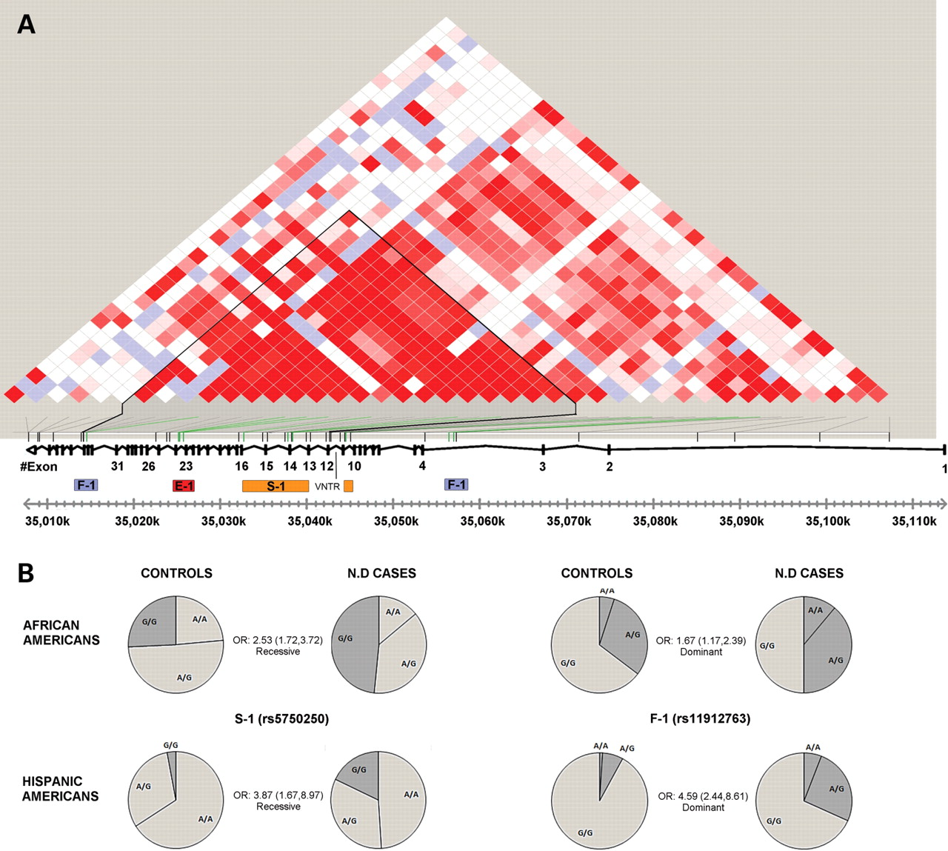
Figure 2. MYH9 LD plot and ESKD associated SNPs. (A) Color scheme (D′/LOD) of the 42 MYH9 SNPs that were genotyped in ...
Notes:
Figure 2. MYH9 LD plot and ESKD associated SNPs. (A) Color scheme (D′/LOD) of the 42 MYH9 SNPs that were genotyped in this study based on the African American control samples (n = 140) was generated using the program HaploView (35). Bright red squares present SNPs with linkage LOD ≥ 2 and D′ = 1. The plot overlaps the actual locations of the SNPs tested herein and the physical map of the MYH9 gene. The SNPs demonstrating the highest peaks for association and their clustering into the haplotypes S-1 (rs5750248, rs2413396, rs5750250), E-1 (rs4821480, rs2032487, rs4821481) and F-1 (rs11912763, rs16996674, rs16996677) and the solo tenth SNP (rs2239784) are marked. A block of reduced recombination, bordered at its 5′ end with a 53 bp variable number tandem repeat in intron 11, determined using the program PHASE 2.1 (36), corresponds to the black triangle outline in the LD plot. (B) Pie charts of genotypes frequencies in non-diabetic ESKD cases versus controls for two SNPs representing the novel haplotypes S-1 (rs5750250) and F-1 (rs11912763) are shown for African and Hispanic Americans. The significant OR value for each SNP of the specified tested model is also indicated.
Unless provided in the caption above, the following copyright applies to the content of this slide: © The Author 2010. Published by Oxford University Press.This is an Open Access article distributed under the terms of the Creative Commons Attribution Non-Commercial License (http://creativecommons.org/licenses/by-nc/2.5/uk) which permits unrestricted non-commercial use, distribution, and reproduction in any medium, provided the original work is properly cited.

