Slide 1
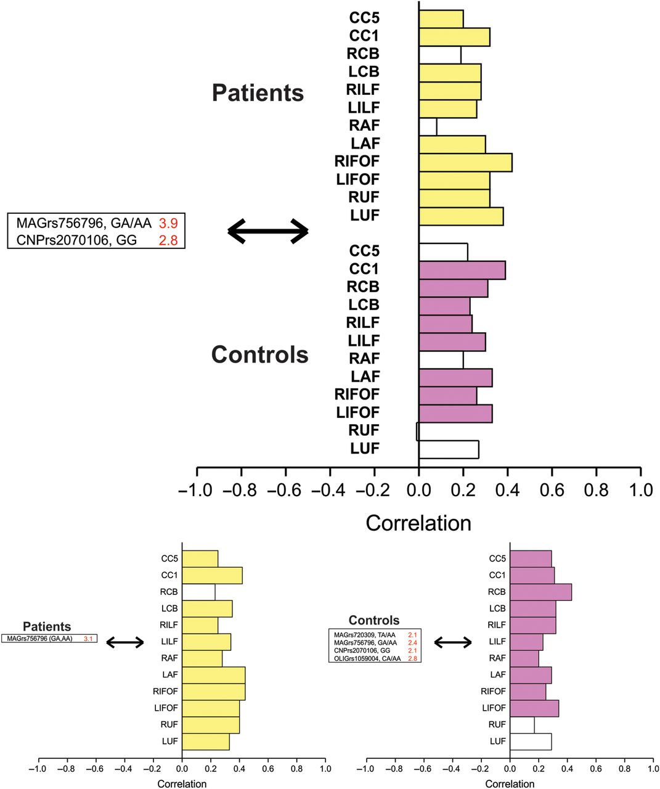
Figure 2. Gene variants covarying with white matter tract integrity. Upper panel: Patients with schizophrenia and ...
Notes:
Figure 2. Gene variants covarying with white matter tract integrity. Upper panel: Patients with schizophrenia and healthy controls analyzed together demonstrating a significant LV of gene variants that reliably predict white matter tract integrity (i.e., SE to salience ratio >2.0). White matter tract integrity reliably correlated as part of this significant LV is strongly colored (schizophrenia: Upper stack, yellow; healthy controls: Lower stack, purple): SV = 1.6, CC = 44%, P 2.0). White matter tract integrity reliably correlated with genetic predictors is strongly colored. In patients (yellow), the MAG rs756796 SNP predicted integrity of all white matter tracts examined, except for right CB: SV = 1.4, CC = 64%, P = 0.03, while in healthy controls (purple), MAG, CNP, and OLIG2 SNPs predicted integrity at all white matter tracts except left and right UF: SV = 1.3, CC = 67%, P = 0.01.
Unless provided in the caption above, the following copyright applies to the content of this slide: © The Author 2012. Published by Oxford University Press. All rights reserved. For Permissions, please e-mail: journals.permissions@oup.com

Slide 2
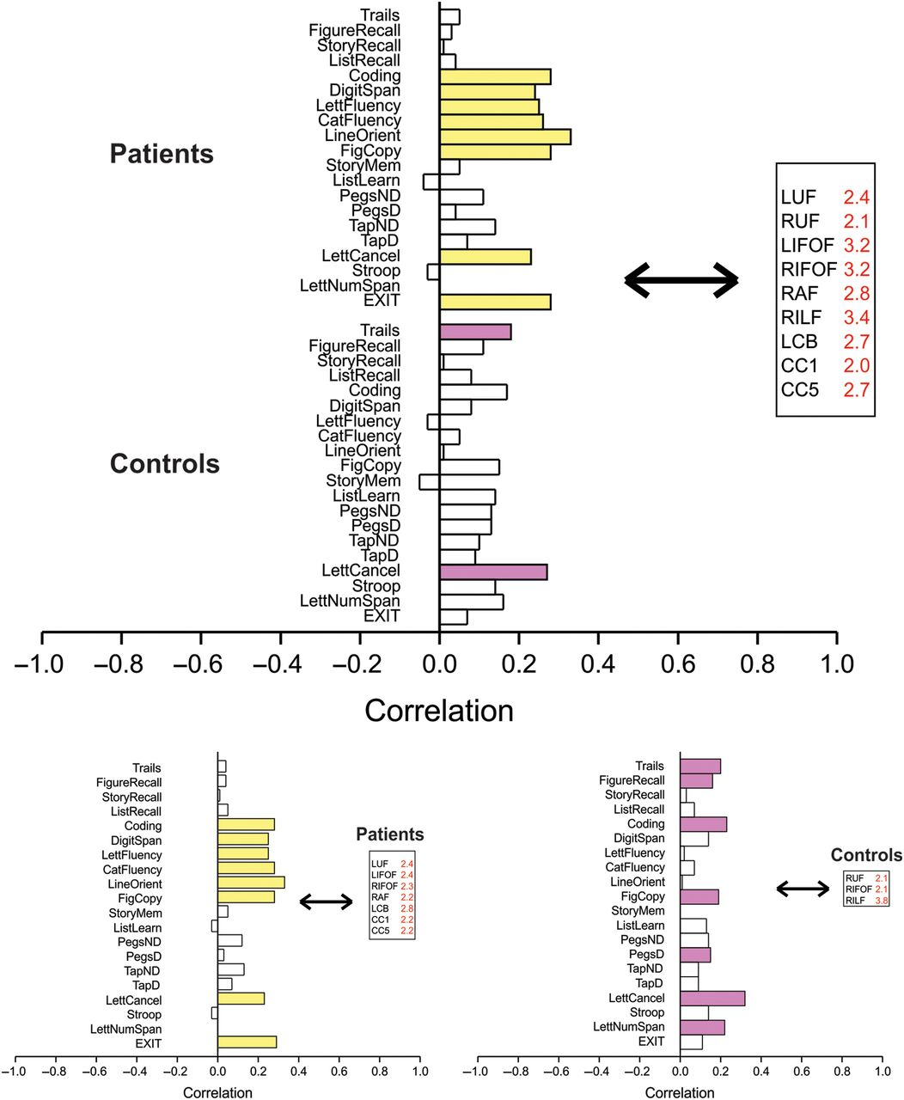
Figure 1. White matter tract integrity covarying with cognitive performance. Upper panel: Patients with schizophrenia ...
Notes:
Figure 1. White matter tract integrity covarying with cognitive performance. Upper panel: Patients with schizophrenia and healthy controls analyzed together. A significant LV was found with SV = 2.3, cross-block covariance (cc) = 56.4%, P 2.0). Cognitive measures reliably correlated with predictors are strongly colored (patients: Upper stack, yellow; controls: Lower stack, purple). This LV was driven by the relationship of white matter tract integrity of left (L) and right (R) UF, IFOF, right AF, right ILF, left CB, and genu (CC1) and splenium (CC5) of the corpus callosum on coding and digit span, letter fluency and category fluency, line orientation and figure copy, letter cancellation task, and the executive interview in schizophrenia patients, and trails ratio score and letter cancellation task performance in controls. Lower panels: Patients (left panel) and controls (right panel) are analyzed separately. Significant LVs were found in both patients and controls. Predictors are those white matter tracts whose integrity reliably predicts cognitive performance (i.e., SE to salience ratio of >2.0). Cognitive measures reliably correlated with predictors are colored. In patients (yellow), FA of left uncinate, left and right inferior occipitofrontal, right arcuate, left cingulum, and genu and splenium of the corpus callosum reliably predicted performance on coding, digit span, letter and category fluency, line orientation and figure copy, letter cancellation task, and executive interview: SV = 2.0, CC = 67%, P < 0.001. In controls (purple), FA of right uncinate, right inferior occipitofrontal, and right ILF reliably predicted performance on the trails tests, figure recall, coding, figure copy, grooved pegboard, letter cancellation, and letter number sequence tasks: SV = 1.4, CC = 52%, P = 0.02.
Unless provided in the caption above, the following copyright applies to the content of this slide: © The Author 2012. Published by Oxford University Press. All rights reserved. For Permissions, please e-mail: journals.permissions@oup.com

Slide 3
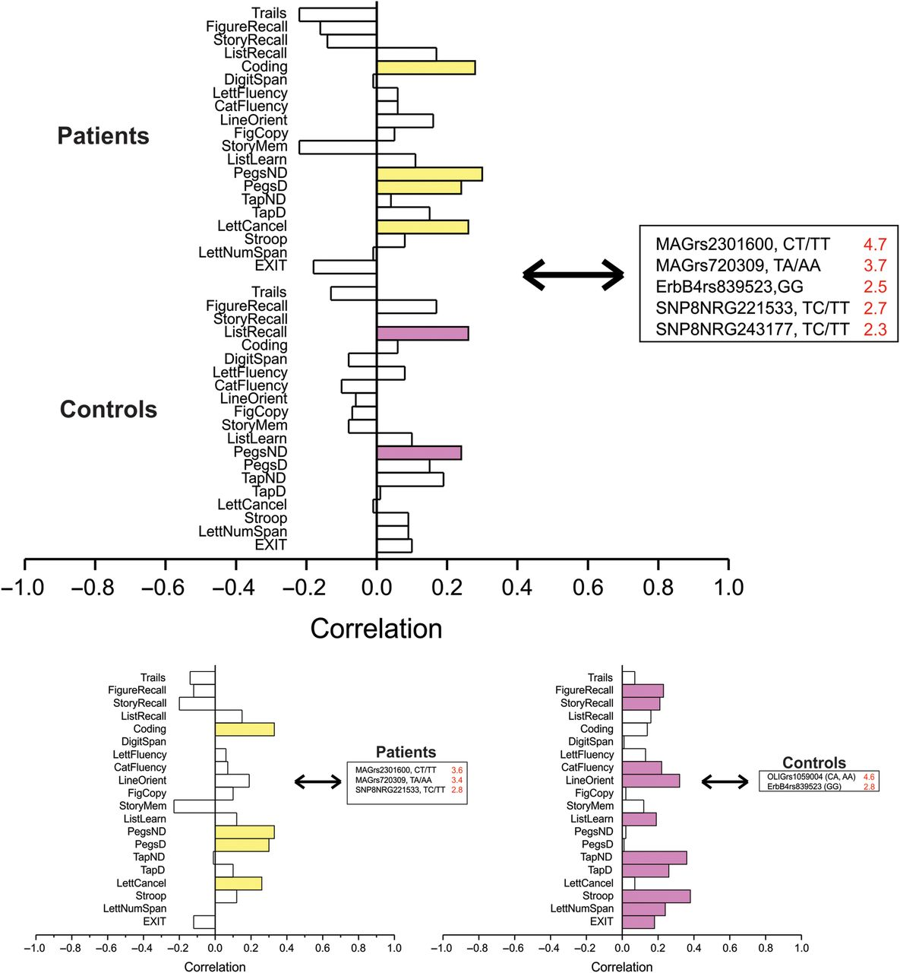
Figure 3. Gene variants covarying with cognitive performance. Upper panel: Patients with schizophrenia and healthy ...
Notes:
Figure 3. Gene variants covarying with cognitive performance. Upper panel: Patients with schizophrenia and healthy controls analyzed together. A significant LV was found where gene variants reliably predict cognitive task performance (i.e., SE to salience ratio >2.0) (patients: Upper stack, yellow; healthy controls: Lower stack, purple). Cognitive tasks reliably correlated with genetic predictors are strongly colored: SV = 1.3, CC = 25%, P = 0.02. Here, the pattern was driven by the relationship of MAG, NRG1, and ErbB4 SNPs reliably predicting performance on the coding, grooved pegboard, and letter cancellation tasks in patients, and list recall and grooved pegboard in controls. Lower panels: Patients (left) and controls (right) analyzed separately. Significant LV were found in each group patients, where gene variants reliably predict cognitive task performance (i.e., SE to salience ratio >2.0). Cognitive tasks reliably correlated with genetic predictors are strongly colored. In schizophrenia patients (yellow), MAG and NRG1 SNPs reliably predicted performance on the coding, grooved pegboard, and letter cancellation tasks: SV = 1.1, CC = 32%, P = 0.01. In healthy individuals, OLIG2 and ErbB4 SNPs reliably predicted performance on memory, language, visuospatial ability, visuomotor speed, working memory, and executive function: SV = 1.0, CC = 36%, P = 0.05.
Unless provided in the caption above, the following copyright applies to the content of this slide: © The Author 2012. Published by Oxford University Press. All rights reserved. For Permissions, please e-mail: journals.permissions@oup.com

Slide 4
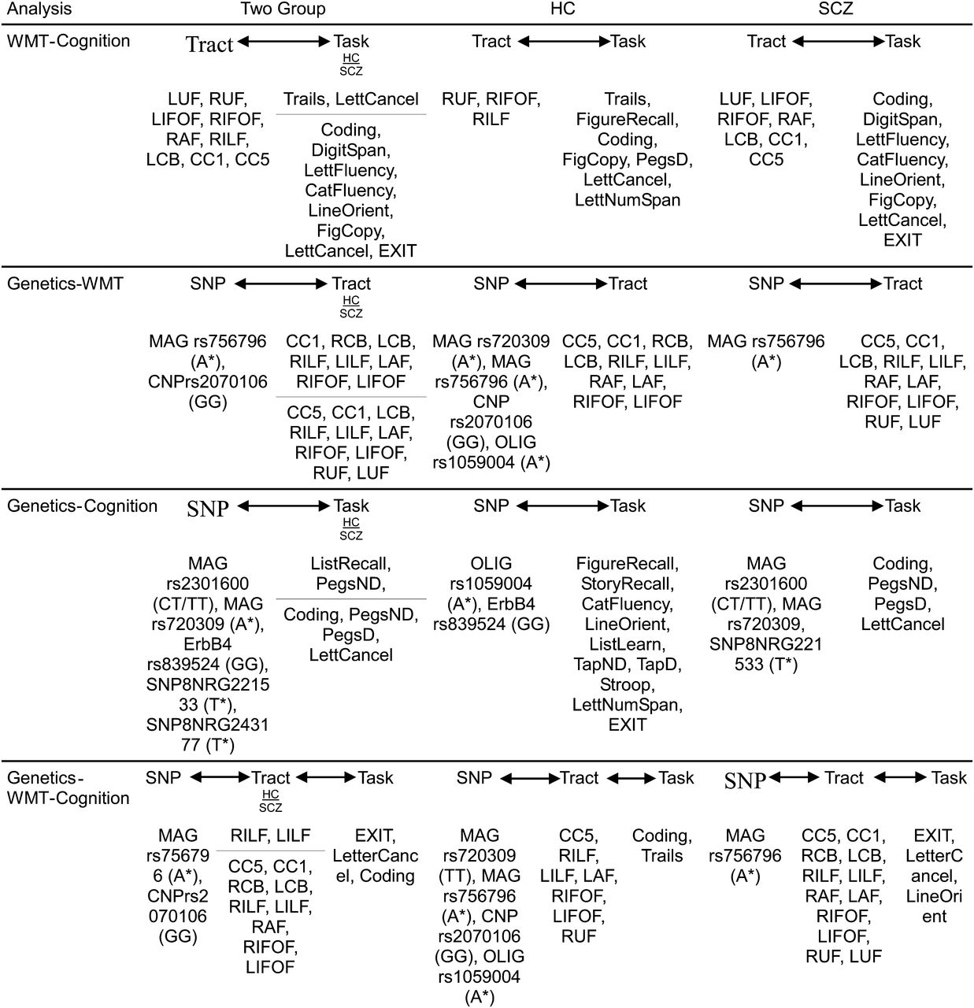
Figure 5. Summary of significant correlations from PLS analysis. HC, healthy controls; SCZ, schizophrenic patients; ...
Notes:
Figure 5. Summary of significant correlations from PLS analysis. HC, healthy controls; SCZ, schizophrenic patients; WMT, white matter tracts; SNP, single-nucleotide polymorphism; LUF/RUF, left/right uncinate fasciculus; LIFOF/RIFOF, left/right inferior fronto-occipital fasciculus; LAF/RAF, left/right arcuate fasciculus; LILF/RILF, left/right inferior longitudinal fasciculus; LCB/RCB, left/right cingulum bundle; CC1, genu of corpus callosum; CC5, splenium of corpus callosum. *Allele carrier (either homozygote or heterozygote).
Unless provided in the caption above, the following copyright applies to the content of this slide: © The Author 2012. Published by Oxford University Press. All rights reserved. For Permissions, please e-mail: journals.permissions@oup.com

Slide 5
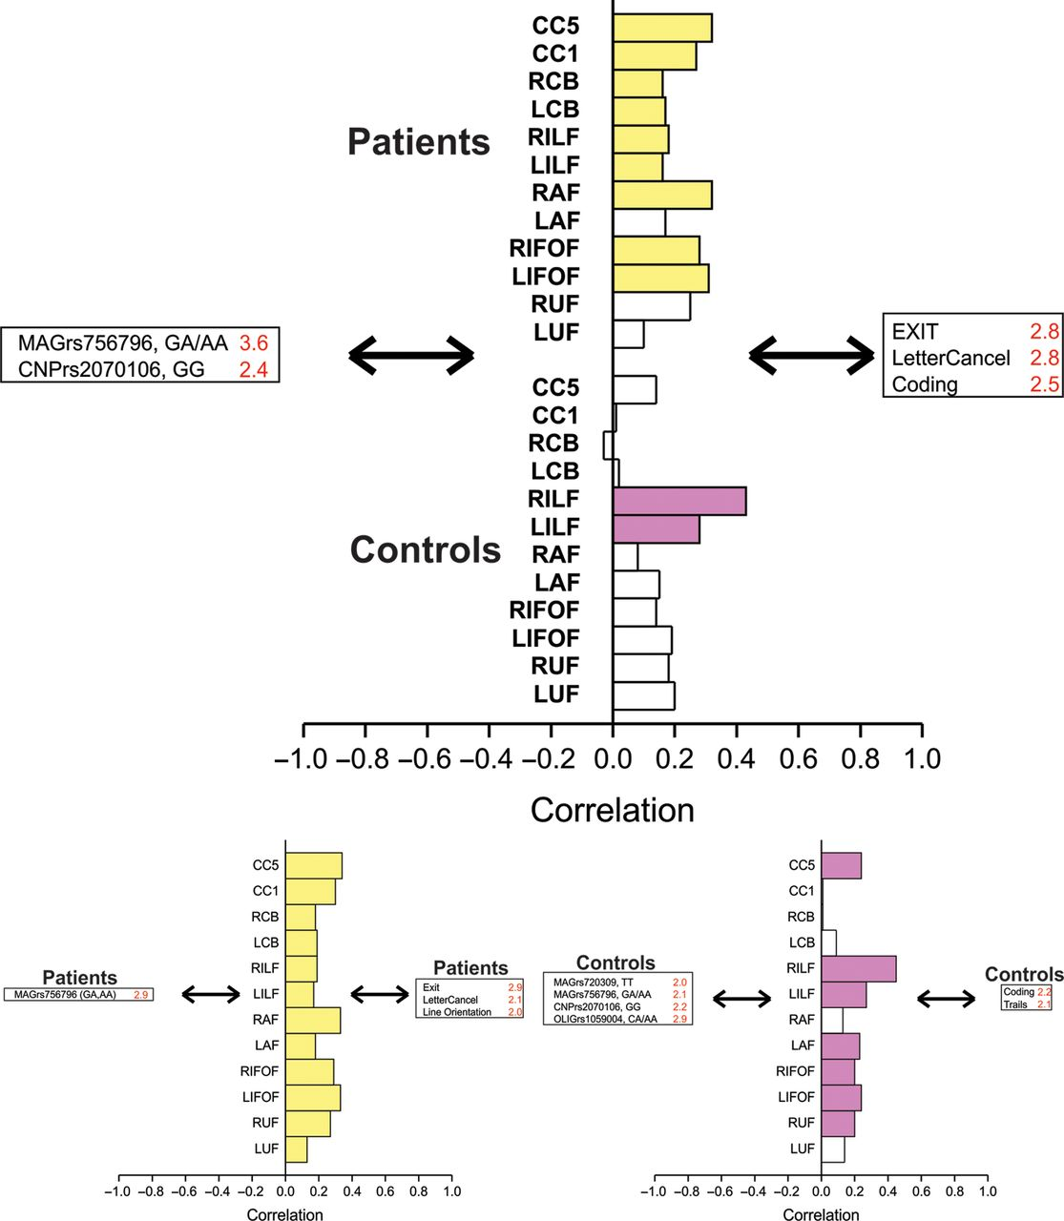
Figure 4. Integrity of white matter tracts mediating relationships between gene variants and cognitive performance. ...
Notes:
Figure 4. Integrity of white matter tracts mediating relationships between gene variants and cognitive performance. Upper panel: Schizophrenia patients and healthy controls analyzed together. A significant LV was found where microstructural integrity of white matter tracts reliably mediate relationships between gene variants and cognitive task performance (i.e., SE to salience ratio of >2.0). Gene variants, white matter tracts, and cognitive tasks reliably correlated (95% confidence interval) are strongly colored: SV = 2.6, CC = 43%, P < 0.001. Here, nearly all white matter tracts in schizophrenia patients: Upper stack, yellow, and right and left ILF in healthy controls: Lower stack, purple, mediated the relationship of MAG and CNP SNPs with cognitive performance on coding, letter cancellation task, and the executive interview. Lower panels: Schizophrenia patients and healthy controls analyzed separately. A significant LV was found in schizophrenia patients (yellow), where microstructural integrity of all white matter tracts mediated the relationships between the MAG rs756796 SNP with performance on visuospatial and visuomotor speed tasks, and executive function: SV = 2.3, CC = 63%, P = 0.05. In healthy controls, bilateral ILF and IFOF, left AF and UF, and splenium of CC mediated effects of MAG, CNP, and OLIG2 SNPs on coding and trials BA ratio scores: SV = 2.0, CC = 53%, P = 0.02.
Unless provided in the caption above, the following copyright applies to the content of this slide: © The Author 2012. Published by Oxford University Press. All rights reserved. For Permissions, please e-mail: journals.permissions@oup.com

