Slide 1
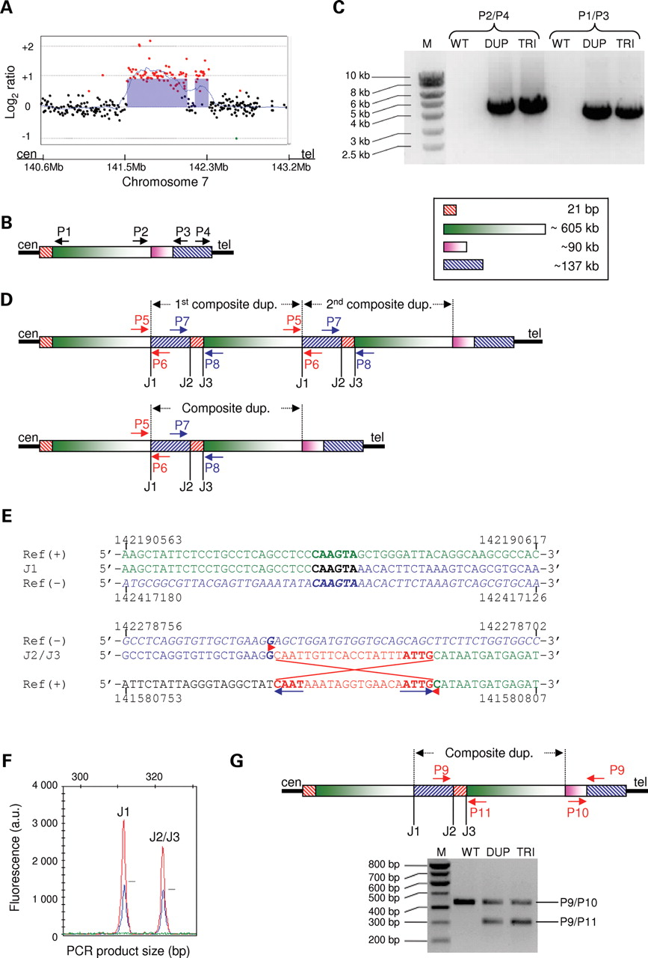
Figure 1. Characterization of the trypsinogen locus triplication. ( A ) The two large triplications as revealed by ...
Notes:
Figure 1. Characterization of the trypsinogen locus triplication. ( A ) The two large triplications as revealed by array-CGH. Red data points indicate copy number gains whilst black data points indicate no copy-number change. The left hand blue block corresponds to the previously described ∼605 kb triplication ( 19 ) whereas the right hand blue block denotes the location of the newly identified ∼137 kb triplication. The two segments are separated by ∼90 kb on chromosome 7q34. ( B ) Relative positions of the four outward-facing primers (P1, P2, P3 and P4; see Table 2 for primer sequences) used for cloning the aberrant junctions by long-range PCR, in the context of the wild-type chromosome at 7q34 with the ∼605, ∼90 and ∼137 kb segments. ( C ) Electrophoretic separation of the P2/P4- and P1/P3-mediated long-range PCR products. M, DNA marker; WT, normal control; DUP, duplication carrier; TRI, triplication carrier. ( D ) Schema of the complex triplication (top panel) and duplication (lower panel) alleles (not drawn to scale). Primers (i.e. P5, P6, P7 and P8; see Table 3 for primer sequences) used for quantifying the number of aberrant junctions (i.e. J1, J2 and J3) are indicated. ( E ) Alignment of the sequenced junctions of the rearrangement and reference (wild-type) genomic sequences. Ref (+), plus strand of the reference sequence. Ref (−), minus strand of the reference sequence. A 6 bp microhomology (CAAGTA) is present at J1. The inverted repeats, putatively involved in the formation of J2 and J3, are indicated by coloured arrows. The extent of the 21 bp inversion is indicated by crossed red lines. The sequence has also been colour coded. ( F ) QFM-PCR analysis of the aberrant junctions in a triplication carrier [i.e. III.2 in pedigree C ( 19 ); red], a duplication carrier [i.e. patient 2193 (26); blue] and a control (green). The relative peak heights of the J1 and J2/J3 amplicons indicate the relative copy numbers of the respective junctions in the duplication (one copy) and triplication (two copies) carriers as well as in the healthy control (zero copies). ( G ) Rapid detection of the duplication and triplication mutations by conventional PCR. Top panel illustrates the relative positions of the two primer pairs (i.e. P9 /P10 and P9/P11; see Table 4 for primer sequences) whereas the lower panel shows the electrophoretic separation of the P9/P10- and P9/P11-mediated PCR products. M, DNA marker; WT, normal control; DUP, duplication carrier; TRI, triplication carrier.
Unless provided in the caption above, the following copyright applies to the content of this slide: © The Author 2009. Published by Oxford University Press. All rights reserved. For Permissions, please email: journals.permissions@oxfordjournals.org

Slide 2
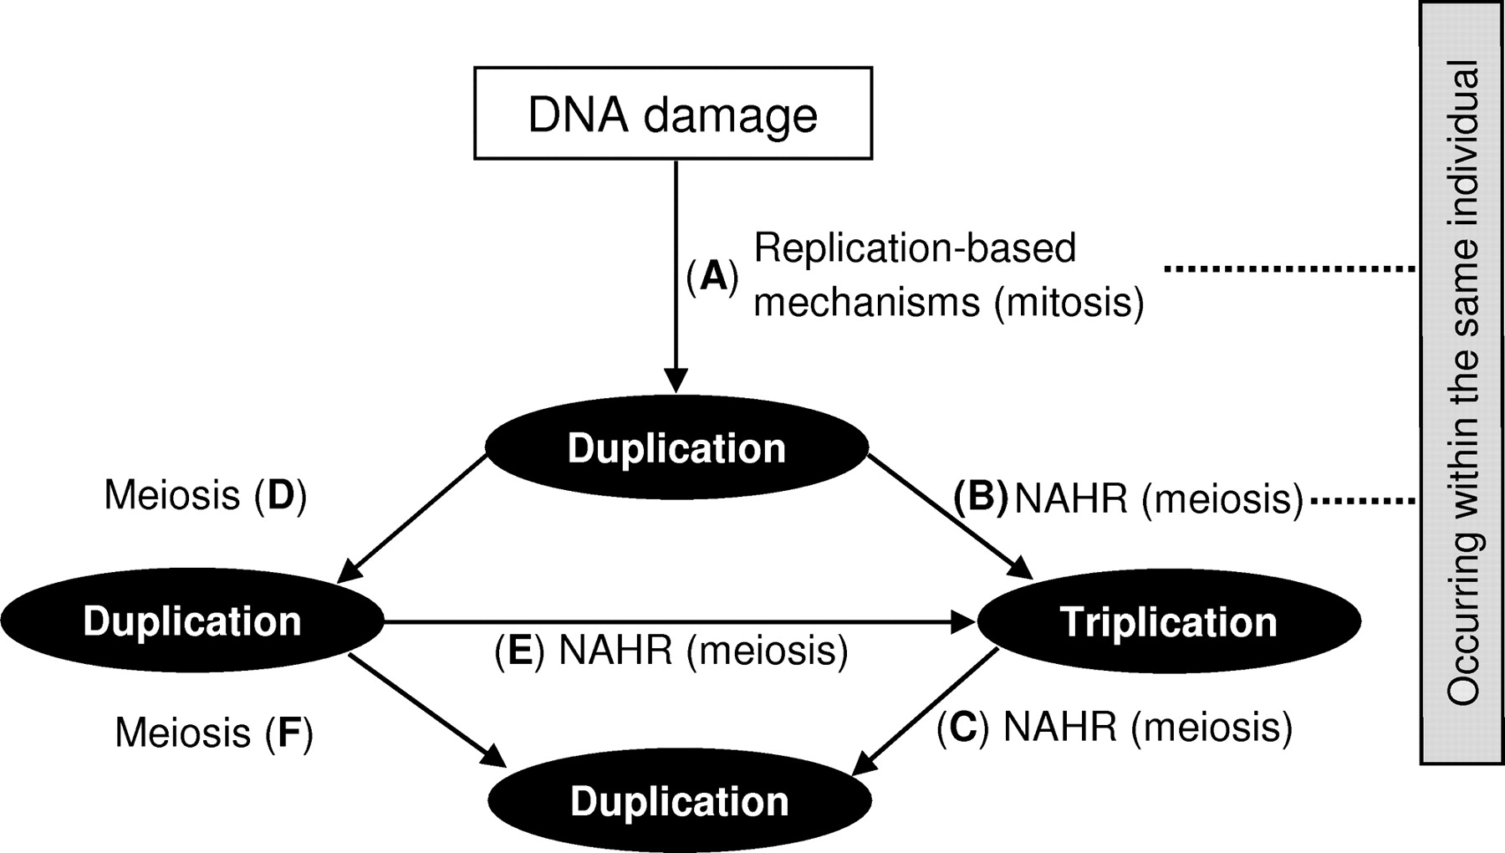
Figure 3. Potential scenarios for how the clinically observed duplication and triplication rearrangements could have ...
Notes:
Figure 3. Potential scenarios for how the clinically observed duplication and triplication rearrangements could have been generated. A - B - C indicates the possibility that the initial duplication and subsequent triplication were generated in the same individual; and the clinically observed duplications were then generated from the triplicated allele(s). A - D indicates the other possibility, namely the initially generated duplication was not converted to a triplication in the same individual, which may have led to two further alternative scenarios (i.e. D - E - C versus D - F ). See text for details.
Unless provided in the caption above, the following copyright applies to the content of this slide: © The Author 2009. Published by Oxford University Press. All rights reserved. For Permissions, please email: journals.permissions@oxfordjournals.org

Slide 3
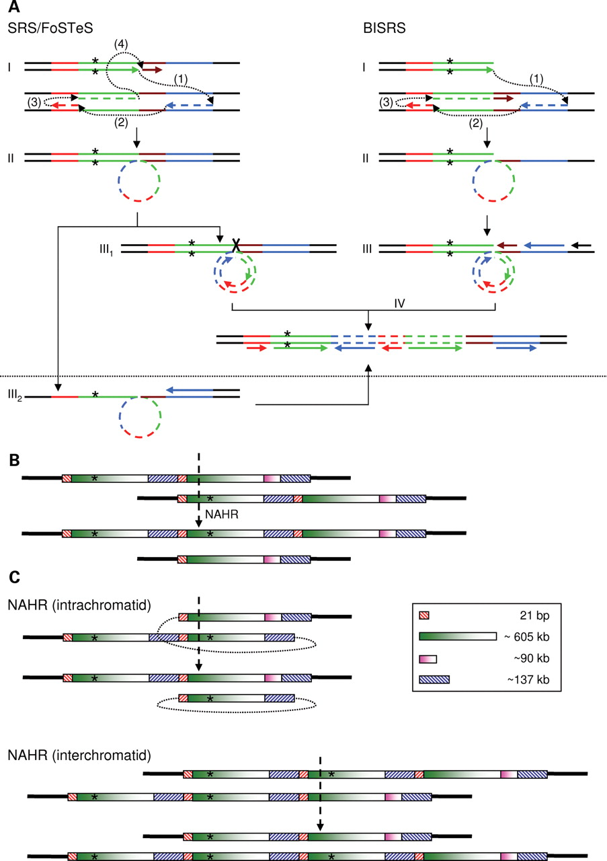
Figure 2. Mechanisms underlying the generation of the trypsinogen locus duplication and triplication. ( A ) Two ...
Notes:
Figure 2. Mechanisms underlying the generation of the trypsinogen locus duplication and triplication. ( A ) Two possible replication-based mechanisms, SRS/FoSTeS and BISRS, underlying the generation of the first composite duplication. In both models, the direction of replication of the nascent primer strand (5′ > 3′) is indicated by horizontal arrows (I). The different steps of replication slippage are numbered sequentially (I). The newly synthesized duplicated sequence is indicated by coloured dotted lines. The use of colour is consistent with the scheme as used in Figure 1 . In IV, the orientation of the duplicated sequences, with respect to the wild-type, is indicated by colour coded horizontal lines. The rare 163 allele of the microsatellite marker, rs3222967, is indicated by a star. See text for details as to how the second mutant strand could have been generated. ( B ) Schema of how the second composite duplication block could have been generated by NAHR giving rise to the complex triplication allele. Both the triplication allele and its alterative product (i.e. the predicted and inherently unobservable normal allele) of NAHR are shown. The composite first duplication block was presumed to have been generated from one of the scenarios described in A. ( C ) The clinically observed complex duplications could have been derived from the triplication allele through either intrachromatid or interchromatid NAHR. The alternative products of these events are also shown. The dotted lines are used only for illustration purposes and hence do not represent actual sequence.
Unless provided in the caption above, the following copyright applies to the content of this slide: © The Author 2009. Published by Oxford University Press. All rights reserved. For Permissions, please email: journals.permissions@oxfordjournals.org

