Slide 1
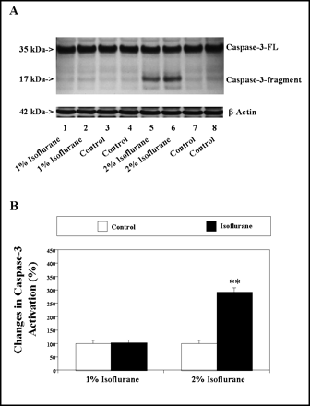
Figure 1. Two percent isoflurane induced caspase-3 activation in H4-APP-FL cells. A, A 6-hour 2% isoflurane treatment ...
Notes:
Figure 1. Two percent isoflurane induced caspase-3 activation in H4-APP-FL cells. A, A 6-hour 2% isoflurane treatment (Lanes 5 and 6) induced caspase-3 cleavage (activation) compared with control conditions (Lanes 7 and 8), but a 6-hour 1% isoflurane treatment (Lanes 1 and 2) did not induce caspase-3 activation compared with control conditions (Lanes 3 and 4), in H4-APP-FL cells. B, Quantitation of the Western blot showed that the 2% isoflurane (black bar, right panel), but not 1% isoflurane (black bar, left panel), increased caspase-3 activation compared with control conditions (white bars)
Unless provided in the caption above, the following copyright applies to the content of this slide: The Gerontological Society of America

Slide 2
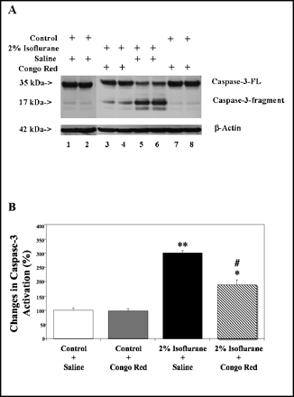
Figure 2. Congo red (CR) inhibited caspase-3 activation induced by 2% isoflurane in H4-APP-FL cells. A, Two percent ...
Notes:
Figure 2. Congo red (CR) inhibited caspase-3 activation induced by 2% isoflurane in H4-APP-FL cells. A, Two percent isoflurane plus saline treatment (Lanes 5 and 6), but not the control conditions plus CR treatment (Lanes 7 and 8), caused caspase-3 activation compared with control conditions plus saline treatment (Lanes 1 and 2). The 2% isoflurane plus CR treatment (Lanes 3 and 4) caused less caspase-3 activation than did 2% isoflurane plus saline treatment (Lanes 5 and 6). B, Quantitation of the Western blots showed that 2% isoflurane plus saline treatment (black bar) induced caspase-3 activation as compared to the treatment with either control conditions plus saline (white bar) or control conditions plus CR (gray bar). Two percent isoflurane plus CR treatment (hatched bar) induced less caspase-3 activation as compared to that induced by the treatment of 2% isoflurane plus saline (black bar). * = p < 0.05; ** = p < 0.01, the difference between isoflurane treatment and control condition; # = p < 0.05, the difference between Congo red treatment and saline treatment
Unless provided in the caption above, the following copyright applies to the content of this slide: The Gerontological Society of America

Slide 3
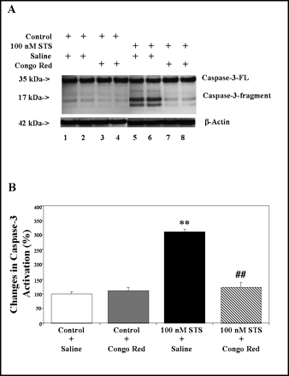
Figure 3. Congo red (CR) inhibited caspase-3 activation induced by 100 nM staurosporine (STS) in H4-APP-FL cells. A, ...
Notes:
Figure 3. Congo red (CR) inhibited caspase-3 activation induced by 100 nM staurosporine (STS) in H4-APP-FL cells. A, STS plus saline treatment (Lanes 5 and 6) caused caspase-3 activation as compared to control conditions plus saline treatment (Lanes 1 and 2) or control conditions plus CR treatment (Lanes 3 and 4). STS plus CR treatment (Lanes 7 and 8), however, did not cause caspase-3 activation as compared to control conditions plus saline treatment (Lanes 1 and 2) or control conditions plus CR treatment (Lanes 3 and 4). B, Quantitation of the Western blots showed that STS plus saline treatment (black bar), but not STS plus CR treatment (hatched bar), induced caspase-3 activation as compared to the treatment with either control conditions plus saline (white bar) or control conditions plus CR (gray bar), normalized to β-actin levels in H4-APP-FL cells. ** = p < 0.01, the difference between isoflurane treatment and control condition; ## = p < 0.01, the difference between Congo red treatment and saline treatment
Unless provided in the caption above, the following copyright applies to the content of this slide: The Gerontological Society of America

