Slide 1
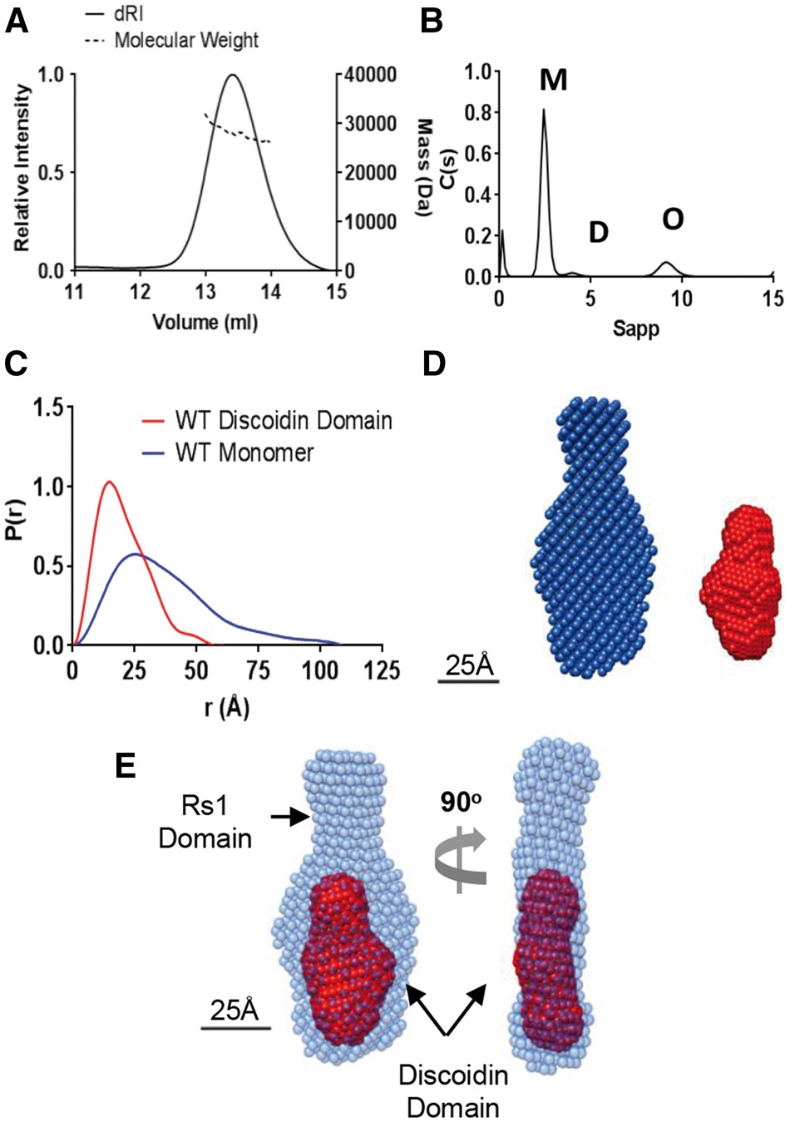
Figure 1. Structure of the retinoschisin monomer. (A) SEC-MALS analysis of wild-type retinoschisin monomer shows a ...
Notes:
Figure 1. Structure of the retinoschisin monomer. (A) SEC-MALS analysis of wild-type retinoschisin monomer shows a molecular weight of approximately 27 kDa. (B) AUC analysis of monomeric (M) retinoschisin indicates an S20,w 2.6S, Rh 2.4 nm and an f/f0 1.21, dimeric (D) and octameric (O) species are marked. (C) Overlayed pair distribution profiles from SAXS data for the retinoschisin monomer and discoidin domain with Dmax of 10.8 nm and 5.5 nm for the monomer and isolated discoidin domain, respectively. (D) DAMMIF volumetric bead modelling of the retinoschisin monomer (blue) and the discoidin domain (red) modelled ab initio from the SAXS data. (E) Comparison of the retinoschisin monomer and discoidin domain revealing the relative positions of the two domains.
Unless provided in the caption above, the following copyright applies to the content of this slide: © The Author 2016. Published by Oxford University Press.This is an Open Access article distributed under the terms of the Creative Commons Attribution License (http://creativecommons.org/licenses/by/4.0/), which permits unrestricted reuse, distribution, and reproduction in any medium, provided the original work is properly cited.

Slide 2
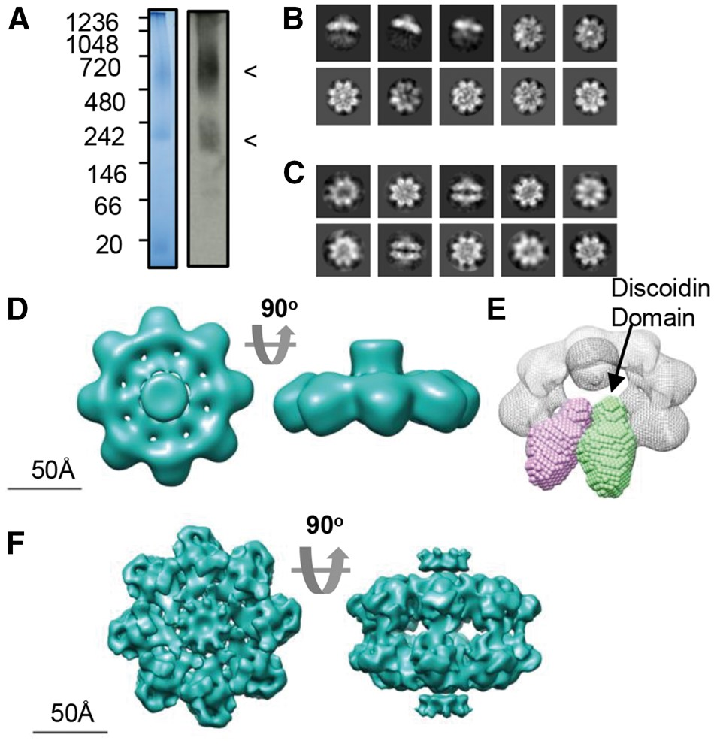
Figure 2. Cryo-TEM analysis of wild-type retinoschisin. (A) Blue-native PAGE and native-blot analysis of retinoschisin. ...
Notes:
Figure 2. Cryo-TEM analysis of wild-type retinoschisin. (A) Blue-native PAGE and native-blot analysis of retinoschisin. Marked are two distinct bands for the octamer and dimer of octamer complexes. (B) Reference-free class averages of the octamer and (C) dimer of octamers formed in solution. Box size = 24 nm. (D) Map of the C8 symmetrical octamer complex at 13.6Å resolution. (E) Comparison of the SAXS discoidin domain model to the assembled octamer, the positions of the discoidin domains are shown. (F) Map of the retinoschisin dimer of octamers at 9.3Å resolution.
Unless provided in the caption above, the following copyright applies to the content of this slide: © The Author 2016. Published by Oxford University Press.This is an Open Access article distributed under the terms of the Creative Commons Attribution License (http://creativecommons.org/licenses/by/4.0/), which permits unrestricted reuse, distribution, and reproduction in any medium, provided the original work is properly cited.

Slide 3
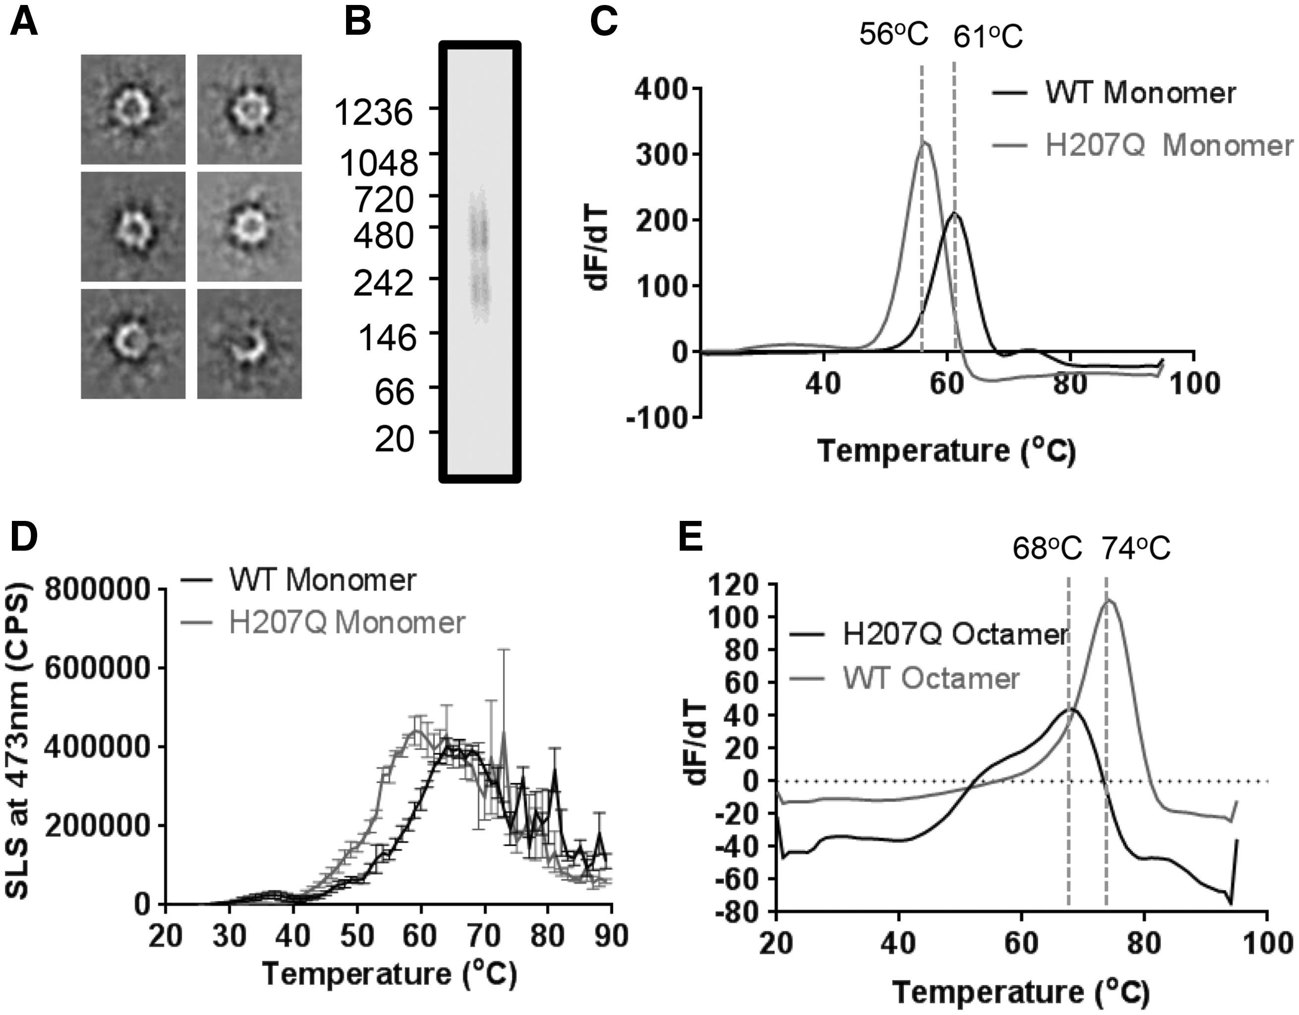
Figure 3. Destabilising effect of the H207Q mutation. (A) Reference-free class averages of H207Q octamers under ...
Notes:
Figure 3. Destabilising effect of the H207Q mutation. (A) Reference-free class averages of H207Q octamers under negative-stain conditions. Box size = 35 nm. (B) Native-PAGE analysis of H207Q shows two species representing the octamer and dimer of octamers. (C) Differential scanning fluorimetry Tm comparison of wild-type and H207Q monomers (n = 5). (D) Static Light Scattering analysis of wild-type and H207Q monomeric protein during a temperature ramp experiment (n = 3) showing Tagg (WT) of 46.2°C and Tagg (H207Q) of 43.5°C. (E) Differential scanning fluorimetry Tmcomparison of wild-type and H207Q octamers (n = 5).
Unless provided in the caption above, the following copyright applies to the content of this slide: © The Author 2016. Published by Oxford University Press.This is an Open Access article distributed under the terms of the Creative Commons Attribution License (http://creativecommons.org/licenses/by/4.0/), which permits unrestricted reuse, distribution, and reproduction in any medium, provided the original work is properly cited.

Slide 4
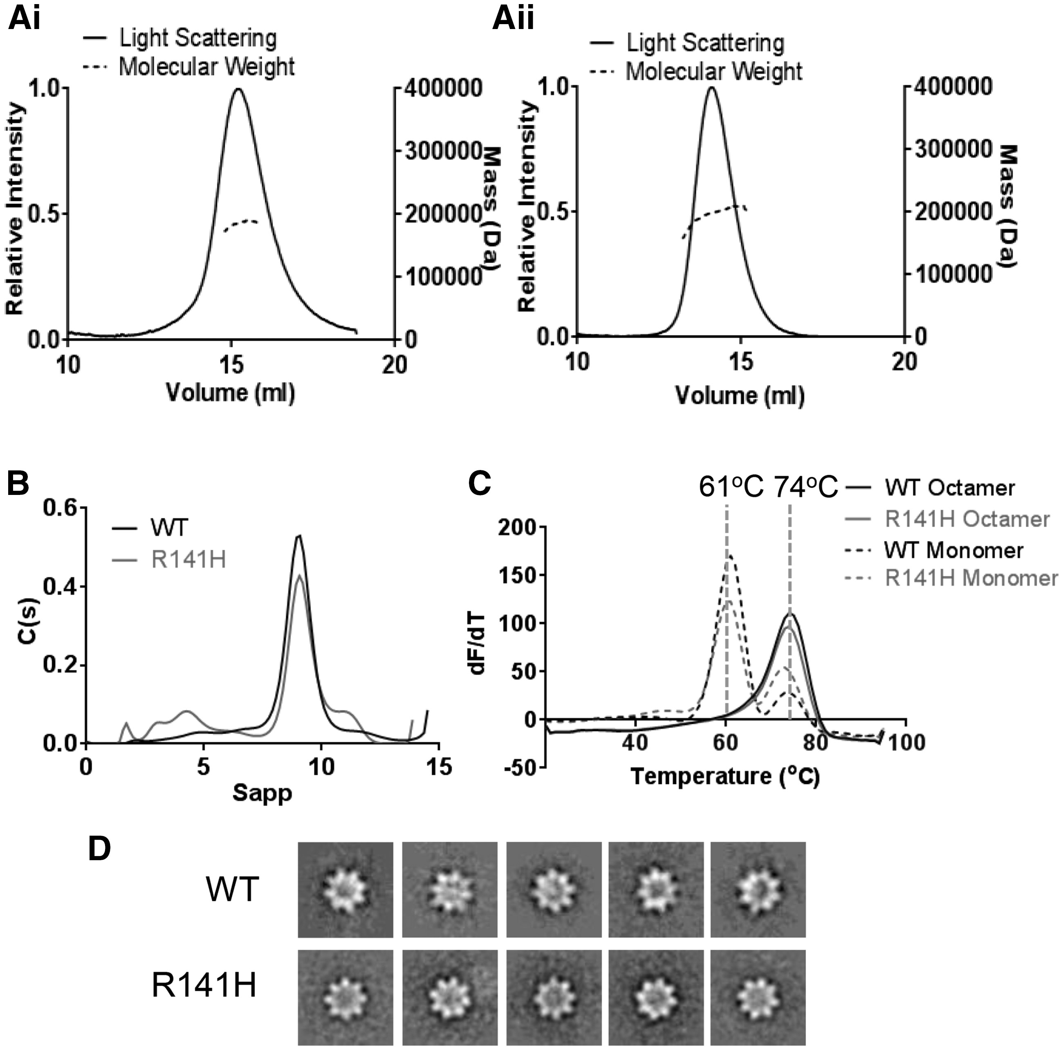
Figure 4. Biophysical comparison of wild-type and R141H retinoschisin. (A) SEC-MALS analysis of the wild-type (i) and ...
Notes:
Figure 4. Biophysical comparison of wild-type and R141H retinoschisin. (A) SEC-MALS analysis of the wild-type (i) and R141H (ii) octamer. (B) Overlayed sedimentation velocity profiles of wild-type and R141H octamer, both with similar S20,w (9.38S and 9.79S, respectively), Rh (5.1nm and 5.0 nm, respectively) and f/f0 (1.33 and 1.29 respectively) values. (C) Overlayed differential scanning fluorimetry analysis of wild-type and R141H monomers and octamers showing identical Tm for both species (n = 5). (D) Negatively stained reference-free class averages of wild-type and R141H retinoschisin octamers, box size: 33 nm.
Unless provided in the caption above, the following copyright applies to the content of this slide: © The Author 2016. Published by Oxford University Press.This is an Open Access article distributed under the terms of the Creative Commons Attribution License (http://creativecommons.org/licenses/by/4.0/), which permits unrestricted reuse, distribution, and reproduction in any medium, provided the original work is properly cited.

Slide 5
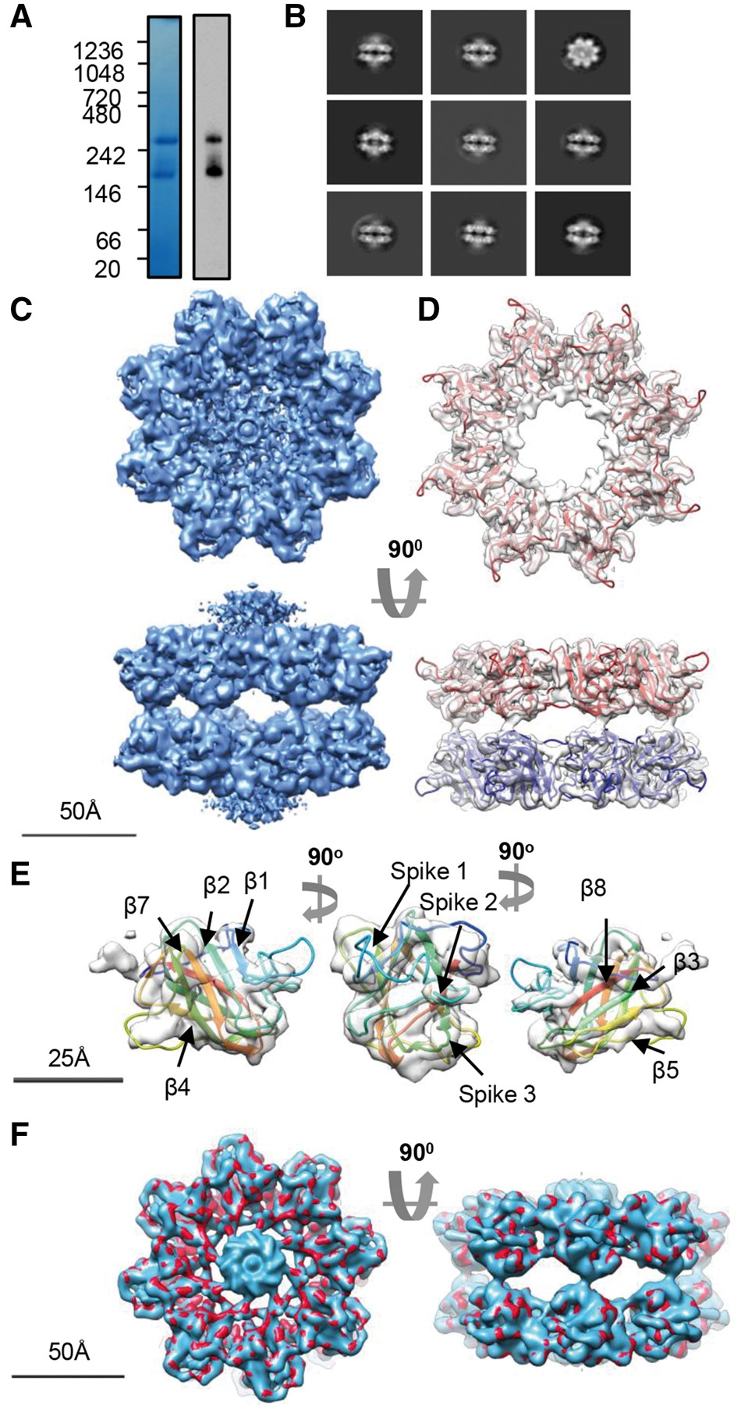
Figure 5. Cryo-EM analysis of the R141H dimer of octamers. (A) Blue-native PAGE and native-blot analysis of R141H ...
Notes:
Figure 5. Cryo-EM analysis of the R141H dimer of octamers. (A) Blue-native PAGE and native-blot analysis of R141H retinoschisin. (B) Reference-free class averages of R141H dimer of octamers. Box size = 33 nm (C) Three-dimensional reconstruction at 4.2Å resolution of the R141H dimer of octamers. Shown is the unmasked map. (D) Fitting of the R141H discoidin domain model (residues 63-219) shown in red, with associated subunits in the opposing octamer shown in blue. The central density of Rs1 domains has been removed for clarity. (E) Fit into single subunit showing the fitting of the β-sheets and positions of the spike regions. (F) Comparison between wild-type hexadecamer (blue, emd_6425) and R141H retinoschisin (red) structures at 5Å resolution.
Unless provided in the caption above, the following copyright applies to the content of this slide: © The Author 2016. Published by Oxford University Press.This is an Open Access article distributed under the terms of the Creative Commons Attribution License (http://creativecommons.org/licenses/by/4.0/), which permits unrestricted reuse, distribution, and reproduction in any medium, provided the original work is properly cited.

Slide 6
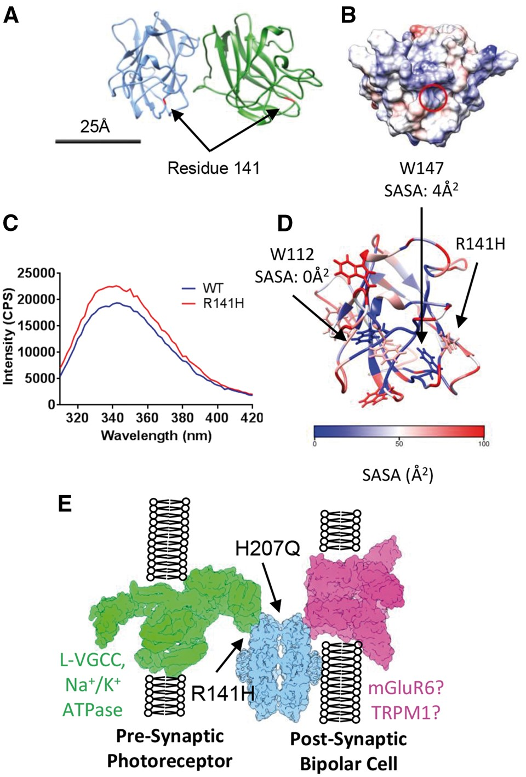
Figure 6. Mapping XLRS-causative conservative mutations onto the quasi-atomic model. (A) The position of residue R141 ...
Notes:
Figure 6. Mapping XLRS-causative conservative mutations onto the quasi-atomic model. (A) The position of residue R141 within the octamer is highlighted in red. (B) Electrostatic surface potential of the face of the discoidin domain containing residue R141 (circled) with overall positive charge. Scale bar for (A) and (B) = 25 nm. (C) Intrinsic fluorescence comparison of wild-type and R141H retinoschisin monomer. The R141H mutant has reduced fluorescence quenching suggesting increased solvent exposure of tryptophans. Shown is the emission spectrum after excitation at 295nm (n = 3). (D) Solvent accessible surface area (SASA) analysis of the tryptophans in the retinoschisin discoidin domain. W147 and W112 are buried and close to the R141H mutation site. (E) The paired octamer model for retinoschisin structural support between photoreceptor and bipolar cell synaptic membranes, with the sites affected by R141H and H207Q mutations labelled.
Unless provided in the caption above, the following copyright applies to the content of this slide: © The Author 2016. Published by Oxford University Press.This is an Open Access article distributed under the terms of the Creative Commons Attribution License (http://creativecommons.org/licenses/by/4.0/), which permits unrestricted reuse, distribution, and reproduction in any medium, provided the original work is properly cited.

