Slide 1
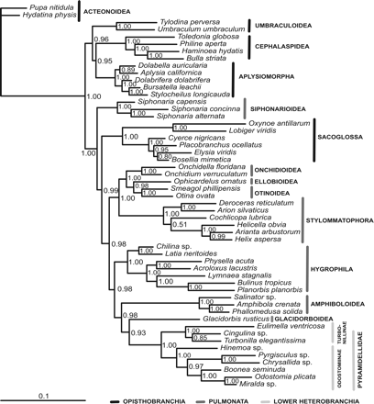
Figure 1. Bayesian inference phylogram (50% majority-rule consensus tree) based on the concatenated sequences of 18S ...
Notes:
Figure 1. Bayesian inference phylogram (50% majority-rule consensus tree) based on the concatenated sequences of 18S rRNA, 28S rRNA, 16S rRNA and COI (without third-codon positions); support values are PP.
Unless provided in the caption above, the following copyright applies to the content of this slide: © The Author 2010. Published by Oxford University Press on behalf of The Malacological Society of London, all rights reserved

