Slide 1
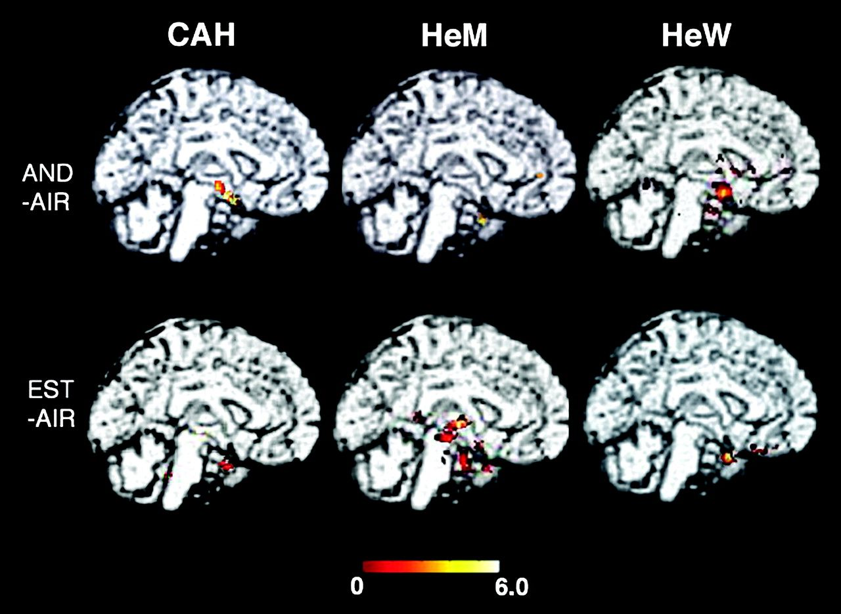
Figure 1. Illustration of group-specific activations with putative pheromones and odors. The Sokoloff's color scale ...
Notes:
Figure 1. Illustration of group-specific activations with putative pheromones and odors. The Sokoloff's color scale illustrates Z values reflecting the degree of activation. As the same brain section is chosen, the figures do not always illustrate maximal activation for each condition. Clusters of activated regions are superimposed on the standard brain MRI, midsagittal plane.
Unless provided in the caption above, the following copyright applies to the content of this slide: © The Author 2008. Published by Oxford University Press. All rights reserved. For permissions, please e-mail: journals.permissions@oxfordjournals.org

Slide 2
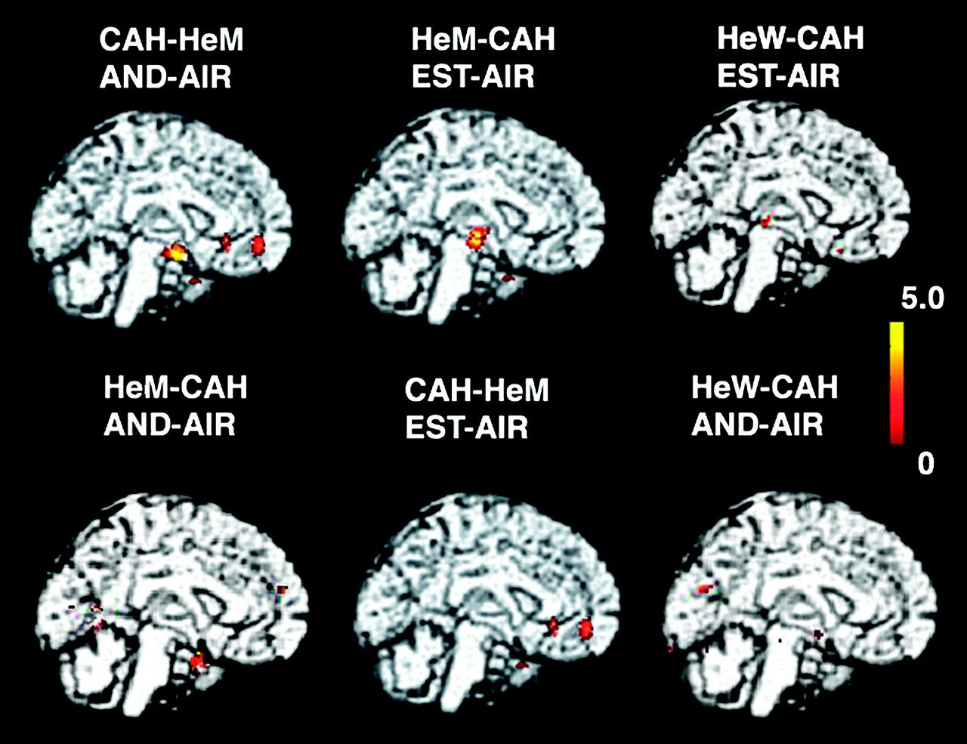
Figure 2. Group differences. Shown are the clusters calculated with 2-group random effect analysis, superimposed on ...
Notes:
Figure 2. Group differences. Shown are the clusters calculated with 2-group random effect analysis, superimposed on standard brain MRI. The Sokoloff's color scale illustrates Z values reflecting the degree of activation. No significant clusters were observed when comparing CAH and HeW.
Unless provided in the caption above, the following copyright applies to the content of this slide: © The Author 2008. Published by Oxford University Press. All rights reserved. For permissions, please e-mail: journals.permissions@oxfordjournals.org

Slide 3
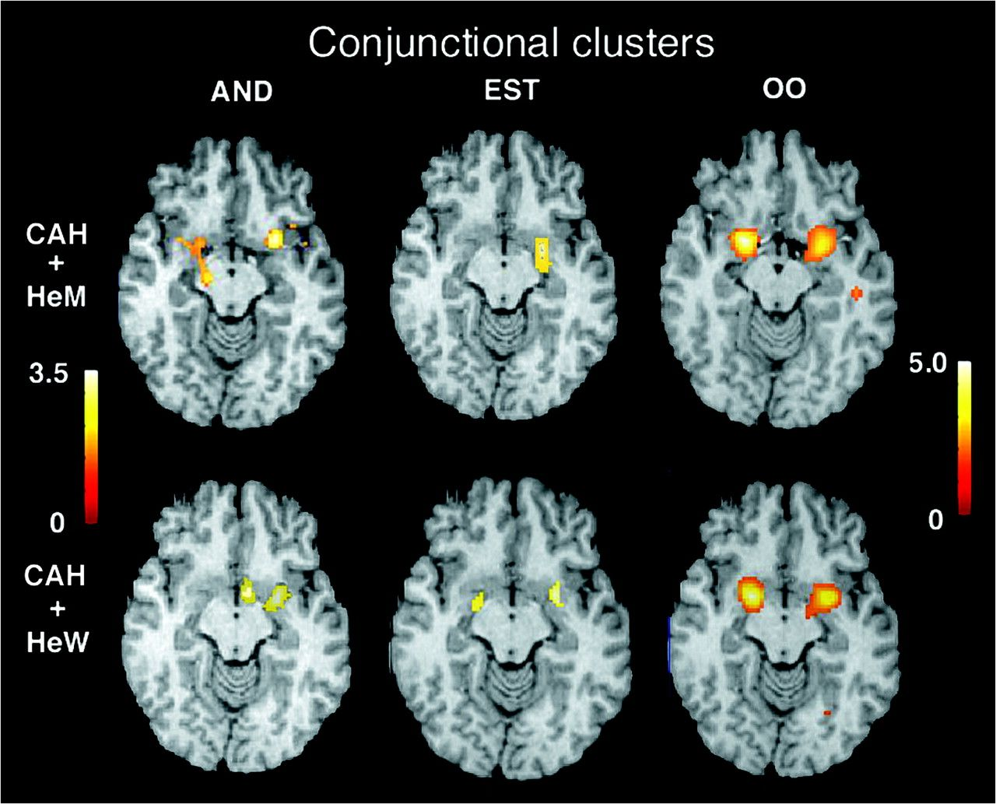
Figure 3. Group-sharing activations. Shown are conjunctional clusters in different groups of subjects, superimposed on ...
Notes:
Figure 3. Group-sharing activations. Shown are conjunctional clusters in different groups of subjects, superimposed on the standard brain. All images show horizontal sections at Z = −8 according to Talairach's atlas. The Sokoloff's color scale illustrates Z values (0.0–3.5 for AND and EST and 0.0–5.0 for OO). The OO clusters were large and covered several sections. Because the same brain section is chosen, figures do not always illustrate maximal activation for each condition. Subject's right side is to the left.
Unless provided in the caption above, the following copyright applies to the content of this slide: © The Author 2008. Published by Oxford University Press. All rights reserved. For permissions, please e-mail: journals.permissions@oxfordjournals.org

Slide 4
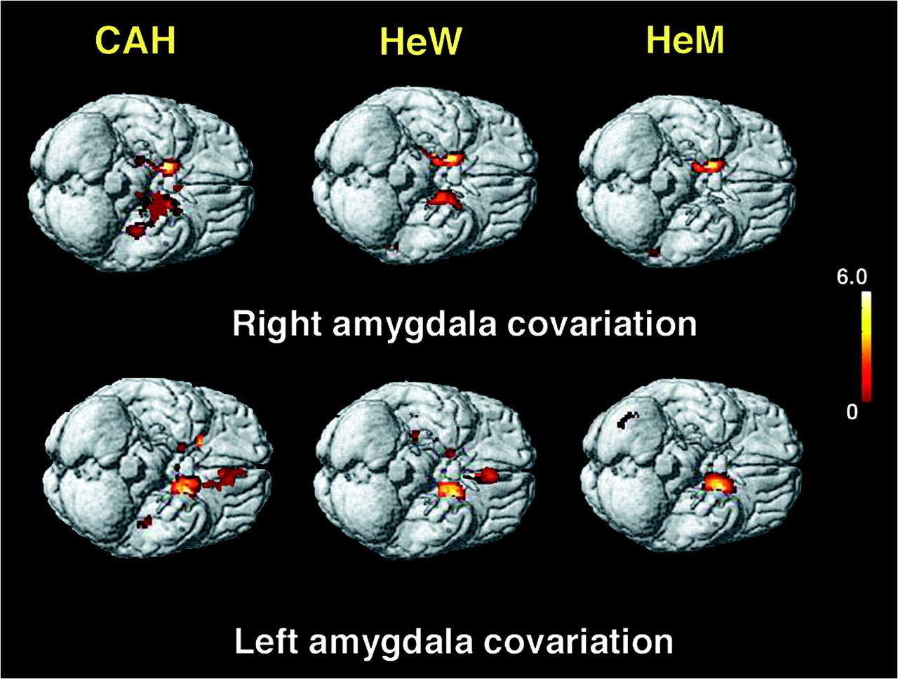
Figure 4. Covariations with the left and right amygdala seed ROI in the 3 study groups. The Sokoloff's scale indicates ...
Notes:
Figure 4. Covariations with the left and right amygdala seed ROI in the 3 study groups. The Sokoloff's scale indicates T-values. Clusters detected at T = 3.0 and P < 0.05 corrected, are superimposed on the standard MR of the brain.
Unless provided in the caption above, the following copyright applies to the content of this slide: © The Author 2008. Published by Oxford University Press. All rights reserved. For permissions, please e-mail: journals.permissions@oxfordjournals.org

Slide 5
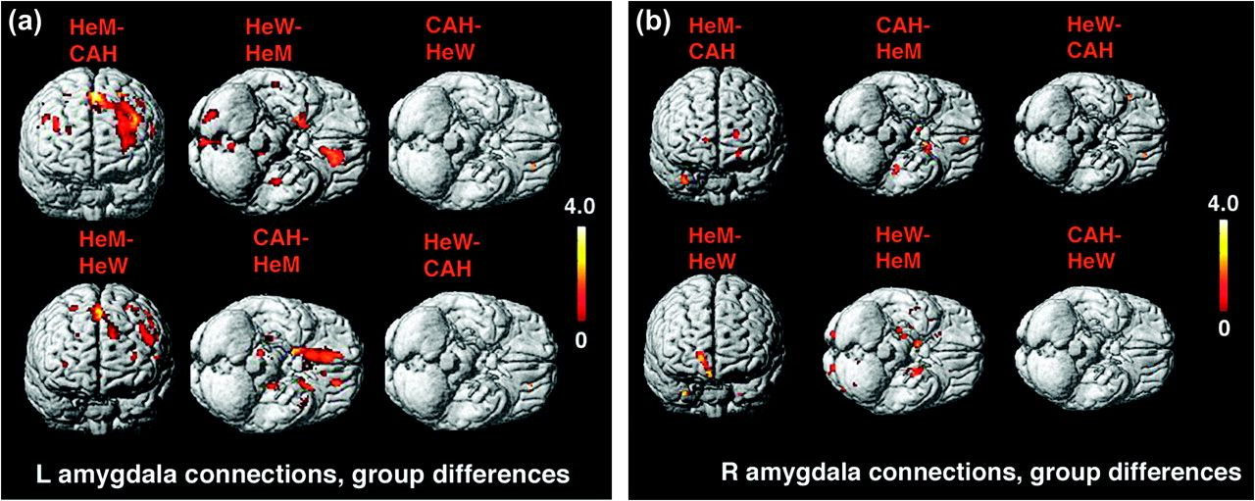
Figure 5. Between-group differences in covariations with the left (a) and right (b) amygdala seed region. The ...
Notes:
Figure 5. Between-group differences in covariations with the left (a) and right (b) amygdala seed region. The Sokoloff's scale indicates T-values. Clusters detected at T = 3.0 are superimposed on the standard MR of the brain. Brain views illustrating typical group differences are shown. The clusters calculated from HeM to CAH were not significant.
Unless provided in the caption above, the following copyright applies to the content of this slide: © The Author 2008. Published by Oxford University Press. All rights reserved. For permissions, please e-mail: journals.permissions@oxfordjournals.org

