Slide 1
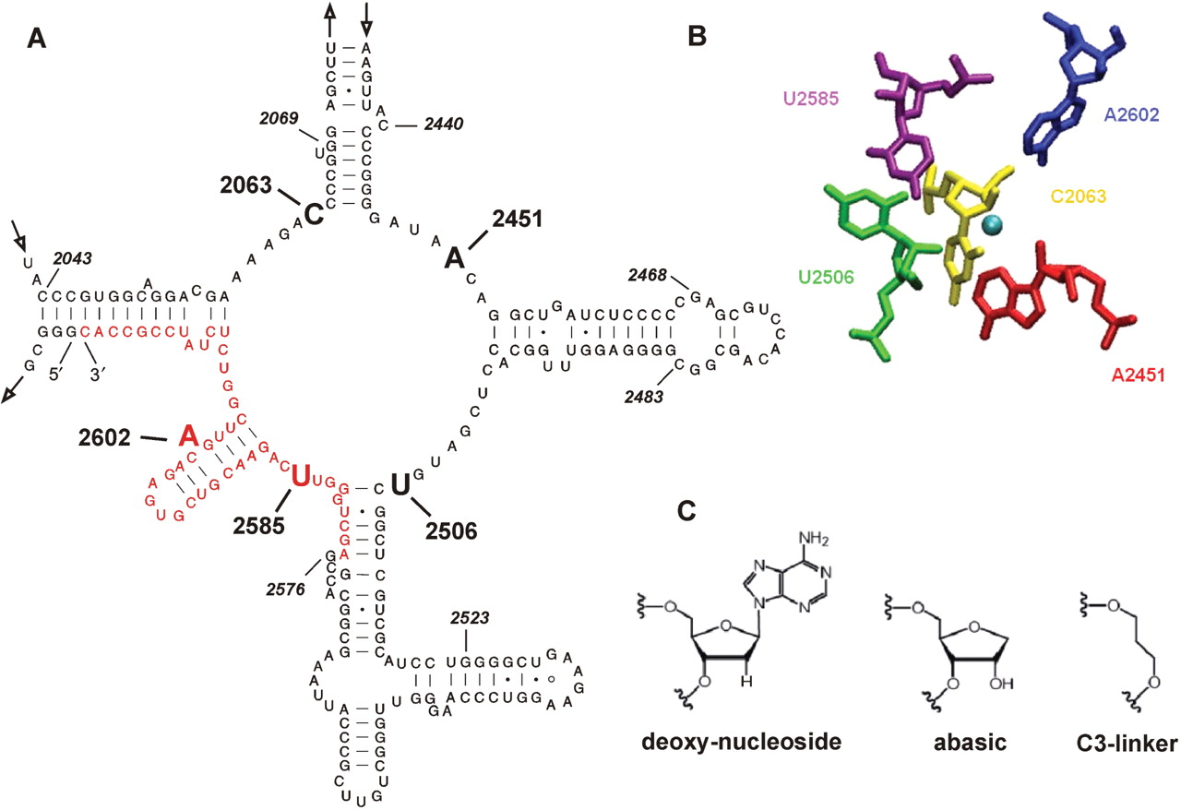
Figure 1. Structural aspects of the PTC of gapped-cp-reconstituted 50S subunits. (A) Secondary structure of the central ...
Notes:
Figure 1. Structural aspects of the PTC of gapped-cp-reconstituted 50S subunits. (A) Secondary structure of the central loop of domain V of 23S rRNA of T. aquaticus showing the new endpoints of the cp-23S rRNA at positions 2623 and 2622 (5′ and 3′, respectively) which was constructed to investigate the effects of nucleoside modifications at positions A2602, U2585 and U2584. The chemically synthesized 45-nucleotides RNA, which was ligated to the 3′-end of the cp-23S rRNA transcript at position 2576, is shown in red. Additional active site residues that have been replaced by the modified nucleoside analogs depicted in (C) using the gapped-cp-reconstitution approach are in bold. The endpoints of the corresponding cp-23S rRNA constructs are italic. Cp2523-2483, cp2468-2440 and cp2069-2043 were constructed to study U2506, A2451 and C2063, respectively, whereas the first nucleotide always indicates the new 5′-end and the second residue the 3′-end of the cp-23S rRNA transcript. (B) View of the three-dimensional architecture of the PTC structure. The green sphere marks the location of the nitrogen atom of the α-amino nucleophile of an aminoacyl-tRNA mimicry. The figure was generated from pdb file 1FG0 (6). (C) The chemical structure of the three nucleoside analogs that have been introduced at all inner shell residues shown in (B) employing the gapped-cp-reconstitution.
Unless provided in the caption above, the following copyright applies to the content of this slide: © 2007 The Author(s)This is an Open Access article distributed under the terms of the Creative Commons Attribution Non-Commercial License (http://creativecommons.org/licenses/by-nc/2.0/uk/) which permits unrestricted non-commercial use, distribution, and reproduction in any medium, provided the original work is properly cited.

Slide 2
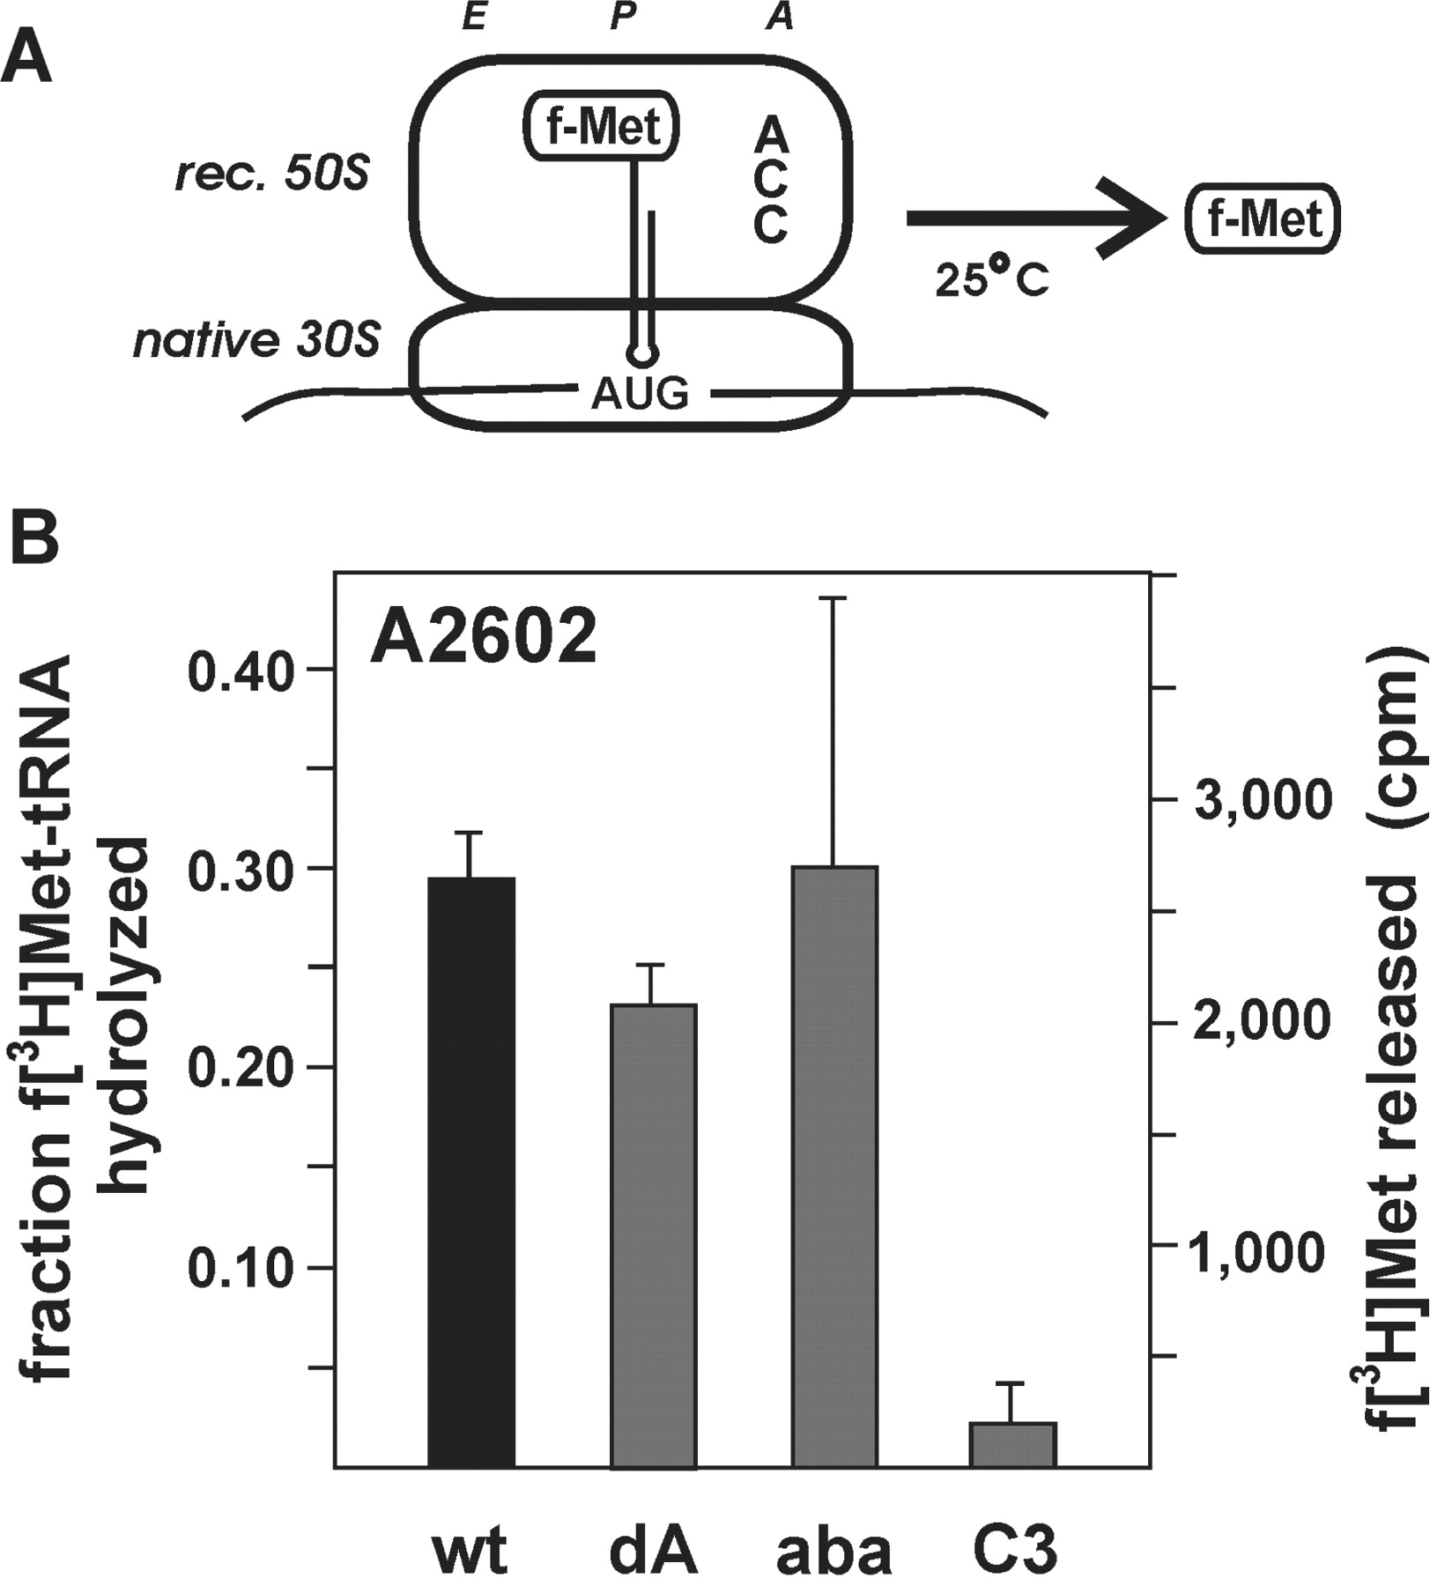
Figure 4. RF-independent peptidyl-tRNA hydrolysis activity of ribosomes carrying modifications at 23S rRNA position ...
Notes:
Figure 4. RF-independent peptidyl-tRNA hydrolysis activity of ribosomes carrying modifications at 23S rRNA position 2602. (A) In the RF-independent assay the hydrolytic activity of ribosomes containing gapped-cp-reconstituted 50S was initiated by binding of the CCA tri-nucleotide to the 50S A-site. (B) The product yields of hydrolyzed f-[3H]Met-tRNA using ribosomes carrying the wild-type sequence (wt), the 2′-deoxy-adenosine (dA), the abasic site analog (aba), or the C3-linker modification (C3) at 23S rRNA positions A2602 after 30 min of incubation are shown. The values represent the mean and SD of three independent experiments. The amount of hydrolyzed peptidyl-tRNA in reactions containing 50S subunits that have been reconstituted in the absence of the synthetic RNA fragment encompassing position A2602 was subtracted from all data points.
Unless provided in the caption above, the following copyright applies to the content of this slide: © 2007 The Author(s)This is an Open Access article distributed under the terms of the Creative Commons Attribution Non-Commercial License (http://creativecommons.org/licenses/by-nc/2.0/uk/) which permits unrestricted non-commercial use, distribution, and reproduction in any medium, provided the original work is properly cited.

Slide 3
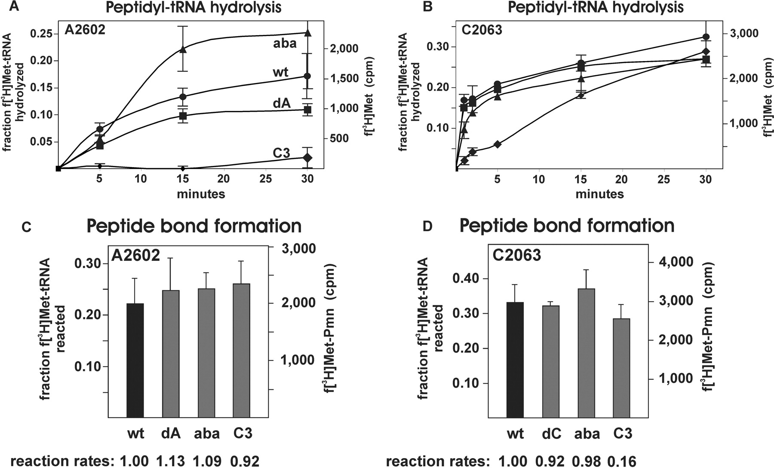
Figure 3. The catalytic activities of the PTC carrying nucleoside modifications at position A2602 or C2063. Time course ...
Notes:
Figure 3. The catalytic activities of the PTC carrying nucleoside modifications at position A2602 or C2063. Time course of peptidyl-tRNA hydrolysis promoted by ribosomes containing gapped-cp-reconstituted 50S carrying either the wild-type sequence (wt; circles), the 2′-deoxyribonucleoside (dN; squares), the abasic site analog (aba; triangles), or the C3-linker modification (C3; diamonds) at 23S rRNA positions A2602 (A) or C2063 (B). The curves represent the mean and the SD of five independent time course experiments. The same particles were also used in peptidyl transferase reactions employing puromycin as an A-site substrate. The amount of product formation at the reaction plateau (incubation time 120 min) formed by ribosomes carrying modifications at A2602 (C) or C2063 (D) are shown (gray bars) and compared to the yields produced by the respective gapped-cp-reconstituted wild-type ribosomes (black bars). The initial peptidyl transferase rates, which were determined from experimental points in the linear range of the reactions within the first 15 min of incubation, are shown below the graphs. The rates were normalized to the rate of gapped-cp-reconstituted ribosomes containing the synthetic wild-type RNA fragments. In all cases (A–D) the background values (amount of product formation in reactions containing 50S subunits that have been reconstituted in the absence of the synthetic RNA fragments) were subtracted from all experimental data points and the fraction of the 0.3 pmol input f-[3H]Met-tRNA that reacted are indicated.
Unless provided in the caption above, the following copyright applies to the content of this slide: © 2007 The Author(s)This is an Open Access article distributed under the terms of the Creative Commons Attribution Non-Commercial License (http://creativecommons.org/licenses/by-nc/2.0/uk/) which permits unrestricted non-commercial use, distribution, and reproduction in any medium, provided the original work is properly cited.

Slide 4
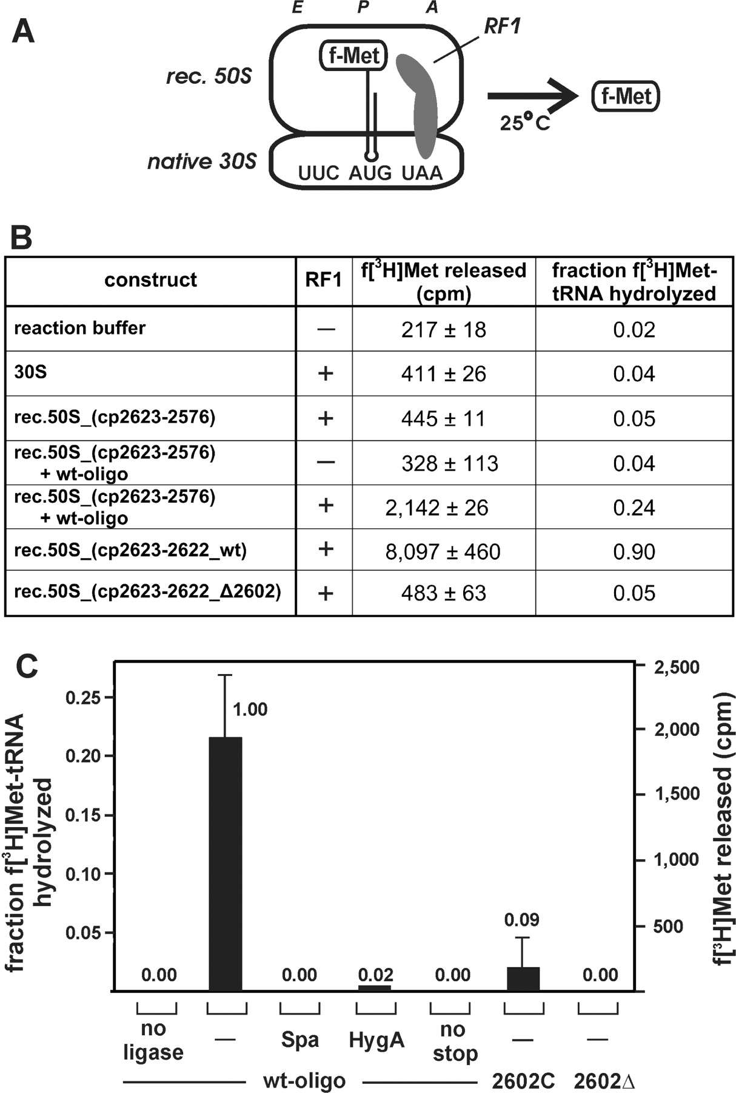
Figure 2. RF1-mediated peptide release activities of gapped-cp-reconstituted 50S subunits. (A) To measure peptidyl-tRNA ...
Notes:
Figure 2. RF1-mediated peptide release activities of gapped-cp-reconstituted 50S subunits. (A) To measure peptidyl-tRNA hydrolysis activity, gapped-cp-reconstituted 50S (rec. 50S) were reassociated with native 30S subunits and programmed with an mRNA analog placing the stop codon UAA into the A-site. The peptidyl-tRNA analog f-Met-tRNA was bound to the P-site and the reaction initiated by the addition of RF1 from T. thermophilus. (B) The amount of hydrolyzed f-[3H]Met-tRNA in the absence of ribosomal particles (reaction buffer), in the presence of the small ribosomal subunit (30S) or in the presence of 70S ribosomes containing native 30S and gapped-cp-reconstituted 50S after 30 min of incubation is shown. Gapped-cp-reconstituted 50S particles assembled from cp2623-2576 were tested in the absence and presence of the ligated 45-mer RNA fragment containing the wild-type sequence (+ wt oligo). 50S assembled form cp2623-2622 were assayed in the context of the wild-type sequence (cp2623-2622_wt) and in the context of the A2602 deletion mutant (cp2623-2622_Δ2602). RF1 was absent (−) or present (+) at a concentration of 0.8 µM. The mean and SD of released f-[3H]Met from two representative experiments are shown (cpm) as well as the fraction of the 0.3 pmol input peptidyl-tRNA that was hydrolyzed are indicated. (C) Peptidyl-tRNA hydrolysis product yields of reconstituted 50S subunits that have been assembled from cp2623-2576 to which the compensating synthetic wild-type 45-mer RNA (wt-oligo) or the 2602C or 2602Δ variants have been ligated. The yield of f-[3H]Met released by particles carrying the wt-oligo at the end of the reaction curve after 30 min of incubation has been taken as 1.00. The relative activities of gapped-cp-reconstituted 50S subunits carrying the ligated wt-oligo in the presence of antibiotics (sparsomycin: Spa; hygromycin A: HygA), or in the absence of an A-site-bound stop codon (no stop), as well as the activities of the two 2602 mutants are shown above the respective bars. The RF1-mediated hydrolysis strictly depends on the covalent connection of the synthetic RNA fragment to the cp-23S rRNA, since no product formation was observed in control experiments where the T4-DNA ligase has been omitted (no ligase). Values shown represent the mean and the SD of at least two independent experiments.
Unless provided in the caption above, the following copyright applies to the content of this slide: © 2007 The Author(s)This is an Open Access article distributed under the terms of the Creative Commons Attribution Non-Commercial License (http://creativecommons.org/licenses/by-nc/2.0/uk/) which permits unrestricted non-commercial use, distribution, and reproduction in any medium, provided the original work is properly cited.

