Slide 1
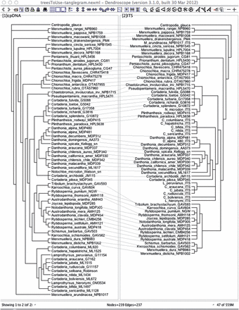
Figure 1. A tanglegram computed by Dendroscope 3 for the cpDNA and ITS trees that are reported in Figure 1 of Pirie et ...
Notes:
Figure 1. A tanglegram computed by Dendroscope 3 for the cpDNA and ITS trees that are reported in Figure 1 of Pirie et al. (2009).
Unless provided in the caption above, the following copyright applies to the content of this slide: © The Author 2012. Published by Oxford University Press, on behalf of the Society of Systematic Biologists. All rights reserved. For Permissions, please email: journals.permissions@oup.com

Slide 2
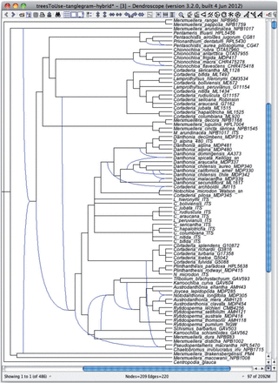
Figure 2. A minimum hybridization network computed by Dendroscope 3 for the cpDNA and ITS trees that are reported in ...
Notes:
Figure 2. A minimum hybridization network computed by Dendroscope 3 for the cpDNA and ITS trees that are reported in Figure 1 of Pirie et al. (2009). It has 12 reticulations and is one of 486 networks calculated by the program.
Unless provided in the caption above, the following copyright applies to the content of this slide: © The Author 2012. Published by Oxford University Press, on behalf of the Society of Systematic Biologists. All rights reserved. For Permissions, please email: journals.permissions@oup.com

Slide 3
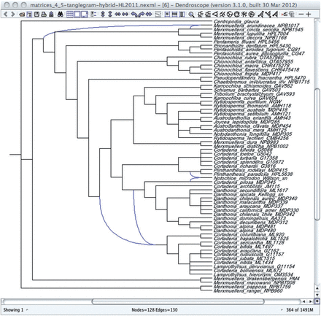
Figure 3. A hybridization network computed from the 2 simplified trees that were used as input for Figure 3(b) of Pirie ...
Notes:
Figure 3. A hybridization network computed from the 2 simplified trees that were used as input for Figure 3(b) of Pirie et al. (2009).
Unless provided in the caption above, the following copyright applies to the content of this slide: © The Author 2012. Published by Oxford University Press, on behalf of the Society of Systematic Biologists. All rights reserved. For Permissions, please email: journals.permissions@oup.com

