Slide 1
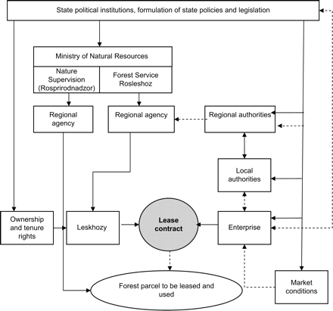
Figure 1. Institutions and organizations that influence the formation of forest lease terms in Russia as defined in the ...
Notes:
Figure 1. Institutions and organizations that influence the formation of forest lease terms in Russia as defined in the lease contract in accordance with the Forest Code in 2006 (solid line indicates formal and broken line informal influence).
Unless provided in the caption above, the following copyright applies to the content of this slide: © Institute of Chartered Foresters, 2007. All rights reserved. For Permissions, please email: journals.permissions@oxfordjournals.org

Slide 2
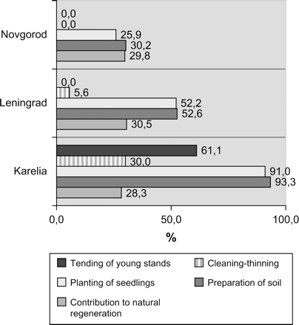
Figure 4. Leaseholders’ contribution to silvicultural operations in 2004 as a proportion of total work area (ha) ...
Notes:
Figure 4. Leaseholders’ contribution to silvicultural operations in 2004 as a proportion of total work area (ha) (source: Original data, 2005).
Unless provided in the caption above, the following copyright applies to the content of this slide: © Institute of Chartered Foresters, 2007. All rights reserved. For Permissions, please email: journals.permissions@oxfordjournals.org

Slide 3
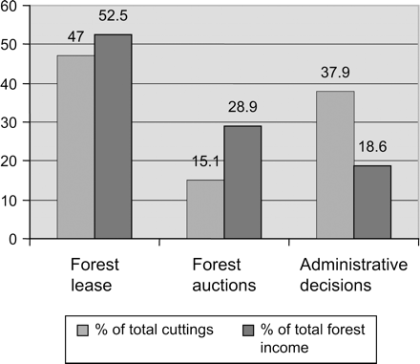
Figure 3. The division of timber removal and revenue accumulation in Russia based on forest allocation method (source: ...
Notes:
Figure 3. The division of timber removal and revenue accumulation in Russia based on forest allocation method (source: Ministry of Natural Resources, 2006).
Unless provided in the caption above, the following copyright applies to the content of this slide: © Institute of Chartered Foresters, 2007. All rights reserved. For Permissions, please email: journals.permissions@oxfordjournals.org

Slide 4
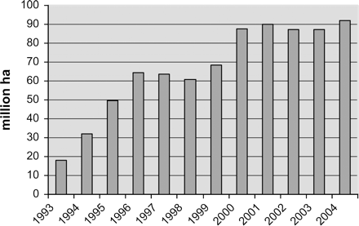
Figure 2. The leased forest area in Russia 1993–2004 (sources: Vasin, 2003; Ministry of Natural Resources, 2006).
Notes:
Figure 2. The leased forest area in Russia 1993–2004 (sources: Vasin, 2003; Ministry of Natural Resources, 2006).
Unless provided in the caption above, the following copyright applies to the content of this slide: © Institute of Chartered Foresters, 2007. All rights reserved. For Permissions, please email: journals.permissions@oxfordjournals.org

