Slide 1
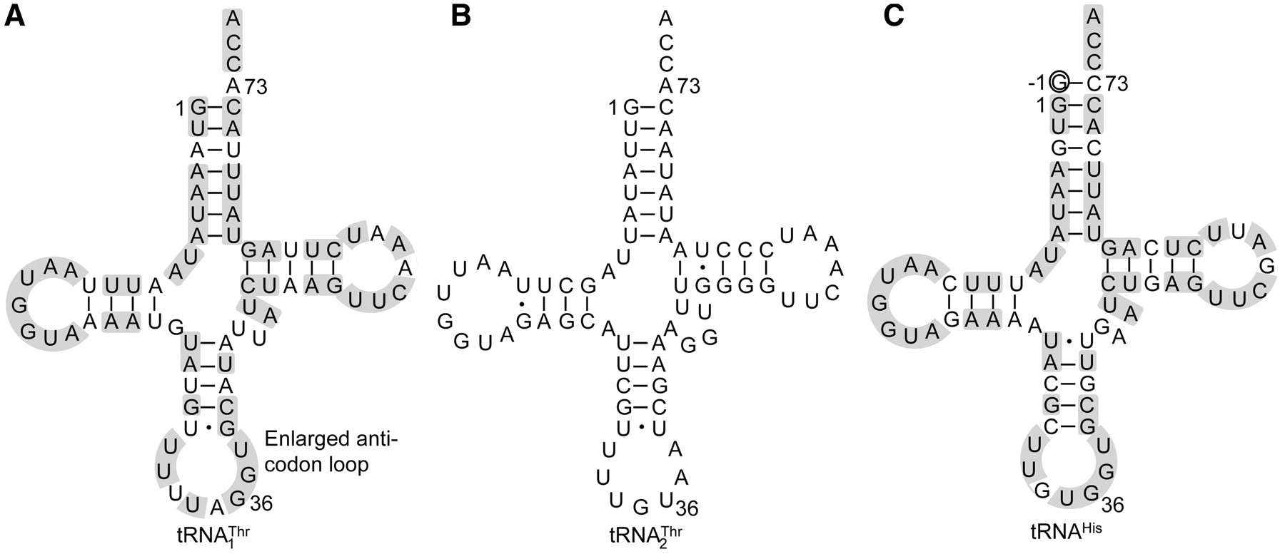
Figure 1. Nucleotide sequences of S. cerevisiae mitochondrial tRNAs. (A) with an 8-nt anticodon loop and a UAG ...
Notes:
Figure 1. Nucleotide sequences of S. cerevisiae mitochondrial tRNAs. (A) with an 8-nt anticodon loop and a UAG anticodon. (B) with a canonical UGU anticodon. (C) tRNAHis with a G−1 (circled, a major anti-determinant for ThrRS). The primary sequences of and tRNAHis are 72% identical (shaded).
Unless provided in the caption above, the following copyright applies to the content of this slide: © The Author(s) 2011. Published by Oxford University Press.This is an Open Access article distributed under the terms of the Creative Commons Attribution Non-Commercial License (http://creativecommons.org/licenses/by-nc/2.5), which permits unrestricted non-commercial use, distribution, and reproduction in any medium, provided the original work is properly cited.

Slide 2
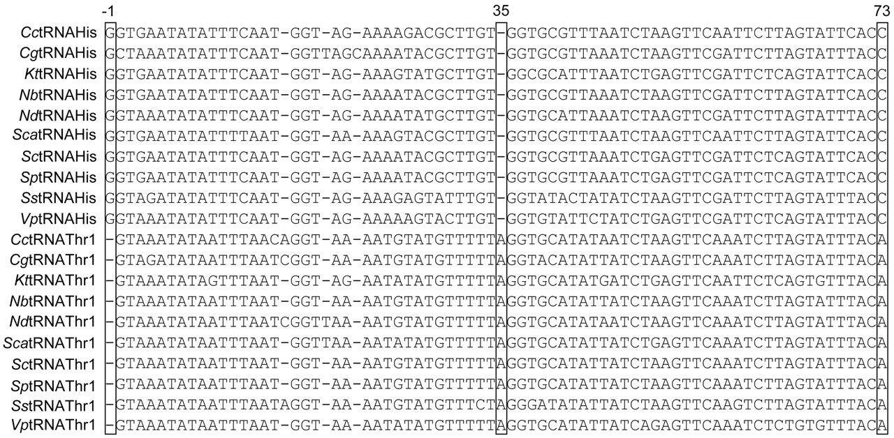
Figure 5. Sequence alignment of mitochondrial and tRNA^{His}. Three major differences between and ...
Notes:
Figure 5. Sequence alignment of mitochondrial and tRNAHis. Three major differences between and tRNAHis sequences are indicated by boxes. Cc, Candida castellii; Cg, Candida glabrata; Kt, Kluyveromyces thermotolerans; Nb, Nakaseomyces bacillisporus; Nd, Nakaseomyces delphensis; Sca, Saccharomyces castellii; Sc, Saccharomyces cerevisiae; Sp, Saccharomyces pastorianus; Ss, Saccharomyces servazzii; Vp, Vanderwaltozyma polyspora.
Unless provided in the caption above, the following copyright applies to the content of this slide: © The Author(s) 2011. Published by Oxford University Press.This is an Open Access article distributed under the terms of the Creative Commons Attribution Non-Commercial License (http://creativecommons.org/licenses/by-nc/2.5), which permits unrestricted non-commercial use, distribution, and reproduction in any medium, provided the original work is properly cited.

Slide 3
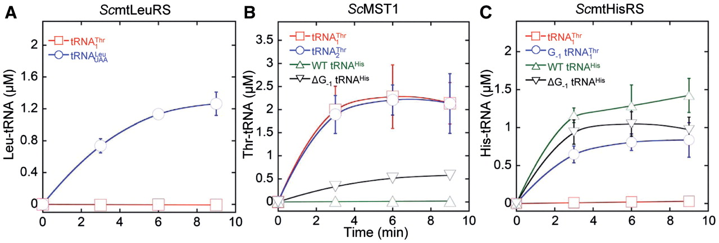
Figure 4. Aminoacylation by S. cerevisiae MST1 and HisRS. (A) Leucylation of (3 µM) and (3 µM) by ScmtLeuRS (0.3 µM). ...
Notes:
Figure 4. Aminoacylation by S. cerevisiae MST1 and HisRS. (A) Leucylation of (3 µM) and (3 µM) by ScmtLeuRS (0.3 µM). (B) Threonylation of (3 µM), (3 µM) and tRNAHis variants (3 µM) by ScMST1 (0.3 µM). (C) Histidylation of (3 µM) and tRNAHis variants (3 µM) by ScmtHisRS (0.3 µM).
Unless provided in the caption above, the following copyright applies to the content of this slide: © The Author(s) 2011. Published by Oxford University Press.This is an Open Access article distributed under the terms of the Creative Commons Attribution Non-Commercial License (http://creativecommons.org/licenses/by-nc/2.5), which permits unrestricted non-commercial use, distribution, and reproduction in any medium, provided the original work is properly cited.

Slide 4
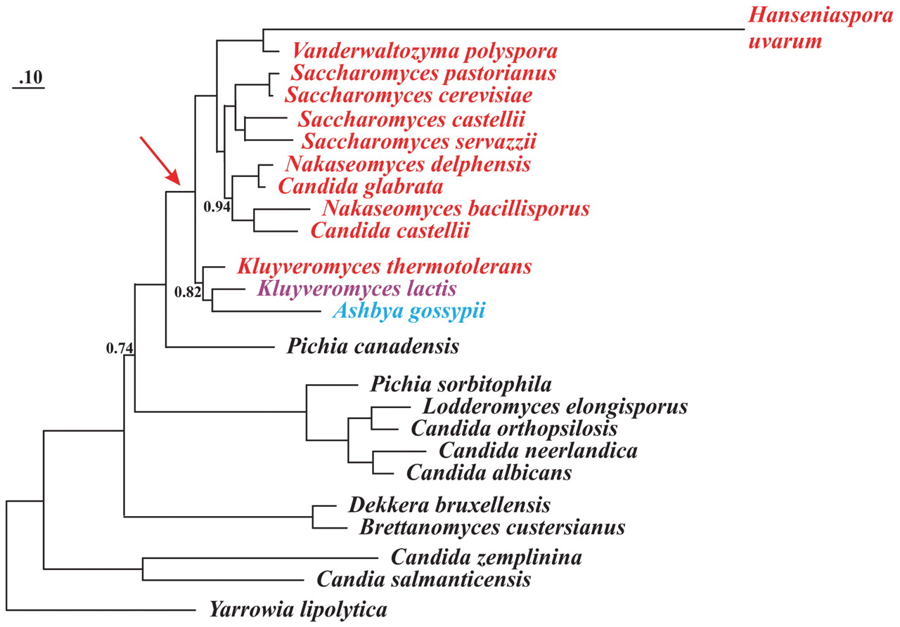
Figure 3. Phylogeny of yeast species based on concatenated mtDNA-encoded protein sequences. The phylogenetic analysis ...
Notes:
Figure 3. Phylogeny of yeast species based on concatenated mtDNA-encoded protein sequences. The phylogenetic analysis with PhyloBayes and the CAT model is based on 13 mtDNA encoded proteins. All divergence points are supported by posterior probability values of 1.0, except where indicated. The red arrow points to the concomitant loss of all seven nad genes and the start of mitochondrial codon reassignments, including AUA methionine, CUN threonine. Species shown in black possess mitochondrial (but not ), and in these organisms CUN codons are assigned to Leu. The yeast species marked red, such as K. thermotolerans, have lost mitochondrial and obtained that decodes CUN codons as Thr. K. lactis is marked magenta as it has no CUN codons and no corresponding tRNA with a UAG anticodon. A. gossypii (marked blue) contains a tRNA species with a UAG anticodon, yet its identity of this tRNA and the amino acid reading CUN codons in A. gossypii remain obscure (to be discussed by BFL in Organelle Genetics: Evolution of Organelle Genomes and Gene Expression, Springer 2011).
Unless provided in the caption above, the following copyright applies to the content of this slide: © The Author(s) 2011. Published by Oxford University Press.This is an Open Access article distributed under the terms of the Creative Commons Attribution Non-Commercial License (http://creativecommons.org/licenses/by-nc/2.5), which permits unrestricted non-commercial use, distribution, and reproduction in any medium, provided the original work is properly cited.

Slide 5
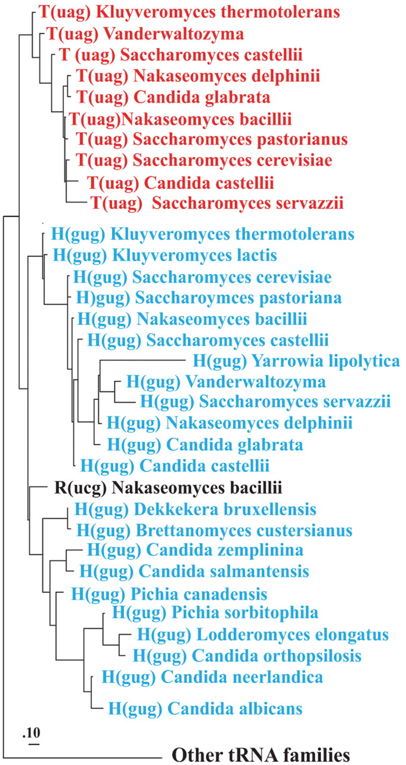
Figure 2. Phylogeny of yeast mitochondrial tRNAs. The phylogenetic analysis with PhyloBayes (default model parameters) ...
Notes:
Figure 2. Phylogeny of yeast mitochondrial tRNAs. The phylogenetic analysis with PhyloBayes (default model parameters) contained all tRNA sequences from the species shown in Figure 3. Only the section of the tRNA phylogeny covering the and tRNAHis clusters are shown (marked red and blue, respectively), confirming monophyly of and a sister group relationship to tRNAHis. The posterior probability support for the two tRNA groups is 1.0 (note that phylogenetic analysis with tRNA sequences depends on only few informative nucleotide positions, which does not allow to resolve the branching order within these groups). Removal of the anticodon sequence positions from the dataset did not change clustering into the two tRNA groups, nor did an analysis of the same datasets with maximum likelihood and the GTR model.
Unless provided in the caption above, the following copyright applies to the content of this slide: © The Author(s) 2011. Published by Oxford University Press.This is an Open Access article distributed under the terms of the Creative Commons Attribution Non-Commercial License (http://creativecommons.org/licenses/by-nc/2.5), which permits unrestricted non-commercial use, distribution, and reproduction in any medium, provided the original work is properly cited.

Slide 6
Figure 7. Proposed model for CUN codon reassignment in yeast mitochondria. (1) tRNA^{His} duplicated in an ...
Notes:
Figure 7. Proposed model for CUN codon reassignment in yeast mitochondria. (1) tRNAHis duplicated in an ancestral yeast species while CUN codons remain assigned to Leu. (2) CUN codons were changed to UUA or UUG decoded by , and was lost. (3) tRNAHis evolved to , and CUN codons reemerged from various codons.
Unless provided in the caption above, the following copyright applies to the content of this slide: © The Author(s) 2011. Published by Oxford University Press.This is an Open Access article distributed under the terms of the Creative Commons Attribution Non-Commercial License (http://creativecommons.org/licenses/by-nc/2.5), which permits unrestricted non-commercial use, distribution, and reproduction in any medium, provided the original work is properly cited.

Slide 7
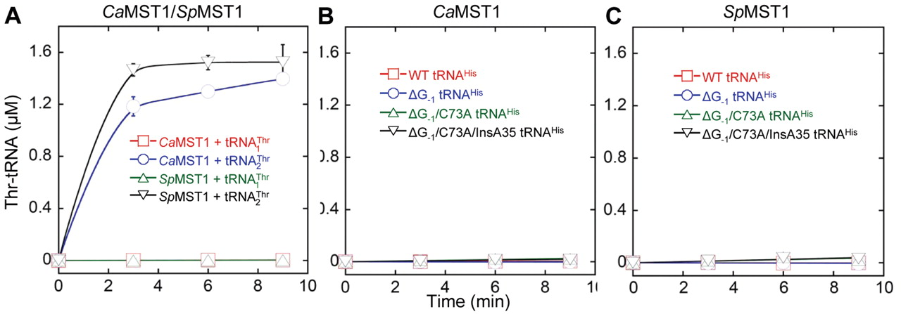
Figure 6. Threonylation of and tRNA^{His} variants (3 µM) by C. albicans and S. pombe MST1 (0.3 µM). (A) ...
Notes:
Figure 6. Threonylation of and tRNAHis variants (3 µM) by C. albicans and S. pombe MST1 (0.3 µM). (A) CaMST1 and SpMST1 threonylate but not . (B and C) CaMST1 and SpMST1 are unable to threonylate tRNAHis variants.
Unless provided in the caption above, the following copyright applies to the content of this slide: © The Author(s) 2011. Published by Oxford University Press.This is an Open Access article distributed under the terms of the Creative Commons Attribution Non-Commercial License (http://creativecommons.org/licenses/by-nc/2.5), which permits unrestricted non-commercial use, distribution, and reproduction in any medium, provided the original work is properly cited.

