Slide 1
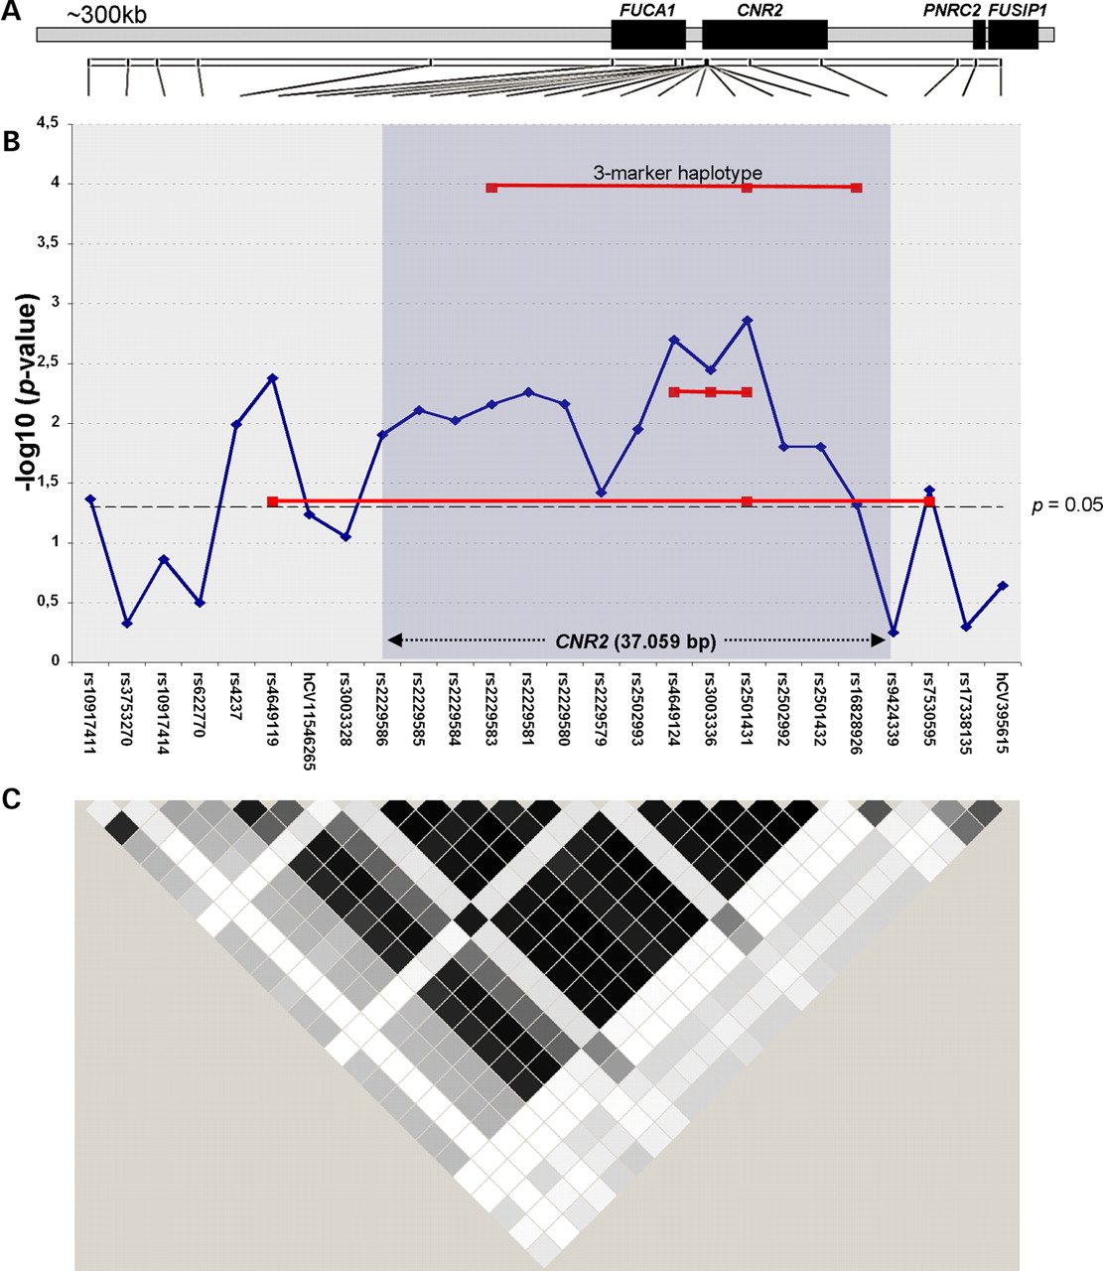
Figure 1. Schematic representation of the extended CNR2 locus. (A) Location of known genes in a region of ...
Notes:
Figure 1. Schematic representation of the extended CNR2 locus. (A) Location of known genes in a region of ∼300 kb on human chromosome 1p36.11 including the position of 26 typed SNPs. FUCA1, alpha-l fucosidase; CNR2, cannabinoid receptor type 2; PNRC2, proline-rich nuclear receptor co-activator 2; FUSIP1, FUS interacting protein (serine–arginine rich) 1. (B) Results of the association analyses of SNPs in the CNR2 region. The −log 10 P-values (y-axis) of the genotypic association are plotted against the typed SNPs (x-axis). The red lines indicate the global P-values of three-marker haplotypes rs4649124–rs3003336–rs2501431, rs2229583–rs2501431–rs16828926 and rs4649119–rs2501431–rs7530595. The dotted black line shows the significance level of P=0.05. A shaded box delineates the region harboring the CNR2 gene with two arrows showing the size of the CNR2 gene. (C) Representation of LD structure in the CNR2 region. Pairwise r2-values between markers are shown as calculated by the program haploview (20) (http://www.broad.mit.edu/mpg/haploview/) (black denotes complete LD with r2=1; white denotes no LD with r2=0; gray denotes r2 between 0 and 1 with intermediate LD). Note the presence of a region of strong LD between SNPs rs4237 and rs2501432 including the CNR2 coding region.
Unless provided in the caption above, the following copyright applies to the content of this slide: © The Author 2005. Published by Oxford University Press. All rights reserved. For Permissions, please email: journals.permissions@oxfordjournals.org

