Slide 1
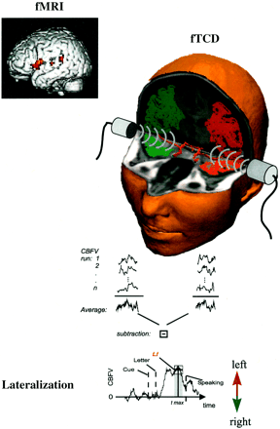
Fig. 1 Schematic illustration of the fTCD procedure in a single subject. For comparison, an fMRI of the same subject ...
Notes:
Fig. 1 Schematic illustration of the fTCD procedure in a single subject. For comparison, an fMRI of the same subject during an identical language task is shown (upper left). The fMRI analysis was performed by statistical parametric mapping, using software from the Wellcome Department of Cognitive Neurology, London, UK. fTCD measures the modulation of the cerebral blood flow velocity (CBFV) in the middle cerebral arteries (MCAs) at a depth of 50 mm during word generation. This allows the assessment of activity-related perfusion changes in the vascular territories of the left (red) and right (green) MCAs. These territories comprise potential language areas (van der Zwan et al., 1993). After a cueing tone (Cue), a letter (Letter) is presented on a computer screen and the subject has to find silently as many words as possible that start with the displayed letter. Task performance is controlled by having the subject report the words (Speaking) after a second auditory signal, presented 15 s after presentation of the letter. The averaging procedure used for fTCD is depicted schematically below. CBFV changes in both MCAs during single runs (1 to n) of the language task are collected and averaged (usually a total of 20 runs). Subtraction of averaged CBFV changes in the right and the left MCA provides a measure of the mean interhemispheric difference in CBFV. The mean interhemispheric CBFV difference curve is time-locked to fixed events during the task. Calculation of the laterality index during word generation (LI) is based on the maximal left–right difference during word generation. The LI is highly reproducible and is proportional to lateralization, as assessed by fMRI and the Wada test (Deppe et al., 1997, 1998, 2000; Knecht et al., 1998a, b). Positive indices represent left-hemisphere language dominance; negative indices represent right-hemisphere language dominance. In this subject, a positive value indicates left-hemisphere lateralization for word generation.
Unless provided in the caption above, the following copyright applies to the content of this slide: © Oxford University Press 2000

Slide 2
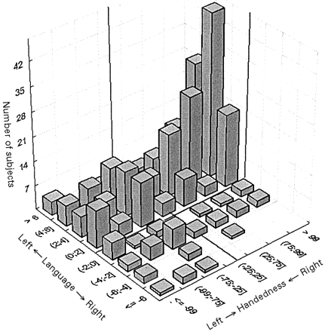
Fig. 2 Three-dimensional frequency histogram demonstrating the number of subjects (z-axis) with a given degree of ...
Notes:
Fig. 2 Three-dimensional frequency histogram demonstrating the number of subjects (z-axis) with a given degree of handedness (y-axis) and language lateralization, as determined by fTCD (x-axis), in a total of 326 healthy subjects, comprising 198 females (age range 15–49 years, mean 26, SD 5.5) and 128 males (age range 19–46 years, mean 26, SD 4.6). These subjects include those reported in a preceding paper (Knecht et al., 2000). Handedness was assessed by the Edinburgh Inventory (Oldfield, 1971) (positive values indicate relative right-handedness and negative values indicate relative left-handedness).
Unless provided in the caption above, the following copyright applies to the content of this slide: © Oxford University Press 2000

Slide 3
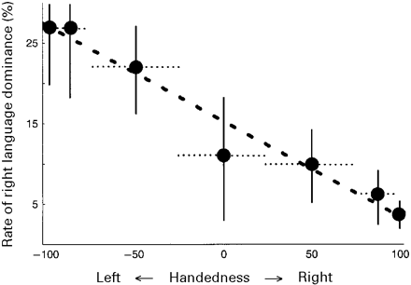
Fig. 3 Relationship between the degree of handedness by the Edinburgh Inventory (x-axis) and the incidence of ...
Notes:
Fig. 3 Relationship between the degree of handedness by the Edinburgh Inventory (x-axis) and the incidence of right-hemisphere language dominance (y-axis). Bin width for each subgroup is represented by dotted horizontal lines. Error bars, represented by vertical lines, are based on the formula: \batchmode \documentclass[fleqn,10pt,legalpaper]{article} \usepackage{amssymb} \usepackage{amsfonts} \usepackage{amsmath} \pagestyle{empty} \begin{document} \[{\sigma}\ =\ \sqrt{\frac{(100\ {\mbox{--}}\ \mathit{P})\ \mathit{P}}{\mathit{n}}}\] \end{document} The relationship between the rate of right-hemisphere dominance and handedness can be approximated by the formula: \batchmode \documentclass[fleqn,10pt,legalpaper]{article} \usepackage{amssymb} \usepackage{amsfonts} \usepackage{amsmath} \pagestyle{empty} \begin{document} \(likelihood\ of\ right\ language\ dominance\ (\%)\ =\ 15\%\ {\mbox{--}}\ {handedness\ (\%)}/{10}\) \end{document}. Specific information on the subgroups [width of handedness categories by the Edinburgh Inventory; number of subjects per category (n) and percent right dominance] is given in the table below the graph.
Unless provided in the caption above, the following copyright applies to the content of this slide: © Oxford University Press 2000

Slide 4
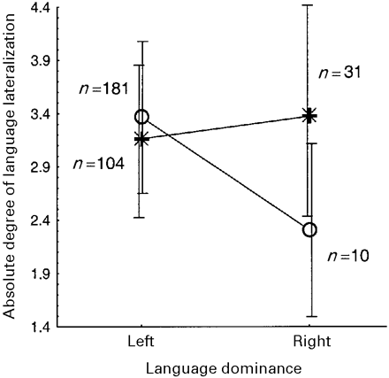
Fig. 4 Two-way interaction between the absolute degree of language lateralization for left and right language ...
Notes:
Fig. 4 Two-way interaction between the absolute degree of language lateralization for left and right language dominance (and standard deviations) in right-handers (handedness >30 by the Edinburgh Inventory, circles) and non-right-handers (handedness ≤30 by the Edinburgh handedness inventory, asterisks).
Unless provided in the caption above, the following copyright applies to the content of this slide: © Oxford University Press 2000

