Slide 1
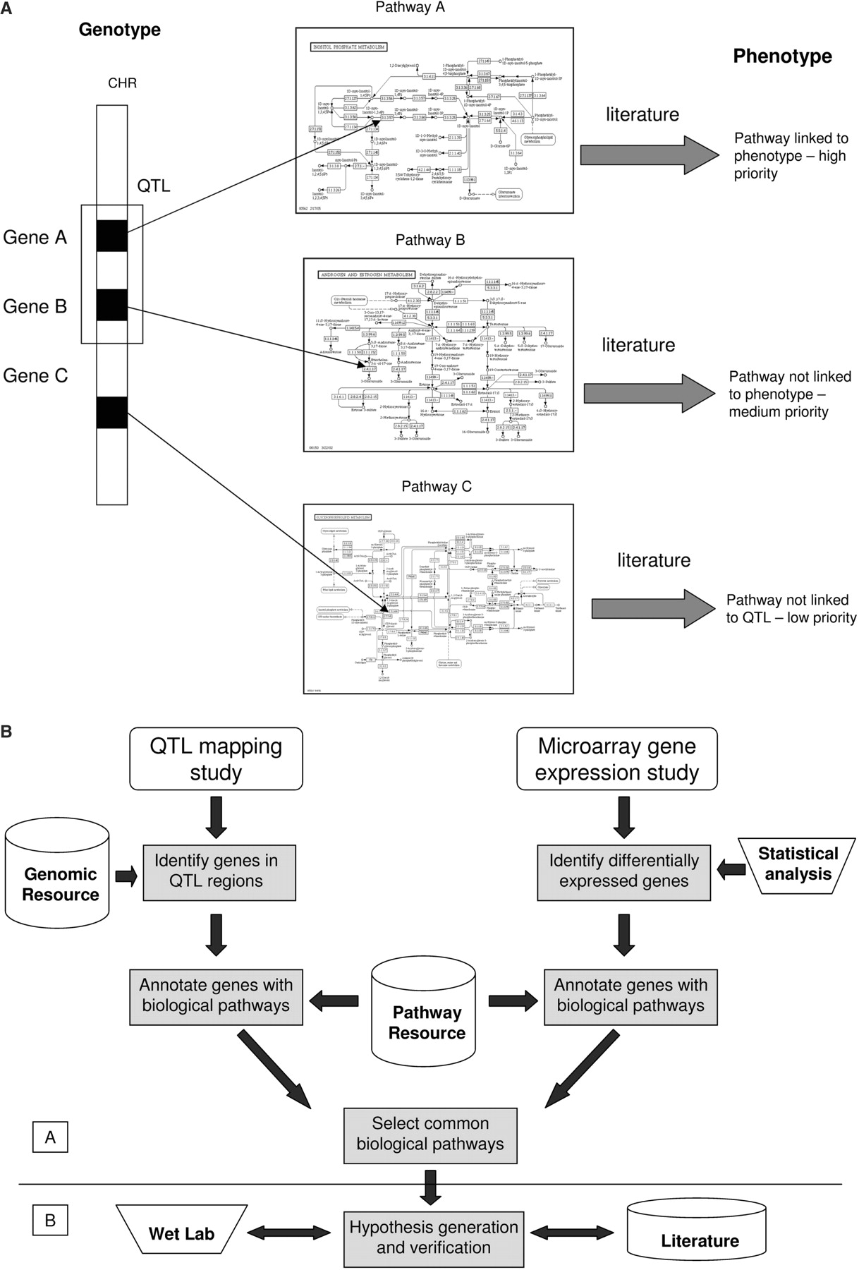
Figure 1. (a) An illustration showing the prioritization of phenotype candidates, from the pathway-driven approach. All ...
Notes:
Figure 1. (a) An illustration showing the prioritization of phenotype candidates, from the pathway-driven approach. All pathways are differentially expressed in the microarray data. Those pathways which contain genes from the QTL region are assigned a higher priority (pathways A and B) than those with no link to the QTL region (pathway C). Higher priority pathways are then ranked according to their involvement in the phenotypes expression, based on literature evidence. Abbreviations: CHR:Chromosome; QTL:Quantitative Trait Loci. (b) An illustration for the pathway-driven approach to genotype–phenotype correlations. The process of annotating candidate genes from microarray and QTL investigations with their biological pathways is shown. The pathways gathered from both studies are compared and those common to both are extracted as the candidate pathways for further analysis.These pathways represent a set of hypotheses, in that the candidates are the hypothetical processes which may contribute to the expression of the observed phenotype. Subsequent verification is required for each pathway by wet lab investigation and literature searches. This apporach is separated into two sections, distinguished by the dividing line between the selction of common pathways and the generation of hypotheses. The section labelled A represents the workflow side of the investigation;, whilst the section labelled B represents verification of the hypotheses through wet lab experimentation and literature mining.
Unless provided in the caption above, the following copyright applies to the content of this slide: © 2007 The Author(s)This is an Open Access article distributed under the terms of the Creative Commons Attribution Non-Commercial License (http://creativecommons.org/licenses/by-nc/2.0/uk/) which permits unrestricted non-commercial use, distribution, and reproduction in any medium, provided the original work is properly cited.

Slide 2
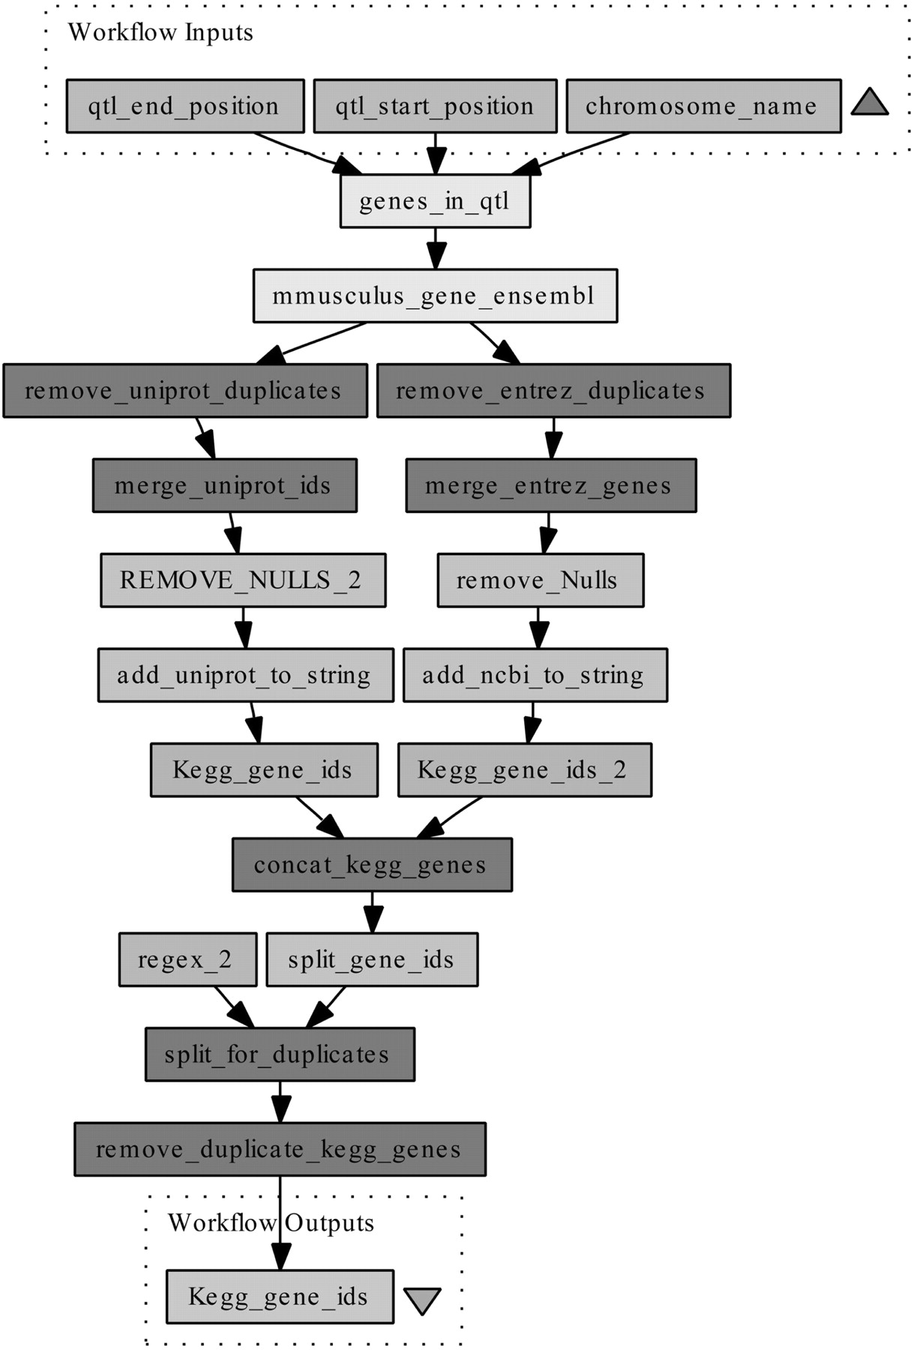
Figure 2. Annotation workflow to gather genes in a QTL region, and provide information on the pathways involved with a ...
Notes:
Figure 2. Annotation workflow to gather genes in a QTL region, and provide information on the pathways involved with a phenotype. This workflow, shown as a sub-set of the complete workflow, requires a chromosome, and QTL start and stop positions in base pairs. The genes in this QTL region are then returned from Ensembl via a BioMart plug-in. These genes are subsequently annotated with UniProt and Entrez identifiers, start and end positions, Ensembl Transcript ids and Affymetrix probeset identifiers for the chips Mouse430_2 and Mouse430a_2. The UniProt and Entrez ids are submitted to the KEGG gene database, retrieving a list of KEGG gene ids.
Unless provided in the caption above, the following copyright applies to the content of this slide: © 2007 The Author(s)This is an Open Access article distributed under the terms of the Creative Commons Attribution Non-Commercial License (http://creativecommons.org/licenses/by-nc/2.0/uk/) which permits unrestricted non-commercial use, distribution, and reproduction in any medium, provided the original work is properly cited.

Slide 3
Figure 3. Alignment of part of the acidic region of the Daxx gene in which an aspartate was deleted. 35/41 amino acids ...
Notes:
Figure 3. Alignment of part of the acidic region of the Daxx gene in which an aspartate was deleted. 35/41 amino acids in this region are aspartic acid (D) or glutamic acid (E).
Unless provided in the caption above, the following copyright applies to the content of this slide: © 2007 The Author(s)This is an Open Access article distributed under the terms of the Creative Commons Attribution Non-Commercial License (http://creativecommons.org/licenses/by-nc/2.0/uk/) which permits unrestricted non-commercial use, distribution, and reproduction in any medium, provided the original work is properly cited.

