Slide 1
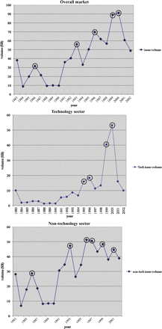
Figure 1 New Issue Activity (1983–2002) This figure plots the total new issue volume (IPO + SEO) for the overall ...
Notes:
Figure 1 New Issue Activity (1983–2002) This figure plots the total new issue volume (IPO + SEO) for the overall market, the technology sector, and the nontechnology sector. All new issue volumes are measured in billions of 1983 dollars. Circled years indicated peaks.
Unless provided in the caption above, the following copyright applies to the content of this slide: © Oxford University Press 2009

Slide 2
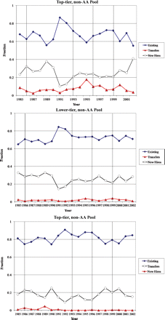
Figure 2 Compositions of Analyst Pools These figures plot the compositions of three analyst pools: the top-tier non-AA ...
Notes:
Figure 2 Compositions of Analyst Pools These figures plot the compositions of three analyst pools: the top-tier non-AA pool, the top-tier AA pool, and the lower-tier non-AA pool. Each analyst pool each year is first divided into existing analysts and newcomers. An existing analyst is in a pool for a given year and was also in the same pool the previous year. The rest are considered newcomers. Newcomers are further divided into transfers and new hires. A transfer is an analyst who did not belong to a particular pool but was in the database in the previous year. The remaining analysts are new to the database and are considered new hires.
Unless provided in the caption above, the following copyright applies to the content of this slide: © Oxford University Press 2009

Slide 3
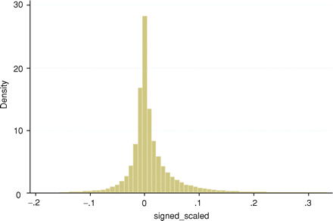
Figure A.1 Histogram of Signed Forecast Errors This graph plots the signed scaled forecast error, defined as EPS ...
Notes:
Figure A.1 Histogram of Signed Forecast Errors This graph plots the signed scaled forecast error, defined as EPS forecast minus actual release EPS scaled by book value of equity.
Unless provided in the caption above, the following copyright applies to the content of this slide: © Oxford University Press 2009

