Slide 1
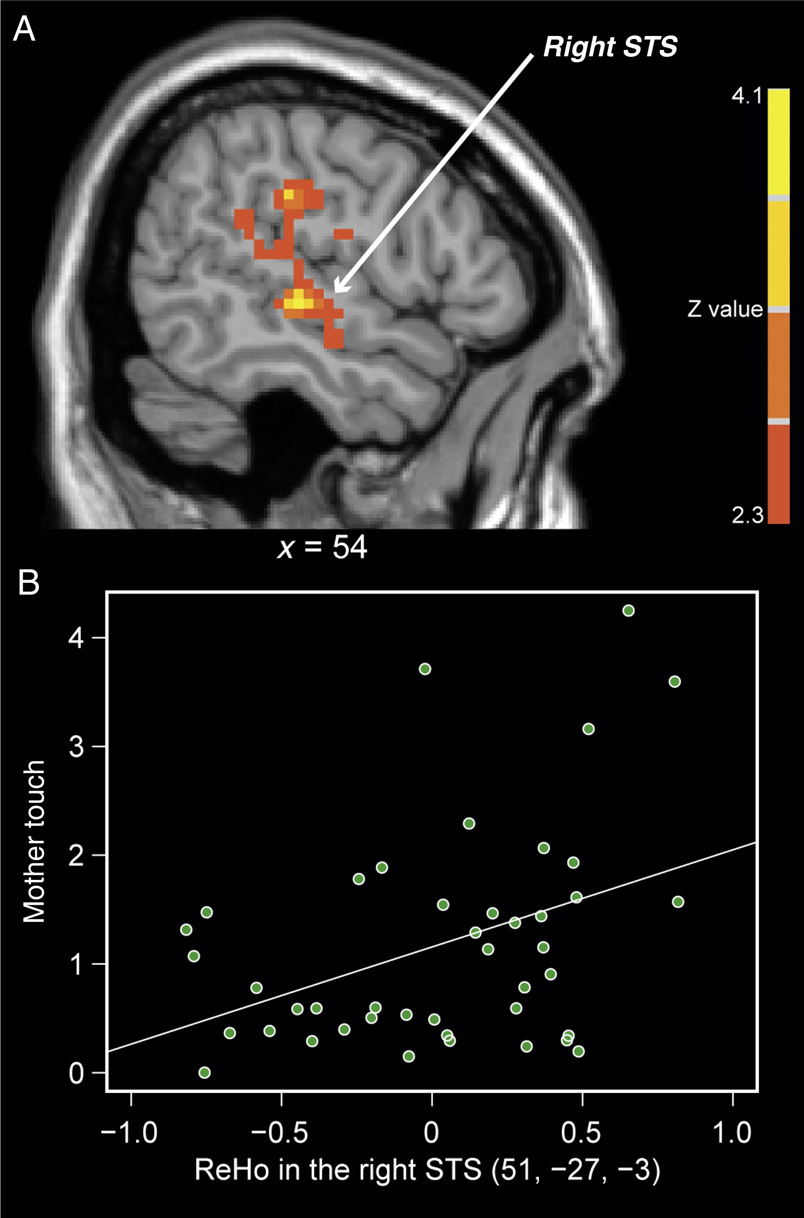
Figure 1. A significant correlation between regional homogeneity in resting-state fMRI time series and mother touch was ...
Notes:
Figure 1. A significant correlation between regional homogeneity in resting-state fMRI time series and mother touch was observed in a cluster with peak in the right STS (A). The scatter plot (B) illustrates individual data points for ReHo in the right STS cluster and mother touch (r = 0.40, P 2.3, cluster-wise P < 0.05, GRF corrected). STS, superior temporal sulcus.
Unless provided in the caption above, the following copyright applies to the content of this slide: © The Author 2016. Published by Oxford University Press.This is an Open Access article distributed under the terms of the Creative Commons Attribution Non-Commercial License (http://creativecommons.org/licenses/by-nc/4.0/), which permits non-commercial re-use, distribution, and reproduction in any medium, provided the original work is properly cited. For commercial re-use, please contact journals.permissions@oup.com

Slide 2
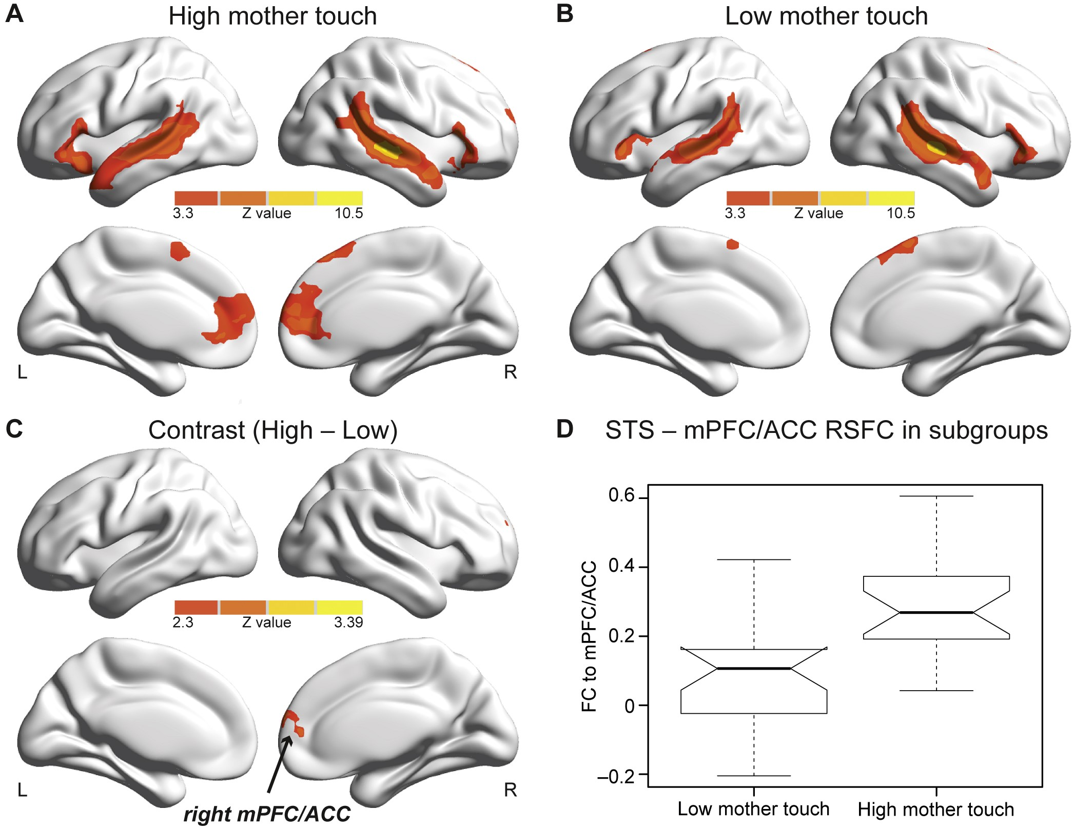
Figure 2. Functional connectivity maps based on the right STS seed in high and low mother touch subgroups (A and B) as ...
Notes:
Figure 2. Functional connectivity maps based on the right STS seed in high and low mother touch subgroups (A and B) as well as their comparison (C). The notched boxplot (D) depicts the connectivity strength between the right STS seed and mPFC/ACC in both low and high mother touch groups. Functional connectivity maps for both groups were thresholded at Z > 3.3 (P 2.3 (P < 0.05, GRF corrected). mPFC/ACC, medial prefrontal cortex/anterior cingulate cortex.
Unless provided in the caption above, the following copyright applies to the content of this slide: © The Author 2016. Published by Oxford University Press.This is an Open Access article distributed under the terms of the Creative Commons Attribution Non-Commercial License (http://creativecommons.org/licenses/by-nc/4.0/), which permits non-commercial re-use, distribution, and reproduction in any medium, provided the original work is properly cited. For commercial re-use, please contact journals.permissions@oup.com

