Slide 1
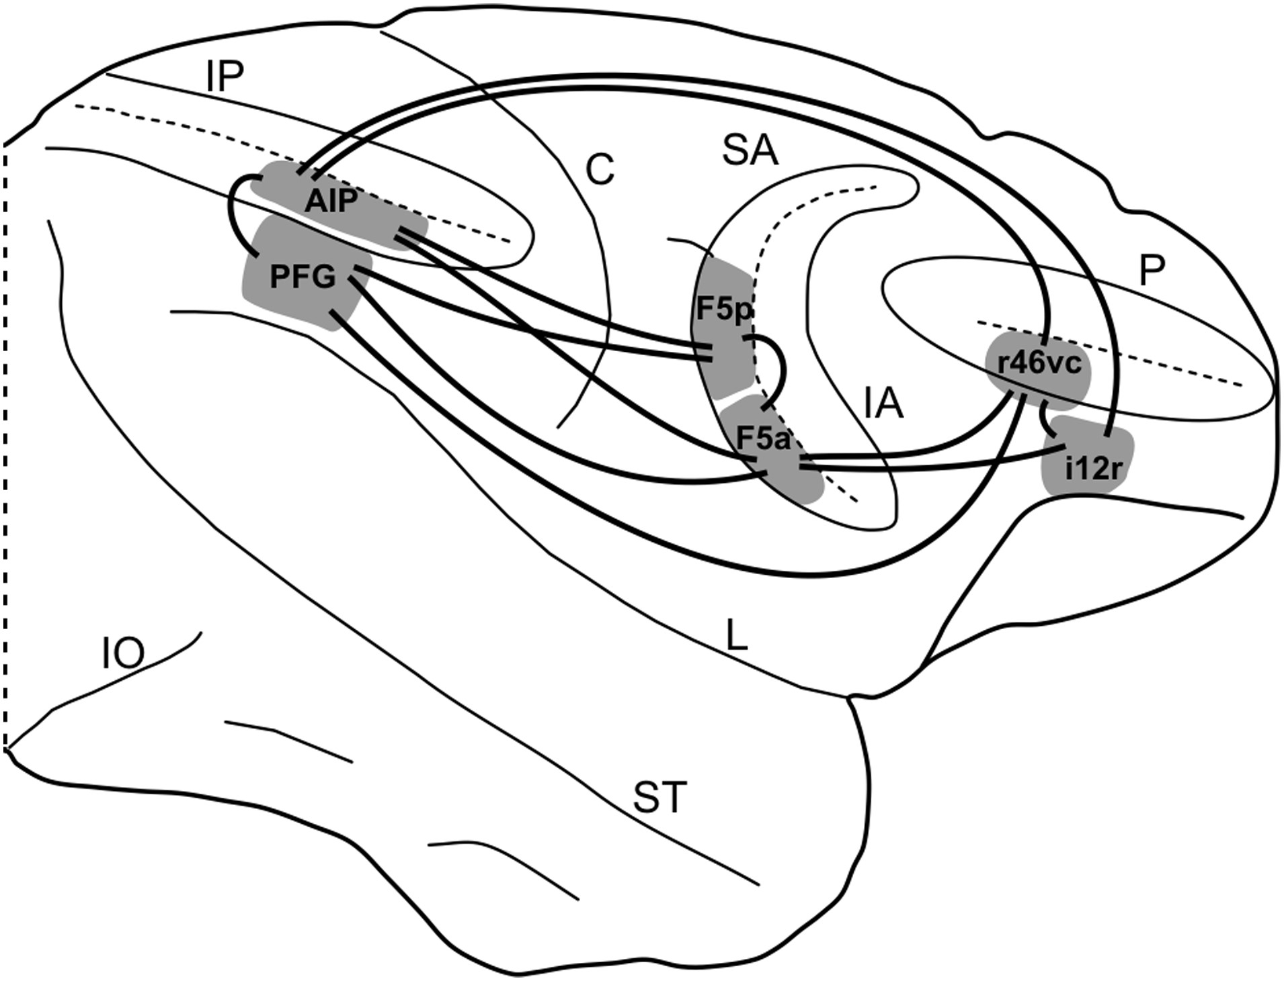
Figure 1. Summary view of the areas of the lateral grasping network object of the present study and of their ...
Notes:
Figure 1. Summary view of the areas of the lateral grasping network object of the present study and of their interconnections. C, central sulcus; IA, inferior arcuate sulcus; IO, inferior occipital; IP, intraparietal sulcus; i12r, intermediate part of area 12r; L, lateral fissure; P, principal sulcus; r46vc, rostral part of ventrocaudal area 46; SA, superior arcuate sulcus; ST, superior temporal sulcus.
Unless provided in the caption above, the following copyright applies to the content of this slide: © The Author 2015. Published by Oxford University Press. All rights reserved. For Permissions, please e-mail: journals.permissions@oup.com

Slide 2
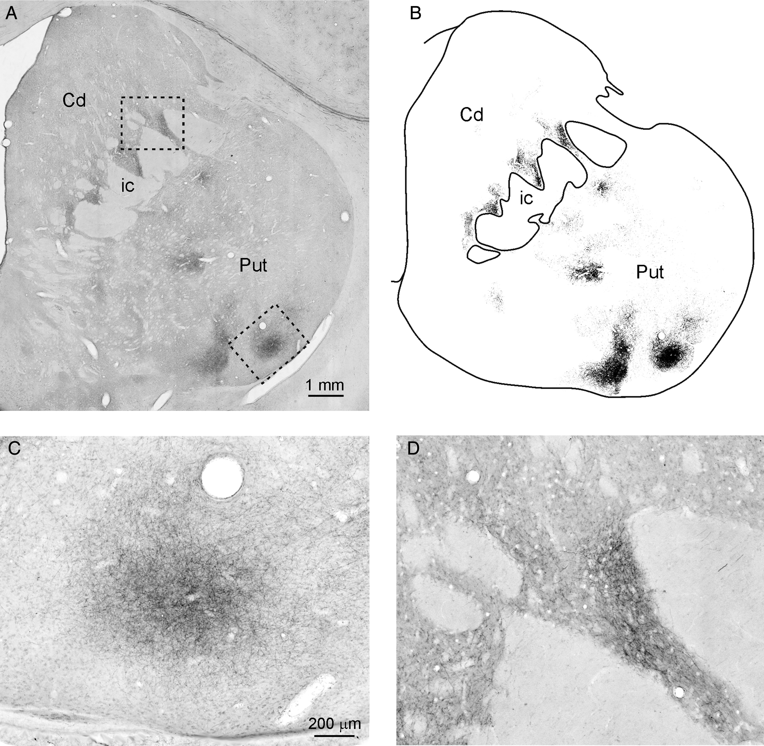
Figure 2. (A) Low-power view of a digitalized photomicrograph, taken with a ×10 objective, showing the distribution of ...
Notes:
Figure 2. (A) Low-power view of a digitalized photomicrograph, taken with a ×10 objective, showing the distribution of the striatal anterograde labeling at about 1.8 mm rostral to the AC in Case 34l BDA. Dashed boxes indicate the location of the higher magnification views shown in (C) and (D). (B) Same image as in (A) after the delineation of the outlines of the nuclear structures and extraction of the labeling using Adobe Photoshop as described in Materials and Methods section. (C and D) Higher magnification views of patches of dense labeled terminals (focal projections), relatively sharply demarcated from surrounding zones in which labeled terminals were sparser (diffuse projections), taken from the section shown in (A). Scale bar in (A) applies also to (B). Scale bar in (C) applies also to (D). Cd, caudate nucleus; ic, internal capsule; Put, putamen.
Unless provided in the caption above, the following copyright applies to the content of this slide: © The Author 2015. Published by Oxford University Press. All rights reserved. For Permissions, please e-mail: journals.permissions@oup.com

Slide 3
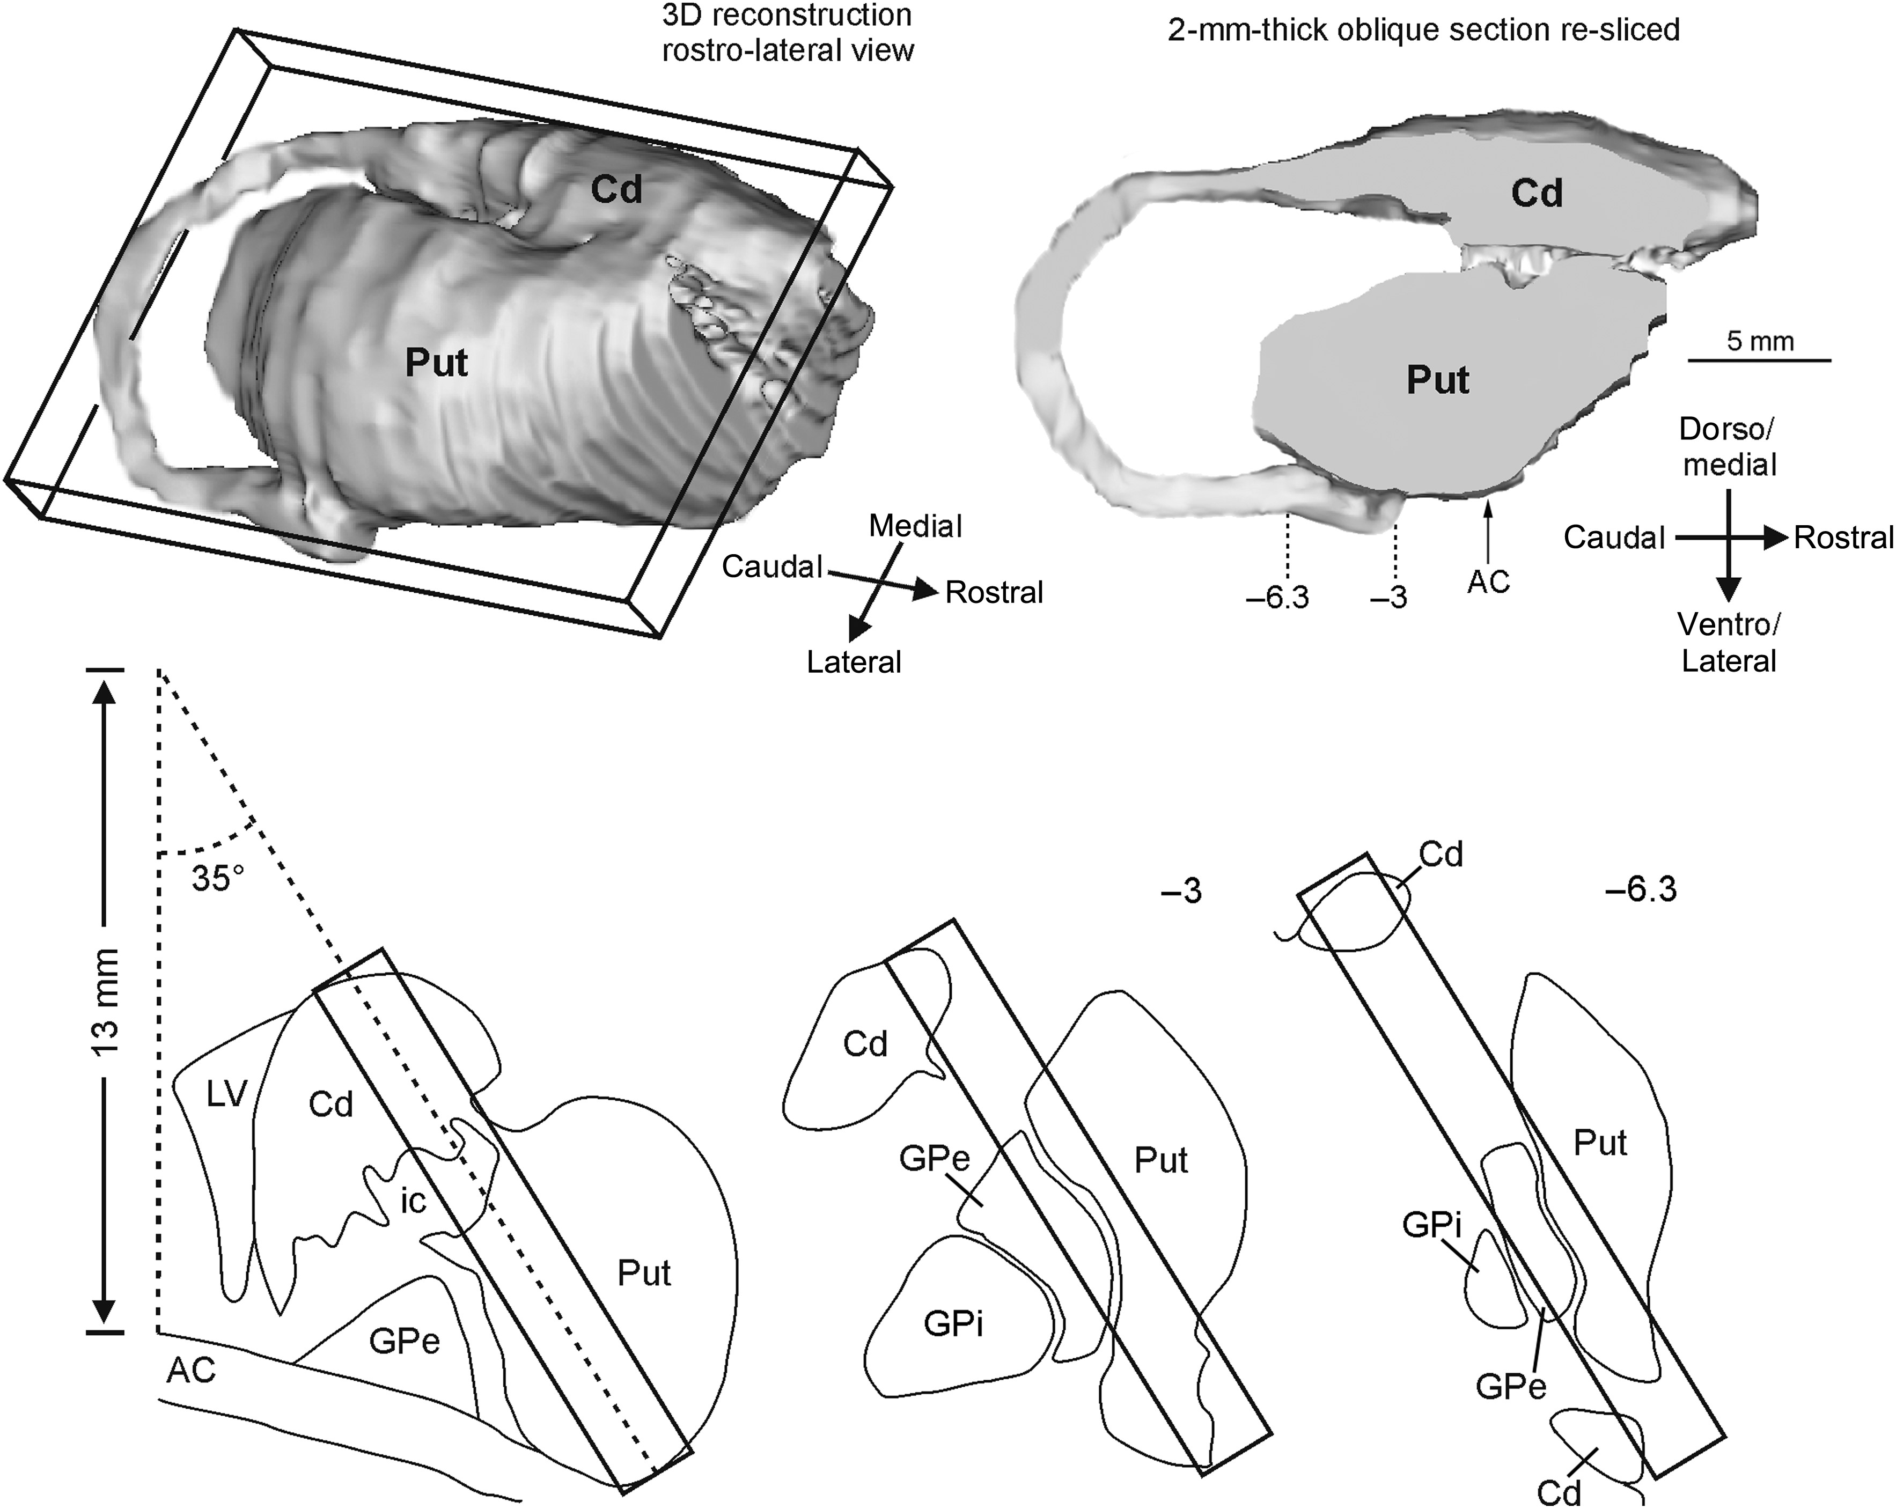
Figure 3. Sectioning procedure of the 3D reconstructions of the striatum. Based on the distribution of the labeling, a ...
Notes:
Figure 3. Sectioning procedure of the 3D reconstructions of the striatum. Based on the distribution of the labeling, a 2-mm-thick plane was first sectioned from the 3D reconstruction of Case 34l (upper part of the figure). The lower part of the figure shows the position of this plane in the striatum at 3 different rostrocaudal levels indicated in the re-sliced section in the upper right part of the figure. At the level of the AC (lower left), this plane intersects the midline at 13 mm above the upper border of the AC with an angle of 35°. These same parameters were then used to obtain similar oblique slices from the 3D reconstructions of all the other cases. For the sake of comparison, all the striatum reconstructions and sections in this and subsequent figures are shown as right. AC, anterior commissure; GPe, external globus pallidus; GPi, internal globus pallidus; LV, Lateral Ventricle. Other abbreviations as in Figure 2.
Unless provided in the caption above, the following copyright applies to the content of this slide: © The Author 2015. Published by Oxford University Press. All rights reserved. For Permissions, please e-mail: journals.permissions@oup.com

Slide 4
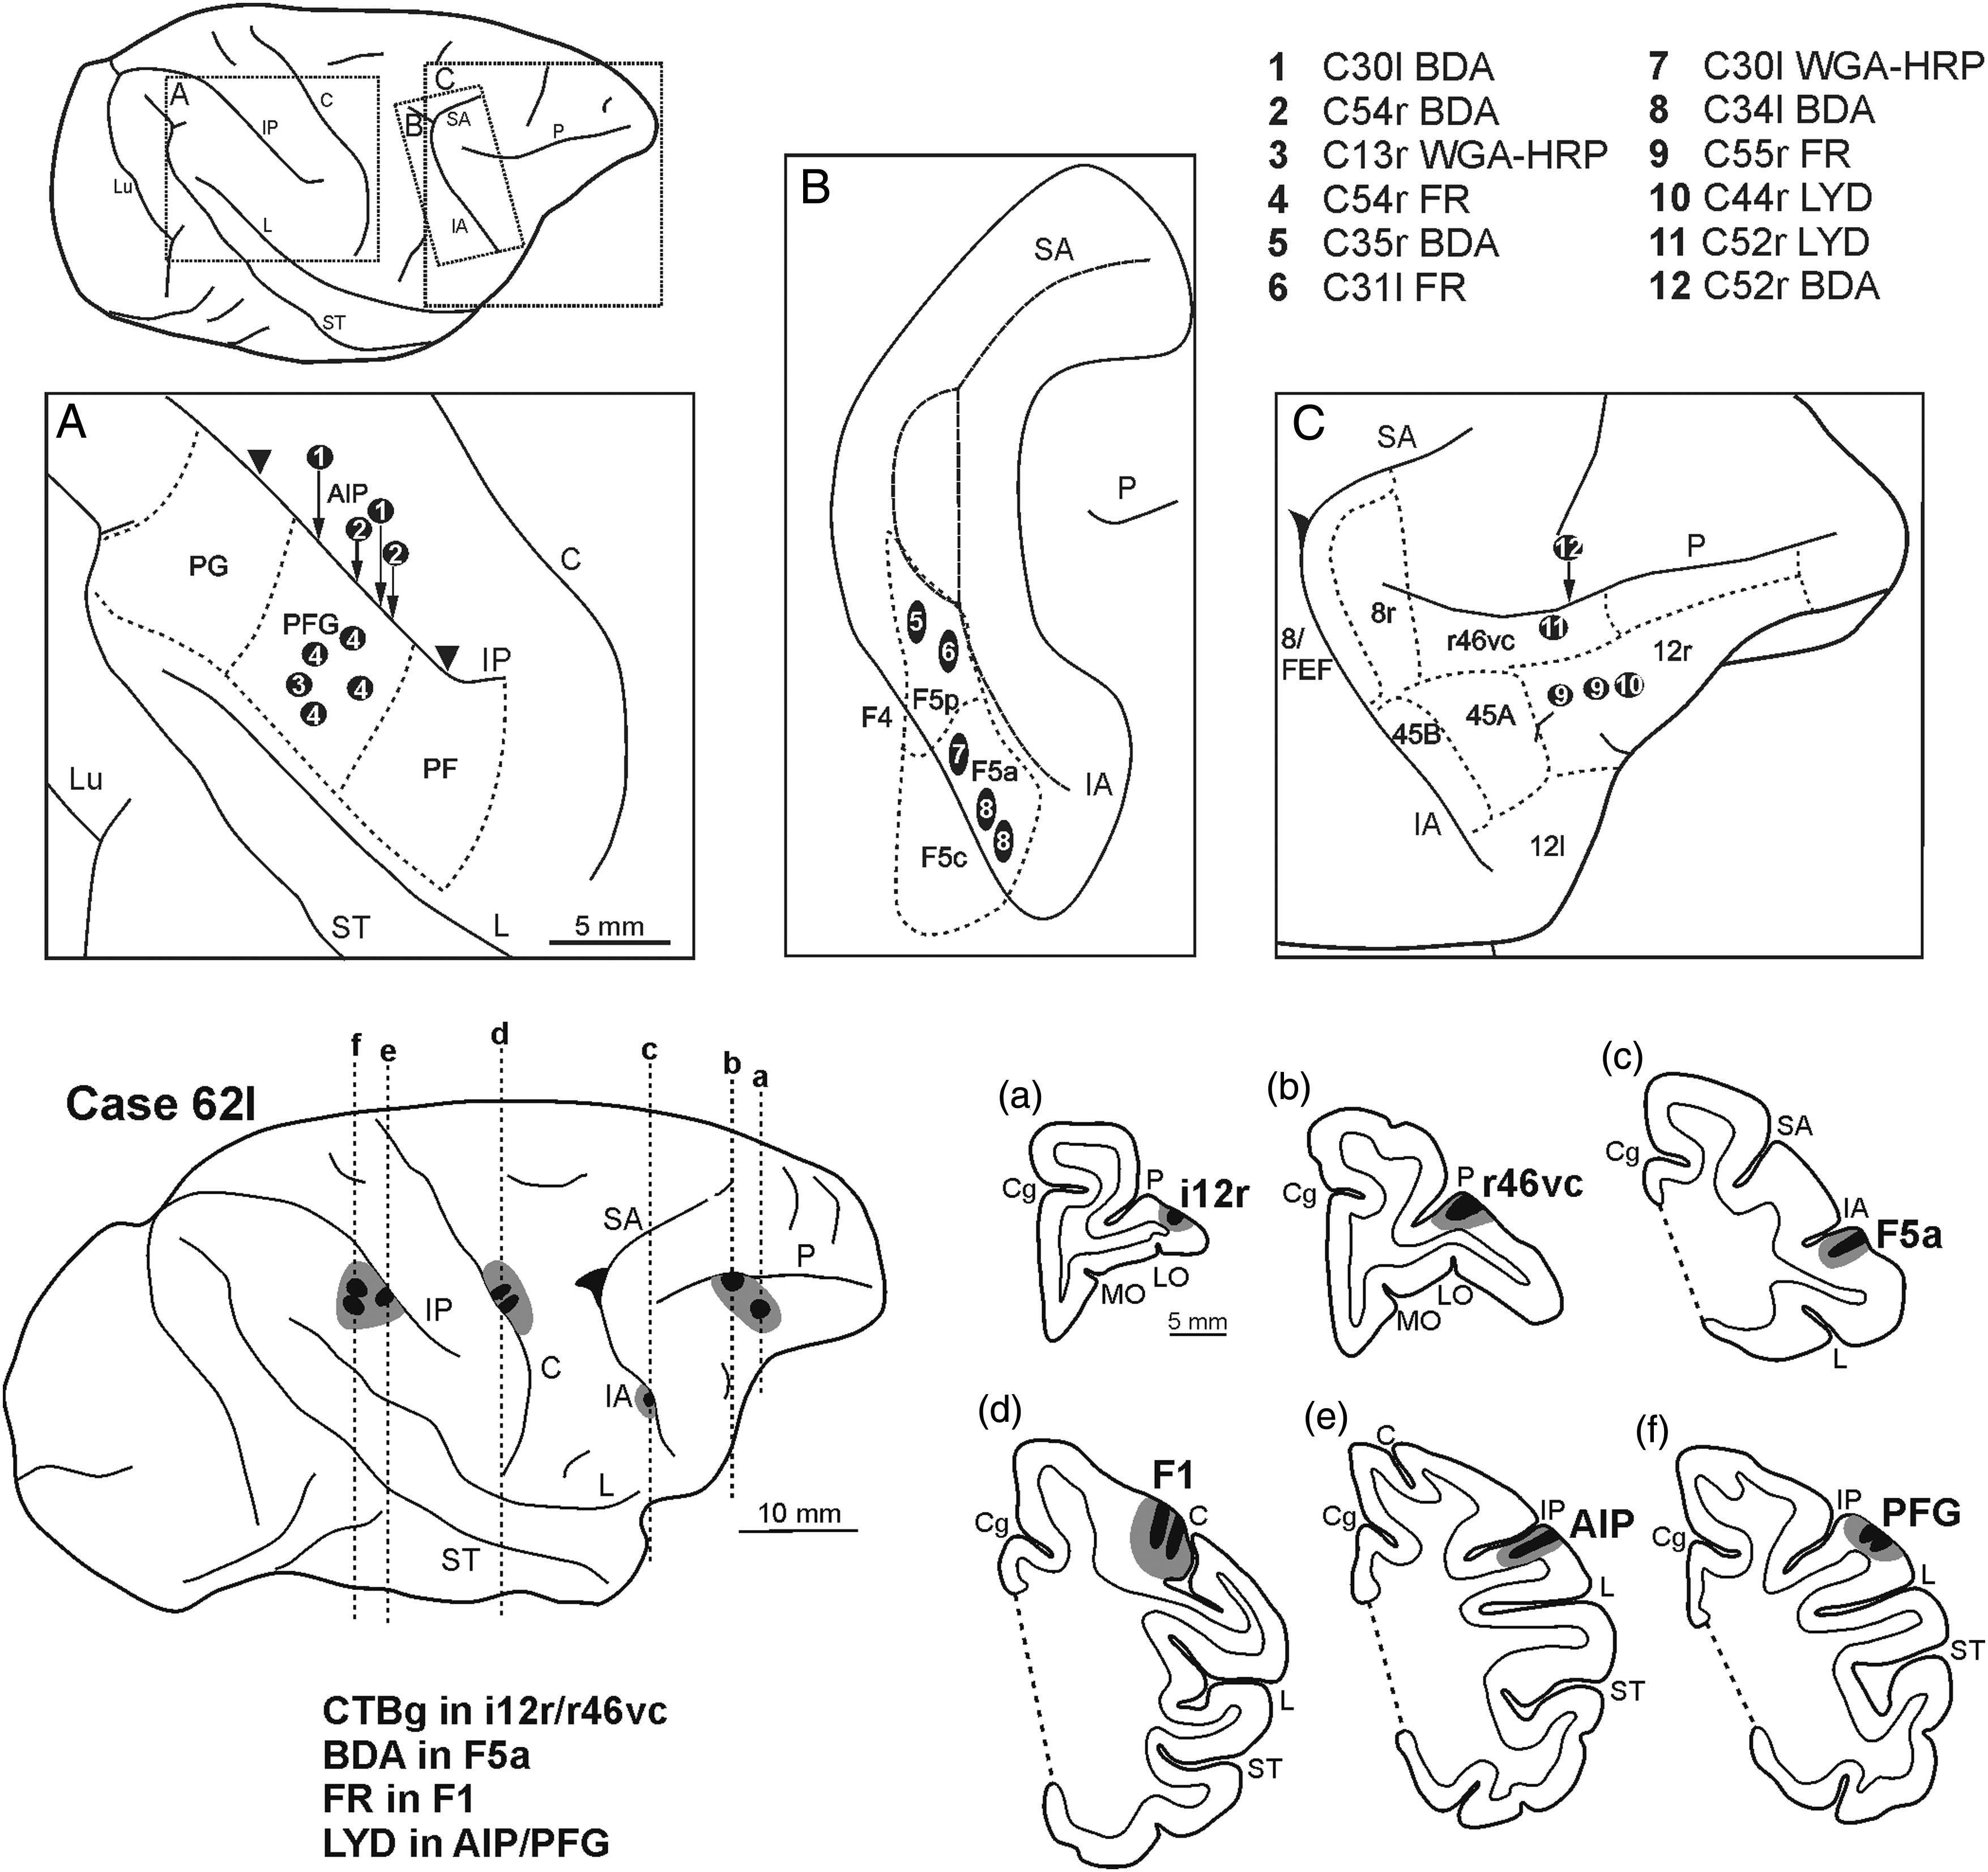
Figure 4. Location of injection sites. Upper part: composite view of all the injection sites mapped on a template right ...
Notes:
Figure 4. Location of injection sites. Upper part: composite view of all the injection sites mapped on a template right hemisphere, except for those in Case 62. Each injection site is numbered and reported, based on anatomical landmarks and stereotaxic coordinates, in the inferior parietal lobule (A), in the posterior bank of the arcuate sulcus (B), and in the ventrolateral prefrontal cortex (C). Arrows indicate the location of the injections sites in anterior intraparietal (AIP) in the lateral bank of the inferior parietal sulcus and in r46vc in the ventral bank of PS. Arrowheads in (A) indicate the rostrocaudal extent of area AIP, which does not extend on the lateral surface. Lower part: location of the injection sites in Cases 62l (shown as a right hemisphere) shown on dorsolateral views of the injected hemisphere and in coronal sections through the core (shown in black) and the halo (shown in lighter grey). Cg, cingulate sulcus; LO, lateral orbital sulcus; Lu, lunate sulcus; MO, medial orbital sulcus. Other abbreviations as in Figure 1. Scale bar in (A) applies also to (B–C). Scale bar in (a) applies also to (b–f).
Unless provided in the caption above, the following copyright applies to the content of this slide: © The Author 2015. Published by Oxford University Press. All rights reserved. For Permissions, please e-mail: journals.permissions@oup.com

Slide 5
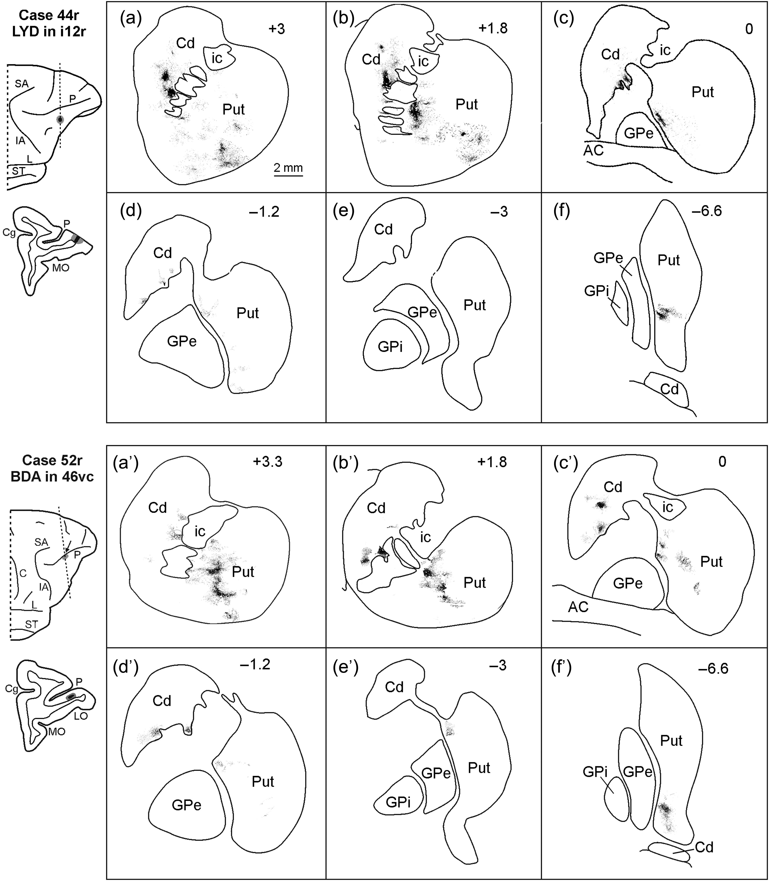
Figure 5. Drawings of coronal sections through the striatum showing the distribution of the anterograde labeling ...
Notes:
Figure 5. Drawings of coronal sections through the striatum showing the distribution of the anterograde labeling observed in Case 44r after the LYD injection in i12r (upper part) and in Case 52r after the BDA injection in r46vc (lower part). The sections are shown in a rostral to caudal order (a–f and a′–f′) and their AP level is indicated in terms of distance in mm from the AC. Scale bar in a applies also to (b–f) and to (a′–f′). Abbreviations as in Figures 1–4.
Unless provided in the caption above, the following copyright applies to the content of this slide: © The Author 2015. Published by Oxford University Press. All rights reserved. For Permissions, please e-mail: journals.permissions@oup.com

Slide 6
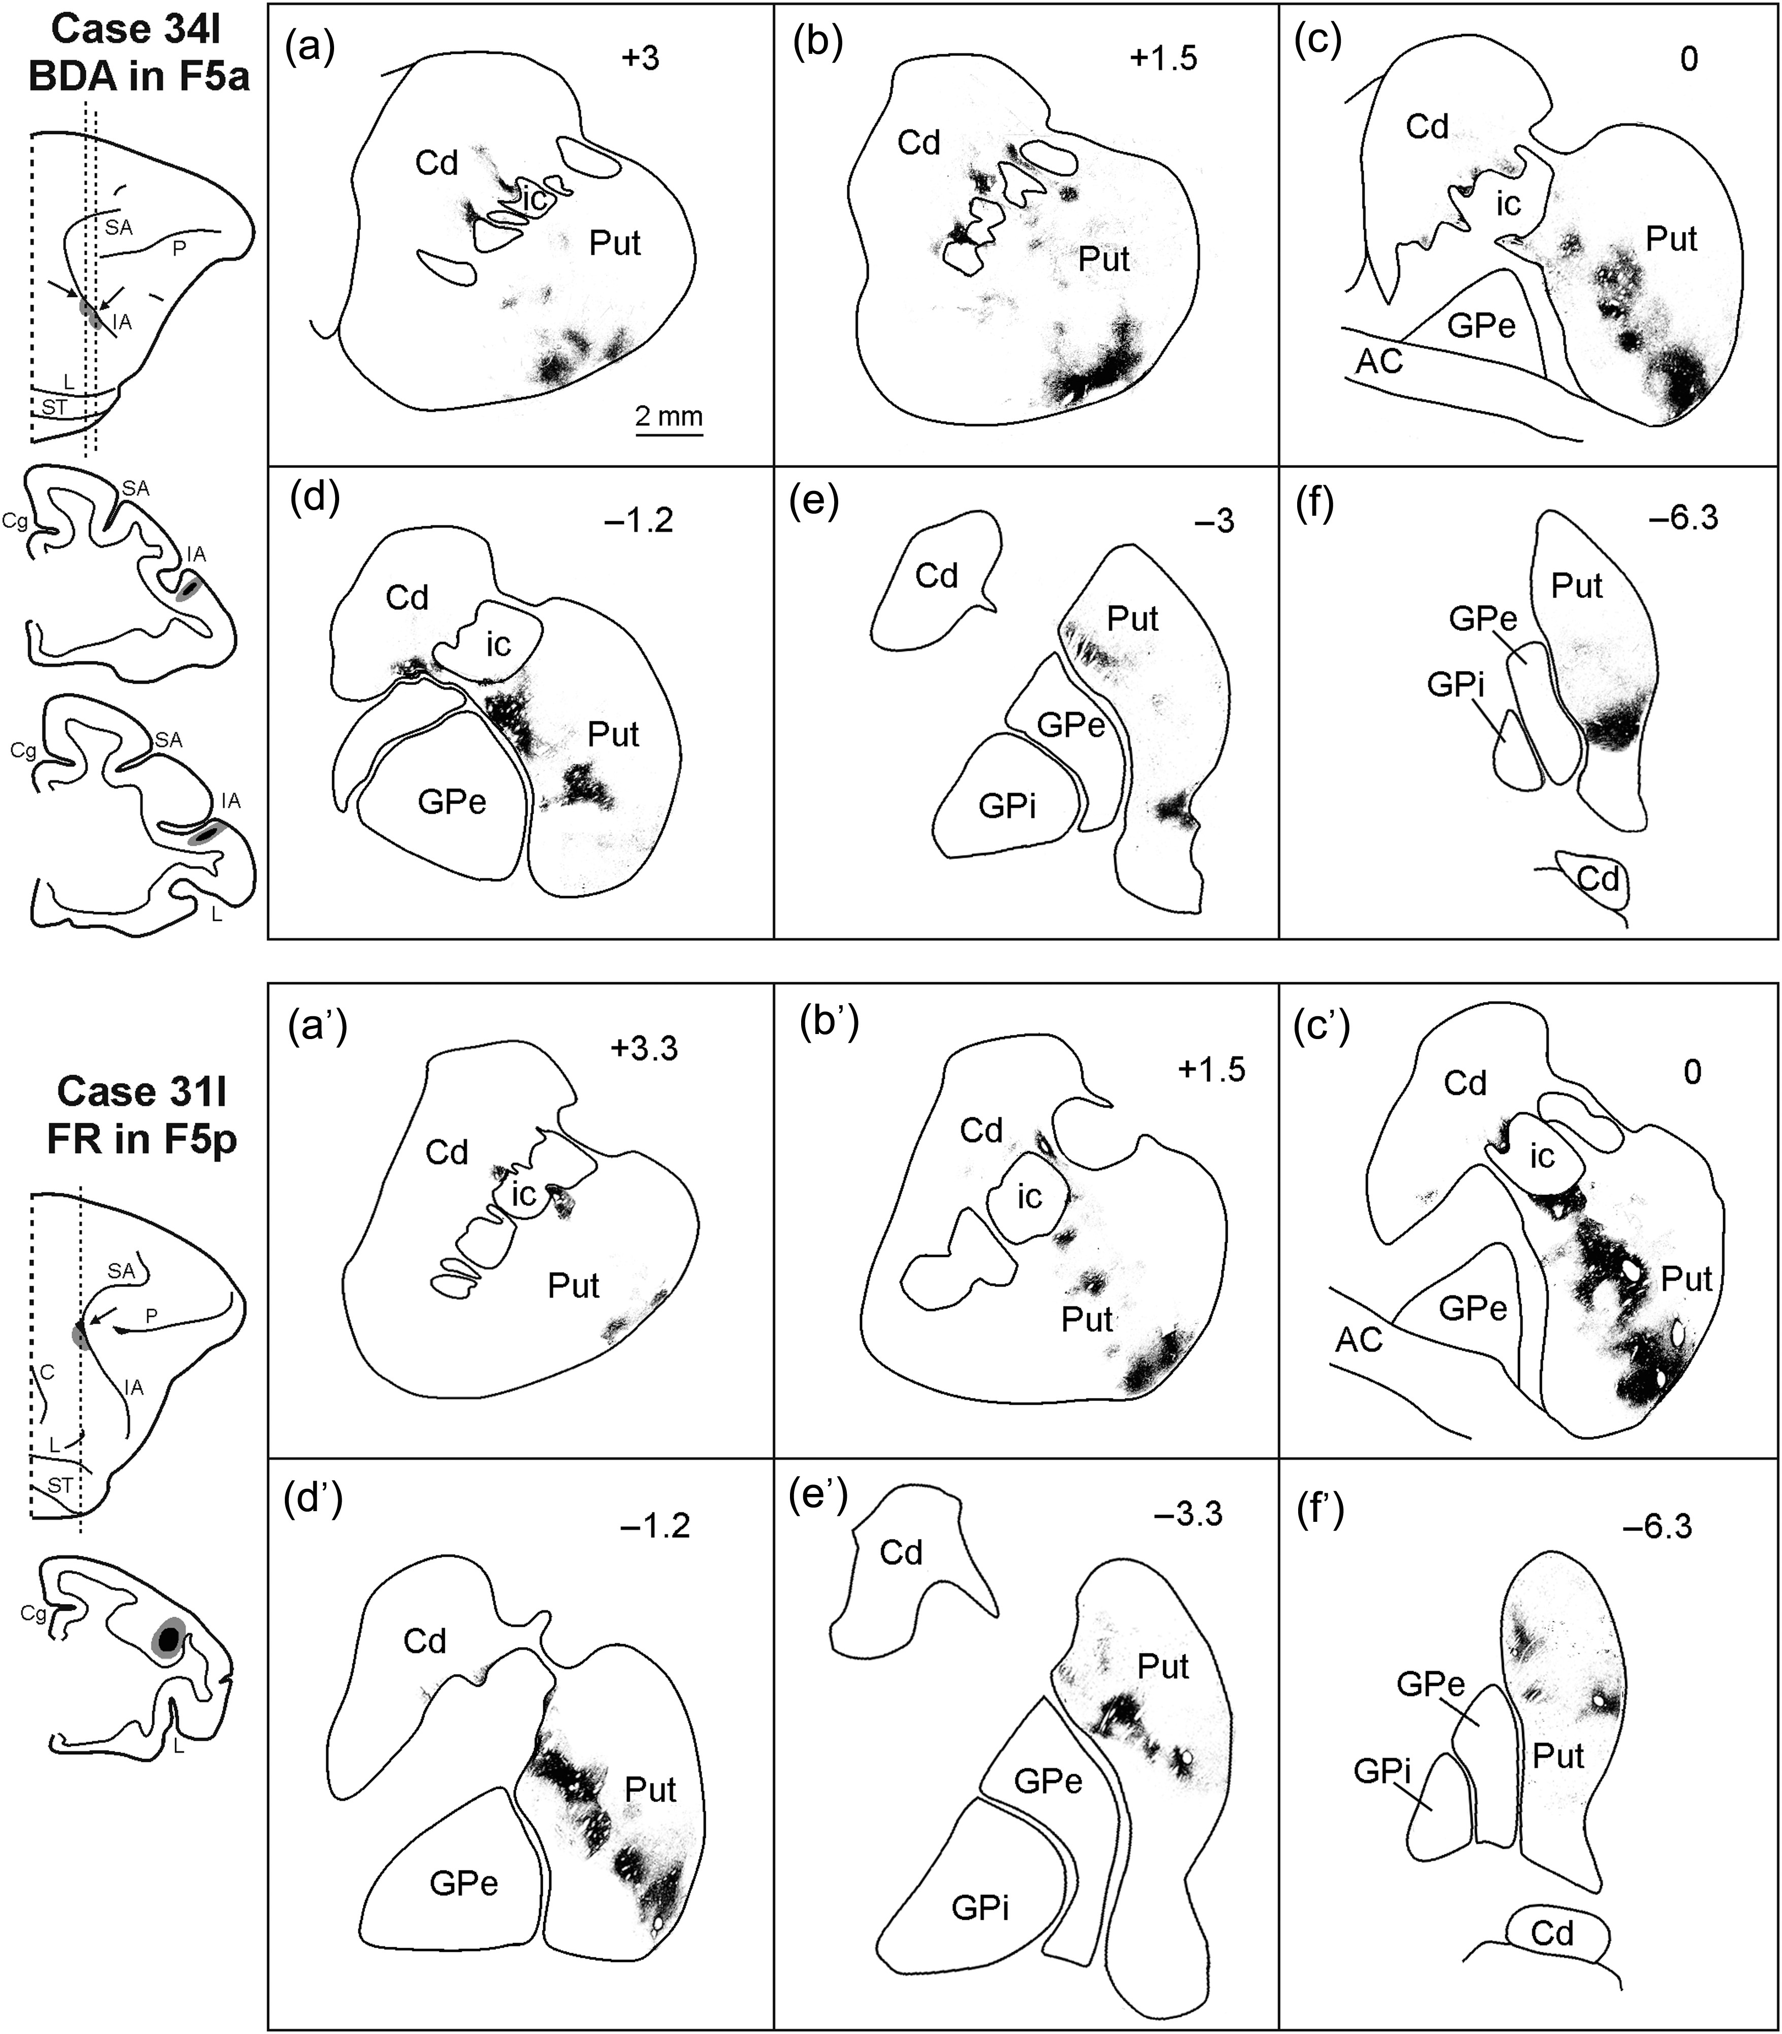
Figure 6. Drawings of coronal sections through the striatum showing the distribution of the anterograde labeling ...
Notes:
Figure 6. Drawings of coronal sections through the striatum showing the distribution of the anterograde labeling observed in Case 34l after the BDA injection in F5a (upper part) and in Case 31l after FR injection in F5p (lower part). Conventions and abbreviations as in Figures 1–5.
Unless provided in the caption above, the following copyright applies to the content of this slide: © The Author 2015. Published by Oxford University Press. All rights reserved. For Permissions, please e-mail: journals.permissions@oup.com

Slide 7
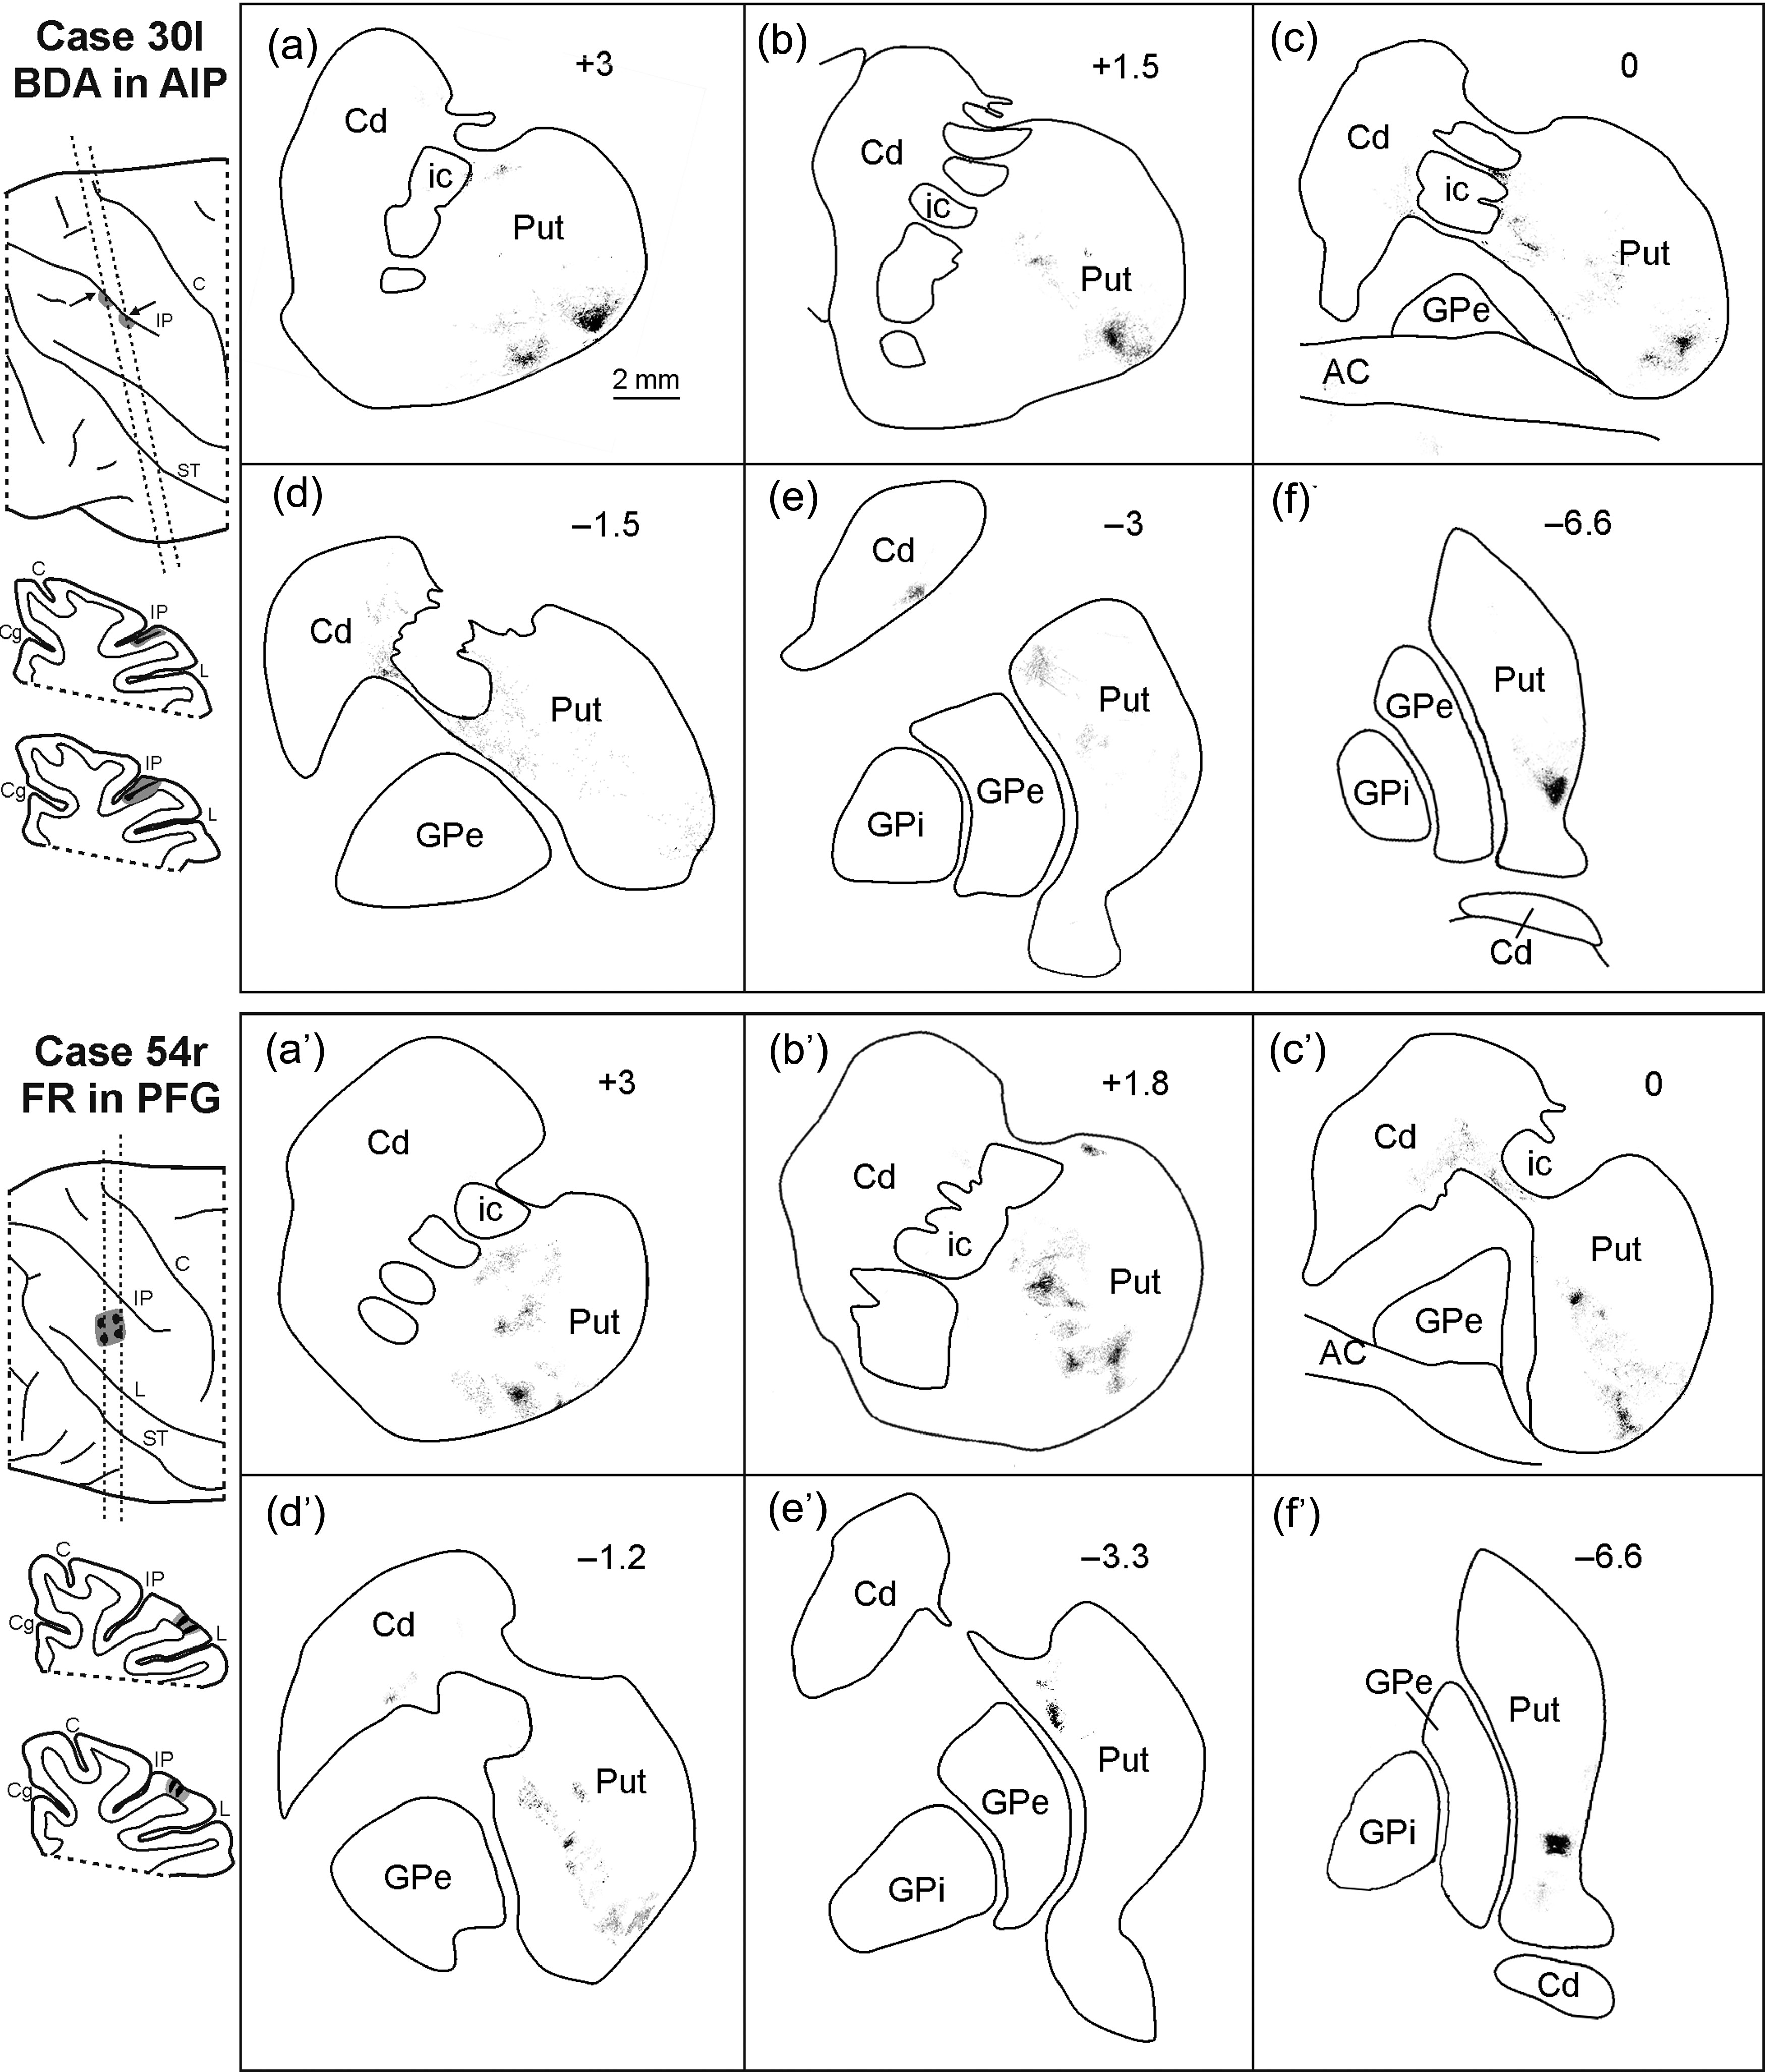
Figure 7. Drawings of coronal sections through the striatum showing the distribution of the anterograde labeling ...
Notes:
Figure 7. Drawings of coronal sections through the striatum showing the distribution of the anterograde labeling observed in Case 30l after the BDA injection in AIP (upper part) and in Case 54r after FR injection in PFG (lower part). Conventions and abbreviations as in Figures 1–5.
Unless provided in the caption above, the following copyright applies to the content of this slide: © The Author 2015. Published by Oxford University Press. All rights reserved. For Permissions, please e-mail: journals.permissions@oup.com

Slide 8
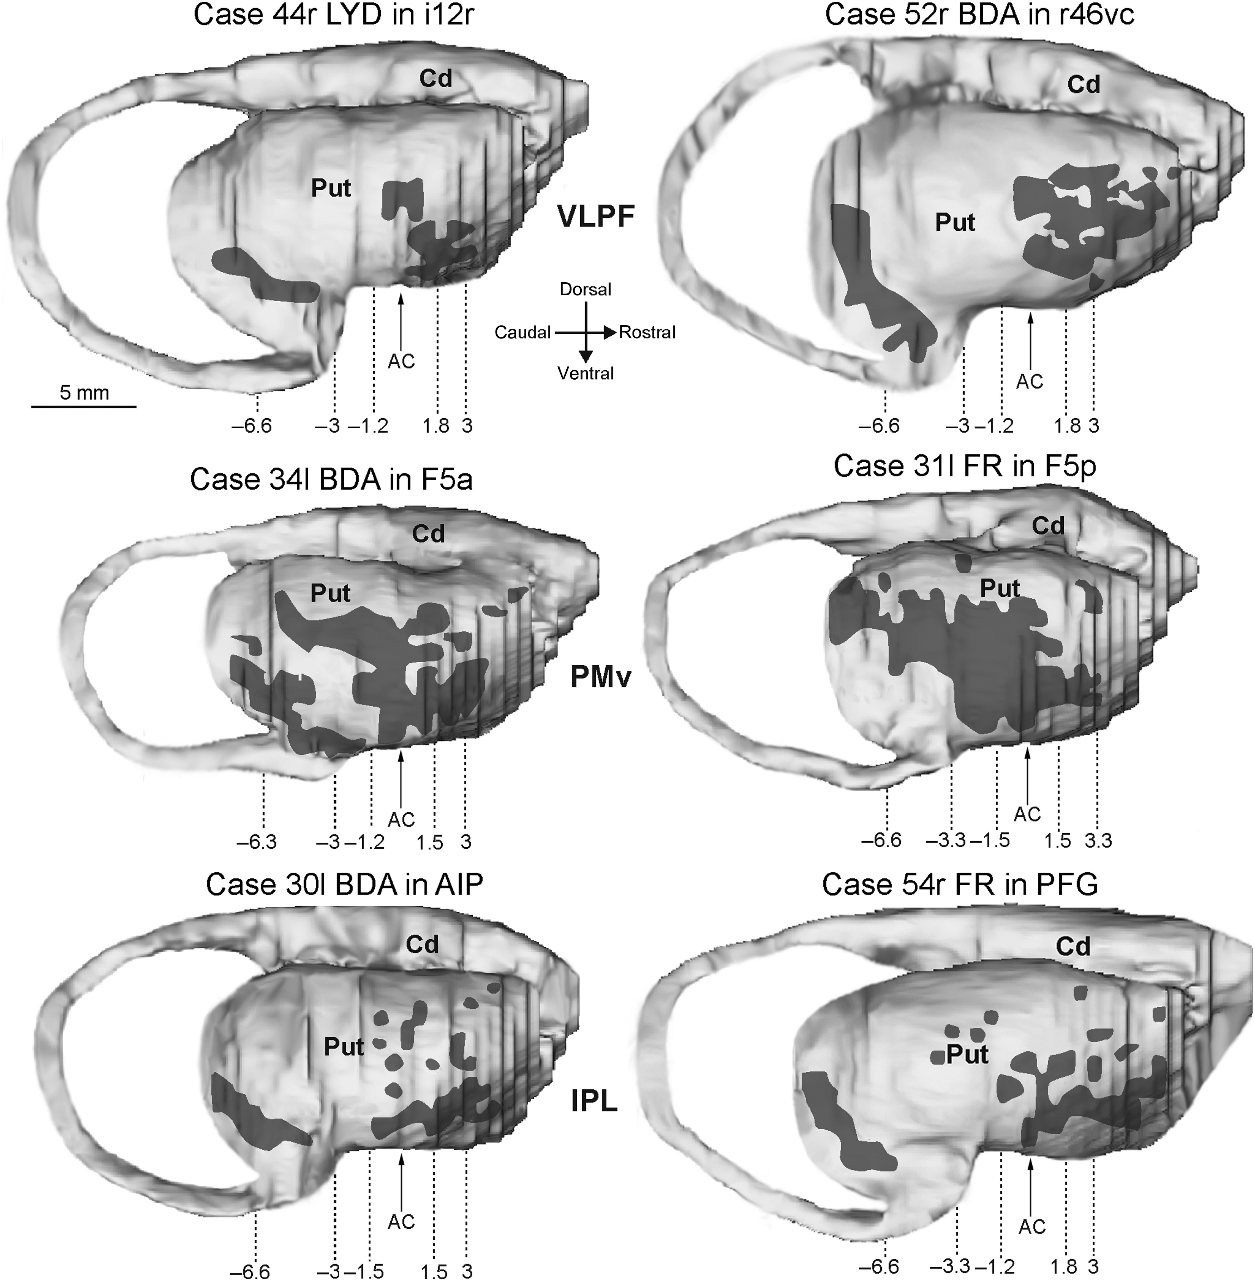
Figure 8. Distribution of the focal projections (indicated by shaded areas) observed in the putamen after tracer ...
Notes:
Figure 8. Distribution of the focal projections (indicated by shaded areas) observed in the putamen after tracer injections in the hand-related VLPF (upper part), PMv (middle part), and in IPL (lower part) areas shown in lateral views of the 3D reconstructions of the striatum. In each reconstruction the arrow marks the AP level of the AC and the dashed lines indicate the level of the sections showed in Figures 5 (VLPF injections), 6 (PMv injections), and 7 (IPL injections). Scale bar in upper left part applies to all the 3D reconstructions. Abbreviations as in Figures 2 and 3.
Unless provided in the caption above, the following copyright applies to the content of this slide: © The Author 2015. Published by Oxford University Press. All rights reserved. For Permissions, please e-mail: journals.permissions@oup.com

Slide 9
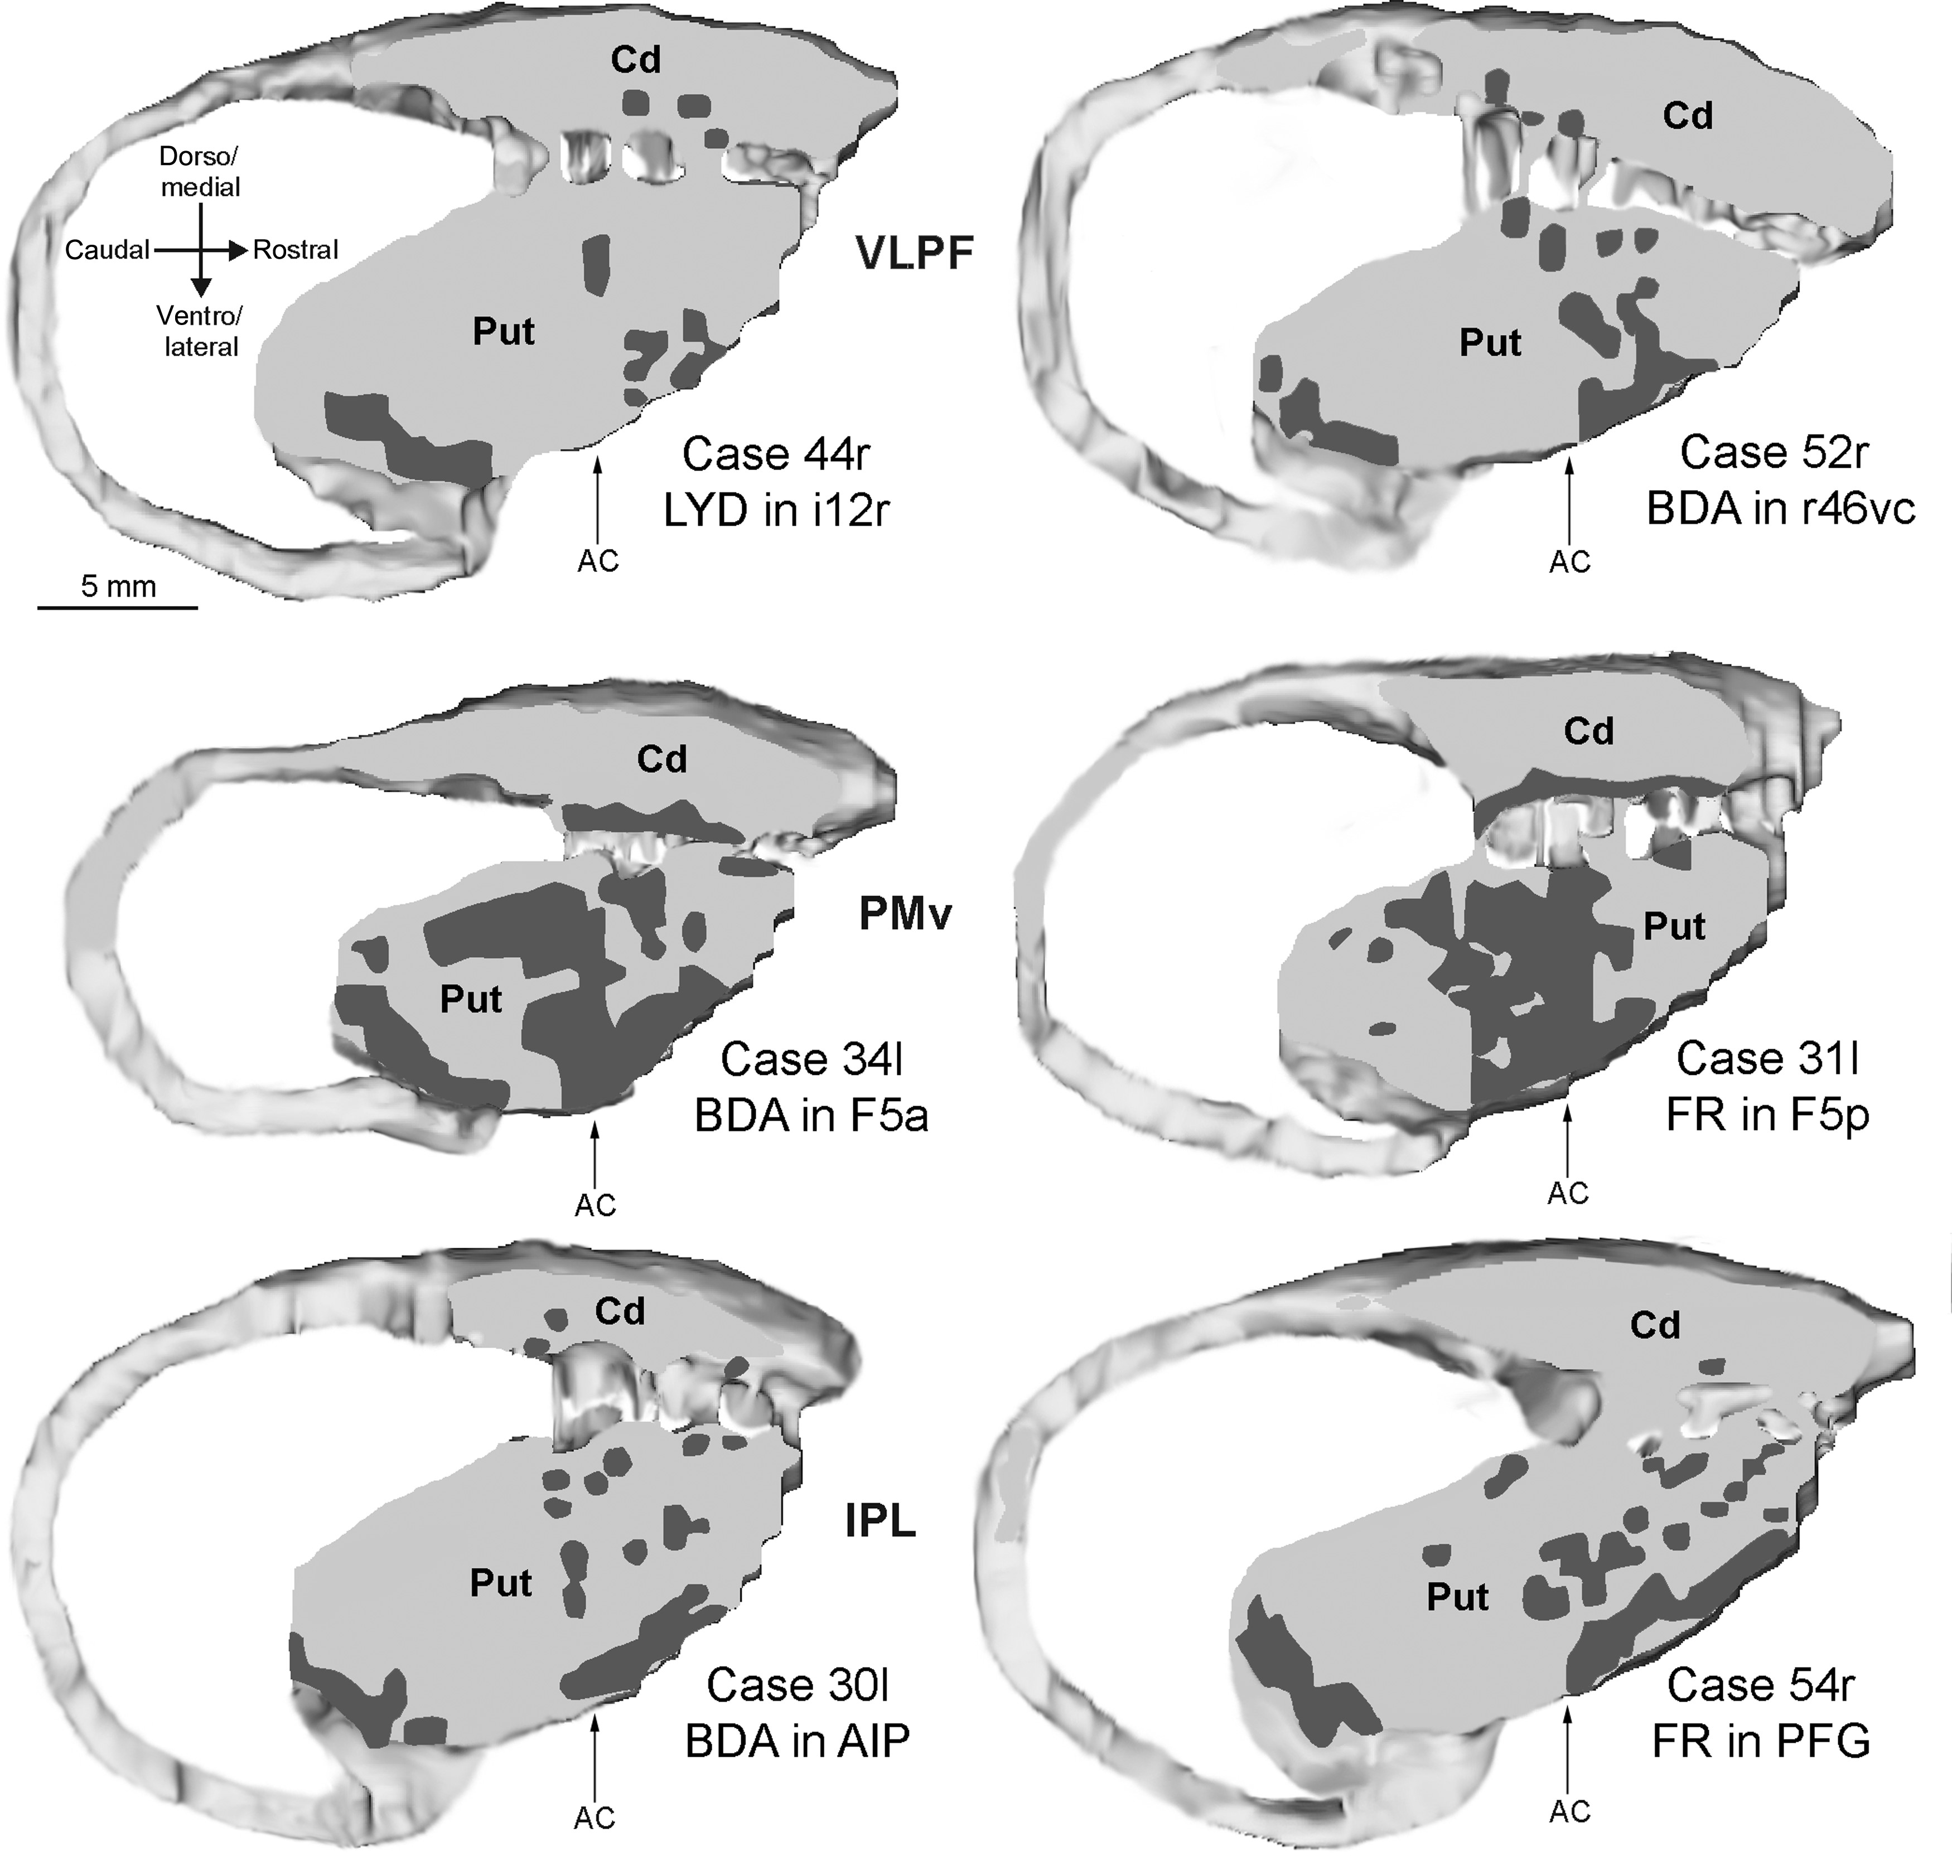
Figure 9. Distribution of the striatal focal projections observed after tracer injections in the hand-related VLPF ...
Notes:
Figure 9. Distribution of the striatal focal projections observed after tracer injections in the hand-related VLPF (upper part), PMv (middle part), and in IPL (lower part) areas shown in 2-mm-thick oblique sections re-sliced from the 3D reconstruction at the level shown in Figure 3. Conventions and abbreviations as in Figures 2, 3, and 8.
Unless provided in the caption above, the following copyright applies to the content of this slide: © The Author 2015. Published by Oxford University Press. All rights reserved. For Permissions, please e-mail: journals.permissions@oup.com

Slide 10
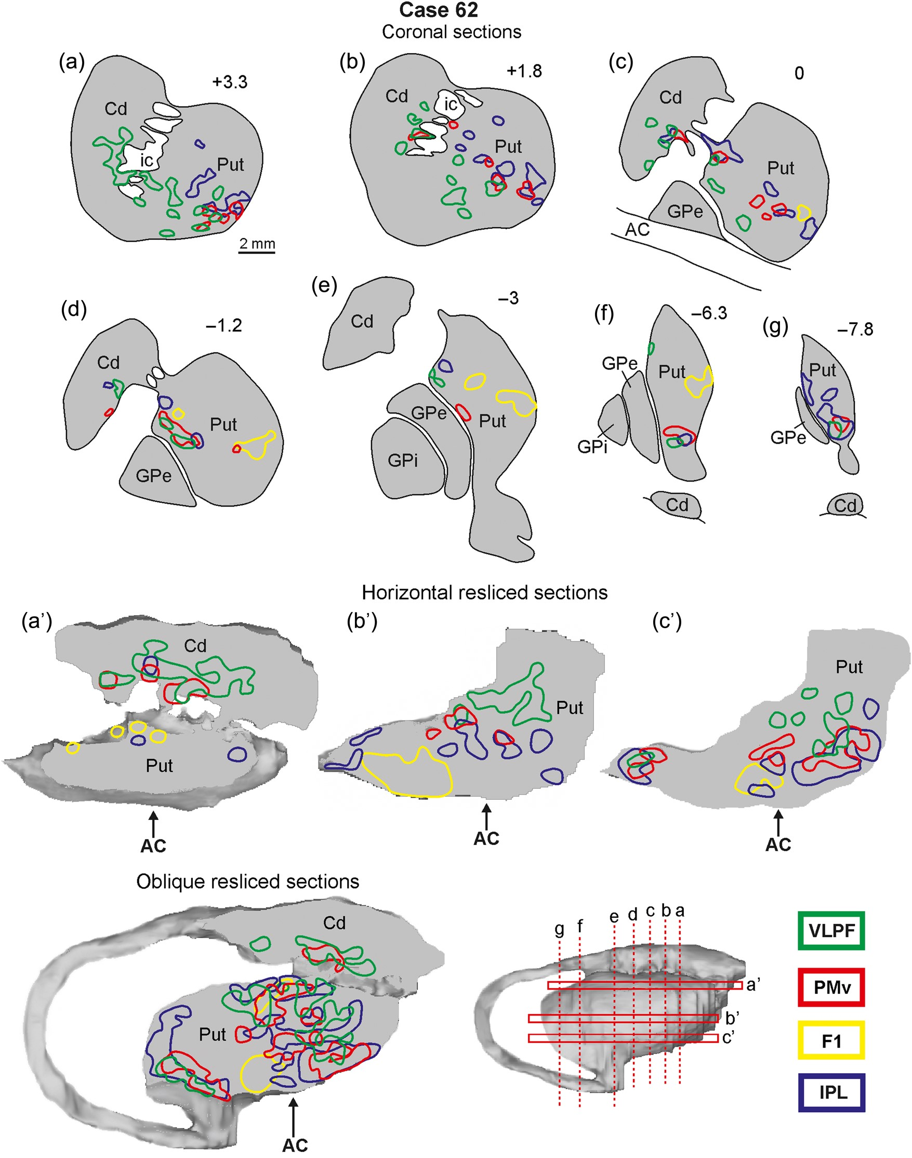
Figure 10. Distribution of the striatal focal projections observed in Case 62l after tracer injections in hand-related ...
Notes:
Figure 10. Distribution of the striatal focal projections observed in Case 62l after tracer injections in hand-related VLPF and IPL regions (green and blue lines, respectively), in area F5a (red lines), and in the hand field of the primary motor area F1 (yellow lines), shown in coronal sections and in 1-mm-thick horizontal sections and a 2-mm-thick oblique section re-sliced from the 3D reconstruction. The horizontal sections are shown in dorsal to ventral order (a′–c′). The level at which the coronal and horizontal sections were taken is indicated in the 3D reconstruction in the right lower part. Abbreviations as in Figures 2 and 3.
Unless provided in the caption above, the following copyright applies to the content of this slide: © The Author 2015. Published by Oxford University Press. All rights reserved. For Permissions, please e-mail: journals.permissions@oup.com

Slide 11
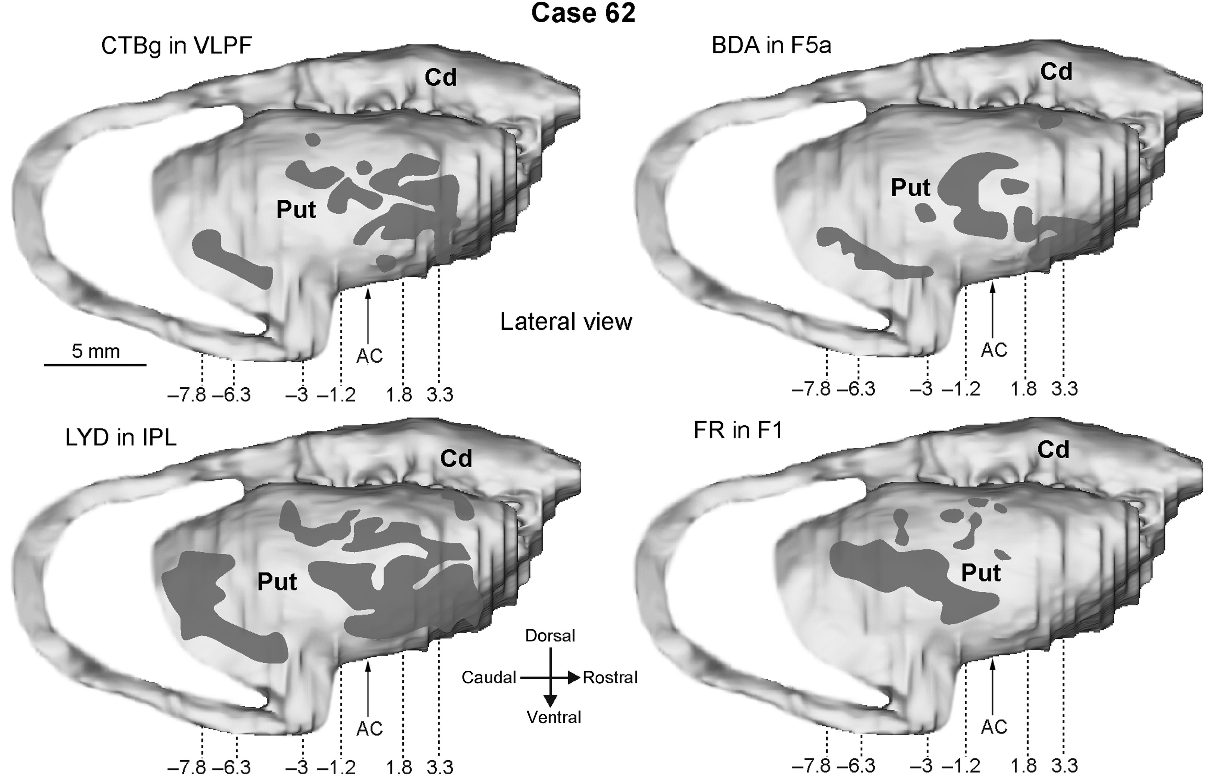
Figure 11. Distribution of the focal projections observed in Case 62l after tracer injections in hand-related VLPF and ...
Notes:
Figure 11. Distribution of the focal projections observed in Case 62l after tracer injections in hand-related VLPF and IPL regions, in PMv area F5a, and in primary motor area F1 shown in lateral views of the 3D reconstruction of the striatum. Other conventions and abbreviations as in Figures 2, 3, and 8.
Unless provided in the caption above, the following copyright applies to the content of this slide: © The Author 2015. Published by Oxford University Press. All rights reserved. For Permissions, please e-mail: journals.permissions@oup.com

Slide 12
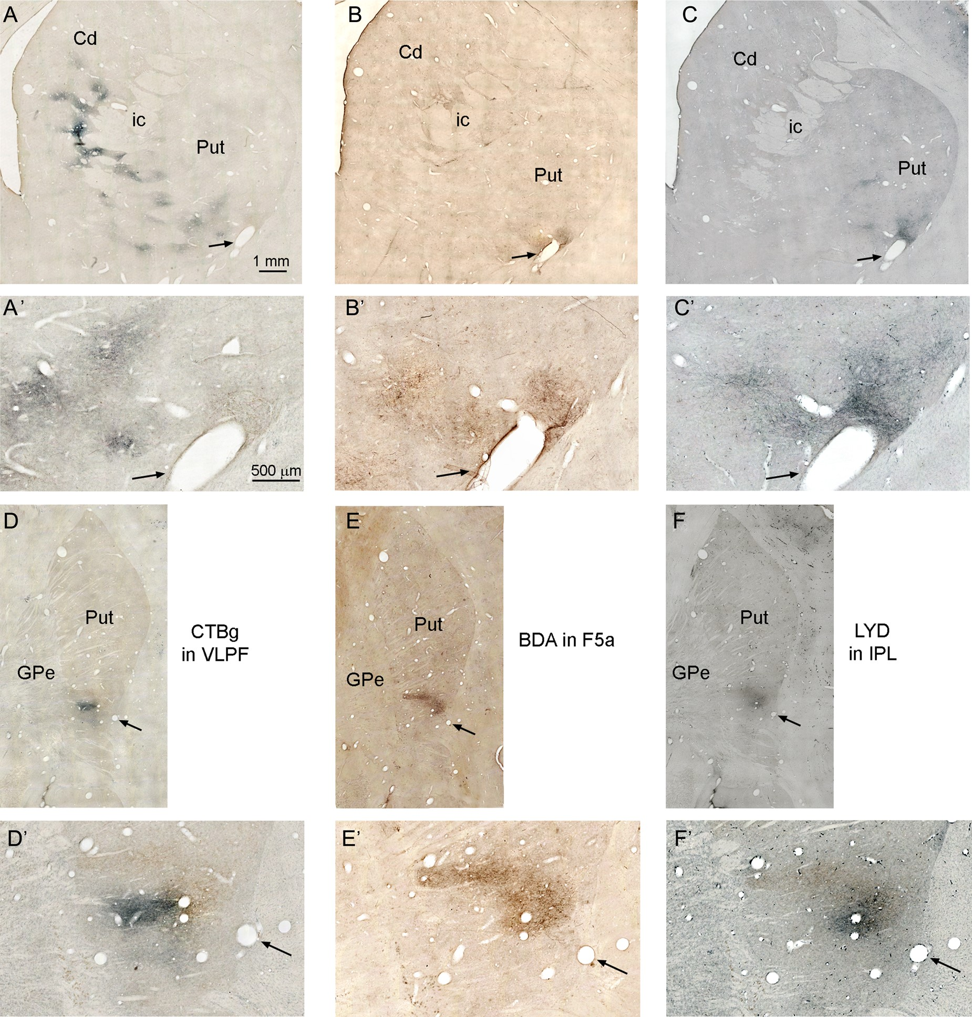
Figure 12. (A–F) Low-power photomicrographs showing the distribution of striatal anterograde labeling observed in Case ...
Notes:
Figure 12. (A–F) Low-power photomicrographs showing the distribution of striatal anterograde labeling observed in Case 62l after tracer injections in hand-related VLPF region (A and D), in PMv area F5a (B and E), and in hand-related IPL region (C and F). Sections A–C are adjacent and correspond to an AP level 3.3 mm rostral to the AC. Sections D–F are adjacent and correspond to an AP level 6.3 mm caudal to the AC. (A′–F′) Higher magnification views, taken from the sections shown in (A–F). Arrows point to the same blood vessel. In the left and right panels, the labeling was visualized with a double-labeling protocol (see Materials and Methods) in which the CTBg (in A, A′, D, and D′) and the LYD (in C, C′, F, and F′) labeling was stained blue and the BDA labeling was stained brown. In the middle panels (B, B′, E, and E′), the BDA labeling was visualized with the much more sensitive standard protocol. Scale bar in (A) applies also to (B–F). Scale bar in (A′) applies also to (B′–F′). Abbreviations as in Figures 2 and 3.
Unless provided in the caption above, the following copyright applies to the content of this slide: © The Author 2015. Published by Oxford University Press. All rights reserved. For Permissions, please e-mail: journals.permissions@oup.com

Slide 13
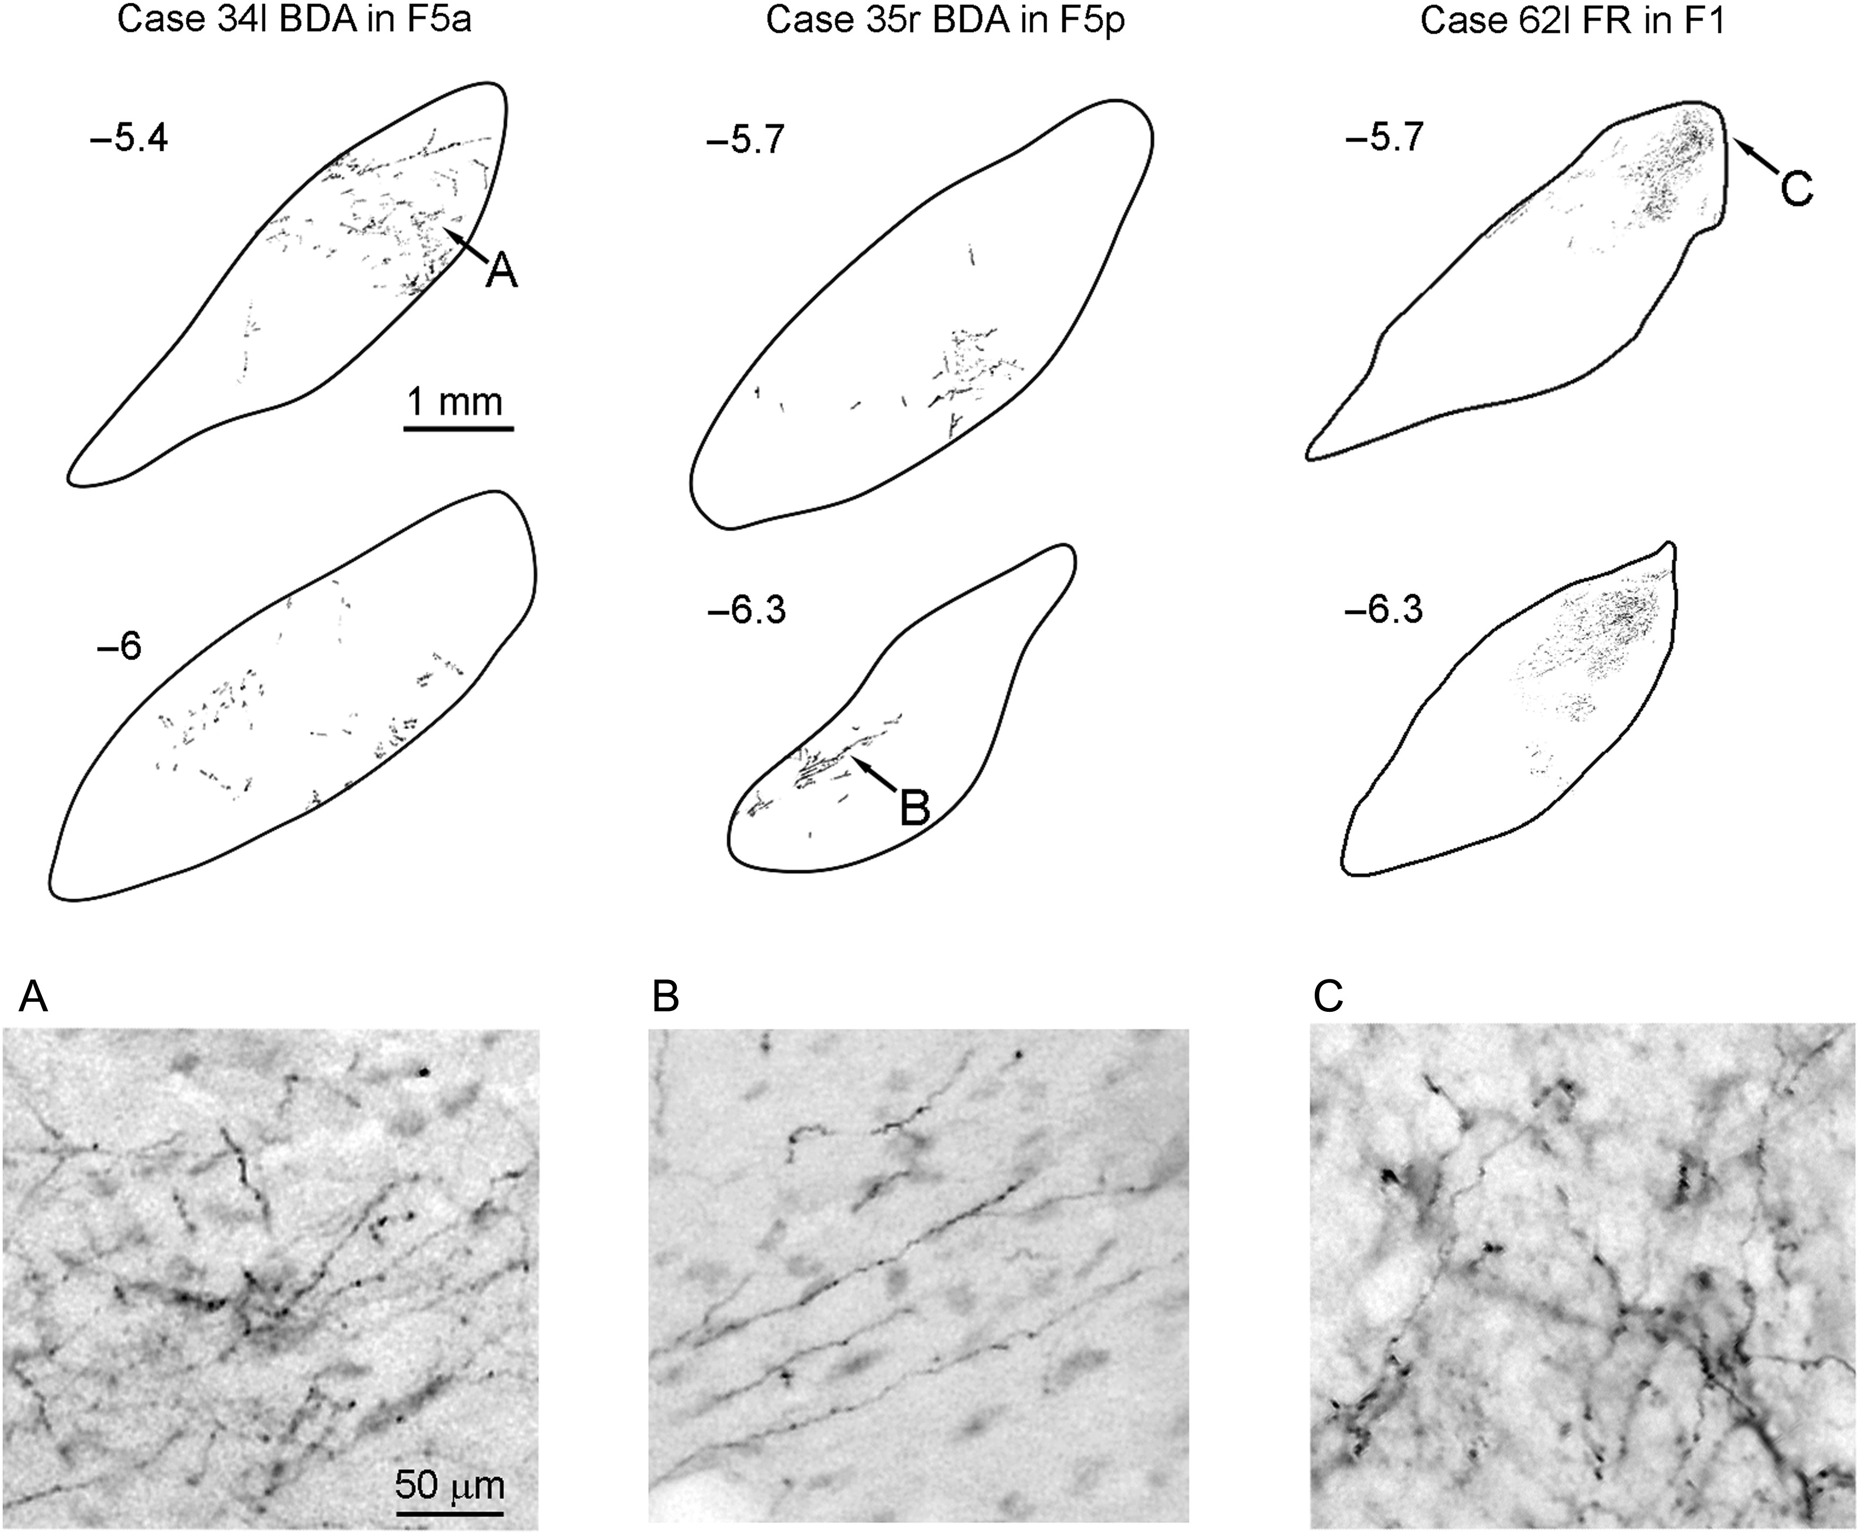
Figure 13. Drawings of coronal sections through the subthalamic nucleus showing the distribution of the anterograde ...
Notes:
Figure 13. Drawings of coronal sections through the subthalamic nucleus showing the distribution of the anterograde labeling observed in Case 34l after the BDA injection in F5a, in Case 35r after BDA injection in F5p, and in Case 62l after the FR injections in F1. For each case, the AP level is indicated in terms of distance in mm from the AC. Small arrows point to the field shown in the photomicrographs in the lower part of the figure.
Unless provided in the caption above, the following copyright applies to the content of this slide: © The Author 2015. Published by Oxford University Press. All rights reserved. For Permissions, please e-mail: journals.permissions@oup.com

Slide 14
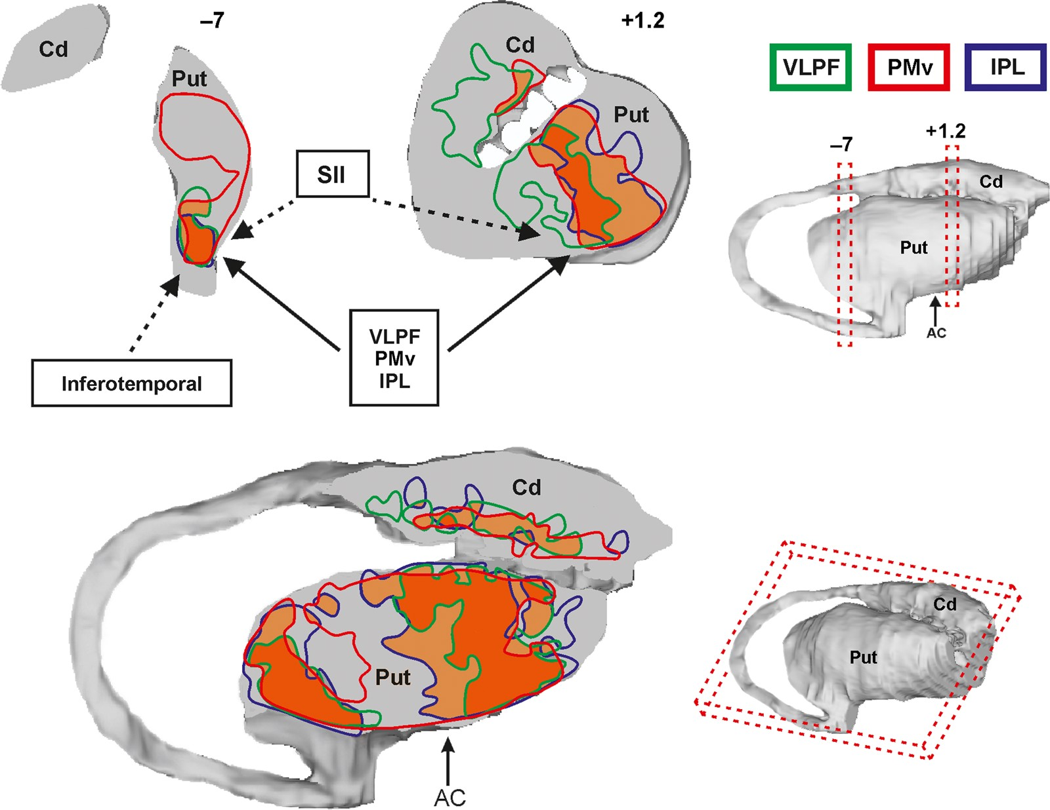
Figure 14. Composite views of the distribution of the striatal focal projections from VLPF (green lines), PMv (red ...
Notes:
Figure 14. Composite views of the distribution of the striatal focal projections from VLPF (green lines), PMv (red lines), and IPL (blue lines) hand-related areas obtained by warping the focal projections observed in each individual case to template 1-mm-thick coronal and 2-mm-thick oblique sections. The sections were taken at the levels indicated in the 3D reconstructions of the striatum shown in the right part of the figure. Overlap of the focal projections from 3 and 2 regions is shown in darker and lighter orange, respectively. In the upper part, arrows indicate the sources of projections, identified in the present study, to the 2 input channels. Dashed arrows indicate possible additional source of projections, based on other studies (Yeterian and Pandya 1993; Webster et al. 1993; Cheng et al. 1997). Abbreviations as in Figures 2 and 3.
Unless provided in the caption above, the following copyright applies to the content of this slide: © The Author 2015. Published by Oxford University Press. All rights reserved. For Permissions, please e-mail: journals.permissions@oup.com

