Slide 1
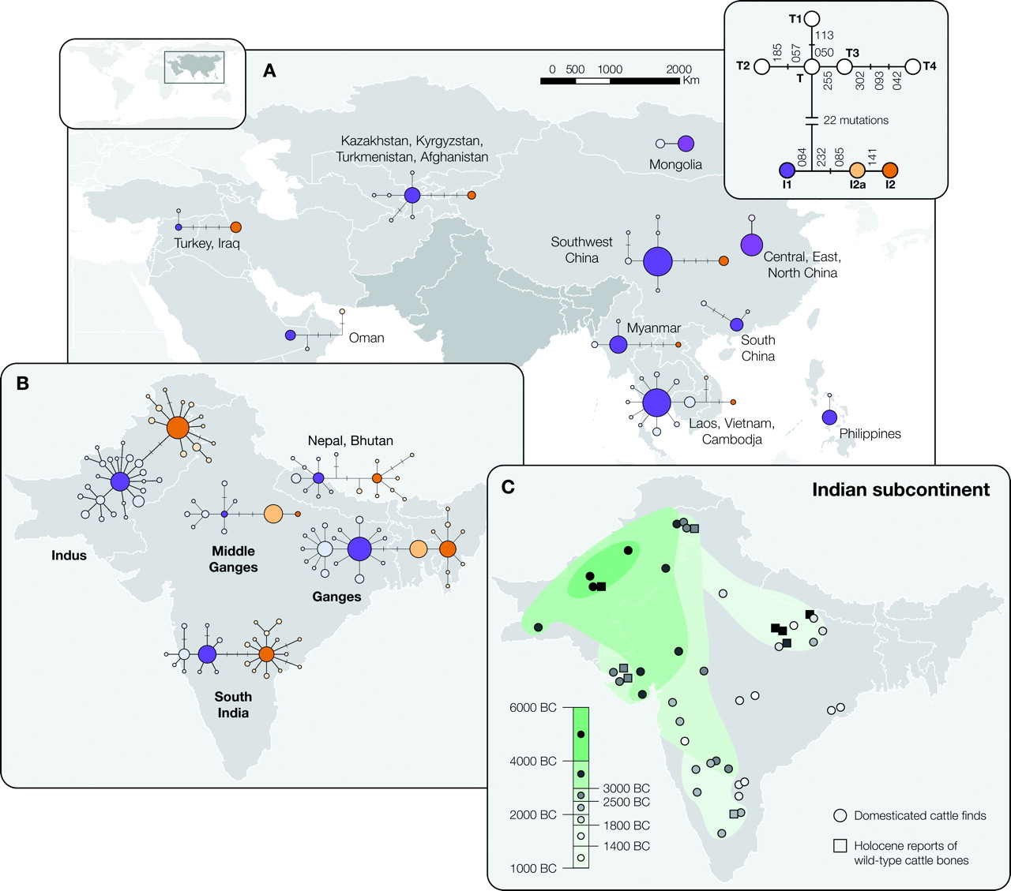
FIG. 1. Geographic distribution compilation between mtDNA genetic patterns across Asia and the archaeological signs ...
Notes:
FIG. 1. Geographic distribution compilation between mtDNA genetic patterns across Asia and the archaeological signs of spread of cattle pastoralism within the Indian subcontinent. (A) Median-reduced networks constructed for zebu haplotypes across Asia; (B) a map of the Indian subcontinent showing median reduced networks for each potential domestication center (Indus, Ganges, and South India); (C) a map of the Indian subcontinent indicating the spread of cattle across time based on archaeological data. Circles represent sites containing domesticated zebu cattle faunal remains, and squares represent reports of Holocene wild-type cattle bones. For dates, see Supplementary table S3 (Supplementary Material online).
Unless provided in the caption above, the following copyright applies to the content of this slide: © The Author 2009. Published by Oxford University Press on behalf of the Society for Molecular Biology and Evolution. All rights reserved. For permissions, please e-mail: journals.permissions@oxfordjournals.org

Slide 2
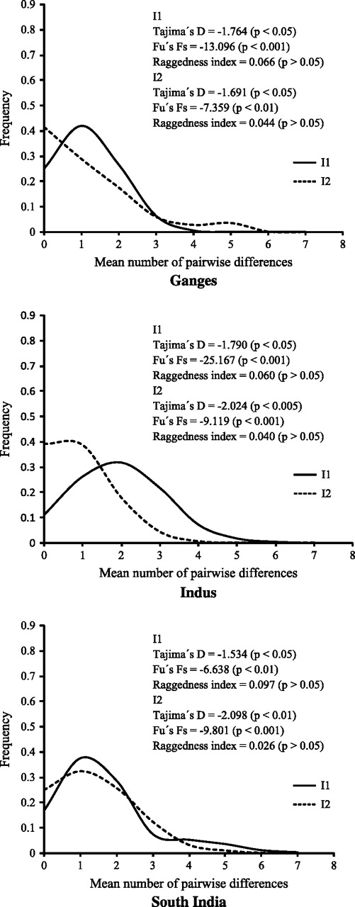
FIG. 2. Mismatch distributions and tests of neutrality for the three hypothesized centers of zebu origin (Ganges, ...
Notes:
FIG. 2. Mismatch distributions and tests of neutrality for the three hypothesized centers of zebu origin (Ganges, Indus, and South India).
Unless provided in the caption above, the following copyright applies to the content of this slide: © The Author 2009. Published by Oxford University Press on behalf of the Society for Molecular Biology and Evolution. All rights reserved. For permissions, please e-mail: journals.permissions@oxfordjournals.org

