Slide 1
Fig. 1. Raw verbal fluency scores for (A) Animals, (B) total COWAT, and (C) individual COWAT letters “F,” “A,” and ...
Notes:
Fig. 1. Raw verbal fluency scores for (A) Animals, (B) total COWAT, and (C) individual COWAT letters “F,” “A,” and “S” in the NC, NON MCI, AMN MCI, and AD groups. Error bars represent the standard error of the mean. Post hoc analyses were Bonferroni corrected (p < .008 vs. *NC, †NON, or ‡AMN groups).
Unless provided in the caption above, the following copyright applies to the content of this slide: © The Author 2013. Published by Oxford University Press. All rights reserved. For permissions, please e-mail: journals.permissions@oup.com.

Slide 2
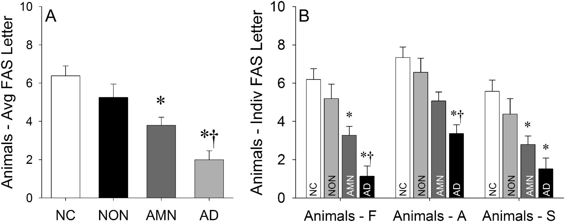
Fig. 2. Raw difference scores for (A) Animals-average FAS letter and (B) Animals-individual FAS letters in the NC, ...
Notes:
Fig. 2. Raw difference scores for (A) Animals-average FAS letter and (B) Animals-individual FAS letters in the NC, NON MCI, AMN MCI, and AD groups. Error bars represent the standard error of the mean. Post hoc analyses were Bonferroni corrected (p < .008 vs. *NC or †NON groups).
Unless provided in the caption above, the following copyright applies to the content of this slide: © The Author 2013. Published by Oxford University Press. All rights reserved. For permissions, please e-mail: journals.permissions@oup.com.

Slide 3
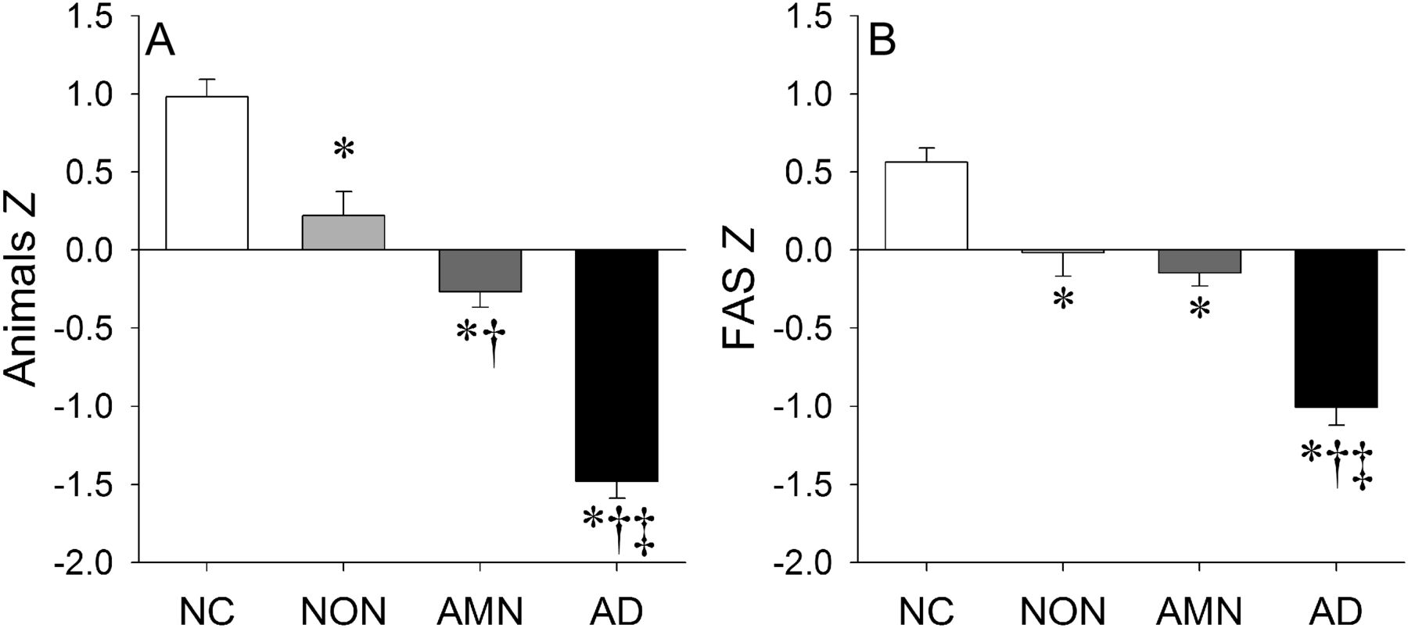
Fig. 3. Standardized z-scores for (A) Animals and (B) total COWAT in the NC, NON MCI, AMN MCI, and AD groups. Error ...
Notes:
Fig. 3. Standardized z-scores for (A) Animals and (B) total COWAT in the NC, NON MCI, AMN MCI, and AD groups. Error bars represent the standard error of the mean. Post hoc analyses were Bonferroni corrected (p < .008 vs. *NC, †NON, or ‡AMN groups).
Unless provided in the caption above, the following copyright applies to the content of this slide: © The Author 2013. Published by Oxford University Press. All rights reserved. For permissions, please e-mail: journals.permissions@oup.com.

Slide 4
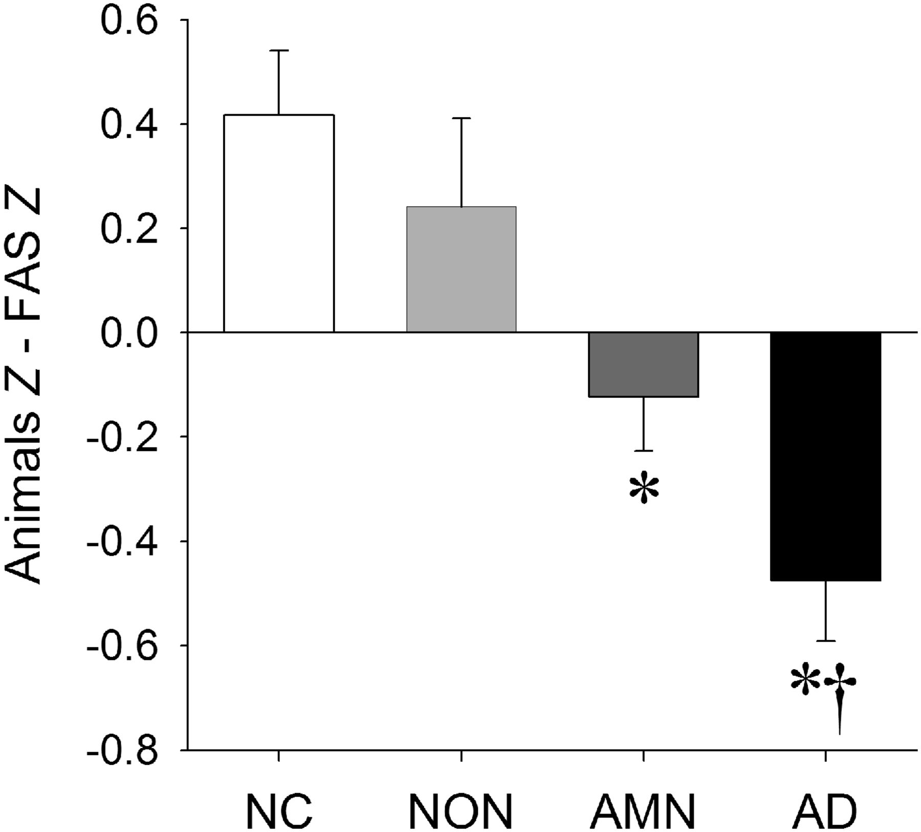
Fig. 4. Standardized verbal fluency difference scores in the NC, NON MCI, AMN MCI, and AD groups. Error bars ...
Notes:
Fig. 4. Standardized verbal fluency difference scores in the NC, NON MCI, AMN MCI, and AD groups. Error bars represent the standard error of the mean. Post hoc analyses were Bonferroni corrected (p < .008 vs. *NC or †NON groups).
Unless provided in the caption above, the following copyright applies to the content of this slide: © The Author 2013. Published by Oxford University Press. All rights reserved. For permissions, please e-mail: journals.permissions@oup.com.

Slide 5
Fig. 5. Raw verbal fluency scores for (A) Animals, (B) total COWAT, and (C) individual COWAT letters in the sdAMN and ...
Notes:
Fig. 5. Raw verbal fluency scores for (A) Animals, (B) total COWAT, and (C) individual COWAT letters in the sdAMN and mdAMN MCI groups. Error bars represent the standard error of the mean. *p < .05 versus sdAMN.
Unless provided in the caption above, the following copyright applies to the content of this slide: © The Author 2013. Published by Oxford University Press. All rights reserved. For permissions, please e-mail: journals.permissions@oup.com.

Slide 6
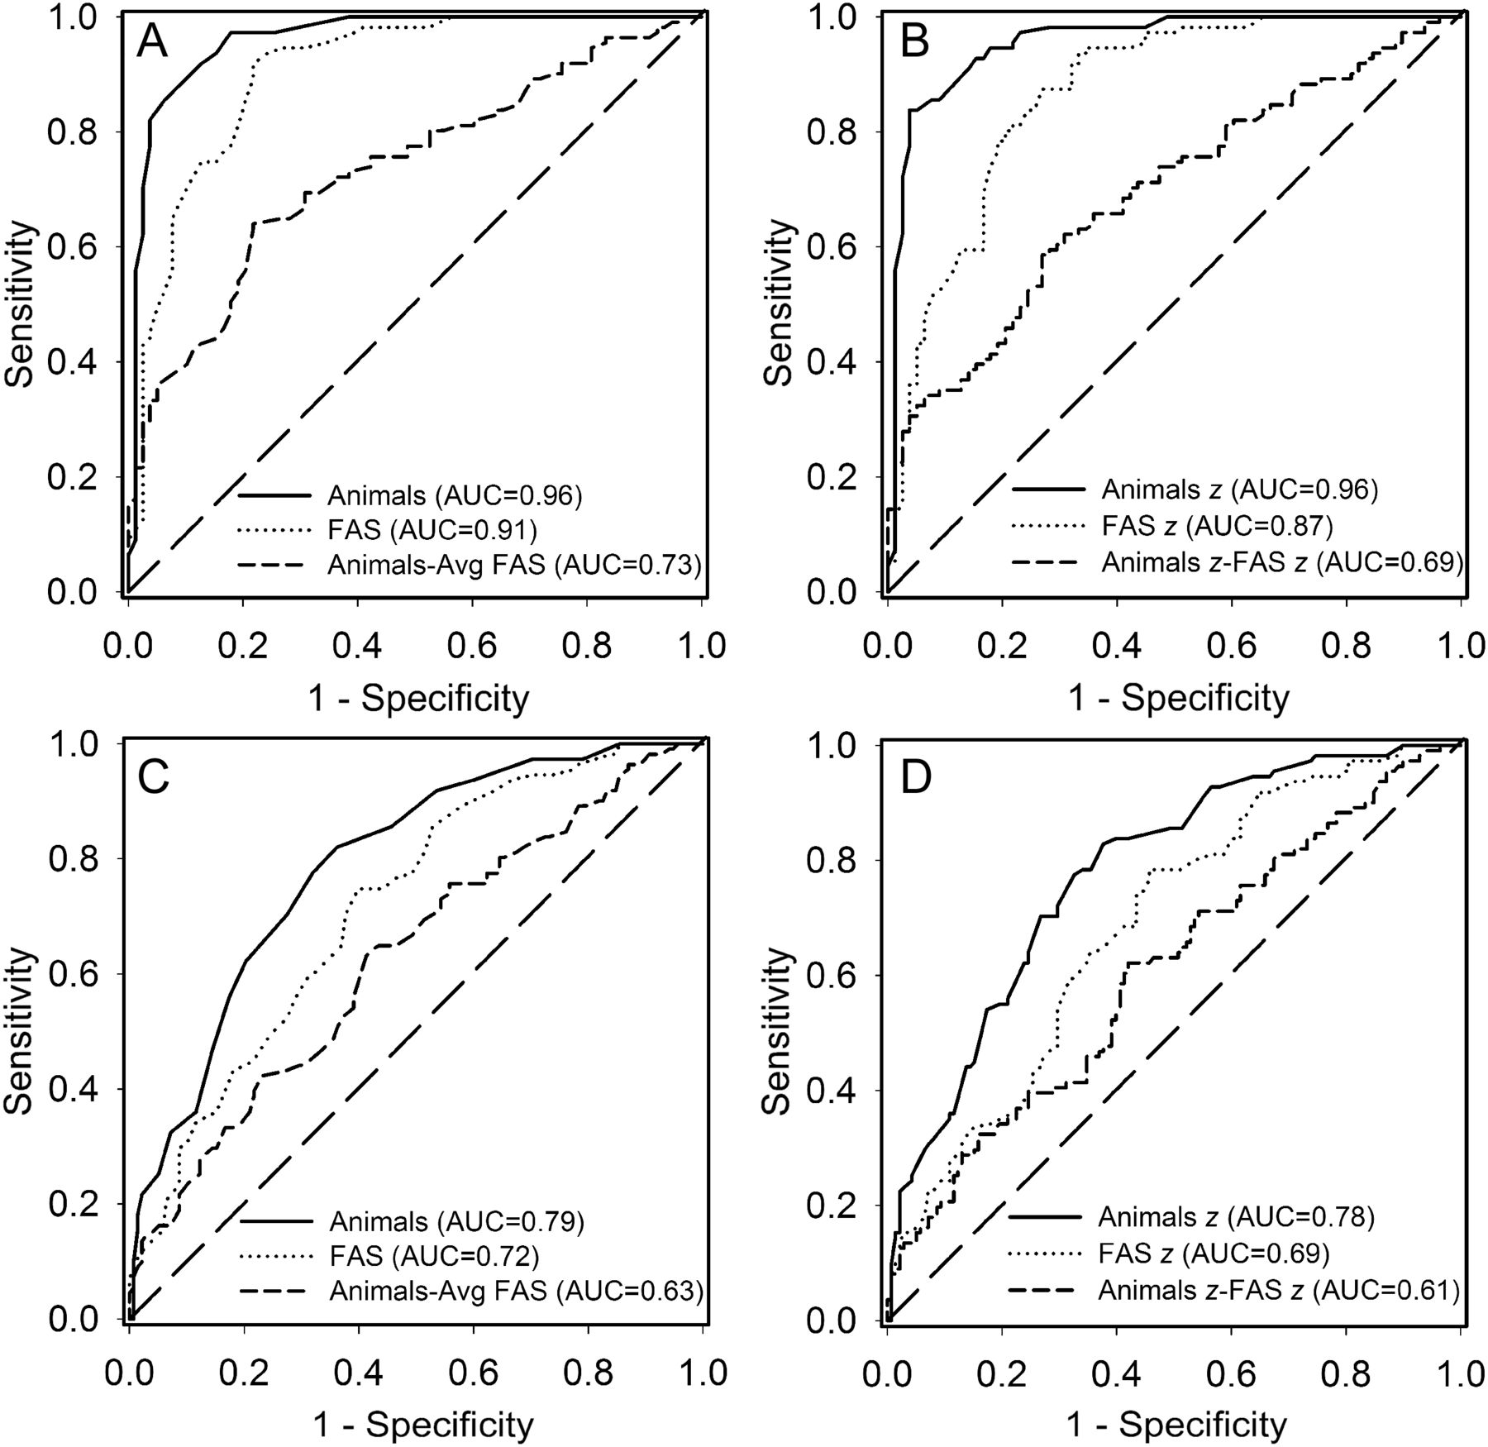
Fig. 6. ROC curves of raw (A and C) and standardized (B and D) verbal fluency indices for distinguishing NC and AD (A ...
Notes:
Fig. 6. ROC curves of raw (A and C) and standardized (B and D) verbal fluency indices for distinguishing NC and AD (A and B) and NC and AMN (C and D) groups. AUC indicates the area under the curve.
Unless provided in the caption above, the following copyright applies to the content of this slide: © The Author 2013. Published by Oxford University Press. All rights reserved. For permissions, please e-mail: journals.permissions@oup.com.

