Slide 1
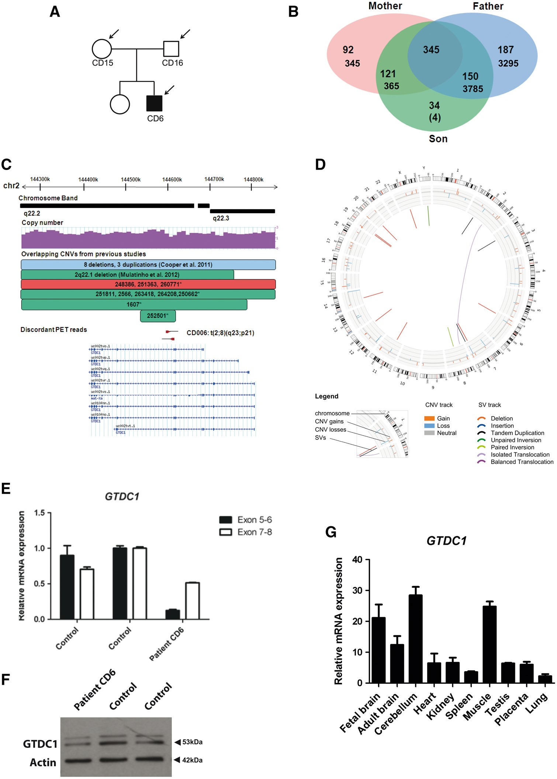
Figure 1. Identification of de novo rearrangements disrupting GTDC1 in the patient CD6 based on parents-offspring trio ...
Notes:
Figure 1. Identification of de novo rearrangements disrupting GTDC1 in the patient CD6 based on parents-offspring trio analysis. (A) Pedigree of patient CD6. The black arrow and coloured box indicate the patient. (B) Number of SVs that overlap between parents and patient CD6 are given as Venn diagram. Majority of SVs found in the patient are shared with either parent or both, and revealed 34 putative de novo SVs in the child. Further filtering with sequencing artifacts and germline SVs of other datasets resulted in 4 high confidence de novo SVs in the offspring, including the cytogenetically visible balanced translocation t(2;8)(q23;p21). (C) An overview of dPET clusters (cluster size: 60 and 85) showing a balanced translocation disrupting GTDC1 and compared with CNVs found in patients with NDDs based on published studies or DECIPHER. Blue blocks indicating CNVs found in the study described by Cooper et al. Green indicating deletion, red indicating duplication, which are published by previous study and DECIPHER Consortium. Asterisks indicate the DECIPHER ID for corresponding CNV. (D) Visualization of translocation cluster between chromosome 2 and 8 in patient CD6 using Circos plot. There are no additional copy number changes aCGH and cPETs data integrated in this plot. (E) Assessment of GTDC1 transcript expression by quantitative RT-PCR using two primer pairs (exon 5-6: P-value<0.001 and exon 6-7: P-value <0.001) by quantitative RT-PCR in patient’s LCL (lymphoblastoid cell line) compared to two sex-matched unrelated healthy controls. (F) Western-blot analysis of GTDC1 protein expression level in Control versus CD6 patient’s cells. (G) Assessment of GTDC1 transcript expression by quantittaive RT-PCR in multiple human tissues.
Unless provided in the caption above, the following copyright applies to the content of this slide: © The Author 2016. Published by Oxford University Press. All rights reserved. For Permissions, please email: journals.permissions@oup.com

Slide 2
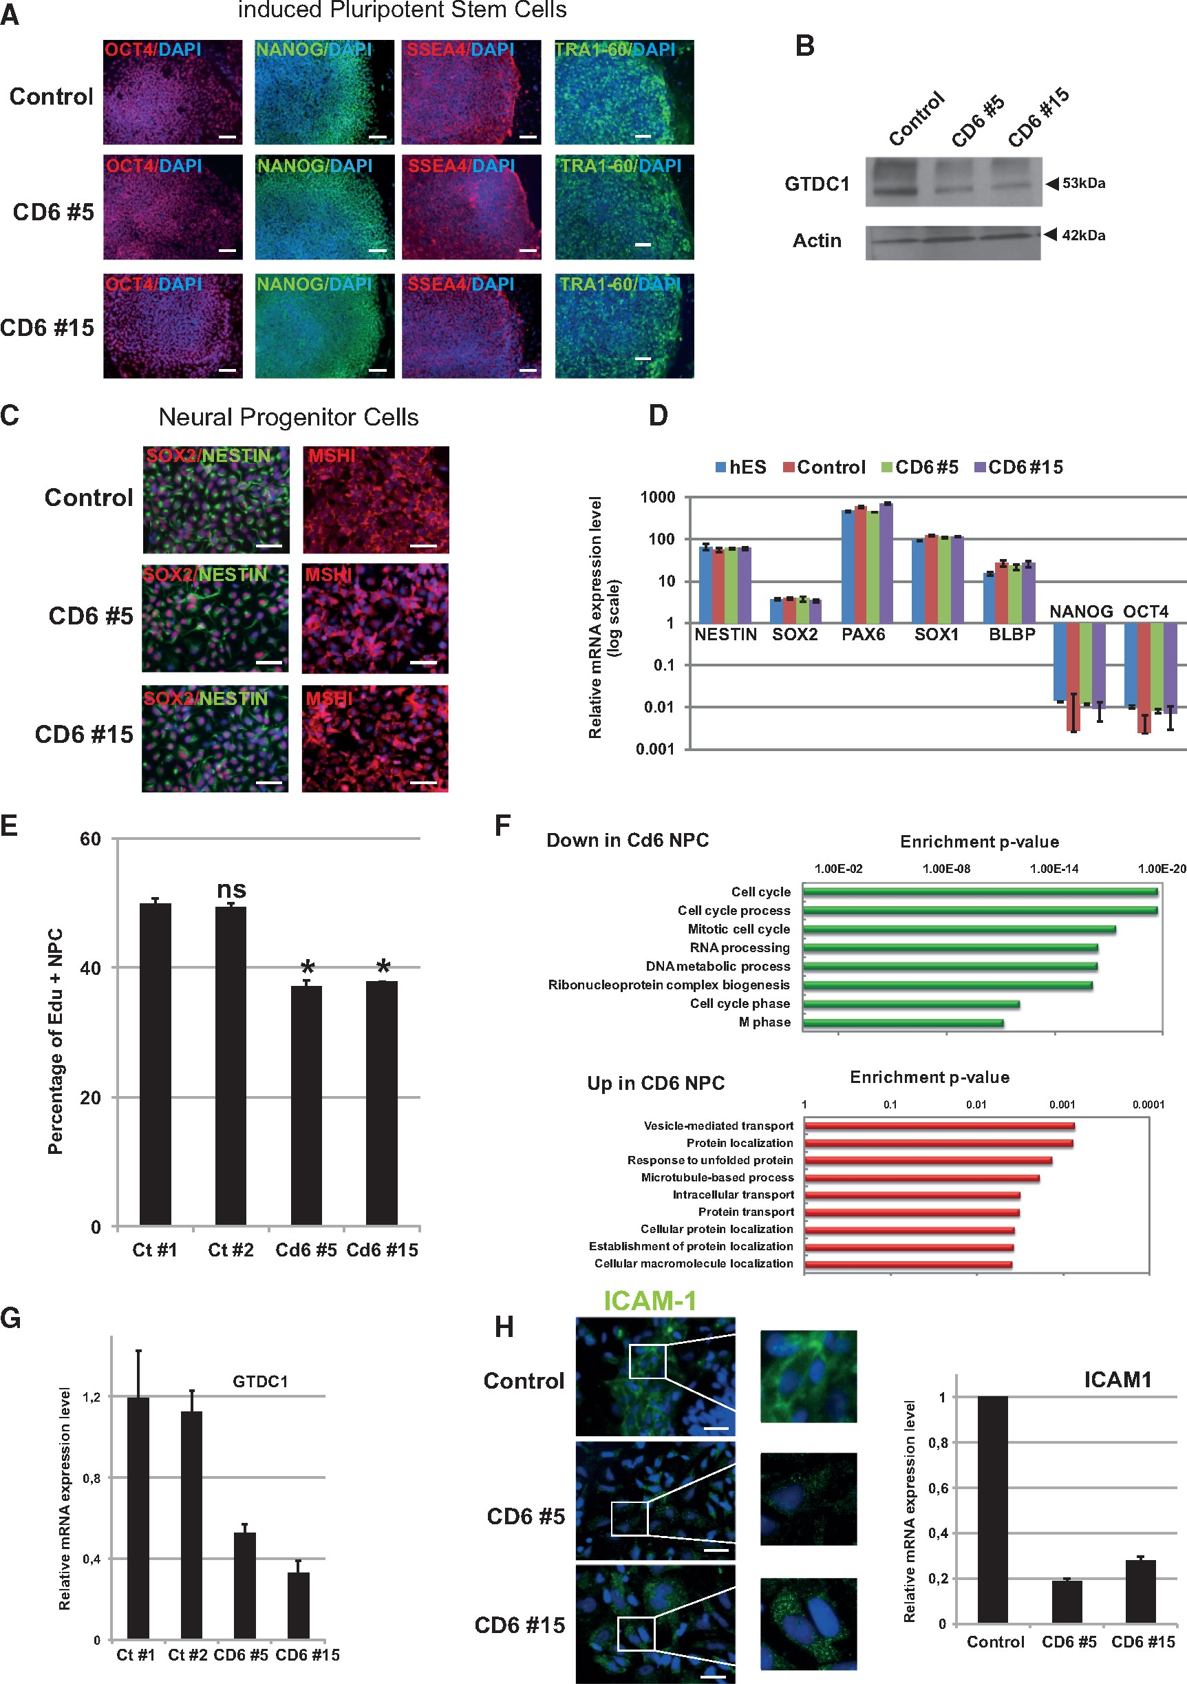
Figure 2. Characterization of CD6-iPScs derived NPCs. (A) Immunostainings of pluripotency markers OCT4, NANOG, SSEA4 ...
Notes:
Figure 2. Characterization of CD6-iPScs derived NPCs. (A) Immunostainings of pluripotency markers OCT4, NANOG, SSEA4 and TRA1-60 in Control and CD6 clones #5 and #15 iPSCs. (B) Western-blot analysis of the expression level of GTDC1 in Control versus CD6 patient’s cells (C) Immunostainings of NPCs markers SOX2, NESTIN and MSHI in Control and CD6 patient-derived NPCs (scale bar 100 µm). (D) Relative mRNA expression as determined by qRT-PCR for NPCs markers NESTIN, SOX2, PAX6, SOX1 and BLBP1 and pluripotency markers NANOG and OCT4 in NPCs generated from hESCs, Control and CD6 NPCs. n = 3; error bars indicate the mean ±s.d (E) Histogram plot representing the percentage of EdU positive cells in Control and CD6 #5 (P-value = 0.048) and CD6 #15 (P-value = 0.047)-NPCs. ns: not significant. (F) Gene ontology analysis of CD6-NPCs transcriptomic data. (G) Relative mRNA expression as determined by qRT-PCR for GTDC1 in Control-NPCs and NPCs derived from CD6 #5 (P-value = 0.02) and CD6 #15 (P-value = 0.007). n = 3; error bars indicate the mean ±s.d (H) Immunostainings of ICAM-1 in Control- and CD6-NPCs (scale bar 100 µm) and relative mRNA expression level of ICAM-1 in Control and patient CD6 #5 (P-value = 0.003) and CD6 #15 (P-value = 0.02) analysed by qRT-PCR. n = 3; error bars indicate the mean ±s.d. Statistics have been performed using the Kruskal-Wallis test.
Unless provided in the caption above, the following copyright applies to the content of this slide: © The Author 2016. Published by Oxford University Press. All rights reserved. For Permissions, please email: journals.permissions@oup.com

Slide 3
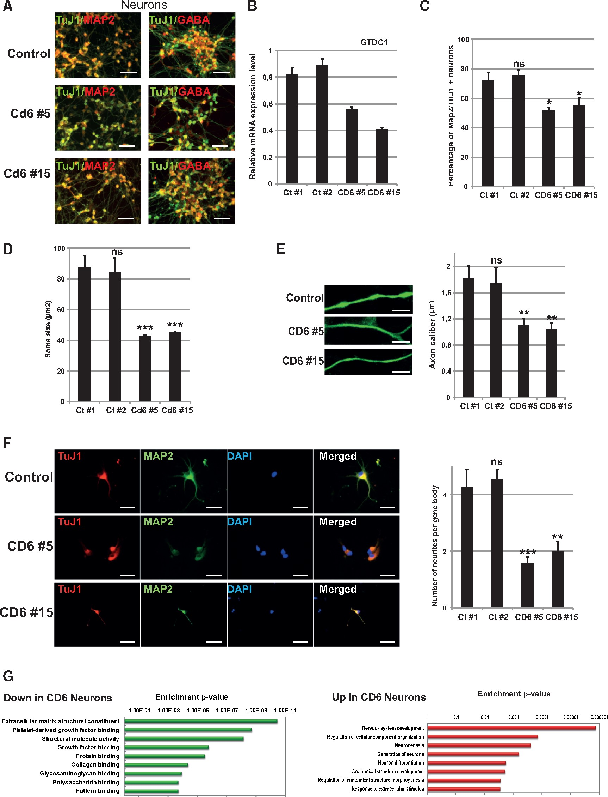
Figure 3. Characterization of CD6-iPScs derived Neurons. (A) Immunostainings of TuJ1, MAP2 and GABA in Control- and CD6 ...
Notes:
Figure 3. Characterization of CD6-iPScs derived Neurons. (A) Immunostainings of TuJ1, MAP2 and GABA in Control- and CD6 patient’s derived neurons (scale bar 200 µm). (B) Relative mRNA expression as determined by qRT-PCR for GTDC1 in Control neurons and neurons derived from CD6 #5 (P-value = 0.02) and CD6 #15 (P-value = 0.03). n = 3; error bars indicate the mean ±s.d (C) Histogram plot representing the percentage of MAP2 versus TuJ1 positive neurons in Control #1 and #2 and CD6 #5 (P-value = 0.05) and #15 (P-value = 0.05). ns: not significant. (D) Soma size of Control #1 and #2 and CD6 #5 (P-value < 0,001) and Cd6 #15 (P-value < 0.001) neurons. ns: not significant. (E). Immunostainings of MAP2 in axonal regions of Control and CD6 #5 (P-value 0.002) and CD6 #15 (P-value = 0.009) neurons and their measurements in µm (scale bar 20 µm). ns: not significant. (F) Immunostainings of TuJ1 and MAP2 in iPSCs-derived neurons (scale bar 100 µm) and quantification of the number of neurites per cell body in Control #1 and #2 and CD6 #5 (P-value = 0.002) and CD6 #15 (P-value < 0.002). ns: not significant. G) Gene ontology analysis of CD6-neurons transcriptomic data. Statistical tests have been performed using the Kruskal-Wallis test.
Unless provided in the caption above, the following copyright applies to the content of this slide: © The Author 2016. Published by Oxford University Press. All rights reserved. For Permissions, please email: journals.permissions@oup.com

Slide 4
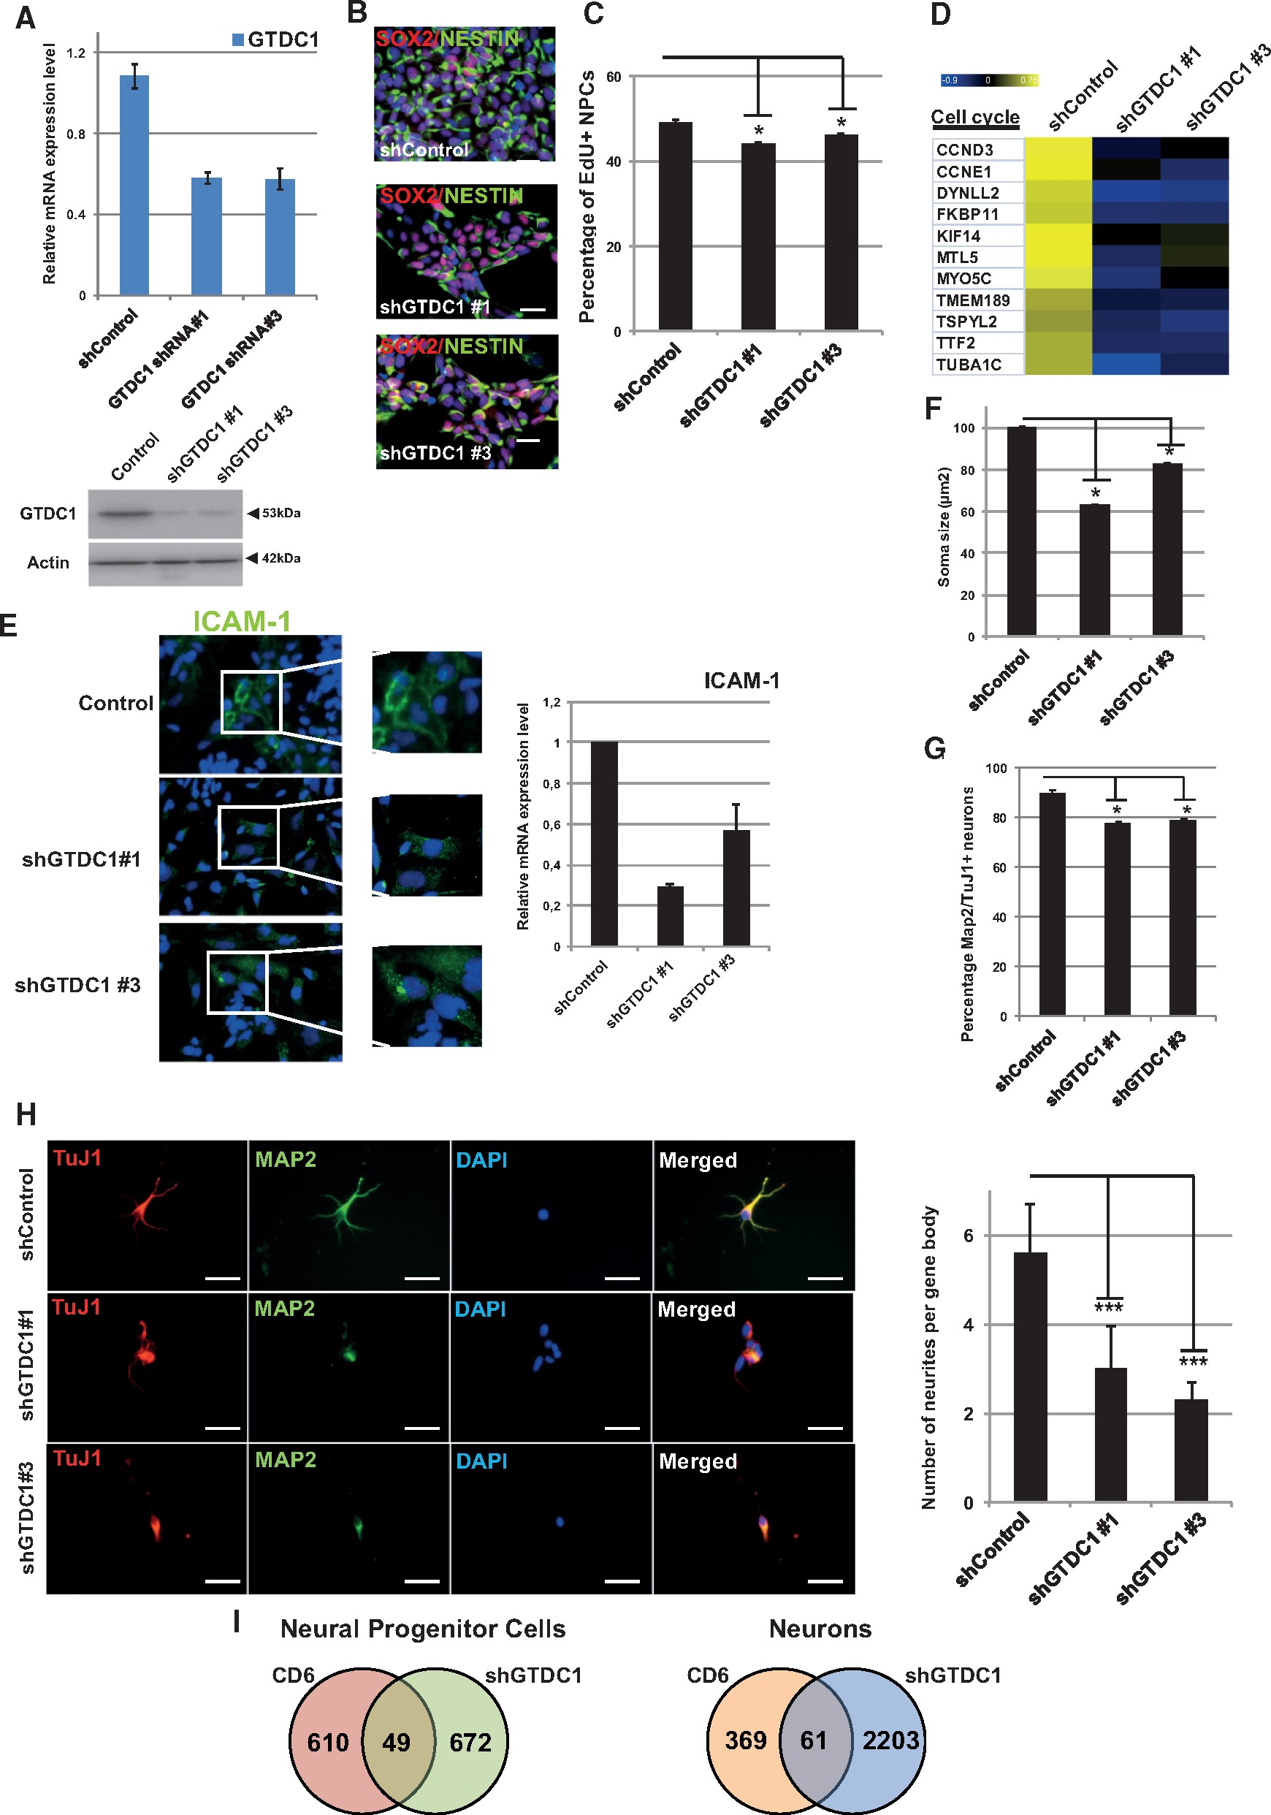
Figure 4. Characterization of shGTDC1-NPCs and neurons. (A) Relative mRNA expression as determined by qRT-PCR for GTDC1 ...
Notes:
Figure 4. Characterization of shGTDC1-NPCs and neurons. (A) Relative mRNA expression as determined by qRT-PCR for GTDC1 in shControl and shGTDC1 #1 (P-value = 0.003) and shGTDC1 #3 (P-value = 0.003) NPCs derived from human ESCs. n = 3; error bars indicate the mean ±s.d (B) Immunostainings of NPCs markers SOX2 and NESTIN in the same cells (scale bar 100 µm). (C) Histogram plot representing the percentage of EdU positive cells in shControl versus shGTDC1 #1 (P-value = 0.05) and shGTDC1 #3 (P-value = 0.05) -NPCs. (D) Heatmap representation of the expression level of Cell cycle genes obtained by microarray analysis done in shControl and shGTDC1 NPCs. (E) Immunocytochemistry of ICAM-1 in shControl versus shGTDC1 cells (scale bar 100 µm) and relative mRNA expression level of ICAM-1 in Control and shGTDC1 #1 (P-value = 0.03) and shGTDC1 #3 (P-value = 0.04) analysed by qRT-PCR. n = 3; error bars indicate the mean ±s.d (F) Soma size of shControl and shGTDC1 #1 (P-value = 0.002) and shGTDC1 #3 (P-value = 0.002)-neurons. (G) Histogram plot representing the percentage of MAP2 versus TuJ1 positive neurons in control and shGTDC1 #1 (P-value = 0.03) and shGTDC1 #3 (P-value = 0.01). (H) Immunostainings of TuJ1 and MAP2 in control and shGTDC1 neurons (scale bar 100 µm) and quantification of the number of neurites per cell body in shControl and shGTDC1 #1 (P-value = 0.05) and shGTDC1 #3 (P-value = 0.05)-derived neurons. (I) Venn diagram representing the number of overlapping genes between iPSCs- and shGTDC1- derived NPCs and neurons. Statistical tests have been performed using the Kruskal Wallis test.
Unless provided in the caption above, the following copyright applies to the content of this slide: © The Author 2016. Published by Oxford University Press. All rights reserved. For Permissions, please email: journals.permissions@oup.com

Slide 5
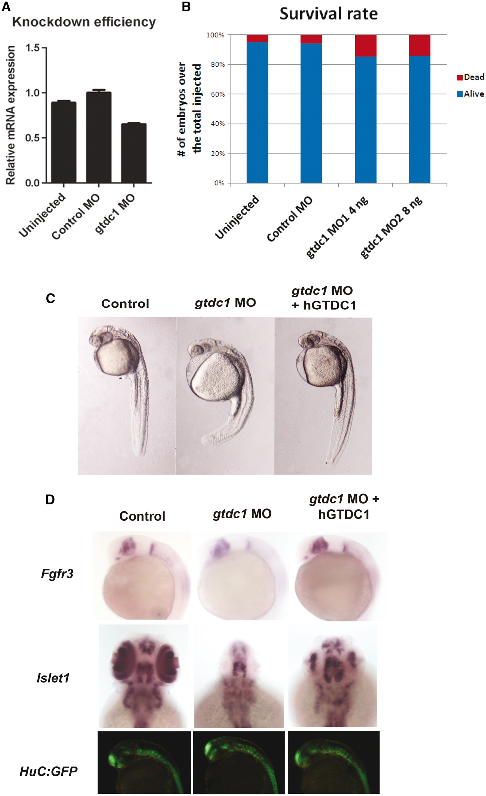
Figure 5. Disruption of GTDC1 induces defects in the zebrafish model. (A) Relative mRNA expression level of GTCD1 in ...
Notes:
Figure 5. Disruption of GTDC1 induces defects in the zebrafish model. (A) Relative mRNA expression level of GTCD1 in uninjected, control and gtdc1 (8 ng) morpholino zebrafish assessed by qRT-PCR (P-value uninjected versus gtdc1 MO = 0.009; P-value control versus gtdc1 MO = 0.01). n = 3; error bars indicate the mean ±s.d (B) Histogram plot representing the surival rate after injection of GTDC1 morpholino in the zebrafish model. n = 3; error bars indicate the mean ±s.d (C) Phenotypic characterization of control, gtdc1 morpholino and gtdc1 rescued zebrafish. n = 3 (D) In situ hybridization of Islet1 and Fgfr3 in control, gtdc1 MO and rescued zebrafish as well as immunofluorescent pictures of HuC:GFP zebrafish under the same conditions. The numbers of embryos evaluated per condition were as follows: uninjected = 100, control MO = 65, gtdc1 MO 4ng = 85 and 8 ng = 121, gtdc1 MO+ hGTDC1 = 60. The experiments were done in triplicates.
Unless provided in the caption above, the following copyright applies to the content of this slide: © The Author 2016. Published by Oxford University Press. All rights reserved. For Permissions, please email: journals.permissions@oup.com

