Slide 1
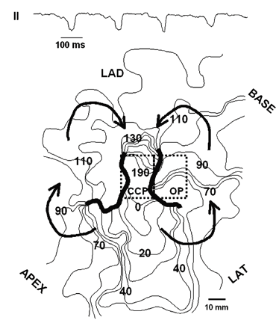
Fig. 1 At the top is a lead II ECG recorded during sustained ventricular tachycardia induced by programmed ...
Notes:
Fig. 1 At the top is a lead II ECG recorded during sustained ventricular tachycardia induced by programmed stimulation in a dog with a 5-day healing myocardial infarction. Below is an isochronal map of one reentrant cycle associated with the tachycardia. Activation begins at the 0–10 ms isochrone and follows the sequence shown by the arrows. The thick vertically oriented black lines represent functional lines of block. The central common pathway (CCP) of the circuit is between the 2 lines of block, the outer pathways (OP) are to the left and right, respectively, of the left and right lines of block. The regions of the circuit delineated by the dashed rectangles show the position of the small high density electrode array in the central and outer pathways.
Unless provided in the caption above, the following copyright applies to the content of this slide: Copyright © 2006, European Society of Cardiology

Slide 2
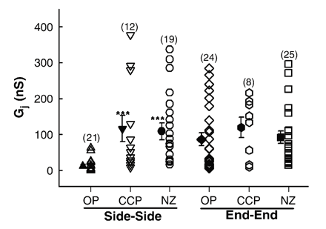
Fig. 3 Steady-state transjunctional conductance (G_{j}) measured at a V_{j} of +10 mV in OP, CCP and ...
Notes:
Fig. 3 Steady-state transjunctional conductance (Gj) measured at a Vj of +10 mV in OP, CCP and NZ pairs. Unfilled symbols are individual measurements for the side-to-side and end to end coupled cells. Solid symbols and vertical bars denote means and standard errors. Numbers of observations are in parentheses. There was no significant difference (P>0.05) between the three groups for end to end coupling conductance. Side-to-side coupling conductance was significantly lower in OP pairs than in CCP or NZ pairs (P<0.05) (asterisks).
Unless provided in the caption above, the following copyright applies to the content of this slide: Copyright © 2006, European Society of Cardiology

Slide 3
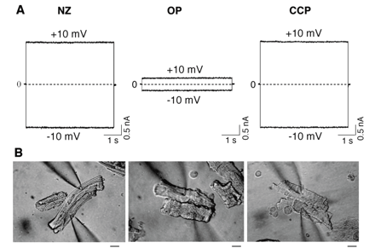
Fig. 2 Representative current traces (A) from side-to-side coupled pairs from NZ (left), OP (center) and CCP ...
Notes:
Fig. 2 Representative current traces (A) from side-to-side coupled pairs from NZ (left), OP (center) and CCP (right). Positive and negative currents in cell 2 are shown in response to Vt of +10 and −10 mV (as marked) (5 s duration) applied to cell 1 while the membrane voltage of cell 2 was maintained at 0 mV. (B) Microscopic images of the side-to-side coupled cell pairs from each of the regions above. Scale bars for images: 20 μm.
Unless provided in the caption above, the following copyright applies to the content of this slide: Copyright © 2006, European Society of Cardiology

Slide 4
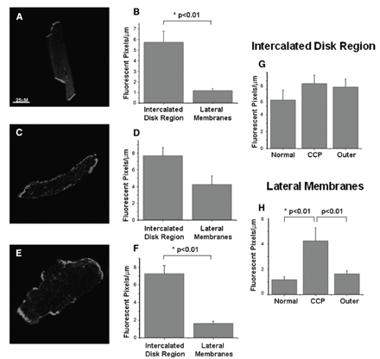
Fig. 4 Connexin43 redistribution in single cells from NZ, CCP and OP regions. In normal myocytes Cx43 is found ...
Notes:
Fig. 4 Connexin43 redistribution in single cells from NZ, CCP and OP regions. In normal myocytes Cx43 is found primarily at the intercalated disk regions (A) in significantly higher levels than that found on the lateral membranes (B). In contrast, cells from the CCP show Cx43 staining at the intercalated disk region as well as along the lateral membranes of the cells (C). There is no difference between the levels of Cx43 on the lateral membranes as compared with the intercalated disk region (D). OP Cells resemble NZs in their Cx43 localization (E) with a significantly higher level of Cx43 found at the intercalated disk region as compared to the lateral membranes (F). Comparisons of Cx43 distribution by region for all three cell groups are shown in (G, H). The scale in Fig. 4A also applies to Figs. 4C and E.
Unless provided in the caption above, the following copyright applies to the content of this slide: Copyright © 2006, European Society of Cardiology

Slide 5
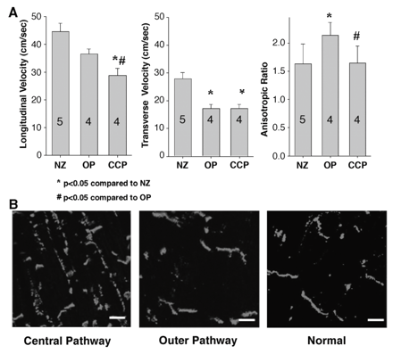
Fig. 6 (A) Conduction velocities (ordinates) in normal (NZ), central common pathway (CCP) and outer pathway (OP) ...
Notes:
Fig. 6 (A) Conduction velocities (ordinates) in normal (NZ), central common pathway (CCP) and outer pathway (OP) (abscissa). Longitudinal velocities are at the left, transverse velocities in the center and anisotropic ratios at the right. Numbers in bars indicate number of experiments in each group. (B) Immunofluorescent images of epicardial border zone of the CCP and OP of a mapped reentrant circuit. Location of Cx43 shown by red fluorescence. In the central pathway significant amounts of Cx43 are located along lateral membranes while also maintaining a presence at the ends of the myocytes. In the normal and outer pathway tissues fluorescence is only seen at the intercalated disk regions of the myocytes. Scale bars: 25 μm.
Unless provided in the caption above, the following copyright applies to the content of this slide: Copyright © 2006, European Society of Cardiology

Slide 6
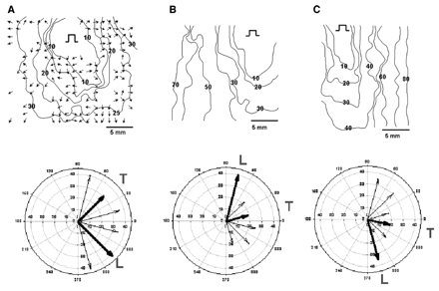
Fig. 5 In each panel, at the top, is an isochronal map (isochrones drawn every 10 ms in B and C and every 5 ms in A) ...
Notes:
Fig. 5 In each panel, at the top, is an isochronal map (isochrones drawn every 10 ms in B and C and every 5 ms in A) obtained during pacing from the center of the high resolution electrode array positioned on normal LV epicardium (A), outer pathway (B) and central common pathway (C) (see Fig. 1). Selected isochrones are labeled. Pulse symbol indicates site of stimulation. Small arrows on the map in A (but omitted in B and C) show local direction of activation (see Methods). Below each panel we have drawn the average of the local vector velocities every 30° to obtain a global value of conduction velocity in the different directions of propagation under the electrode array. Lengths of arrows indicate magnitude of conduction velocities in each direction. Numbers in the x, y and intermediate radial directions are in cm/s. Longest and shortest arrows (thick black arrows) show longitudinal (L) and transverse (T) directions of propagation.
Unless provided in the caption above, the following copyright applies to the content of this slide: Copyright © 2006, European Society of Cardiology

Slide 7
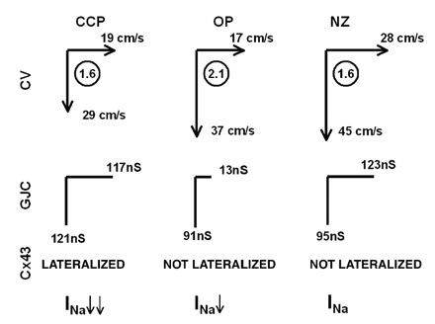
Fig. 7 A summary of properties of central common pathway (CCP), outer pathway (OP) and normal myocardium (NZ) are ...
Notes:
Fig. 7 A summary of properties of central common pathway (CCP), outer pathway (OP) and normal myocardium (NZ) are shown in each column. CV is conduction velocity in transverse (arrows to right) and longitudinal directions (downward arrows). Circled numbers are anisotropic ratios. GJC represents gap junction conductance in transverse (horizontal lines) and longitudinal directions (vertical lines). Downward arrows next to INa at bottom show relative alteration of kinetics of this current with it being greater in CCP than OP. The reduction in conduction velocity (CV) in longitudinal and transverse directions in CCP despite lateralized Cx43 and normal coupling conductance is hypothesized be a result of the alterations in INa.
Unless provided in the caption above, the following copyright applies to the content of this slide: Copyright © 2006, European Society of Cardiology

