Slide 1
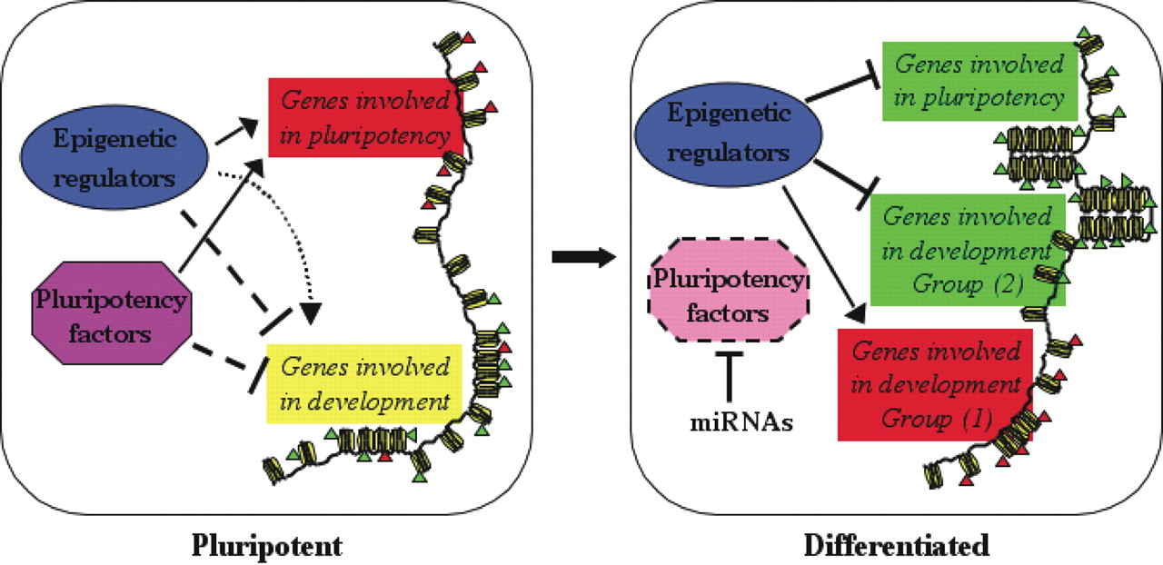
Figure 1. Key regulatory features of pluripotency. The left and right panels show cells in the pluripotent and ...
Notes:
Figure 1. Key regulatory features of pluripotency. The left and right panels show cells in the pluripotent and differentiated states, respectively. Through a collaborative regulation by pluripotency factors and epigenetic regulators, pluripotency-associated genes are actively transcribed in pluripotent cells (highlighted in red), whereas differentiation-related genes are held at a silent but poised state (shown in yellow). Upon differentiation, down-regulation of pluripotency factors with the help of miRNAs results in a rapid change in the transcriptional profile, silencing genes required for pluripotency (green) and differentially regulating development-related genes (green or red). Chromatin also transits from a hyperdynamic state into a more compact state as pluripotent cells differentiate. The red and green triangles represent active and inactive histone modifications, respectively.
Unless provided in the caption above, the following copyright applies to the content of this slide: © The Author 2008. Published by Oxford University Press. All rights reserved. For Permissions, please email: journals.permissions@oxfordjournals.org

