Slide 1
Figure 1. Distribution of the data for the different analyses across rounds 1, 2, and 3 of data collection, based on ...
Notes:
Figure 1. Distribution of the data for the different analyses across rounds 1, 2, and 3 of data collection, based on different age groups.
Unless provided in the caption above, the following copyright applies to the content of this slide: © The Author 2014. Published by Oxford University Press. All rights reserved. For Permissions, please e-mail: journals.permissions@oup.com

Slide 2
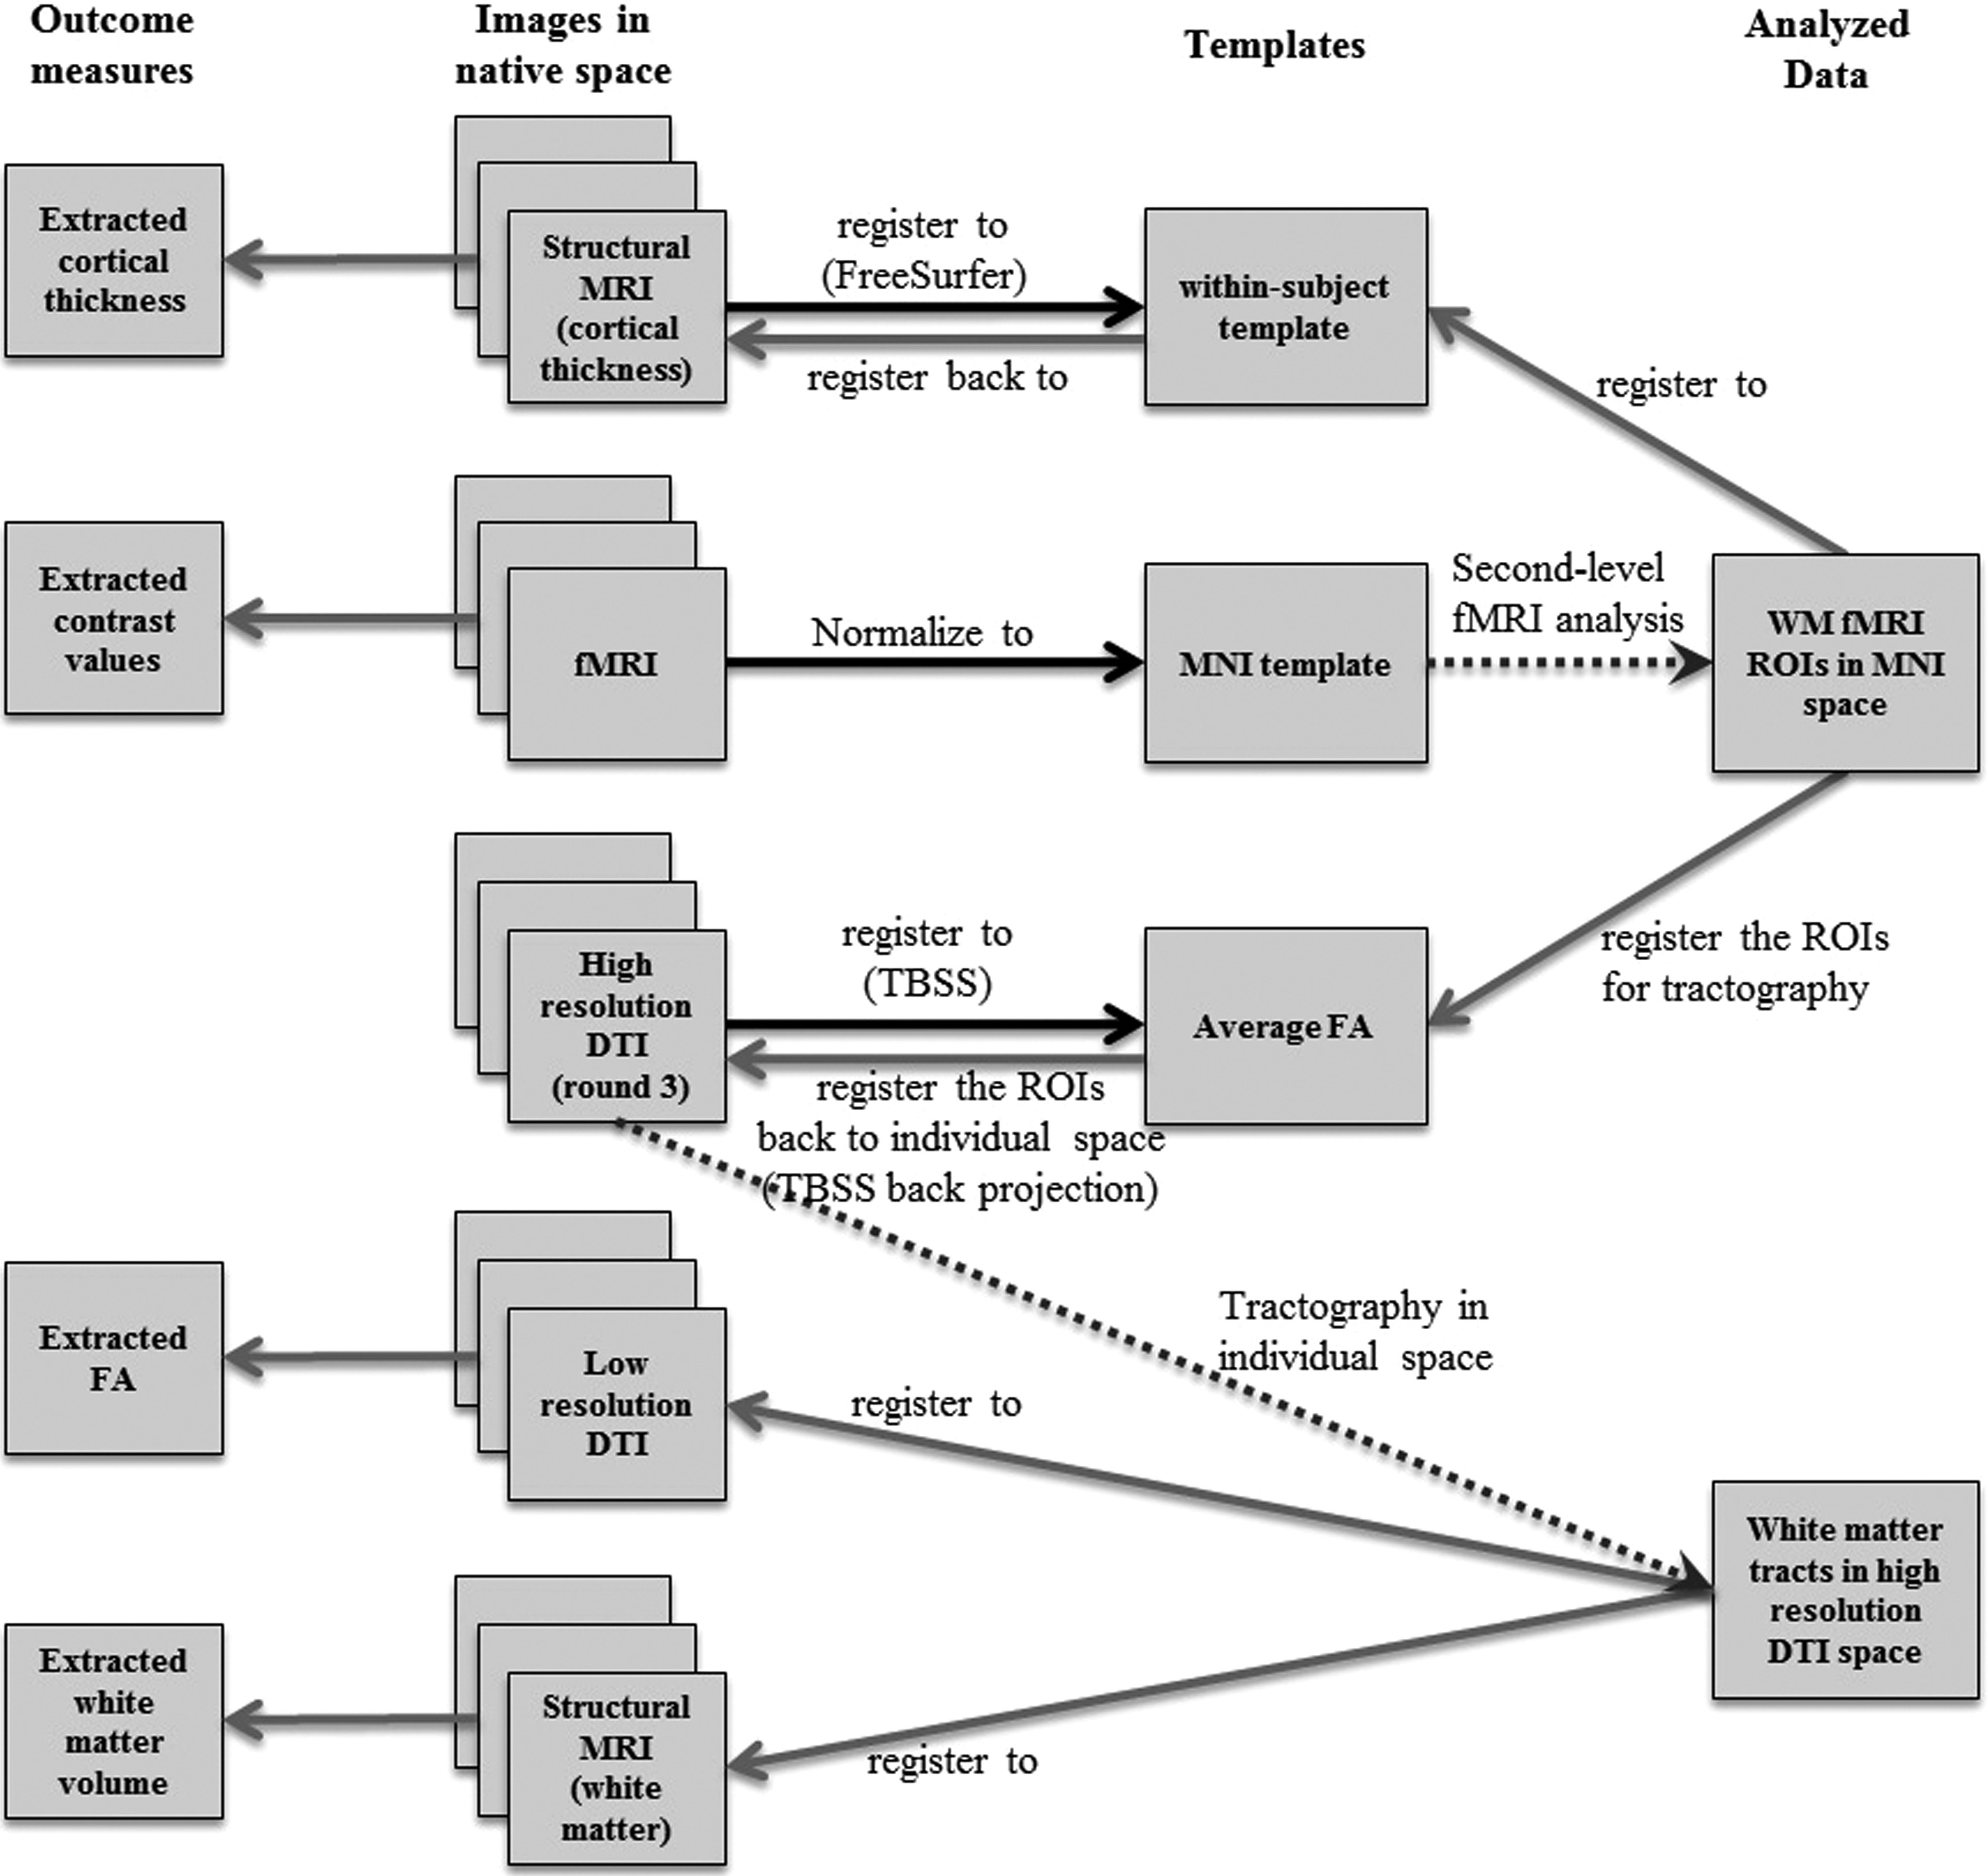
Figure 2. Image analysis and registration pipeline showing the registration between the native space and the template ...
Notes:
Figure 2. Image analysis and registration pipeline showing the registration between the native space and the template within each modality as well as the transformations between different modalities. Black and gray arrows show the registration and back projection transformations, respectively. The dotted arrows show the steps for fMRI second-level analysis as well as DTI tractography.
Unless provided in the caption above, the following copyright applies to the content of this slide: © The Author 2014. Published by Oxford University Press. All rights reserved. For Permissions, please e-mail: journals.permissions@oup.com

Slide 3
Figure 3. (A) Functionally active cortical regions (superior frontal, superior, and inferior parietal) during the ...
Notes:
Figure 3. (A) Functionally active cortical regions (superior frontal, superior, and inferior parietal) during the performance on a visuo-spatial WM task. (B) Population map of the probabilistic fiber tracking of fronto-parietal pathways connecting superior frontal to intraparietal cortex. (C) Population map of fronto-striatal pathways, connecting caudate (shown by light blue) to the superior frontal ROI. The color bars correspond to the number of subjects with available white mater pathways.
Unless provided in the caption above, the following copyright applies to the content of this slide: © The Author 2014. Published by Oxford University Press. All rights reserved. For Permissions, please e-mail: journals.permissions@oup.com

Slide 4
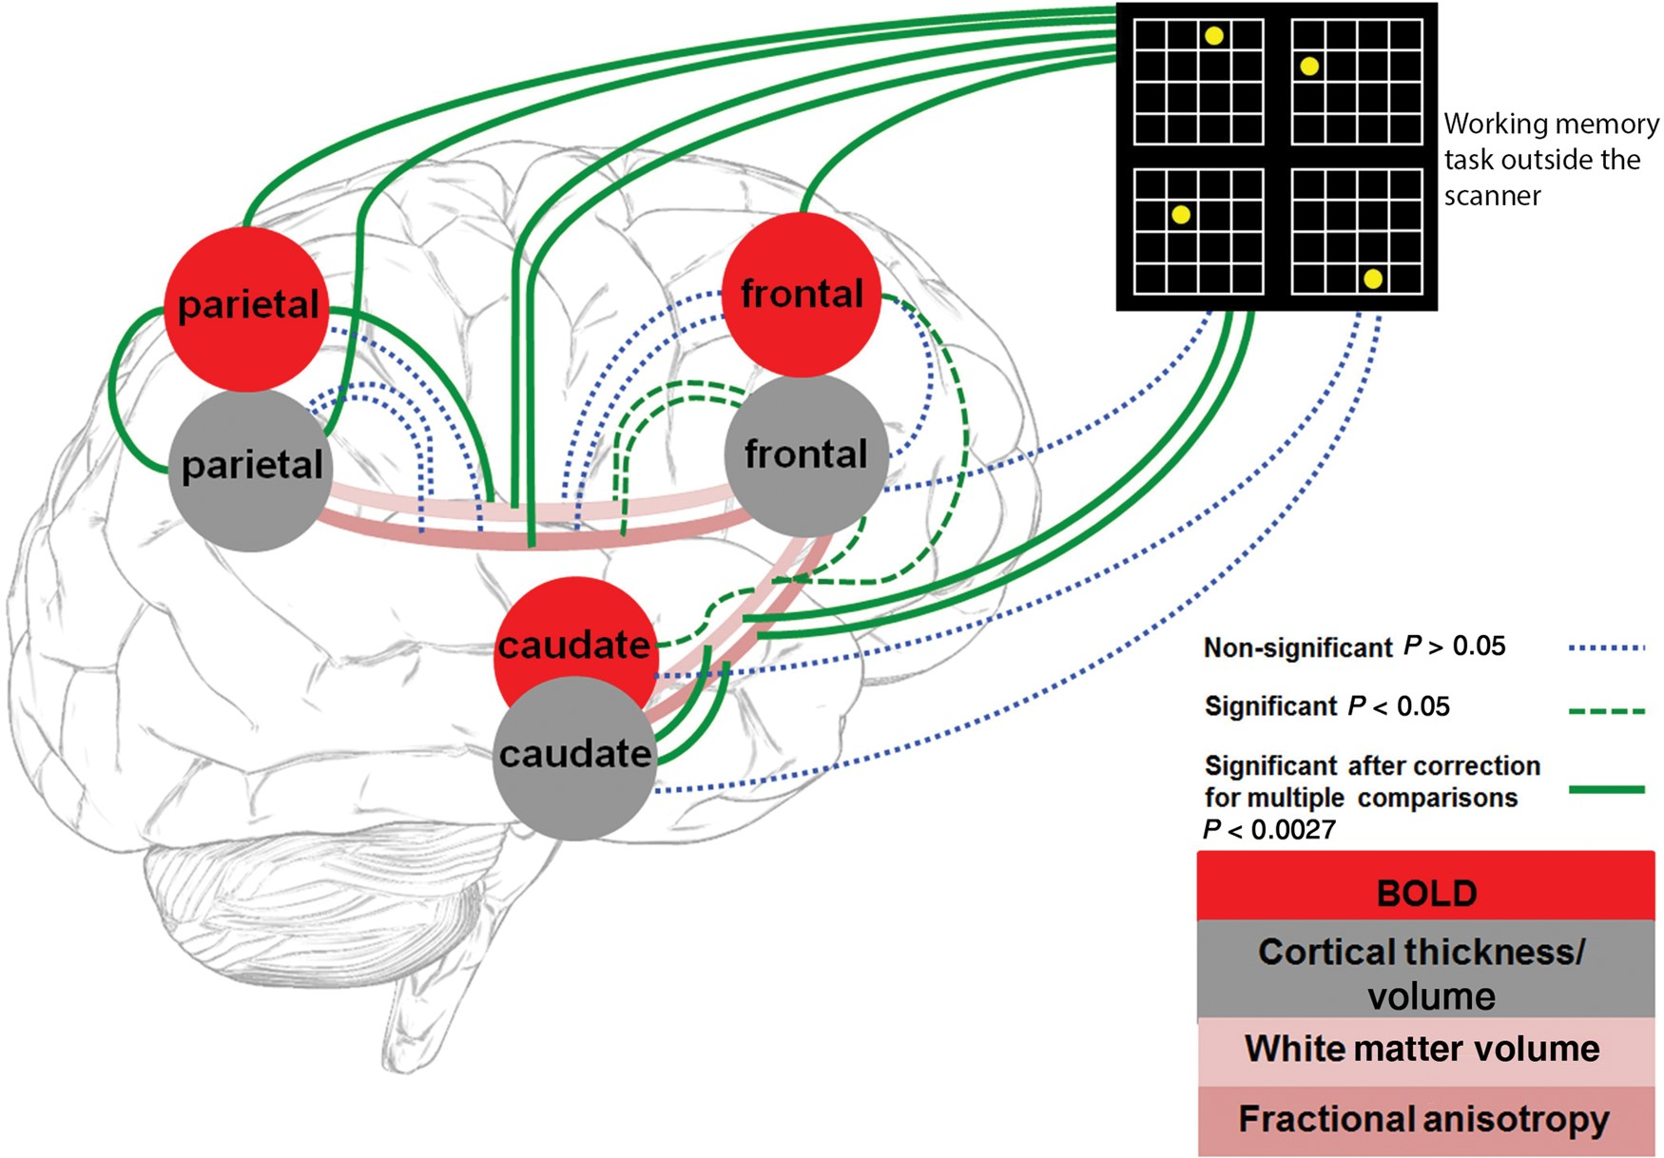
Figure 4. Cross-sectional analysis of correlations between brain–brain and brain–WM. The correlations include all 3 ...
Notes:
Figure 4. Cross-sectional analysis of correlations between brain–brain and brain–WM. The correlations include all 3 rounds of repeated measures for all variables. The dashed green and dotted blue lines show the significant and nonsignificant correlations, respectively, based on Tables 1 and 2. The thick green lines are those that survived the multiple comparisons correction.
Unless provided in the caption above, the following copyright applies to the content of this slide: © The Author 2014. Published by Oxford University Press. All rights reserved. For Permissions, please e-mail: journals.permissions@oup.com

