Slide 1
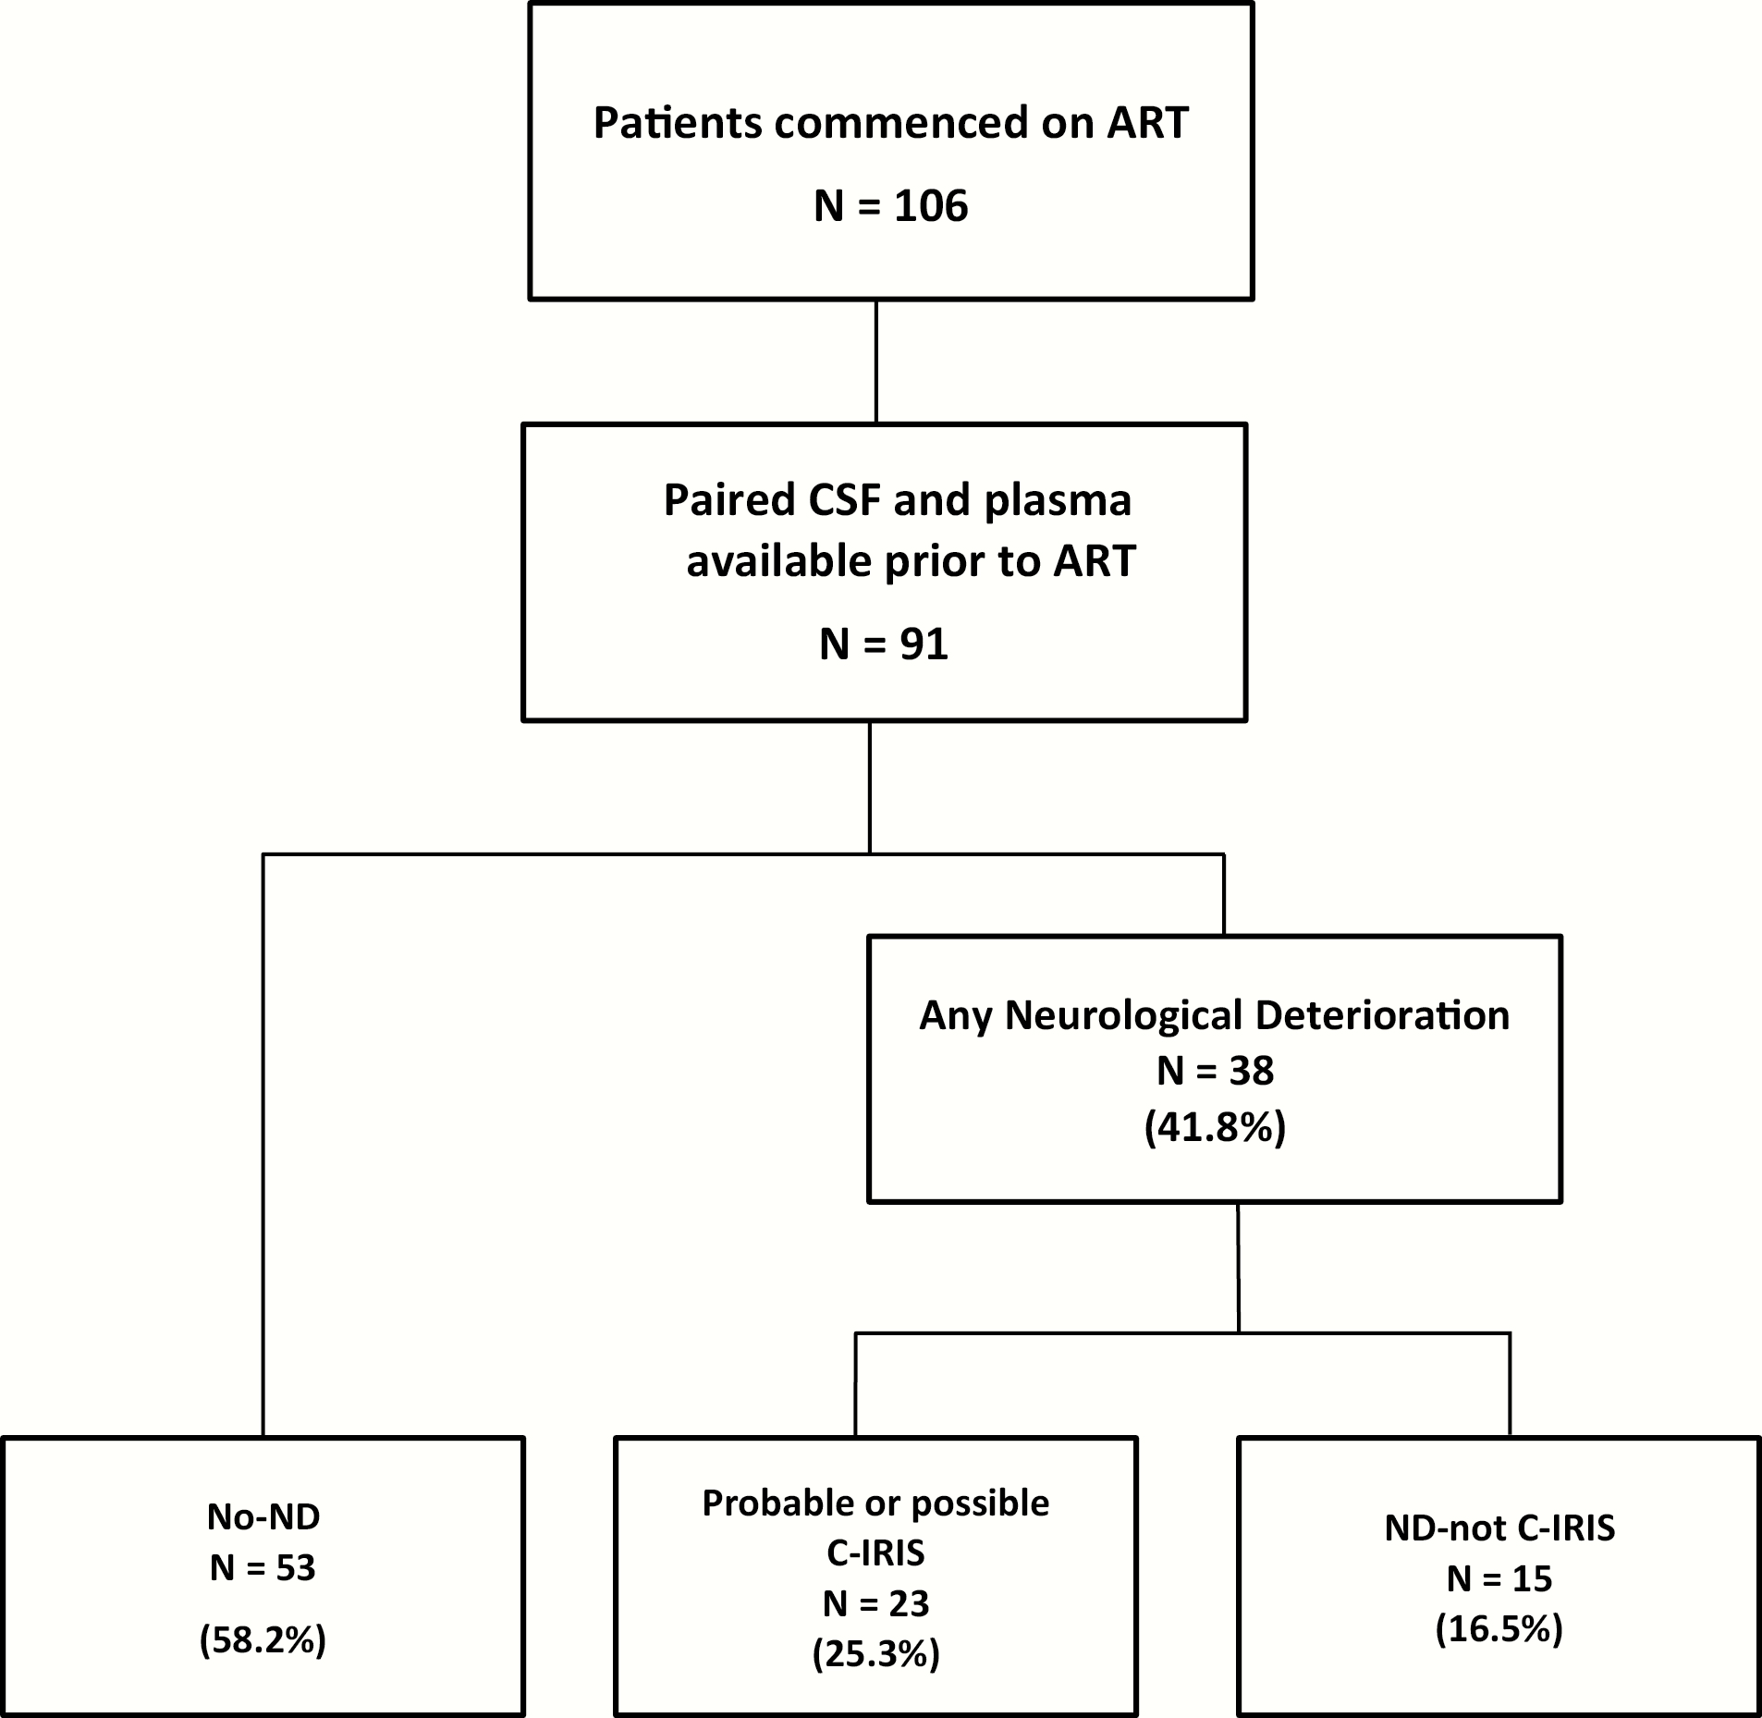
Figure 1. Cohort flowchart. ART, antiretroviral therapy; C-IRIS, cryptococcosis-associated immune reconstitution ...
Notes:
Figure 1. Cohort flowchart. ART, antiretroviral therapy; C-IRIS, cryptococcosis-associated immune reconstitution inflammatory syndrome; CSF, cerebrospinal fluid; ND, neurological deterioration.
Unless provided in the caption above, the following copyright applies to the content of this slide: © The Author 2017. Published by Oxford University Press on behalf of Infectious Diseases Society of America.This is an Open Access article distributed under the terms of the Creative Commons Attribution-NonCommercial-NoDerivs licence (http://creativecommons.org/licenses/by-nc-nd/4.0/), which permits non-commercial reproduction and distribution of the work, in any medium, provided the original work is not altered or transformed in any way, and that the work is properly cited. For commercial re-use, please contact journals.permissions@oup.com

Slide 2
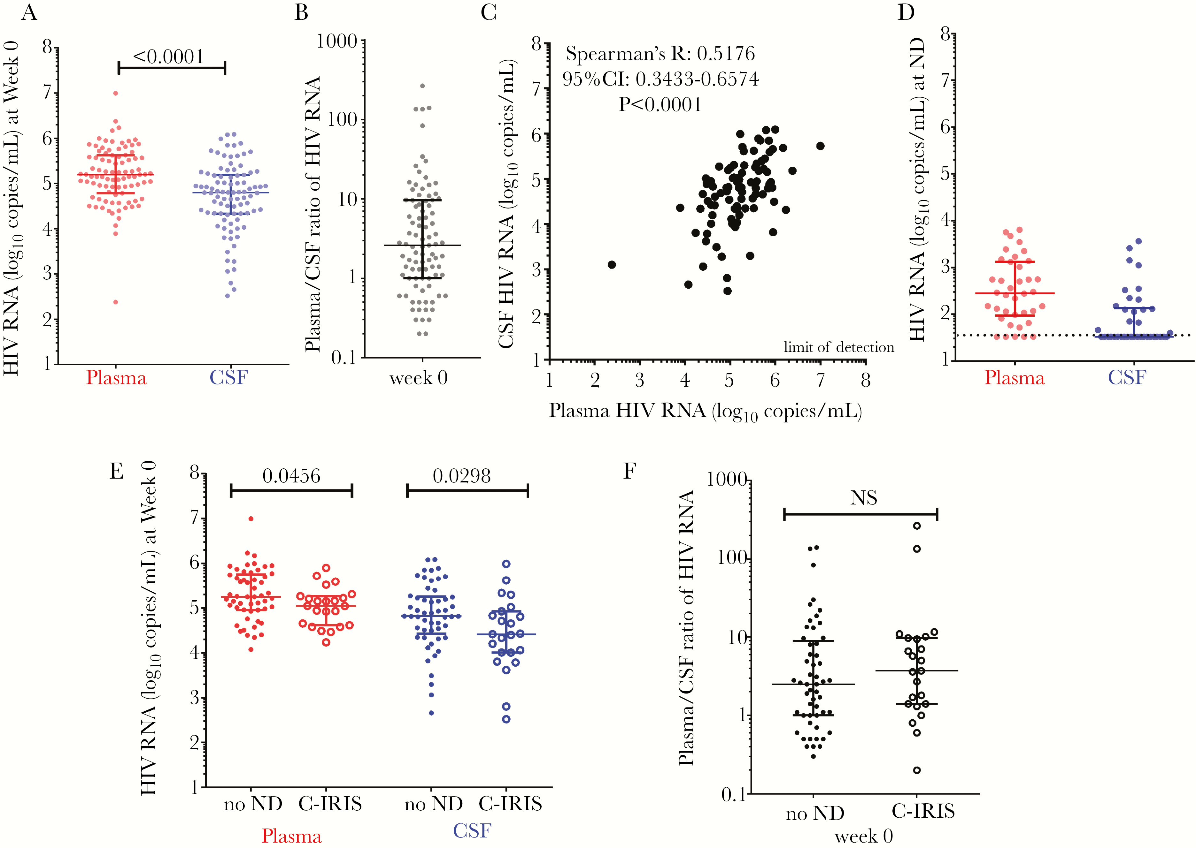
Figure 2. Relationship of human immunodeficiency virus (HIV) ribonucleic acid (RNA) measured in blood and cerebrospinal ...
Notes:
Figure 2. Relationship of human immunodeficiency virus (HIV) ribonucleic acid (RNA) measured in blood and cerebrospinal fluid (CSF) in patients with HIV and cryptococcal meningitis coinfection. (A) Human immunodeficiency virus RNA measured in plasma (in red) and in CSF (in blue) before antiretroviral therapy (ART) commencement. (B) Plasma/CSF ratio of HIV RNA and (C) correlation of plasma to CSF HIV RNA before ART commencement. (D) Human immunodeficiency virus RNA measured in plasma (in red) and in CSF (in blue) at time of neurological deterioration post-ART commencement. (E) Human immunodeficiency virus RNA measured in plasma (in red) and in CSF (in blue), and (F) plasma/CSF HIV RNA ratio (in black), before ART-commencement in those with future cryptococcosis-associated immune reconstitution inflammatory syndrome ([C-IRIS] large circles) and those with no neurological deterioration (ND) (small circles) during the 24-week follow-up period post-ART initiation. CI, confidence interval.
Unless provided in the caption above, the following copyright applies to the content of this slide: © The Author 2017. Published by Oxford University Press on behalf of Infectious Diseases Society of America.This is an Open Access article distributed under the terms of the Creative Commons Attribution-NonCommercial-NoDerivs licence (http://creativecommons.org/licenses/by-nc-nd/4.0/), which permits non-commercial reproduction and distribution of the work, in any medium, provided the original work is not altered or transformed in any way, and that the work is properly cited. For commercial re-use, please contact journals.permissions@oup.com

