Slide 1
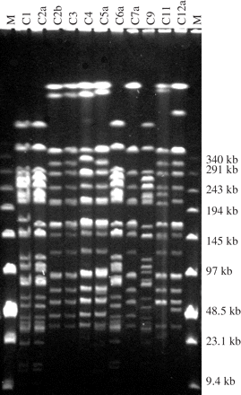
Figure 1. Pulsed-field gel electrophoresis restriction endonuclease digestion profiles of 11 clinical MDREC isolates. M ...
Notes:
Figure 1. Pulsed-field gel electrophoresis restriction endonuclease digestion profiles of 11 clinical MDREC isolates. M = low range lambda ladder.
Unless provided in the caption above, the following copyright applies to the content of this slide: © The Author 2006. Published by Oxford University Press on behalf of the British Society for Antimicrobial Chemotherapy. All rights reserved. For Permissions, please e-mail: journals.permissions@oxfordjournals.org

Slide 2
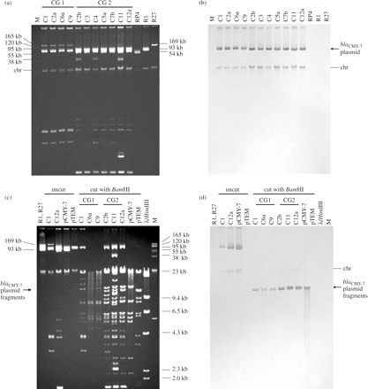
Figure 2. Plasmid profiles, BamHI-digested plasmids and Southern hybridization of 11 clinical MDREC isolates and ...
Notes:
Figure 2. Plasmid profiles, BamHI-digested plasmids and Southern hybridization of 11 clinical MDREC isolates and transformants. (a) Plasmid profiles and (b) Southern hybridization of plasmids using the DIG-labelled blaCMY-7 probe. (c) Comparison of uncut and BamHI-digested plasmids of clinical isolates and transformants and (d) hybridization using the DIG-labelled blaCMY-7 probe. M = plasmid marker (BAC-Tracker™ Supercoiled DNA Ladder). RP4, R1 and R27 are E. coli reference strains that contain plasmids of known size. chr, chromosomal DNA.
Unless provided in the caption above, the following copyright applies to the content of this slide: © The Author 2006. Published by Oxford University Press on behalf of the British Society for Antimicrobial Chemotherapy. All rights reserved. For Permissions, please e-mail: journals.permissions@oxfordjournals.org

