Slide 1
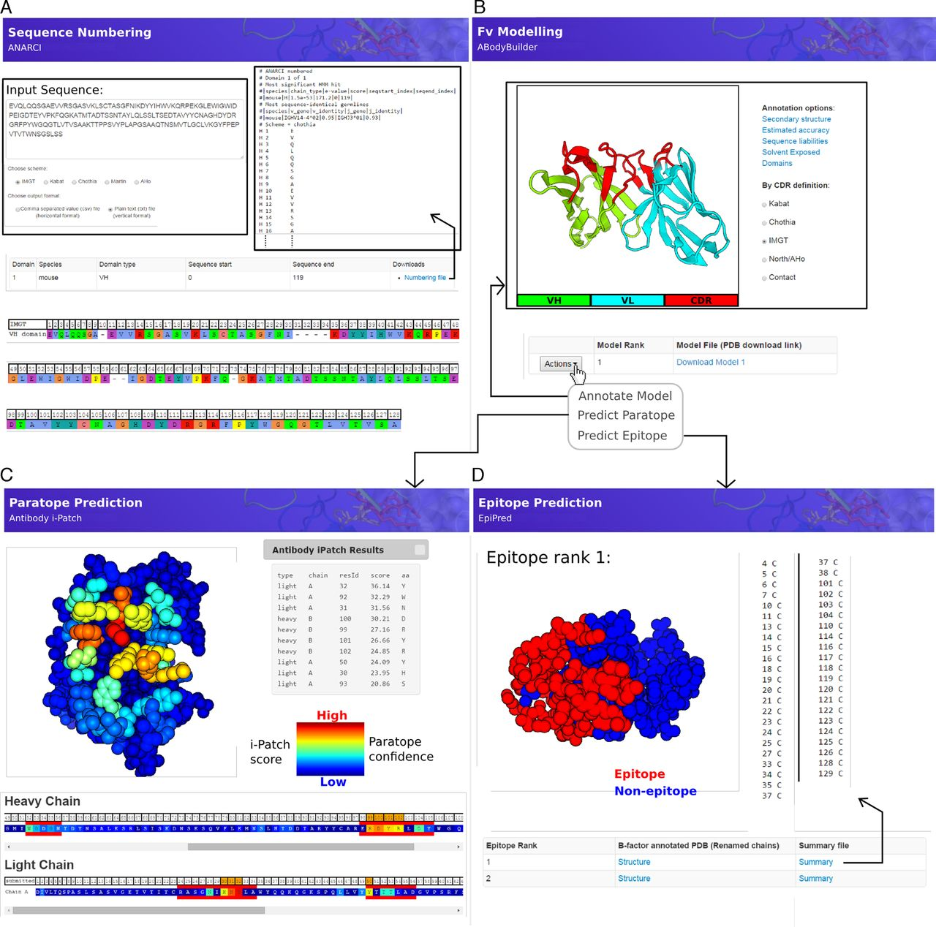
Figure 1. Example outputs of the four main applications provided by SAbPred. (A) The ANARCI tool can be used to apply ...
Notes:
Figure 1. Example outputs of the four main applications provided by SAbPred. (A) The ANARCI tool can be used to apply popular antibody numbering schemes to variable domain amino acid sequences. (B) The ABodyBuilder tool is an automatic Fv modelling protocol. Once a model has been generated it can be annotated with structural properties such as the location of CDRs residues (shown), the estimated accuracy with which each part of the model has been predicted (Supplemental Figure S2) and those residues that may cause issues for in vitro antibody development (Supplemental Figure S3). A model may also be directly used in the (C) paratope or (D) epitope prediction application. (C) Antibody i-Patch predicts those residues most likely to form the paratope. The antibody structure and sequence are coloured according to the i-Patch score (warmer colours indicate a higher score and confidence that the residue will be part of the paratope). A user may export the top N ranked paratope residues and annotate them with a chosen numbering scheme. (D) EpiPred predicts and ranks patches on the antigen surface that are likely to form the antigen epitope. A list of residues is returned and epitope patches may be visualized on the structure.
Unless provided in the caption above, the following copyright applies to the content of this slide: © The Author(s) 2016. Published by Oxford University Press on behalf of Nucleic Acids Research.This is an Open Access article distributed under the terms of the Creative Commons Attribution License (http://creativecommons.org/licenses/by/4.0/), which permits unrestricted reuse, distribution, and reproduction in any medium, provided the original work is properly cited.

