Slide 1
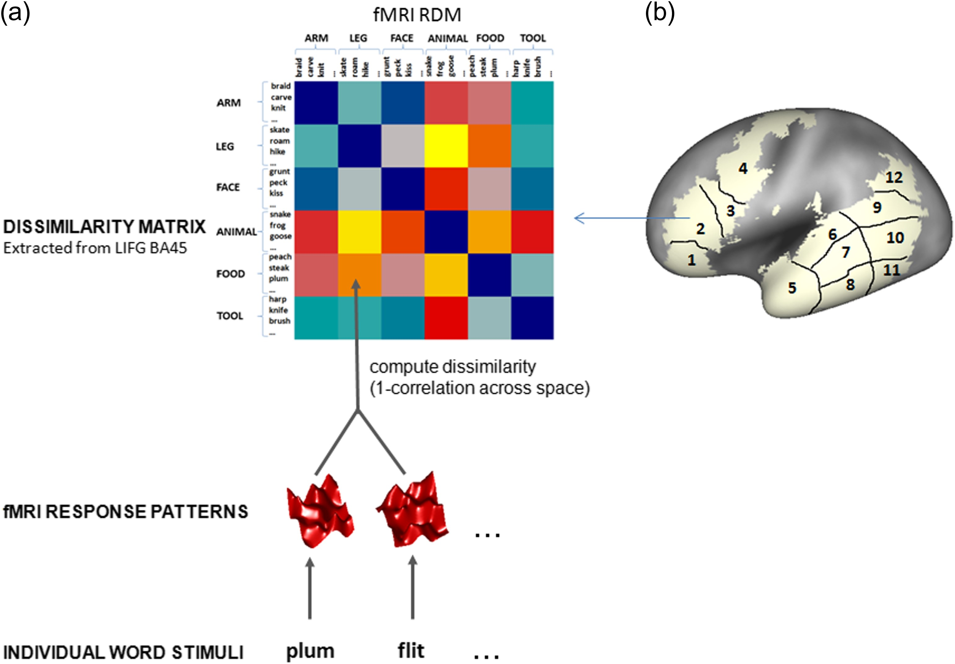
Figure 1. (a) Representational dissimilarity matrix (RDM). Example of RDM computed by combining the fMRI responses to ...
Notes:
Figure 1. (a) Representational dissimilarity matrix (RDM). Example of RDM computed by combining the fMRI responses to words in LIFG BA 45. The 6×6 RDM corresponds to the number of experimental conditions and their corresponding semantic categories. Each cell in the matrix reflects the correlation distance (1−r) between the fMRI patterns associated with each pair of conditions. The RDM is symmetrical along a diagonal expressing maximal similarity for identical condition pairs (e.g., arm words are identical to arm words, leg words identical to leg words, etc.). The off-diagonal cells in both the upper and the lower triangle of the 6×6 RDM contain the similarity values for unique combinations of each condition with the other. The 6×6 RDM comprises a total of 6*5/2 = 15 unique combinations of conditions. (b) The 12 anatomically defined ROIs: 1 = LIFG BA44; 2 = LIFG BA45; 3 = LIFG BA47; 4 = left precentral gyrus; 5 = left temporal pole; 6–9 = left anterior and posterior STG; 7–10 = left anterior and posterior MTG; 8–11 = left anterior and posterior ITG; 12 = angular gyrus.
Unless provided in the caption above, the following copyright applies to the content of this slide: © The Author 2017. Published by Oxford University Press.This is an Open Access article distributed under the terms of the Creative Commons Attribution Non-Commercial License (http://creativecommons.org/licenses/by-nc/4.0/), which permits non-commercial re-use, distribution, and reproduction in any medium, provided the original work is properly cited. For commercial re-use, please contact journals.permissions@oup.com

Slide 2
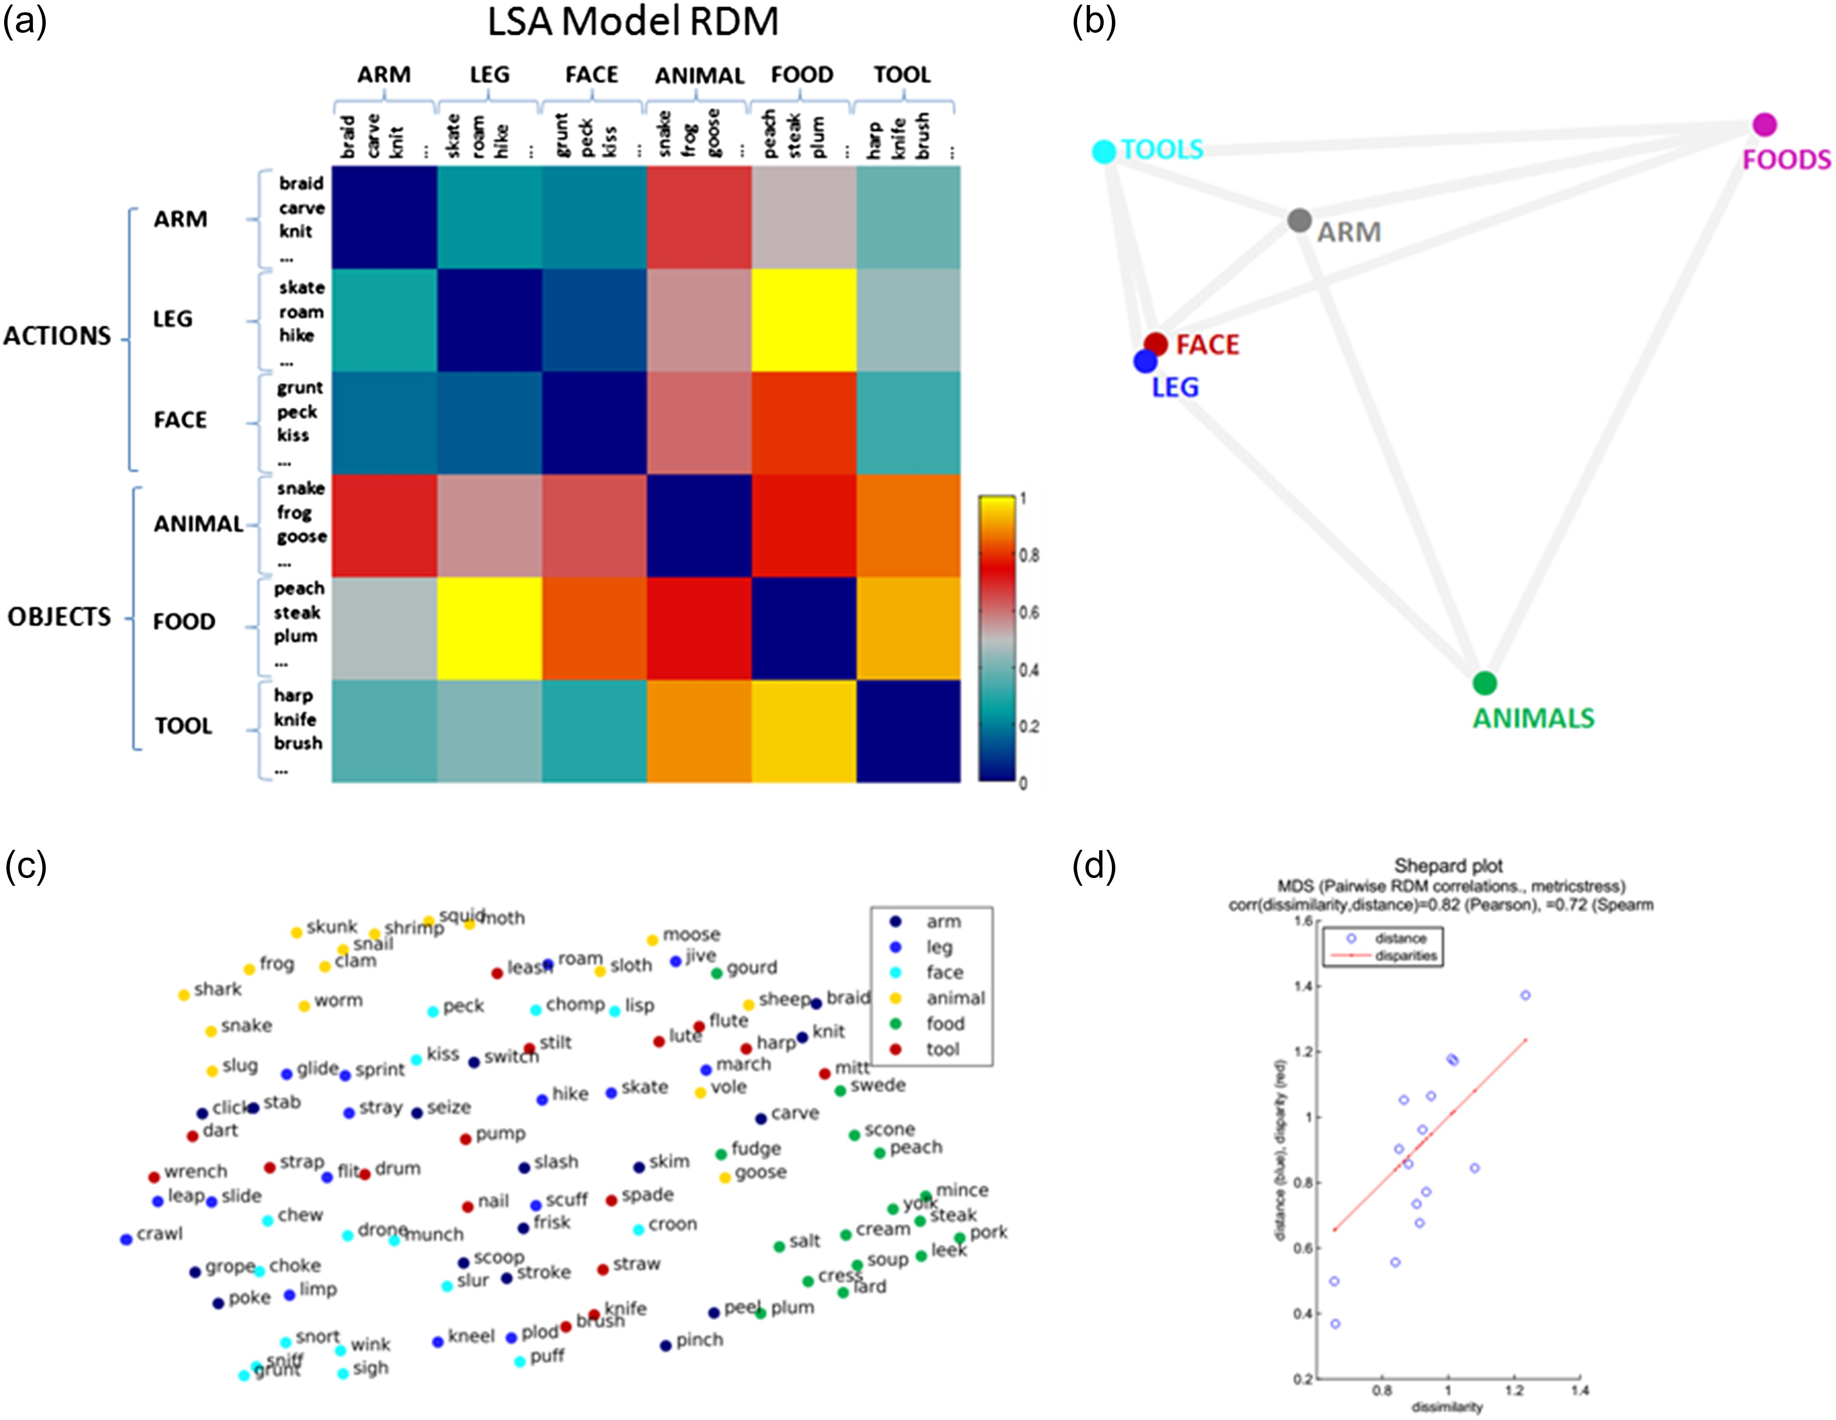
Figure 2. Model of latent semantic similarity. (a) Matrix containing the latent semantic distances between each pair of ...
Notes:
Figure 2. Model of latent semantic similarity. (a) Matrix containing the latent semantic distances between each pair of conditions. The LSA model coded for combinatorial relationships of semantic similarity between the words of each category of action (leg-, arm-, face-related action verbs) and objects (animal-, food-, and tool-related object nouns). The model captures similarity between all action words and, in addition, between action words and tool words. (b) Arrangement by multidimensional scaling of the correlations among the latent semantic values specific to each experimental condition. The graph displays close relationships among action words and also between action words and tool words, while food words are closer to arm words than the remaining action words, and animal words are not closely linked to any word type. (c) Arrangement by multidimensional scaling (MDS) of the correlations among the latent semantic values specific to each word. This graph shows a larger distributional cluster of action words (from dark to light blue), with which tool-related words (in red) are intermixed. Food and animal words (in green and yellow, respectively) form two distinct groups. (d) Shepard plot displaying, for any two conditions, their distances in the 2-dimensional (2D) MDS arrangement versus their dissimilarity (i.e., their distance in the original high-dimensional space). Therefore, if the “mapping” to a 2D space does not cause a large distortion, we expect the two to be highly correlated. The Shepard plot is a way to visualize the quality of the low-dimensional projection.
Unless provided in the caption above, the following copyright applies to the content of this slide: © The Author 2017. Published by Oxford University Press.This is an Open Access article distributed under the terms of the Creative Commons Attribution Non-Commercial License (http://creativecommons.org/licenses/by-nc/4.0/), which permits non-commercial re-use, distribution, and reproduction in any medium, provided the original work is properly cited. For commercial re-use, please contact journals.permissions@oup.com

Slide 3
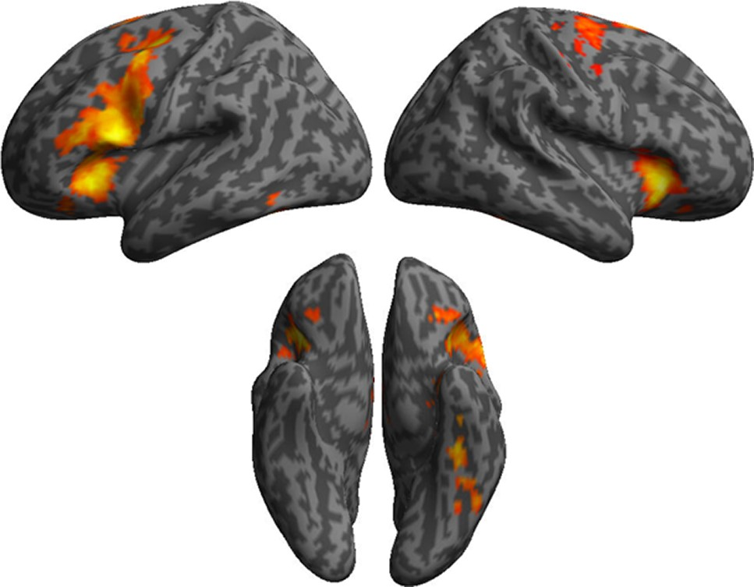
Figure 3. Univariate results. Lateral and ventral views of the cortical activations for general lexical-semantic ...
Notes:
Figure 3. Univariate results. Lateral and ventral views of the cortical activations for general lexical-semantic processing (all experimental words contrasted against visual baseline). Images are significant at P < 0.001, cluster level corrected at FDR 0.05. Table of coordinates and statistics for activation peaks produced by the contrast of all words against baseline (FDR 0.05) RegionsCluster extentVoxel ZCoordinatesxyz(A) All words—Hash marksR middle cingulate12 7025.162044 L middle cingulate5.08−61848 R inferior frontal gyrus (BA 47)4.982828−8L inferior temporal (BA20)10794.48−40−8−28 L fusiform4.28−40−32−20 L temporal pole4.01−347−30R cerebellum4.1122−70−44 R cerebellum11243.940−58−32 R cerebellum3.938−48−32L inferior frontal gyrus (BA 44)3403.52−52818 L precentral gyrus (BA 4)3.41−52028 L precentral gyrus (BA 4)3.4−32−1050
Unless provided in the caption above, the following copyright applies to the content of this slide: © The Author 2017. Published by Oxford University Press.This is an Open Access article distributed under the terms of the Creative Commons Attribution Non-Commercial License (http://creativecommons.org/licenses/by-nc/4.0/), which permits non-commercial re-use, distribution, and reproduction in any medium, provided the original work is properly cited. For commercial re-use, please contact journals.permissions@oup.com

Slide 4
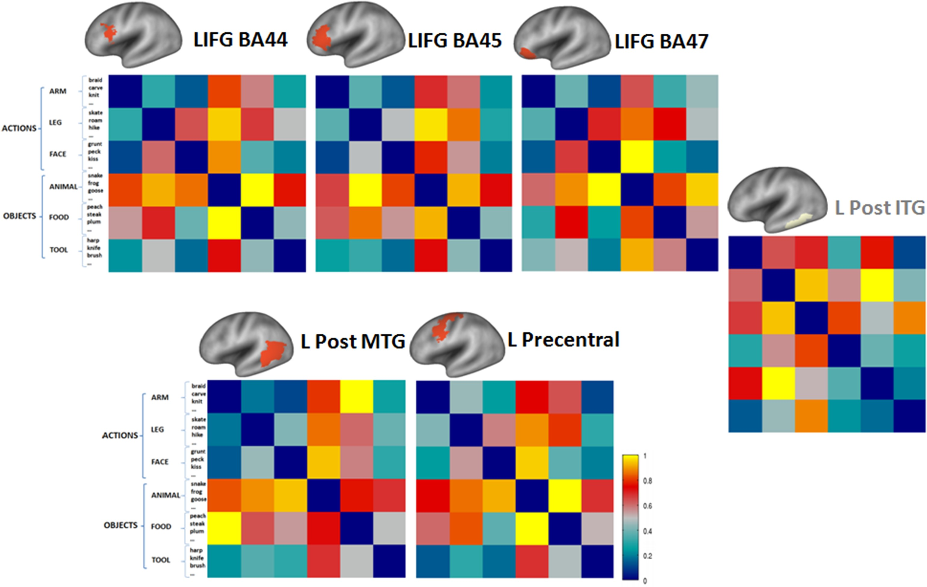
Figure 4. Multivariate RSA results. Brain activity patterns correlating with the LSA model in left inferior gyrus, left ...
Notes:
Figure 4. Multivariate RSA results. Brain activity patterns correlating with the LSA model in left inferior gyrus, left posterior middle temporal gyrus, and precentral gyrus, displayed as RDMs. Note that the categorical structure of some of these brain activity RDMs resembles the one of the LSA model, in which action words are overall represented as being similar to each other, and also similar to tool word and, to a degree, food words. The representational geometry in these regions differs from the one in a typical object processing area, like the left posterior ITG, where object words, but not action words, are represented as being similar. Therefore, the brain activity RDM in the left posterior ITG does not correlate with the LSA model.
Unless provided in the caption above, the following copyright applies to the content of this slide: © The Author 2017. Published by Oxford University Press.This is an Open Access article distributed under the terms of the Creative Commons Attribution Non-Commercial License (http://creativecommons.org/licenses/by-nc/4.0/), which permits non-commercial re-use, distribution, and reproduction in any medium, provided the original work is properly cited. For commercial re-use, please contact journals.permissions@oup.com

Slide 5
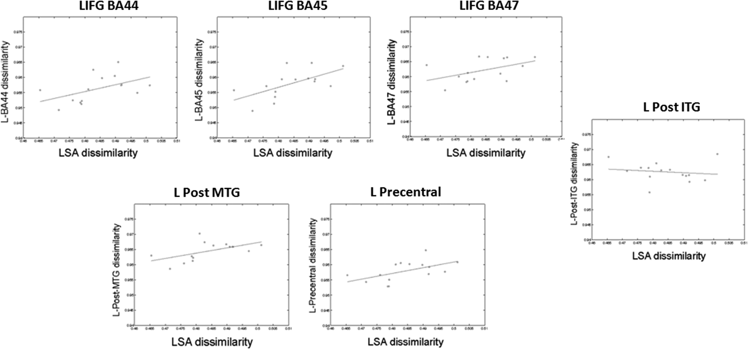
Figure 5. Scatter plots showing correlations across all word categories between the LSA model and the fMRI patterns in ...
Notes:
Figure 5. Scatter plots showing correlations across all word categories between the LSA model and the fMRI patterns in left inferior frontal gyrus (BA44: r = 0.48; P = 0.07; BA45: R = 0.62; P = 0.02; BA47: r = 0.47; P = 0.08), left posterior middle temporal gyrus (r = 0.54; P = 0.04), and precentral gyrus (r = 0.52; P = 0.05). On the rightmost panel, correlation between the LSA model and the brain activity RDM in left inferior posterior temporal (r = −0.31; P = 0.26) is also shown. The gray dots in each scatter plots refer to the 15 unique combinations of each condition with the other, which are also represented by the off-diagonal cells in the upper/lower triangle of the 6×6 RDMs.
Unless provided in the caption above, the following copyright applies to the content of this slide: © The Author 2017. Published by Oxford University Press.This is an Open Access article distributed under the terms of the Creative Commons Attribution Non-Commercial License (http://creativecommons.org/licenses/by-nc/4.0/), which permits non-commercial re-use, distribution, and reproduction in any medium, provided the original work is properly cited. For commercial re-use, please contact journals.permissions@oup.com

Slide 6
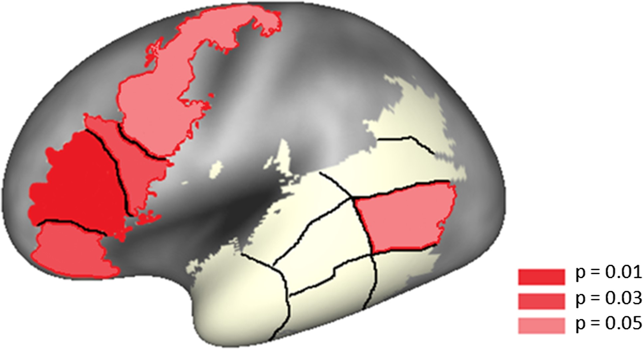
Figure 6. Summary of the multivariate RSA results calculated across all word categories. Regions in which significant ...
Notes:
Figure 6. Summary of the multivariate RSA results calculated across all word categories. Regions in which significant correlations were found between categorical structures of fMRI patterns and of the LSA model are shown in red.
Unless provided in the caption above, the following copyright applies to the content of this slide: © The Author 2017. Published by Oxford University Press.This is an Open Access article distributed under the terms of the Creative Commons Attribution Non-Commercial License (http://creativecommons.org/licenses/by-nc/4.0/), which permits non-commercial re-use, distribution, and reproduction in any medium, provided the original work is properly cited. For commercial re-use, please contact journals.permissions@oup.com

Slide 7
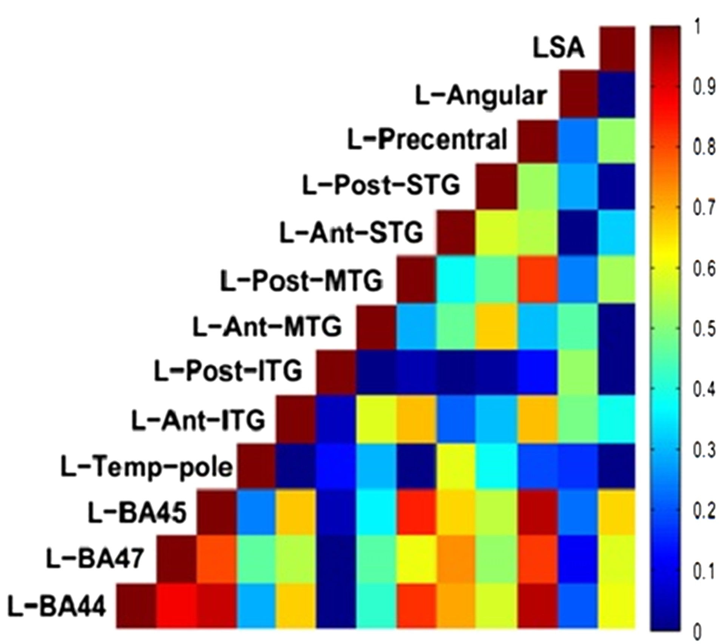
Figure 7. Matrix displaying the correlations between the LSA model RDM and the brain activity RDMs in each ROI. Each ...
Notes:
Figure 7. Matrix displaying the correlations between the LSA model RDM and the brain activity RDMs in each ROI. Each entry compares two RDMs by Spearman rank correlation, from minimum (dark blue) to maximum (dark red) on the diagonal. The matrix is symmetric about a diagonal of ones. Correlations of LSA model and the RDMs in left precentral (green), left posterior MTG (green), and LIFG (BA 44-45-47) (yellow) are shown in the rightmost column. Note that the RDMs in LIFG (BA 44-45-47) and especially in BA 45 are most highly correlated with the LSA similarity measure (rightmost column). Also, these areas’ pattern similarities correlate highly with each other and with precentral and (in part) with posterior MTG (red cells).
Unless provided in the caption above, the following copyright applies to the content of this slide: © The Author 2017. Published by Oxford University Press.This is an Open Access article distributed under the terms of the Creative Commons Attribution Non-Commercial License (http://creativecommons.org/licenses/by-nc/4.0/), which permits non-commercial re-use, distribution, and reproduction in any medium, provided the original work is properly cited. For commercial re-use, please contact journals.permissions@oup.com

