Slide 1
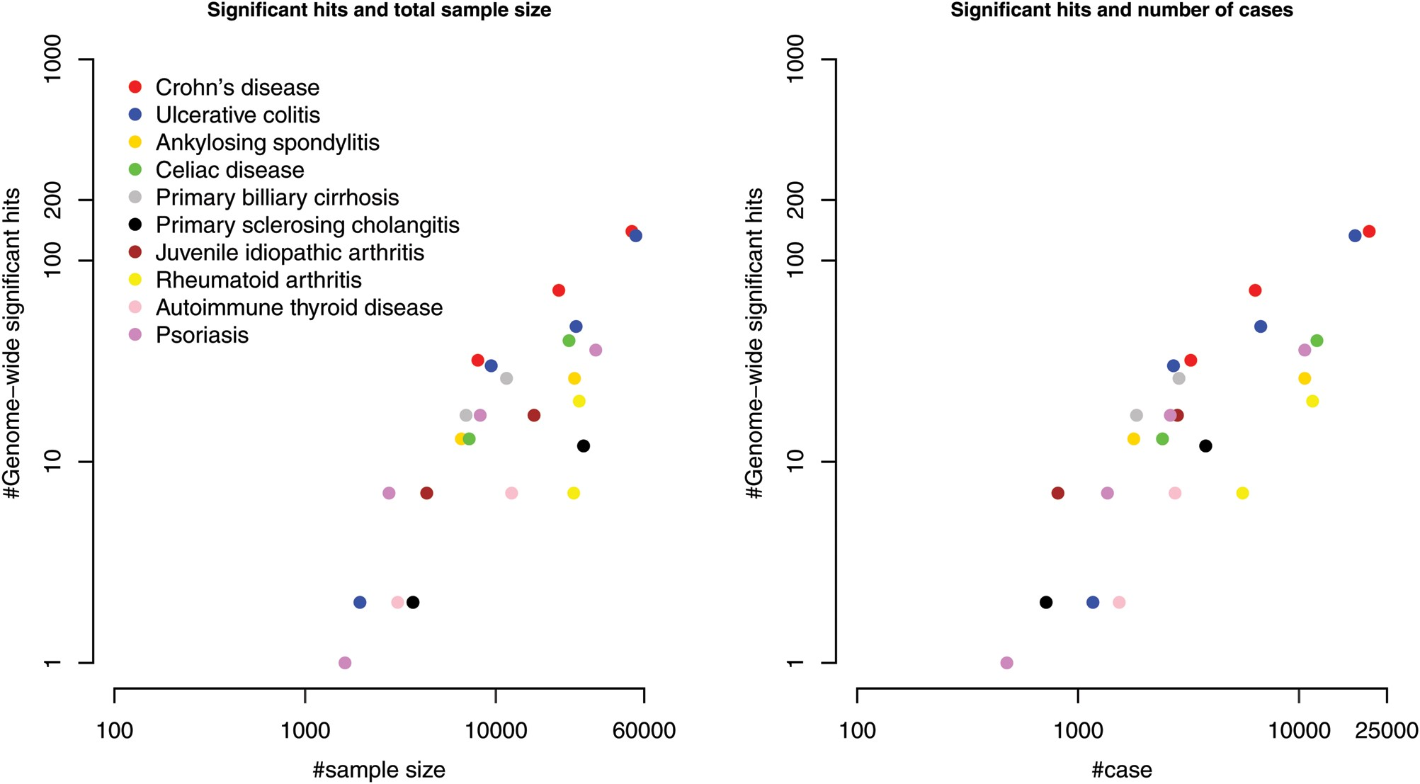
Figure 1. Increase in the number of GWAS-significant signals for total sample size and the number of cases. Both the ...
Notes:
Figure 1. Increase in the number of GWAS-significant signals for total sample size and the number of cases. Both the axes are on a logarithmic scale. The source of the data is in Supplementary Material, Table S1.
Unless provided in the caption above, the following copyright applies to the content of this slide: © The Author 2014. Published by Oxford University Press. All rights reserved. For Permissions, please email: journals.permissions@oup.com

Slide 2
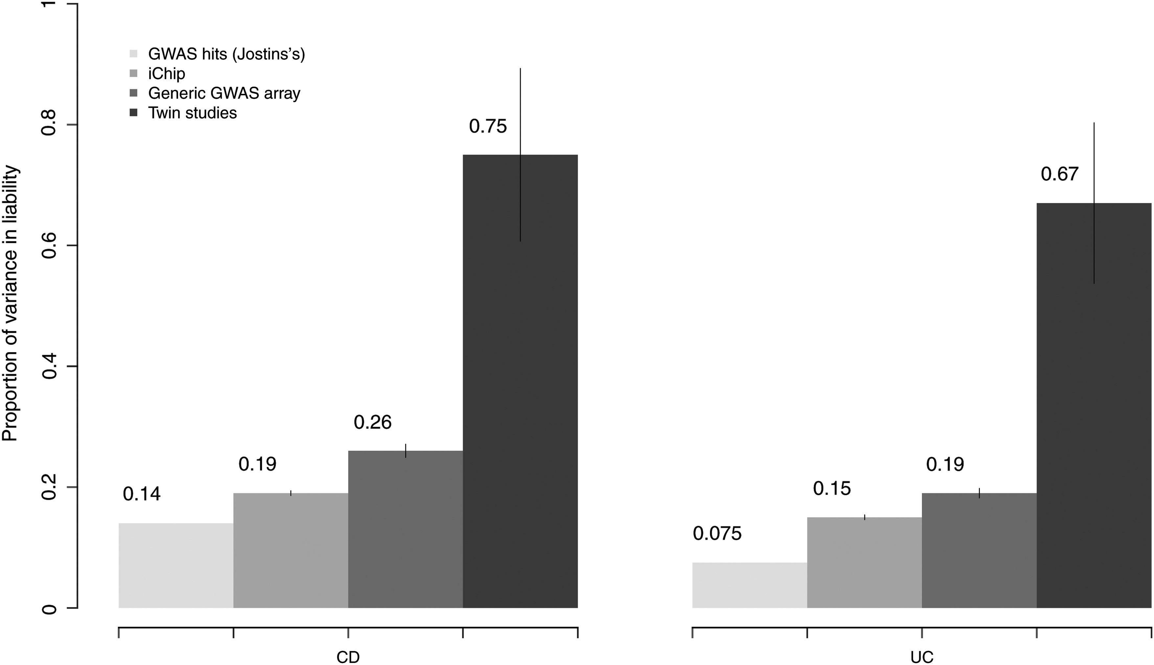
Figure 2. The comprehensive estimation of the explained variance in liability scale for CD and UC. For each disease, ...
Notes:
Figure 2. The comprehensive estimation of the explained variance in liability scale for CD and UC. For each disease, from left to right are the estimates from GWAS hits (12), iChip, generic GWAS array data, and twin studies pooling four published twins cohorts together (Supplementary Material, Note).
Unless provided in the caption above, the following copyright applies to the content of this slide: © The Author 2014. Published by Oxford University Press. All rights reserved. For Permissions, please email: journals.permissions@oup.com

Slide 3
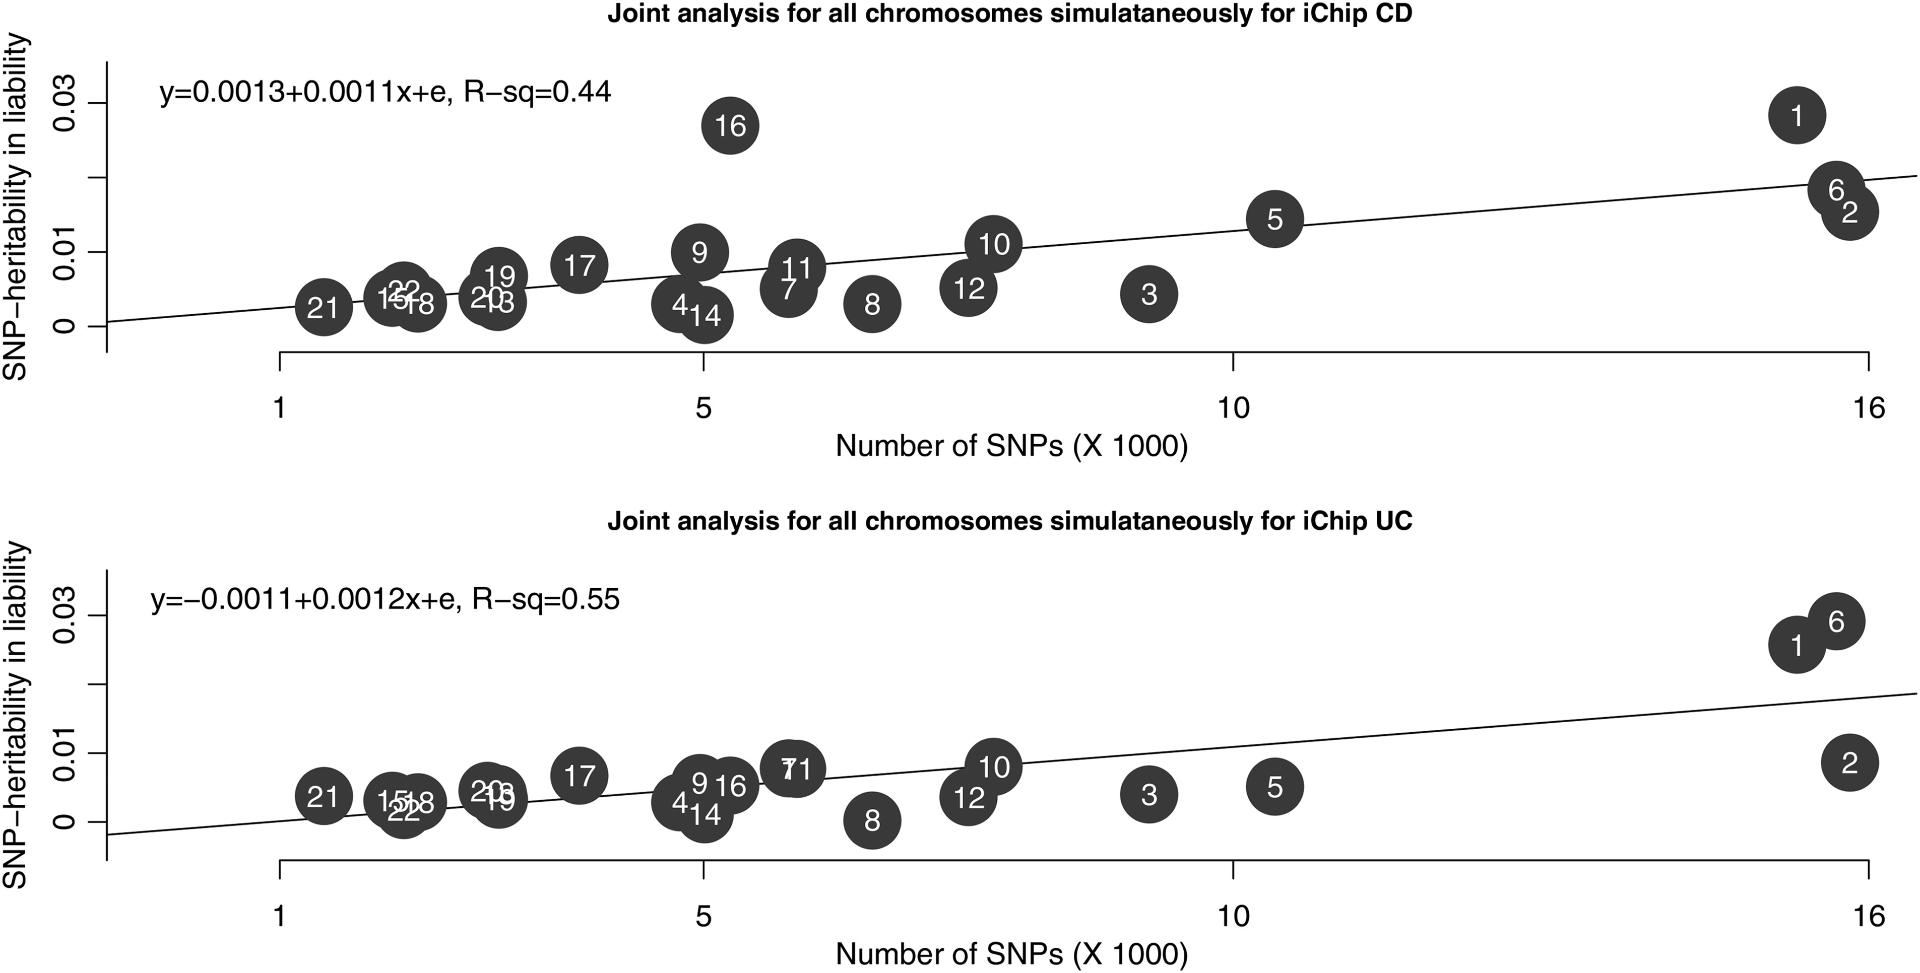
Figure 3. Partitioning of genetic variation in liability to CD and UC across chromosomes. The iChip sample was split ...
Notes:
Figure 3. Partitioning of genetic variation in liability to CD and UC across chromosomes. The iChip sample was split into two subsets, and the averaged heritability was used in this figure.
Unless provided in the caption above, the following copyright applies to the content of this slide: © The Author 2014. Published by Oxford University Press. All rights reserved. For Permissions, please email: journals.permissions@oup.com

Slide 4
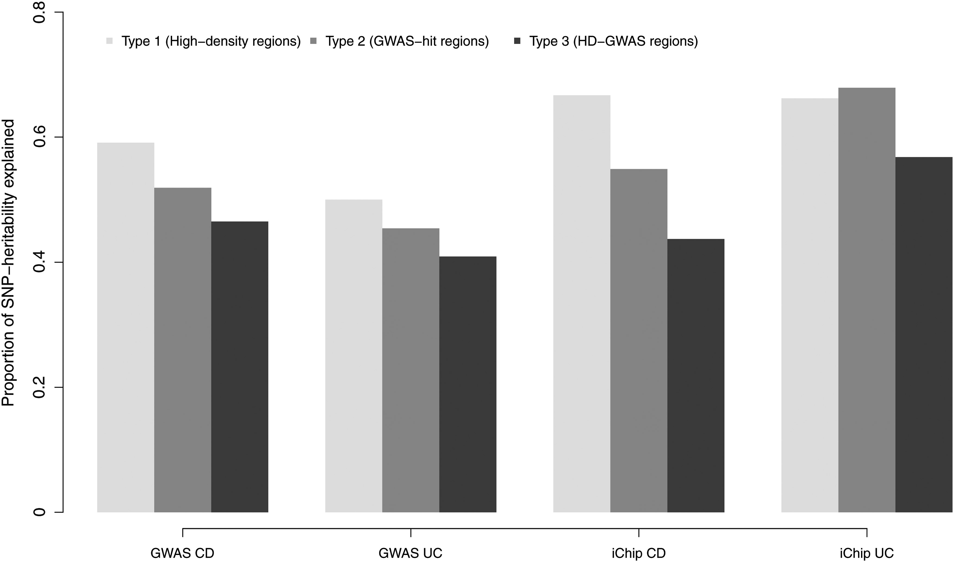
Figure 4. Proportion of the genetic variation in liability to CD and UC explained by the selected regions across three ...
Notes:
Figure 4. Proportion of the genetic variation in liability to CD and UC explained by the selected regions across three types of partitioning of the genome.
Unless provided in the caption above, the following copyright applies to the content of this slide: © The Author 2014. Published by Oxford University Press. All rights reserved. For Permissions, please email: journals.permissions@oup.com

