Slide 1
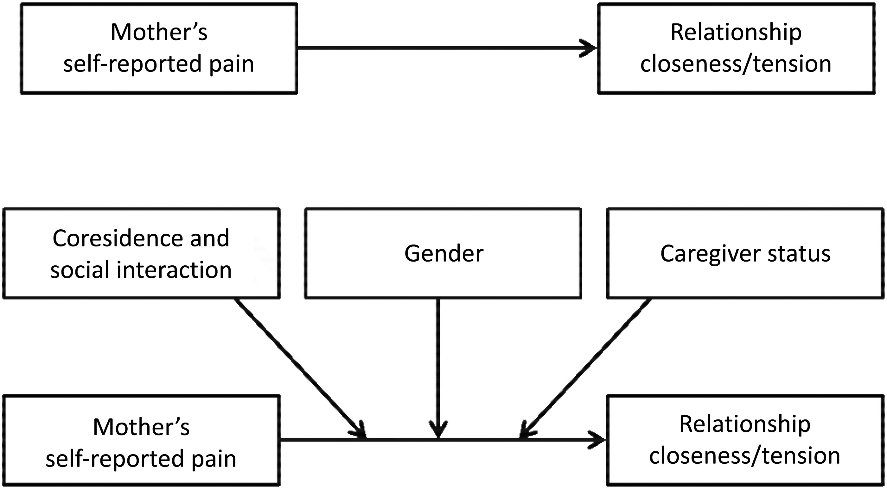
Figure 1 Conceptual model.
Notes:
Figure 1 Conceptual model.
Unless provided in the caption above, the following copyright applies to the content of this slide: © 2017 American Academy of Pain Medicine. All rights reserved. For permissions, please e-mail: journals.permissions@oup.com

