Slide 1
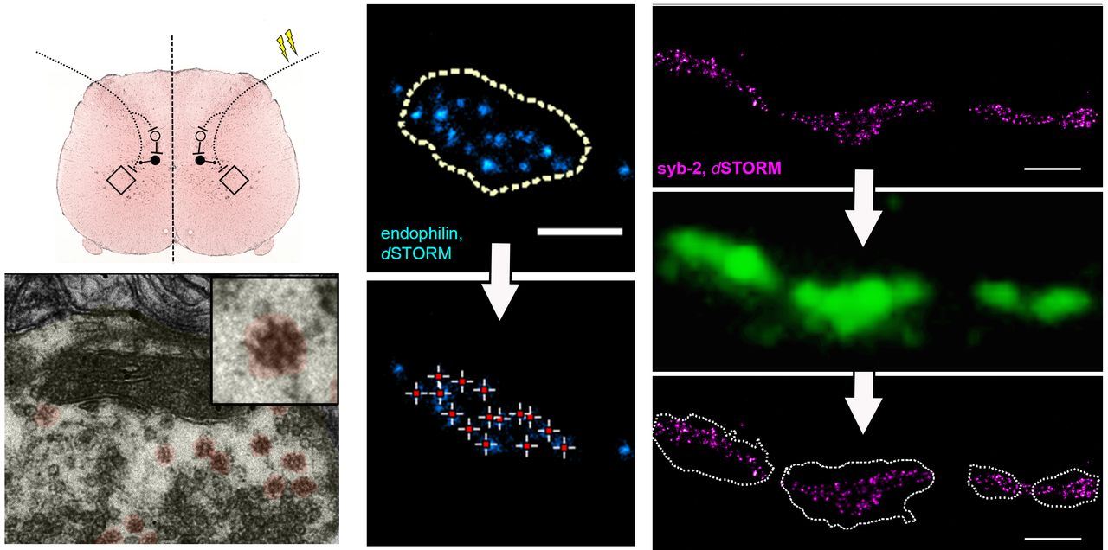
See Irani (doi:10.1093/awv364) for a scientific commentary on this article. The pathophysiological ...
Notes:
See Irani (doi:10.1093/awv364) for a scientific commentary on this article. The pathophysiological mechanisms of anti-amphiphysin antibodies in paraneoplastic stiff person syndrome leading to disease symptoms are unclear. Werner et al. report that purified human anti-amphipysin antibodies lead to changes in the architecture and molecular composition of GABAergic presynaptic nerve terminals both in vitro and in vivo.
Unless provided in the caption above, the following copyright applies to the content of this slide: © The Author (2015). Published by Oxford University Press on behalf of the Guarantors of Brain. All rights reserved. For Permissions, please email: journals.permissions@oup.com

Slide 2
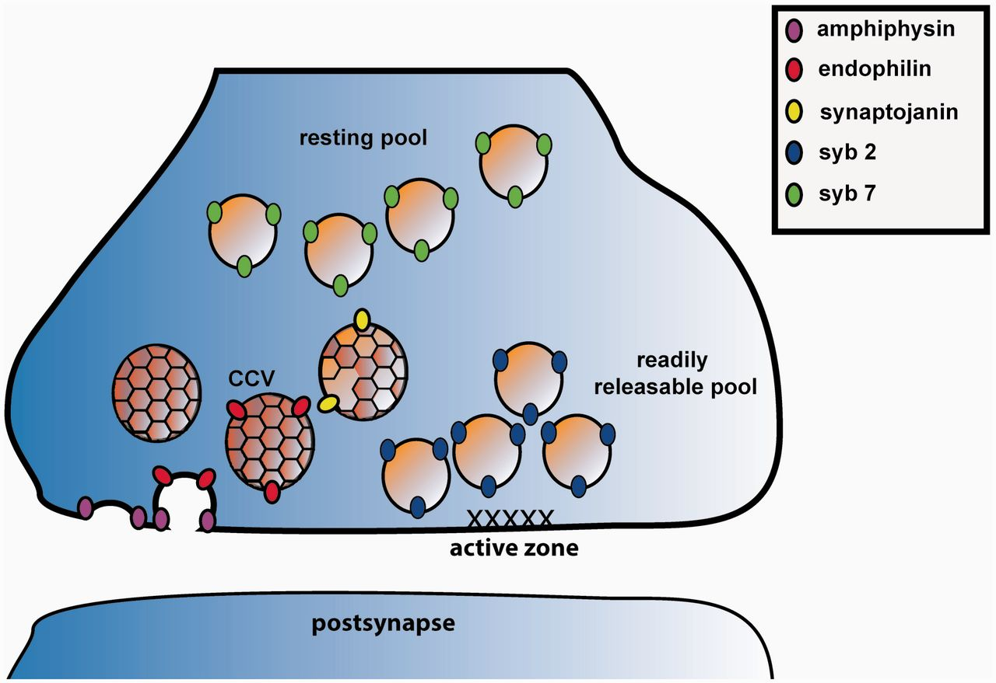
Figure 1 Schematic overview of investigated structural and molecular arrangements within the presynapse. Amphiphysin ...
Notes:
Figure 1 Schematic overview of investigated structural and molecular arrangements within the presynapse. Amphiphysin is involved in membrane bending to initiate the synaptic vesicle budding step in clathrin-mediated endocytosis. Amphiphysin has several interaction proteins in these initial steps of endocytosis. Shown here is the interaction partner endophilin that is also involved in membrane bending and further in promoting the vesicle uncoating phase. Additionally, endophilin plays a role in clathrin-independent endocytosis. Synaptojanin initiates synaptic vesicle uncoating and interacts with amphiphysin and endophilin. Readily releasable vesicles are characterized by preferential molecular equipment with v-SNARE syb2 and resting vesicles are predominantly associated with syb7 isoforms. Further interaction partners of amphiphysin and other synaptic proteins are omitted for simplicity. Clathrin triskelia are illustrated as honeycombs on clathrin-coated vesicles (CCV).
Unless provided in the caption above, the following copyright applies to the content of this slide: © The Author (2015). Published by Oxford University Press on behalf of the Guarantors of Brain. All rights reserved. For Permissions, please email: journals.permissions@oup.com

Slide 3
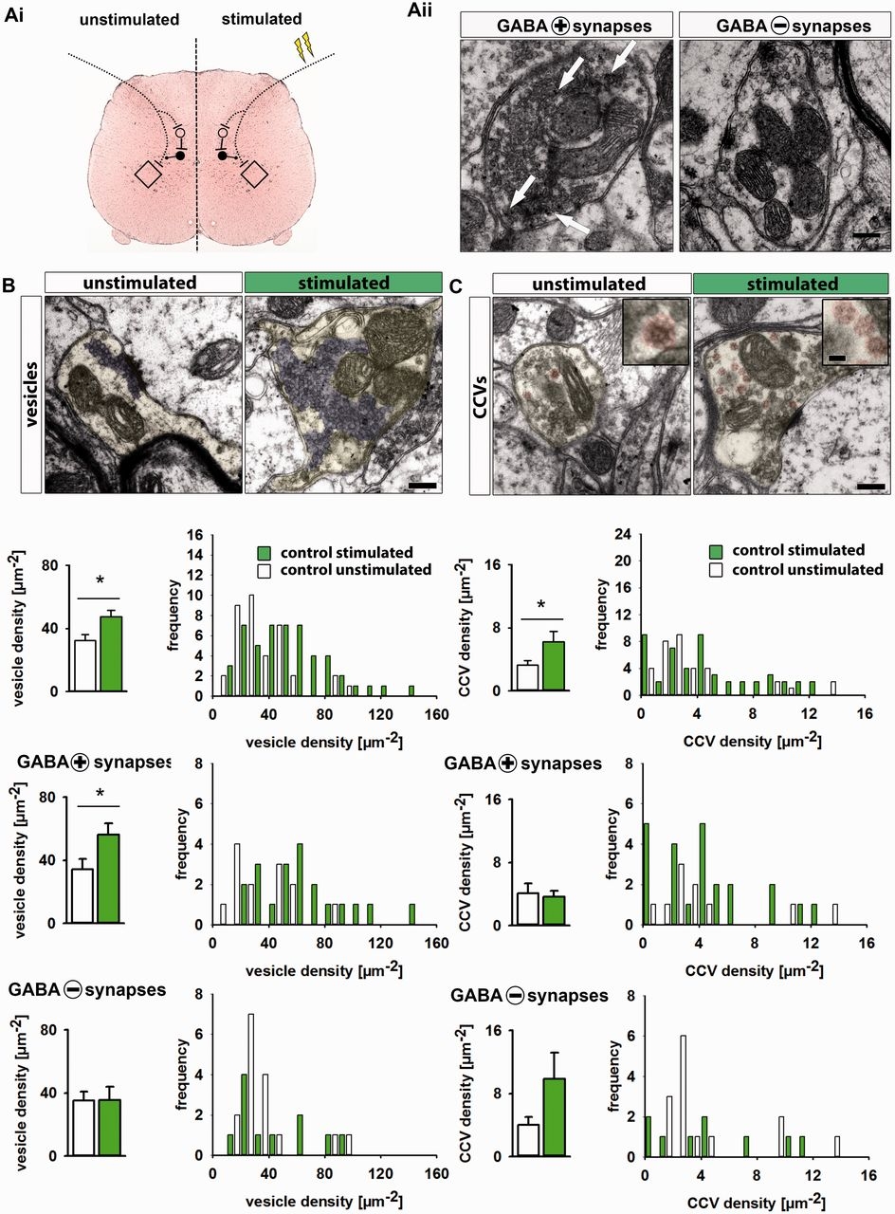
Figure 2 Sustained stimulation increases synaptic vesicle pool size and number of clathrin-coated intermediates in ...
Notes:
Figure 2 Sustained stimulation increases synaptic vesicle pool size and number of clathrin-coated intermediates in spinal control boutons. [A(i)] Scheme of experimental set-up depicting unilateral stimulation of Ia afferents in the peripheral sciatic nerve targeting ventral horn motor neurons. Stimulation leads to concurrent activation of local interneurons with last inhibitory interneuron projecting on terminal Ia afferent axons mediating presynaptic inhibition (rhombus = motor neuron; white circle = excitatory neuron; black circle = local GABAergic inhibitory neuron; flashes represent stimulation of peripheral Ia afferent). [A(ii)] Example micrographs of spinal boutons with high GABA immunoreactivity (arrows, GABA + synapses as defined by level of GABA immunoreactivity in the upper third spectrum of all synapses) or low reactivity (GABA − synapses with GABA immunoreactivity in the lower third spectrum). (B) Increased synaptic vesicle density in stimulated spinal boutons (control condition). Electron micrographs show unstimulated and stimulated spinal boutons (marked with light yellow). Quantification of vesicle (purple) density of all boutons (n = 52 stimulated versus 51 unstimulated boutons) and in the subgroup of primarily GABAergic presynapses (n = 13 versus 20) revealed larger synaptic vesicle pool size in stimulated conditions compared to basal neuronal activity. Frequency distribution histograms show a shift towards a higher number of boutons with high vesicle density. Vesicle density was unchanged in the subgroup of GABA − presynapses (n = 16 versus 11) following stimulation (*P < 0.05). (C) Increased clathrin-coated vesicles (CCVs) during high synaptic activity (control condition). Electron micrographs show increased numbers of CCVs (in red) during high-frequency stimulation (n = 52) compared to only few in unstimulated presynapses (n = 40). Insets present a detailed structure of clathrin coated vesicles with clearly visible triskelia surrounding the vesicle core structure. Low GABA containing synapses showed a similar trend but no significant changes in clathrin coated vesicles density (n = 15 versus 13), synapses predominantly using GABA as neurotransmitter were unchanged (n = 11 versus 23). Frequency distribution histogram represents data distribution of clathrin-coated vesicles density analysis (P < 0.05). Scale bars = 250 nm, insets = 50 nm. Data in bar graphs are provided as mean and SEM.
Unless provided in the caption above, the following copyright applies to the content of this slide: © The Author (2015). Published by Oxford University Press on behalf of the Guarantors of Brain. All rights reserved. For Permissions, please email: journals.permissions@oup.com

Slide 4
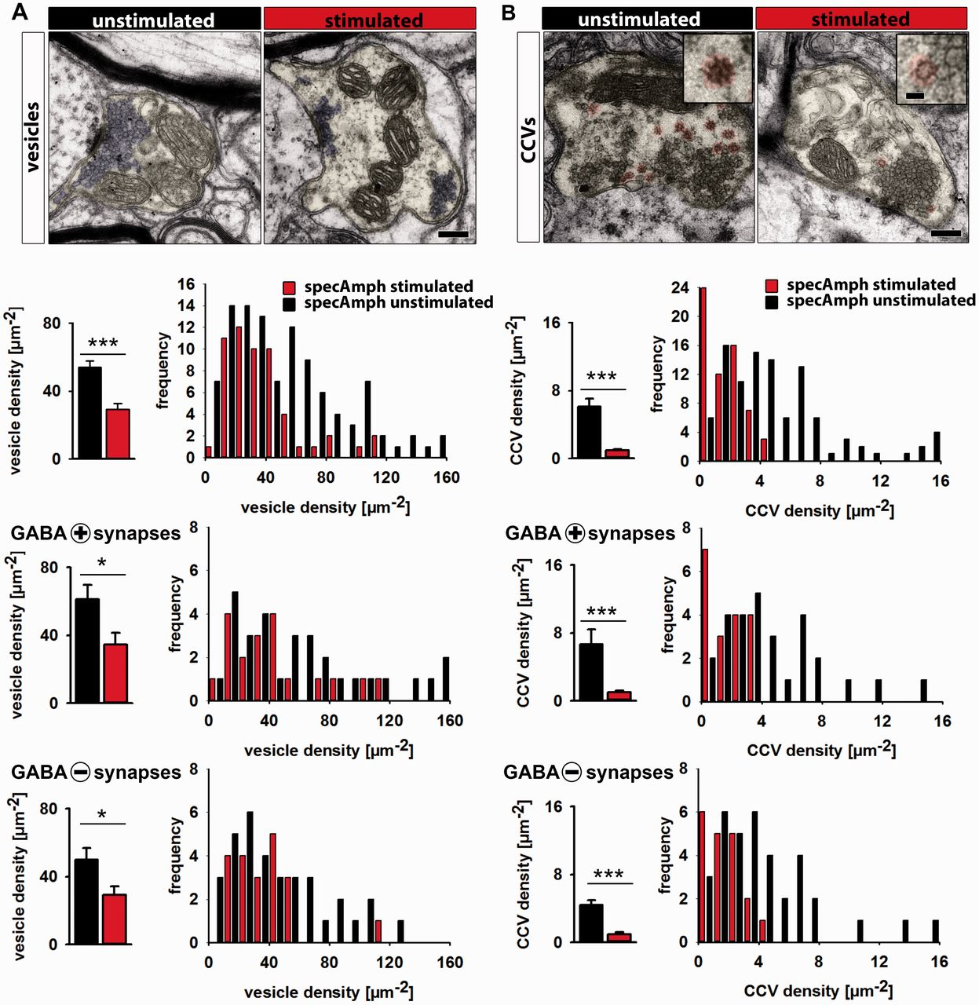
Figure 3 Intrathecal application of specific affinity purified human anti-amphiphysin antibodies (specAmph ...
Notes:
Figure 3 Intrathecal application of specific affinity purified human anti-amphiphysin antibodies (specAmph autoantibodies) leads to stimulus-dependent reduction of synaptic vesicle density and number of clathrin-coated vesicles. (A) Electron micrographs of unstimulated and stimulated spinal boutons (yellow). Quantification of vesicle (purple) density in all boutons (n = 109 unstimulated versus n = 66 stimulated boutons), in the subgroup of GABA+ (unstimulated: n = 30 versus stimulated: n = 19), and GABA − presynapses (unstimulated: n = 35 versus stimulated: n = 20) showed reduced vesicle density at high synaptic activity in all analysed groups. Frequency distribution histograms represent data distribution of vesicle density with a shift towards terminals with reduced vesicle density (Scale bar = 250 nm); *P < 0.05, ***P < 0.001. (B) Electron microscopy analysis of clathrin-coated vesicles (marked in red; insets show detailed structure with visible snowflake-like triskelia edging; Scale bar = 50 nm) in unstimulated (n = 113) and stimulated (n = 63) spinal cord presynapses revealed a high number of vesicles equipped with clathrin coat already in resting conditions which were almost completely lacking after stimulation. The same observation was made in the subgroups of GABA+ (unstimulated: n = 30 versus stimulated: n = 18) and GABA − (unstimulated: n = 35 versus stimulated: n = 19) presynaptic boutons. Frequency distribution histogram represents clathrin-coated vesicles density showing a pronounced shift towards boutons with low number of clathrin-coated vesicles upon stimulation (Scale bar = 250 nm); ***P < 0.001. Data in bar graphs are provided as mean and SEM.
Unless provided in the caption above, the following copyright applies to the content of this slide: © The Author (2015). Published by Oxford University Press on behalf of the Guarantors of Brain. All rights reserved. For Permissions, please email: journals.permissions@oup.com

Slide 5
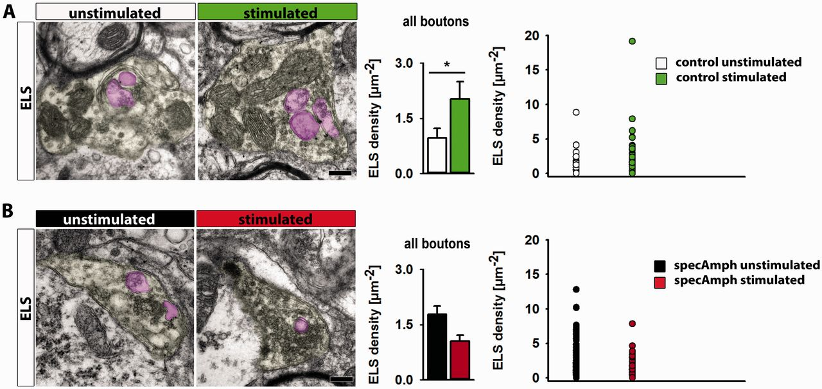
Figure 4 Analysis of endosome-like structures after intrathecal application of specific affinity purified human ...
Notes:
Figure 4 Analysis of endosome-like structures after intrathecal application of specific affinity purified human anti-amphiphysin autoantibodies. (A) Electron micrographs of control spinal boutons showing enlarged organelles defined as endosome-like structures (ELS; pink). These structures are identified by their increased size relative to synaptic vesicles and double-walled membrane margin. During high synaptic activity the density of endosome-like structures was increased (control unstimulated = 1.0 ± 0.3 µm−2, n = 44 boutons; control stimulated = 2.0 ± 0.5 µm−2, n = 53; *P < 0.05). Dot plot shows data distribution of endosome-like structures density in individual boutons with a shift towards terminals with higher numbers of endosome-like structures. (B) Electron micrographs of spinal boutons after specAmph autoantibody treatment. Analysis of endosome-like structures density of all stimulated boutons after repetitive intrathecal application of specAmph autoantibodies revealed not an increase but instead a tendency of endosome-like structures reduction at high synaptic activity (specAmph unstimulated = 1.8 ± 0.2 µm−2, n = 110; specAmph stimulated = 1.0 ± 0.2 µm−2, n = 64; P = 0.061). Dot plot highlights distribution of boutons according density of endosome-like structures. Scale bars = 250 nm.
Unless provided in the caption above, the following copyright applies to the content of this slide: © The Author (2015). Published by Oxford University Press on behalf of the Guarantors of Brain. All rights reserved. For Permissions, please email: journals.permissions@oup.com

Slide 6
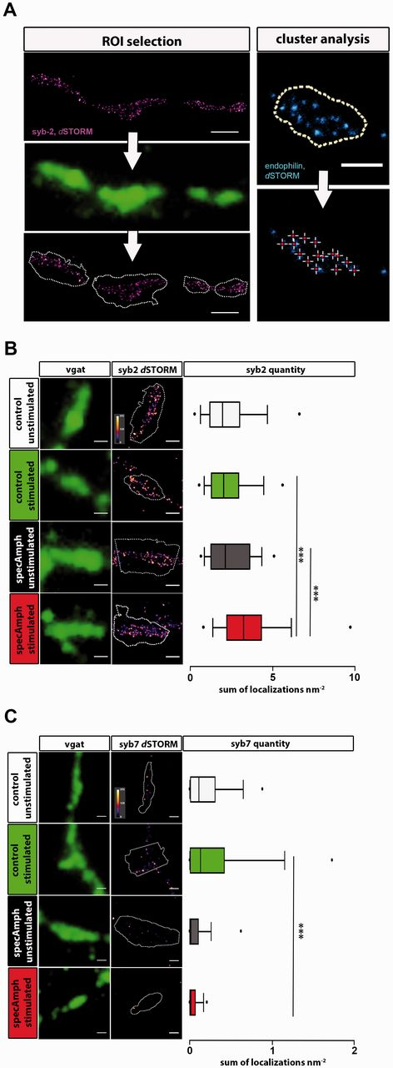
Figure 5 v-SNARE expression and localization within GABAergic synaptic vesicle clusters investigated by dSTORM. (A) ...
Notes:
Figure 5 v-SNARE expression and localization within GABAergic synaptic vesicle clusters investigated by dSTORM. (A) Left: scheme for quantification of dSTORM signals (here shown for syb2) using regions of interests of epifluorescence vgat signal (green). Dashed lines highlight calculated region of interest according to defined and constant signal properties. Right: scheme of dSTORM signals cluster analysis. Crosshairs depict signal maxima automatically detected by predefined parameters. Distances were measured between each maximum. Scale bars = 250 nm. (B) Human affinity purified anti-amphiphysin autoantibody-induced increase of syb2 signal within GABAergic presynapses during high synaptic activity. Images show signal of v-SNARE syb 2 [pseudocolour, dSTORM; signal intensity is encoded by heatmap colour scale (0–255 bits)] over vgat positive boutons (green, epifluorescence) of representative example boutons. Quantitative analyses of syb2 localization counts revealed similar amounts in control boutons regardless of synaptic activity (unstimulated: 2.4 ± 0.3 nm−2, n = 51 analysed boutons; stimulated: 2.3 ± 0.1 nm−2, n = 100). SpecAmph autoantibodies pretreated boutons showed an increased quantity of syb2 signal upon sustained stimulation compared to unstimulated specAmph autoantibodies pretreated terminals (unstimulated: 2.6 ± 0.3 nm −2, n = 85; stimulated: 4.8 ± 1.1 nm−2, n = 70) or to stimulated control terminals. Scale bars = 500 nm; ***P < 0.001. (C) SpecAmph autoantibodies mediate decrease of syb7 signal in GABAergic presynapses. Analysis of signal quantity of v-SNARE syb7 [pseudocolour, dSTORM; heatmap colour scale (0–255 bits)] using vgat signal (green) as a mask for GABAergic boutons revealed a gradual increase of syb7 localization count in controls by stimulation (unstimulated: 0.22 ± 0.03 nm−2, n = 79; stimulated: 0.38 ± 0.07 nm−2, n = 72). Against this, in specAmph autoantibodies pretreated neurons syb7 quantity was markedly decreased (unstimulated: 0.16 ± 0.06 nm−2, n = 98; stimulated: 0.05 ± 0.01 nm−2, n = 78). In comparison to stimulated control conditions, analysis revealed a highly significant reduction of syb7 signal quantity in stimulated GABAergic boutons after specAmph autoantibodies application. Scale bars = 500 nm; ***P < 0.001. Box plots show median values inside boxes depicting 25–75% of data values. Whiskers represent data between 5th and 95th percentile. Extreme values are defined as those exceeding the range of whisker percentiles.
Unless provided in the caption above, the following copyright applies to the content of this slide: © The Author (2015). Published by Oxford University Press on behalf of the Guarantors of Brain. All rights reserved. For Permissions, please email: journals.permissions@oup.com

Slide 7
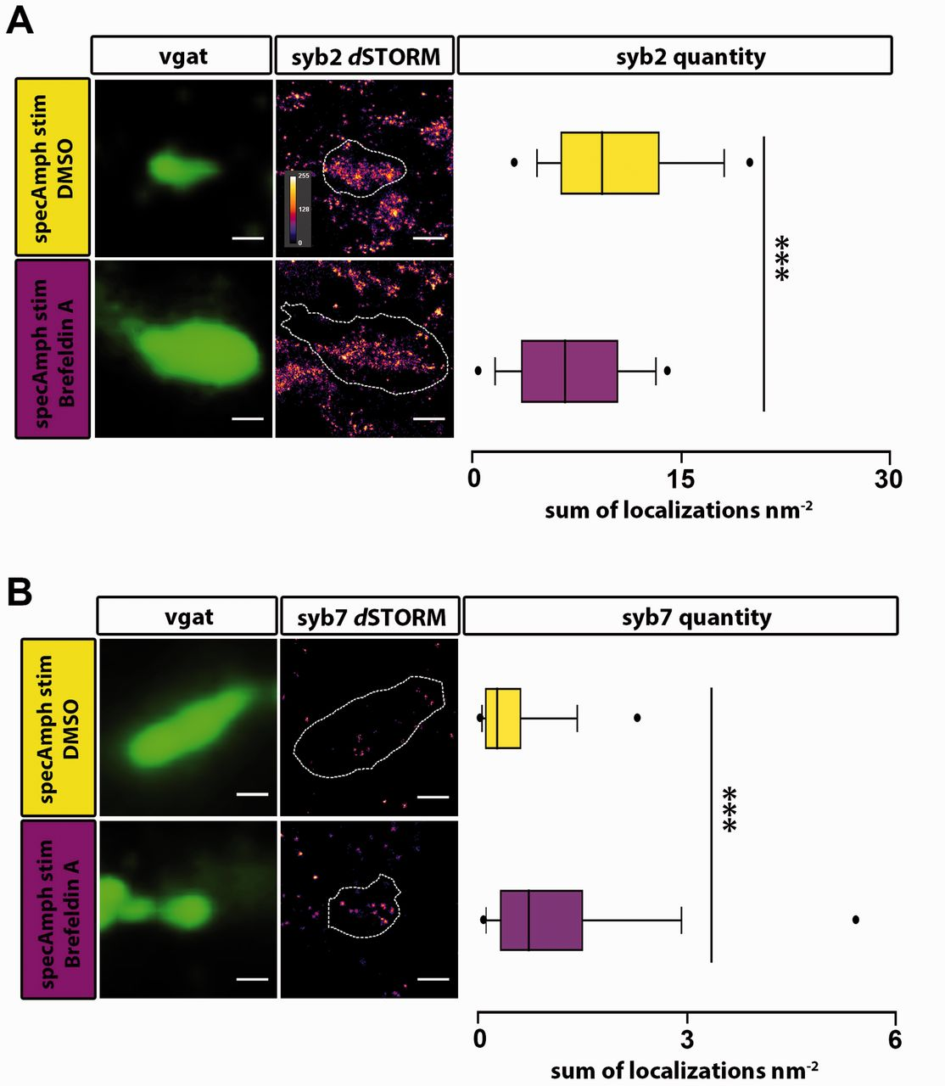
Figure 6 Treatment with brefeldin A partially rescues vesicle pool deregulation induced by specAmph autoantibodies. ...
Notes:
Figure 6 Treatment with brefeldin A partially rescues vesicle pool deregulation induced by specAmph autoantibodies. (A) Analysis of syb2 expression [dSTORM, pseudocolour; signal intensity encoded by heatmap colour scale (0–255 bits)] in GABAergic boutons (epifluorescence, green) treated with brefeldin A. Stimulation in presence of specAmph autoantibodies without brefeldin A results in accumulation of syb2 signal similar to preceding experiments without blocker (specAmph stim DMSO, yellow: 10.3 ± 0.1 nm −2, n = 58 analysed boutons). Brefeldin A treatment results in lower syb2 signal inside GABAergic synapses (specAmph stim Brefeldin A, purple: 7.1 ± 0.1 nm−2, n = 70 analysed boutons); Scale bars = 500 nm; ***P < 0.001. (B) Analysis of syb7 expression [dSTORM, pseudocolour; signal intensity encoded by heatmap colour scale (0–255 bits)] in GABAergic boutons (epifluorescence, green) with and without pretreatment with brefeldin A. Syb7 signal is increased by brefeldin A treatment compared controls (specAmph stim DMSO: 0.60 ± 0.09 nm−2, n = 113 analysed boutons; specAmph stim brefeldin A: 1.50 ± 0.30 nm−2, n = 69 analysed boutons); Scale bars = 500 nm; ***P < 0.001. Box plots show median values inside the boxes depicting 25–75% of data values. Whiskers represent data between 5th and 95th percentile. Extreme values are defined as those exceeding the range of whisker percentiles.
Unless provided in the caption above, the following copyright applies to the content of this slide: © The Author (2015). Published by Oxford University Press on behalf of the Guarantors of Brain. All rights reserved. For Permissions, please email: journals.permissions@oup.com

Slide 8
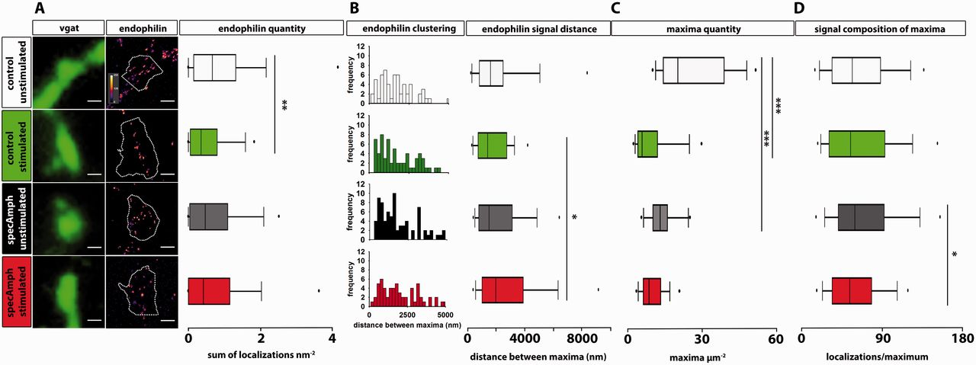
Figure 7 Disturbed expression of endophilin in GABAergic boutons induced by specific human autoantibodies to ...
Notes:
Figure 7 Disturbed expression of endophilin in GABAergic boutons induced by specific human autoantibodies to amphiphysin. (A) Analysis of endophilin expression [dSTORM, pseudocolour; signal intensity encoded by heatmap colour scale (0–255 bits)] in GABAergic boutons (epifluorescence, green). In control condition, sustained high frequency stimulation induced a reduction of total endophilin signal quantity over GABAergic vesicle pools (localization count analysis) (unstimulated: 1.0 ± 0.1 nm−2, n = 107 analysed boutons; stimulated: 0.6 ± 0.1 nm−2, n = 106). This reduction of total endophilin quantity was not present after pretreatment with specAmph autoantibodies (unstimulated: 0.8 ± 0.1 nm−2, n = 154; specAmph stimulated: 1.0 ± 0.3 nm−2, n = 114); Scale bars = 500 nm, **P < 0.01. (B) Stimulation-evoked dispersion of endophilin signal maxima in presence of specAmph autoantibodies as measured by clustering analysis. Sustained synaptic activity led to a significant dispersion of endophilin signal maxima in specAmph autoantibodies pretreated GABAergic boutons (maxima distance of 2962 ± 325 nm, n = 78) compared to stimulated controls (1770 ± 158 nm, n = 69). Frequency distribution histograms and analysis of distance between endophilin signal maxima of unstimulated (2386 ± 343 nm, n = 71) versus stimulated control boutons revealed nearly equal distances. Scale bars = 500 nm, range of heatmaps: 0–255 bits; *P < 0.05. (C) Density of endophilin maxima was reduced in GABAergic boutons after pretreatment with specAmph autoantibodies. According to the analysis of absolute endophilin quantity as shown in (A), sustained stimulation reduced localized clustering of endophilin into single maxima in control condition. This dispersion of endophilin signal was already detected at basal activity in neurons pretreated with specAmph autoantibodies (maxima µm−2: control unstimulated = 26.3 ± 4.2, n = 12; control stimulated = 9.4 ± 2.1, n = 16; specAmph unstimulated = 13.6 ± 1.4, n = 16; specAmph stimulated = 10.2 ± 1.1, n = 20, n depicts number of analysed boutons); ***P < 0.001. (D) Endophilin maxima differ in quantity of localization counts. Endophilin signal quantity within the individual maxima was reduced in specAmph autoantibodies pretreated GABAergic boutons upon stimulation as determined by quantitative localization count analysis (localizations/maximum: control unstimulated = 65.2 ± 3.1, n = 168; control stimulated = 66.4 ± 3.5, n = 160; specAmph unstimulated = 71.2 ± 3.0, n = 218; specAmph stimulated = 59.8 ± 2.3, n = 198, n reflects number of analysed maxima); *P < 0.05. Box plots show median values inside boxes depicting 25–75% of data values. Whiskers represent data between 5th and 95th percentile. Extreme values are defined as those exceeding the range of whisker percentiles.
Unless provided in the caption above, the following copyright applies to the content of this slide: © The Author (2015). Published by Oxford University Press on behalf of the Guarantors of Brain. All rights reserved. For Permissions, please email: journals.permissions@oup.com

