Slide 1
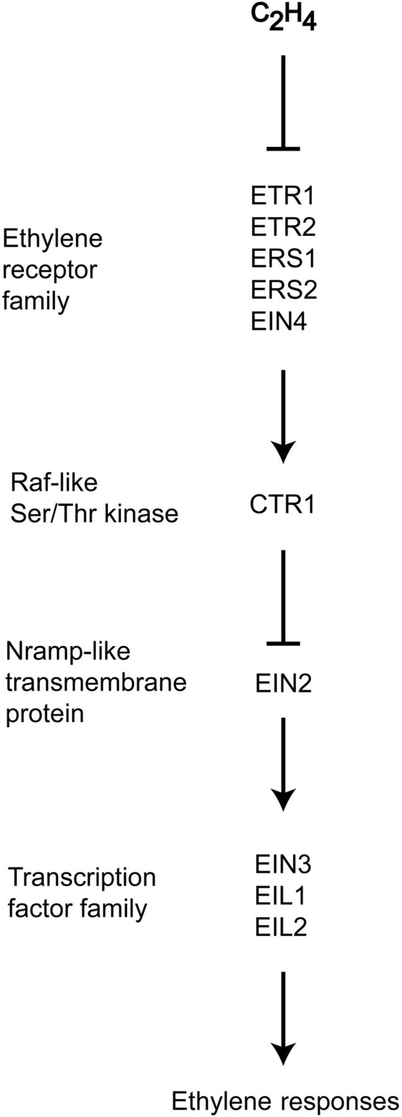
Figure 1. Genetically defined pathway for ethylene signal transduction. Genes in the primary signal transduction ...
Notes:
Figure 1. Genetically defined pathway for ethylene signal transduction. Genes in the primary signal transduction pathway are shown. The order of action is based on double-mutant analysis.
Unless provided in the caption above, the following copyright applies to the content of this slide: Published by Oxford University Press on behalf of the Annals of Botany Company.This is an Open Access article distributed under the terms of the Creative Commons Attribution License (http://creativecommons.org/licenses/by/3.0/), which permits unrestricted use, distribution, and reproduction in any medium, provided the original work is properly cited.

Slide 2
Figure 2. Ethylene receptor family of Arabidopsis. The ethylene receptor family of Arabidopsis is divided into ...
Notes:
Figure 2. Ethylene receptor family of Arabidopsis. The ethylene receptor family of Arabidopsis is divided into subfamilies 1 and 2 based on phylogenetic analysis and structural features. Receptors are shown as homo-dimers. The ethylene-binding domain (EBD) is found within the conserved transmembrane domains (white rectangles), and includes a copper cofactor (Cu); subfamily 2 receptors have an additional predicted transmembrane domain (grey rectangle) that may function as a signal sequence. All five members of the ethylene receptor family have a GAF domain (yellow diamond) implicated in protein–protein interactions. His kinase domains are indicated by green or red rectangles, green indicating a functional His kinase domain and red indicating a diverged His kinase domain. The receiver domains (ovals) have the conserved residues required for function and are therefore coloured green. Conserved His (H) and Asp (D) phosphorylation sites are indicated if present.
Unless provided in the caption above, the following copyright applies to the content of this slide: Published by Oxford University Press on behalf of the Annals of Botany Company.This is an Open Access article distributed under the terms of the Creative Commons Attribution License (http://creativecommons.org/licenses/by/3.0/), which permits unrestricted use, distribution, and reproduction in any medium, provided the original work is properly cited.

Slide 3
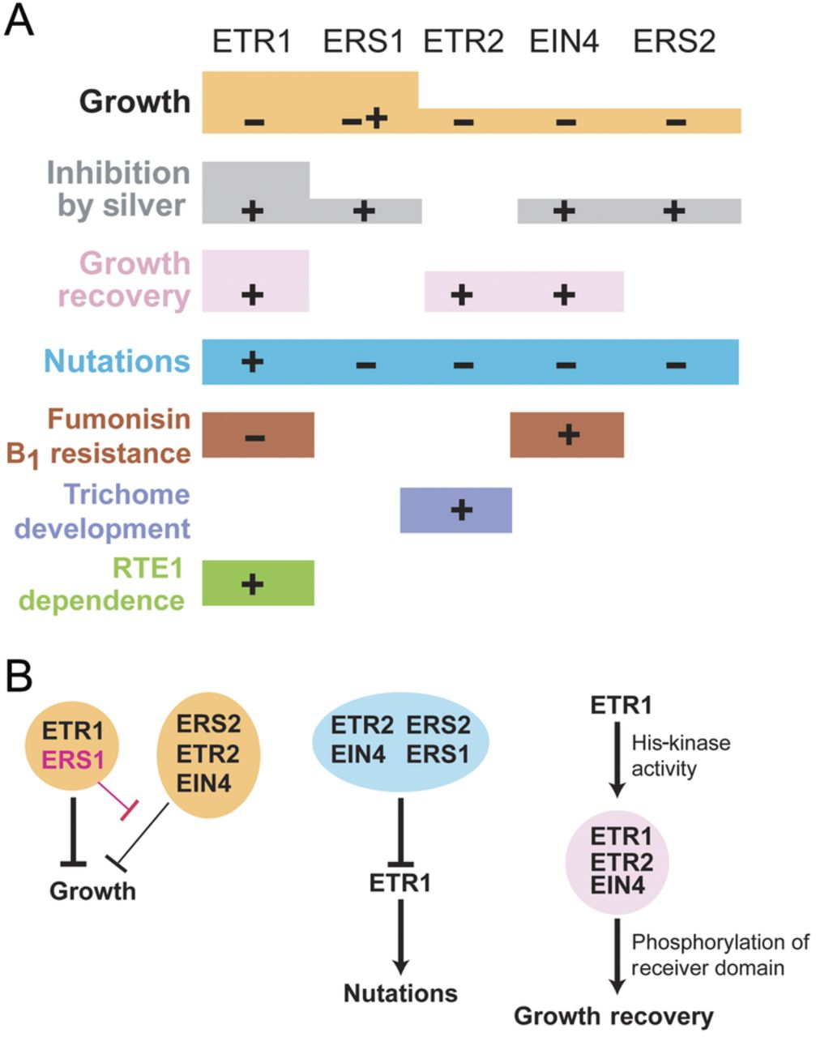
Figure 3. Overlapping and non-overlapping functions within the ethylene receptor family. (A) Roles of individual ...
Notes:
Figure 3. Overlapping and non-overlapping functions within the ethylene receptor family. (A) Roles of individual receptors in ethylene-regulated responses. A plus sign (+) indicates that the receptor activates the response, a negative sign (−) that the receptor inhibits the response and both signs (− +) that the receptor has differing effects dependent on other factors. The lack of a sign indicates that the receptor has no observed effect on the response. Differences in the box height indicate differences in receptor contribution to a particular response. (B) Details of interactions among receptors for selected ethylene responses. Differing thickness of arrows indicates differing contributions to a response.
Unless provided in the caption above, the following copyright applies to the content of this slide: Published by Oxford University Press on behalf of the Annals of Botany Company.This is an Open Access article distributed under the terms of the Creative Commons Attribution License (http://creativecommons.org/licenses/by/3.0/), which permits unrestricted use, distribution, and reproduction in any medium, provided the original work is properly cited.

Slide 4
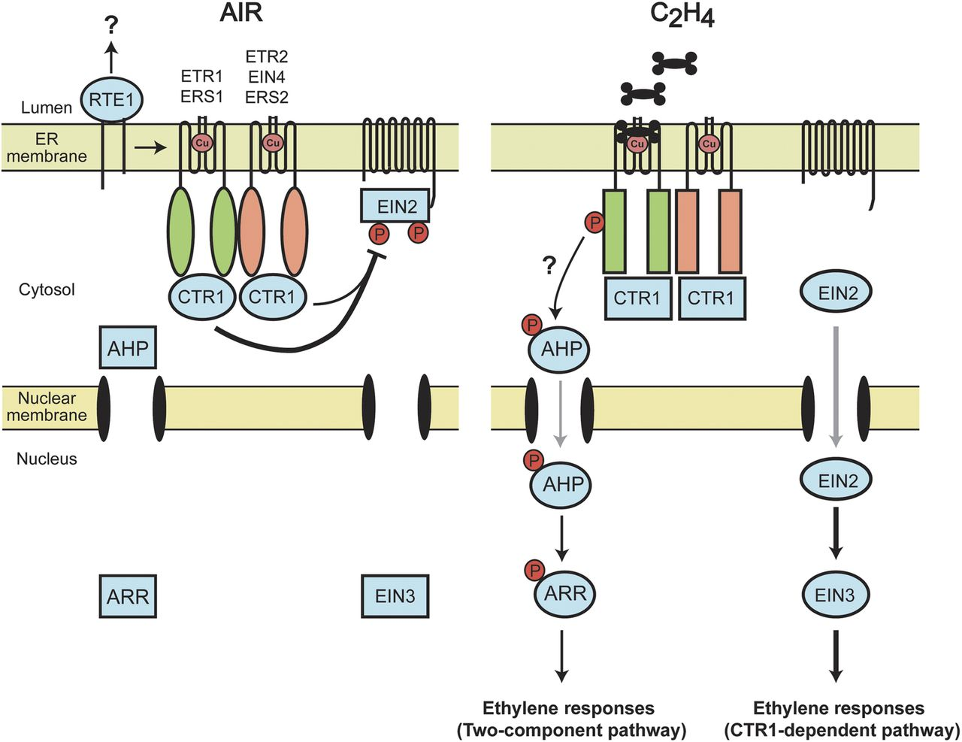
Figure 4. Model for ethylene signal transduction in Arabidopsis. The current model for signalling through the ...
Notes:
Figure 4. Model for ethylene signal transduction in Arabidopsis. The current model for signalling through the CTR1-dependent pathway is shown. In the absence of ethylene, the ethylene receptors activate CTR1, which phosphorylates and inhibits EIN2. In the presence of ethylene, the receptors inactivate CTR1, potentially through propagation of conformational changes in the receptor–CTR1 protein complex. EIN2 becomes dephosphorylated, which results in proteolytic cleavage and release of the C-terminal domain of EIN2. The C-terminal domain of EIN2 translocates to the nucleus, resulting in activation of EIN3 and the transcriptional response to ethylene. Two potential alternative pathways for ethylene signalling are also depicted (indicated by ‘?’). A two-component signalling pathway, initiated by the subfamily 1 receptors and involving phosphotransfer proteins (AHPs) and response regulators (ARRs), may mediate a subset of the ethylene responses. RTE1 may also facilitate ETR1 kinase kinase kinases signal output through a CTR1-independent pathway. Circles indicate the active forms of proteins and rectangles the inactive forms. The thickness of arrows indicates the relative contributions to the ethylene response. Grey arrows indicate translocation from the cytosol to the nucleus of the indicated proteins.
Unless provided in the caption above, the following copyright applies to the content of this slide: Published by Oxford University Press on behalf of the Annals of Botany Company.This is an Open Access article distributed under the terms of the Creative Commons Attribution License (http://creativecommons.org/licenses/by/3.0/), which permits unrestricted use, distribution, and reproduction in any medium, provided the original work is properly cited.

