Slide 1
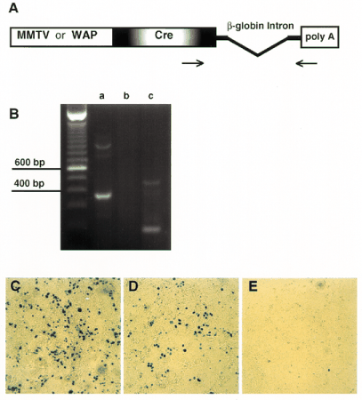
Figure 1 ( A ) Structure of the MMTV- Cre or WAP - Cre transgene. The MMTV LTR or WAP promoter is linked to the ...
Notes:
Figure 1 ( A ) Structure of the MMTV- Cre or WAP - Cre transgene. The MMTV LTR or WAP promoter is linked to the coding sequence of the Cre gene followed by an intron and a polyadenylation site from the rabbit β-globin gene. Arrows represent the primers used for RT-PCR assay. ( B ) Functional analysis of the MMTV- Cre transgene in HC11Cells using RT-PCR assay. (a) A 365 bp band represents the spliced Cre mRNA and a 936 bp indicates unspliced mRNA. (b) Control without reverse transcriptase. (c) Control digest of the amplified cDNA fragment with Ssp I. (C-E) In vitro functional analysis of the MMTV- Cre and WAP - Cre transgenes in HC11Cells using an adenovirus reporter vector (AxCALNLZ). ( C ) Cells transiently expressing MMTV- Cre were infected with AxCALNLZ and stained with X-gal. ( D ) HC11Cells expressing WAP - Cre were infected with AxCALNLZ and stained with X-gal. ( E ) X-Gal staining after electroporation with salmon sperm DNA and infection with AxCALNLZ.
Unless provided in the caption above, the following copyright applies to the content of this slide: © 1997 Oxford University Press

Slide 2
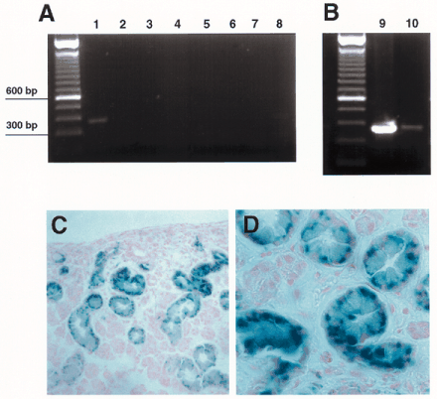
Figure 2 ( A and B ) Expression analysis of MMTV- Cre transgenic mice using RT-PCR. ( A ) MMTV- Cre expression was ...
Notes:
Figure 2 ( A and B ) Expression analysis of MMTV- Cre transgenic mice using RT-PCR. ( A ) MMTV- Cre expression was detected in the salivary gland (lane 1). The other organs are muscle (lane 2), liver (lane 3), heart (lane 4), kidney (lane 5), spleen (lane 6), tail (lane 7) and brain (lane 8). ( B ) MMTV-Cre mRNA was present in the virgin (lane 9) and lactating (lane 10) mammary gland. ( C and D ). X-Gal staining of striated ductal cells in the salivary gland expressing MMTV- Cre after infection with AxCALNLZ. (C) 200×; (D) 630×.
Unless provided in the caption above, the following copyright applies to the content of this slide: © 1997 Oxford University Press

Slide 3
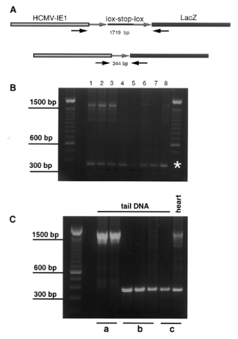
Figure 3 ( A ) Structure of the lox -stop reporter transgene. The CMV promoter and β-galactosidase coding sequences ...
Notes:
Figure 3 ( A ) Structure of the lox -stop reporter transgene. The CMV promoter and β-galactosidase coding sequences are separated by a floxed transcriptional stop sequence. Arrows represent primers used in PCR recombination analysis. The PCR product before recombination is 1719 bp in size. Cre-mediated recombination will excise the stop sequence, resulting in a 344 bp PCR fragment. ( B ) PCR recombination analysis in mice carrying MMTV- Cre and the lox -stop transgene. Deletion of transcriptional stop sequences of the reporter transgene were detected in all tissues: (lane 1) mammary gland, (lane 2) lung, (lane 3) heart, (lane 4) salivary gland, (lane 5) kidney, (lane 6) brain, (lane 7) spleen and (lane 8) muscle. ( C ) Transmission of the recombined lox -stop reporter transgene in the female germline. (a) Control PCR in the parental generation of the reporter strain. (b) Recombination was detected in tail DNA of mice carrying only the reporter transgene when they derived from a double transgenic parent bearing both the MMTV- Cre and the reporter construct. (c) Recombination analysis in a double transgenic mouse carrying the MMTV- Cre and lox -stop construct.
Unless provided in the caption above, the following copyright applies to the content of this slide: © 1997 Oxford University Press

Slide 4
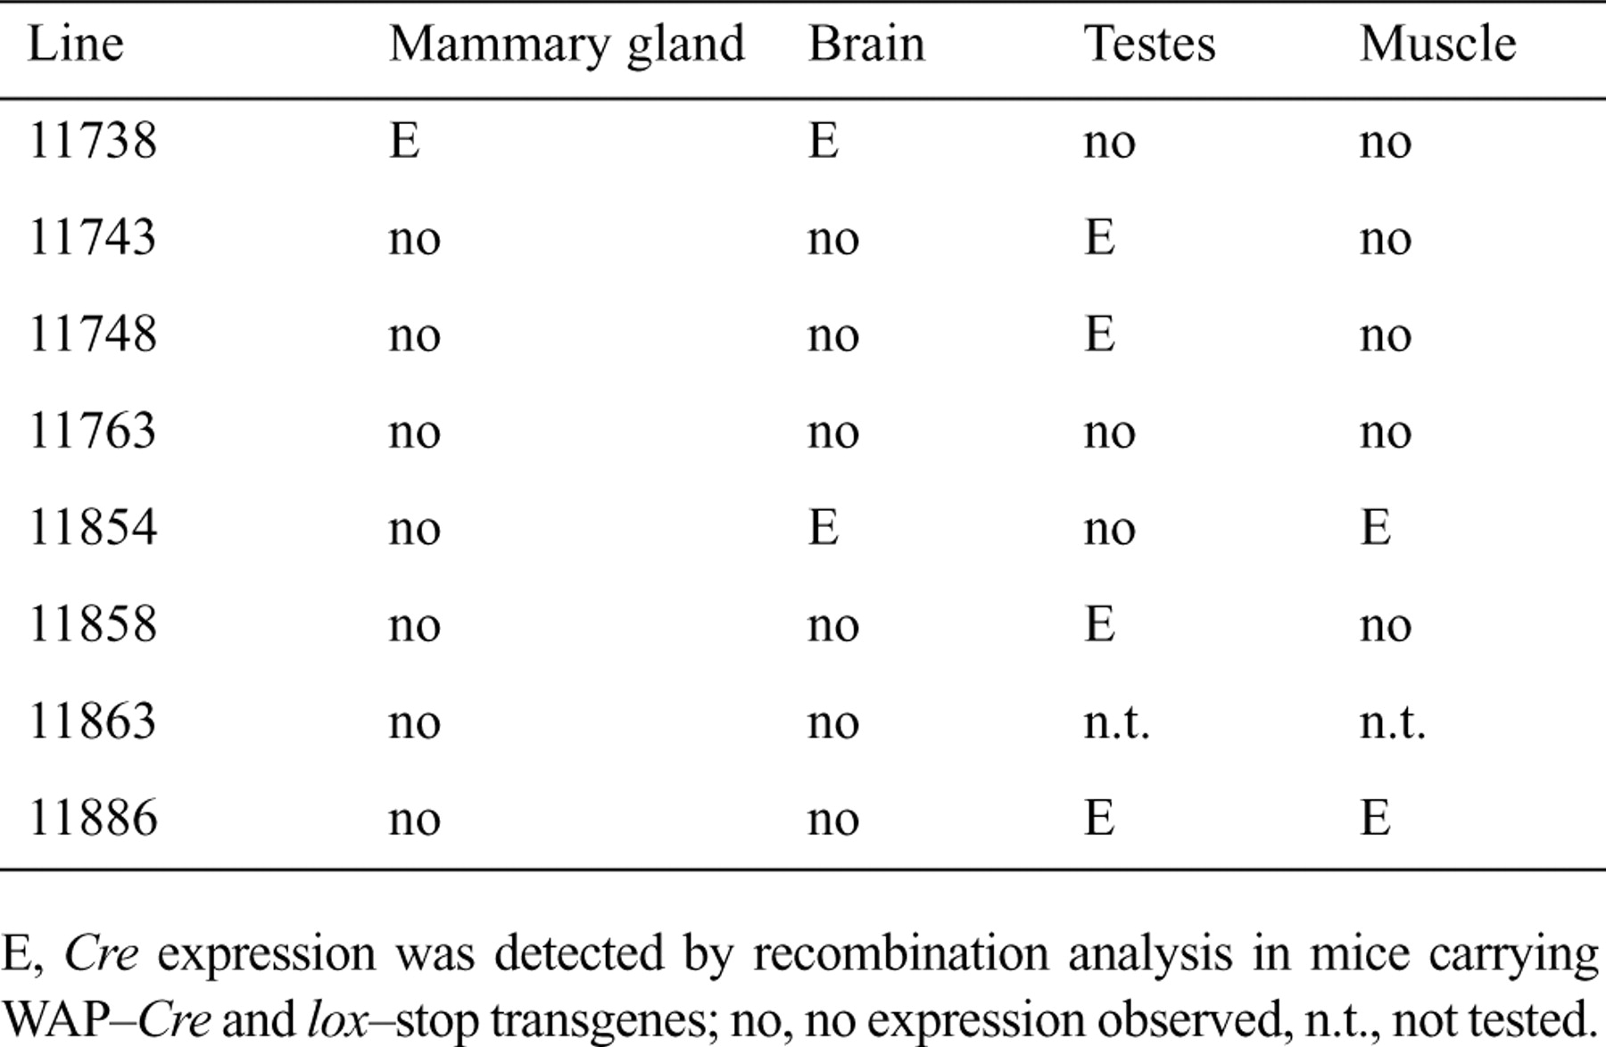
Table 1 Expression of the WAP- Cre transgene in eight different mouse lines
Notes:
Table 1 Expression of the WAP- Cre transgene in eight different mouse lines
Unless provided in the caption above, the following copyright applies to the content of this slide: © 1997 Oxford University Press

Slide 5
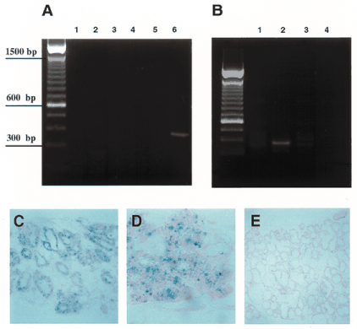
Figure 4 ( A and B ) Expression analysis of different tissues from WAP - Cre transgenic mice using RT-PCR. ( A ) WAP ...
Notes:
Figure 4 ( A and B ) Expression analysis of different tissues from WAP - Cre transgenic mice using RT-PCR. ( A ) WAP - Cre mRNA was detected in the mammary gland (lane 6) at day 18 of gestation, but not in liver (lane 1), heart (lane 2), kidney (lane 3), brain (lane 4) or salivary gland (lane 5). ( B ) WAP - Cre message was present in the lactating mammary gland (lane 2), but absent in the gland of a virgin mouse (lane 1). Lanes 3 and 4 are controls without reverse transcriptase. ( C and D ) X-Gal staining of mammary epithelial cells in gland number 4 of mice expressing WAP - Cre after infection with AxCALNLZ. (C) 200×; (D) 630×. ( E ) The uninfected gland number 4 of the same mouse did not show specific β-galactosidase activity. 200×.
Unless provided in the caption above, the following copyright applies to the content of this slide: © 1997 Oxford University Press

Slide 6
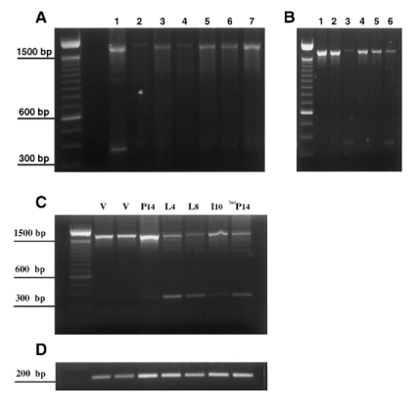
Figure 5 PCR recombination analysis in mice carrying the WAP - Cre and lox -stop transgenes. ( A ) Tissues from a ...
Notes:
Figure 5 PCR recombination analysis in mice carrying the WAP - Cre and lox -stop transgenes. ( A ) Tissues from a female double transgenic mouse at day 18 of gestation. Recombination was observed in the mammary gland (lane 1), but not in DNA from tail (lane 2), liver (lane 3), heart (lane 4), kidney (lane 5), salivary gland (lane 6) or muscle (lane 7). ( B ) Selected tissues from two male double transgenic mice (lanes 1–3 and 4–6). Some Cre-mediated recombination was detected in brain (lanes 3 and 6), but not in testis (lanes 2 and 5) or tail DNA (lanes 1 and 4). ( C ) PCR recombination analysis during stages of mammary gland development in mice carrying the WAP - Cre and lox -stop transgenes. v, virgin; P, pregnant or days of gestation; L, days of lactation; I, involution or days after removing the litter; 2ndP, days of gestation during second pregnancy. ( D ) PCR detection of the presence of the WAP - Cre transgene.
Unless provided in the caption above, the following copyright applies to the content of this slide: © 1997 Oxford University Press

