Slide 1
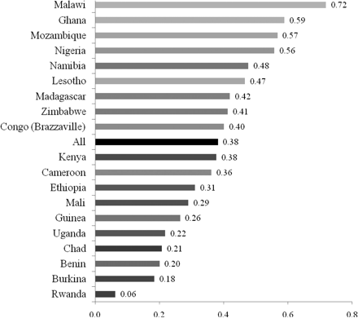
Figure 1 Percentage of antenatal care users who were told about pregnancy complications during their most recent ...
Notes:
Figure 1 Percentage of antenatal care users who were told about pregnancy complications during their most recent pregnancy in 19 countries of sub-Saharan Africa
Unless provided in the caption above, the following copyright applies to the content of this slide: Published by Oxford University Press in association with The London School of Hygiene and Tropical Medicine © The Author 2009; all rights reserved.

