Slide 1
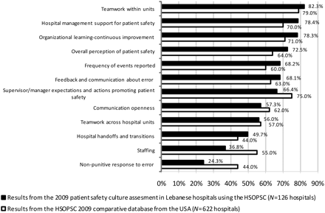
Figure 1 Composite-level average per cent positive response for all participating hospitals.
Notes:
Figure 1 Composite-level average per cent positive response for all participating hospitals.
Unless provided in the caption above, the following copyright applies to the content of this slide: © The Author 2010. Published by Oxford University Press in association with the International Society for Quality in Health Care; all rights reserved

Slide 2
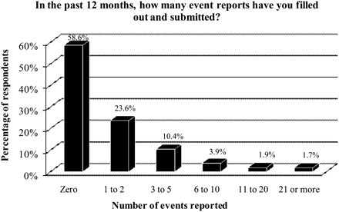
Figure 2 Percentage of respondents reporting events in the past 12 months.
Notes:
Figure 2 Percentage of respondents reporting events in the past 12 months.
Unless provided in the caption above, the following copyright applies to the content of this slide: © The Author 2010. Published by Oxford University Press in association with the International Society for Quality in Health Care; all rights reserved

Slide 3
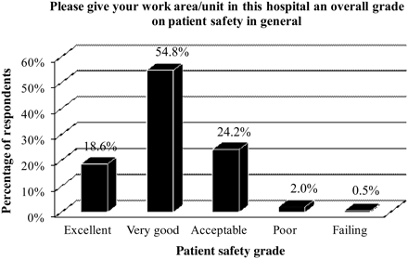
Figure 3 Percentage of respondents giving their work area/unit a patient safety grade.
Notes:
Figure 3 Percentage of respondents giving their work area/unit a patient safety grade.
Unless provided in the caption above, the following copyright applies to the content of this slide: © The Author 2010. Published by Oxford University Press in association with the International Society for Quality in Health Care; all rights reserved

