Slide 1
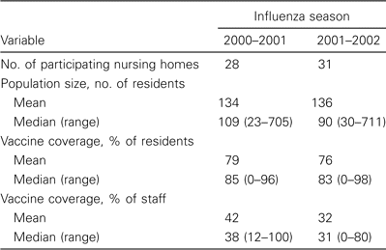
Table 1 Size and vaccination characteristics of participating nursing homes: 2000–2001 and 2001–2002 influenza ...
Notes:
Table 1 Size and vaccination characteristics of participating nursing homes: 2000–2001 and 2001–2002 influenza seasons.
Unless provided in the caption above, the following copyright applies to the content of this slide: © 2004 by the Infectious Diseases Society of America

Slide 2
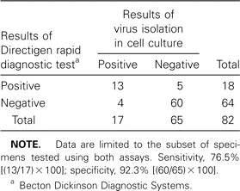
Table 2 Sensitivity and specificity of the Directigen rapid antigen detection test for identifying influenza ...
Notes:
Table 2 Sensitivity and specificity of the Directigen rapid antigen detection test for identifying influenza infection, using virus isolation in cell culture as the gold standard (influenza season 2001–2002).
Unless provided in the caption above, the following copyright applies to the content of this slide: © 2004 by the Infectious Diseases Society of America

Slide 3
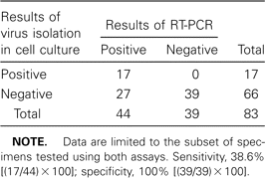
Table 3 Sensitivity and specificity of virus isolation in cell culture for identifying influenza infection, using ...
Notes:
Table 3 Sensitivity and specificity of virus isolation in cell culture for identifying influenza infection, using RT-PCR as the gold standard (influenza season 2001–2002).
Unless provided in the caption above, the following copyright applies to the content of this slide: © 2004 by the Infectious Diseases Society of America

